Slide 1
9-10
Classes:
A Deeper Look

Slide 2
9.3 Class Scope and Accessing Class Members
Dot member selection operator (.)
  Accesses the object’s members
  Used with an object’s name or with a reference to an object
Arrow member selection operator (->)
  Accesses the object’s members
  Used with a pointer to an object

Slide 3
10.5 Using the this Pointer
Member functions know which object’s data members to manipulate
  Every object has access to its own address through a pointer called this (a C++ keyword)
  An object’s this pointer is not part of the object itself
  The this pointer is passed (by the compiler) as an implicit argument to each of the object’s non-static member functions
Objects use the this pointer implicitly or explicitly
  Implicitly when accessing members directly
  Explicitly when using keyword this
  Type of the this pointer depends on the type of the object and whether the executing member function is declared const

Slide 4
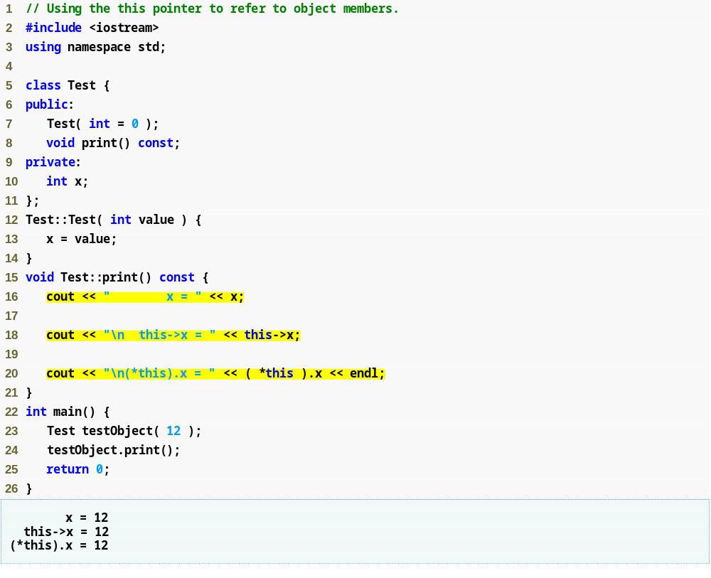

Slide 5
10.7 static Class Members
static data member
  Only one copy of a variable shared by all objects of a class
    “Class-wide” information
    A property of the class shared by all instances, not a property of a specific object of the class
  Declaration begins with keyword static

Slide 6
10.7 static Class Members (Cont.)
Declare a member function static
  If it does not access non-static data members or non-static member functions of the class
  A static member function does not have a this pointer
  static data members and static member functions exist independently of any objects of a class
  When a static member function is called, there might not be any objects of its class in memory

Slide 7
9.6 Constructors with Default Arguments
Constructors can specify default arguments
  Can initialize data members to a consistent state
    Even if no values are provided in a constructor call
  Constructor that defaults all its arguments is also a default constructor
    Can be invoked with no arguments
    Maximum of one default constructor per class

Slide 8
9.7 Destructors
Destructor
  A special member function
  Name is the tilde character (~) followed by the class name, e.g., ~GradeBook
  Called implicitly when an object is destroyed
    For example, this occurs as an automatic object is destroyed when program execution leaves the scope in which that object was instantiated
  Does not actually release the object’s memory
    It performs termination housekeeping
    Then the system reclaims the object’s memory
      So the memory may be reused to hold new objects

Slide 9
9.7 Destructors
Destructor
  Receives no parameters and returns no value
    May not specify a return type—not even void
  A class may have only one destructor
    Destructor overloading is not allowed
  If the programmer does not explicitly provide a destructor, the compiler creates an “empty” destructor

Slide 10
9.8 When Constructors and Destructors Are Called
Constructors and destructors
  Called implicitly by the compiler
    Order of these function calls depends on the order in which execution enters and leaves the scopes where the objects are instantiated
  Generally,
    Destructor calls are made in the reverse order of the corresponding constructor calls
  However,
    Storage classes of objects can alter the order in which destructors are called

Slide 11
9.8 When Constructors and Destructors Are Called
For objects defined in global scope
  Constructors are called before any other function (including main) in that file begins execution
  The corresponding destructors are called when main terminates
    Function exit
      Forces a program to terminate immediately
      Does not execute the destructors of automatic objects

Slide 12
9.8 When Constructors and Destructors Are Called
For an automatic local object
  Constructor is called when that object is defined
  Corresponding destructor is called when execution leaves the object’s scope
  Constructors and destructors are called each time execution enters and leaves the scope of the object

Slide 13
9.8 When Constructors and Destructors Are Called
For a static local object
  Constructor is called only once
    When execution first reaches where the object is defined
  Destructor is called when main terminates or the program calls function exit
Global and static objects are destroyed in the reverse order of their creation

Slide 14
10.6 Dynamic Memory Management with Operators new and delete
Initializing an object allocated by new
  Array *A1 = new Array;
  Array *A2 = new Array( 12 );
  Array *A3 = new Array[ 10 ];

Slide 15
Common Programming Error 10.9
Using delete instead of delete [] for arrays of objects can lead to runtime logic errors. To ensure that every object in the array receives a destructor call, always delete memory allocated as an array with operator delete [].
Similarly, always delete memory allocated as an individual element with operator delete.

Slide 16
9.10 Default Memberwise Assignment
Copy constructor
  Enables pass-by-value for objects
    Used to copy original object’s values into new object to be passed to a function or returned from a function
  Compiler provides a default copy constructor
    Copies each member of the original object into the corresponding member of the new object
    (i.e., memberwise assignment)
  Also can cause serious problems when data members contain pointers to dynamically allocated memory

Slide 17
9.10 Default Memberwise Assignment
Default memberwise assignment
  Assignment operator (=)
    Can be used to assign an object to another object of the same type
      Each data member of the right object is assigned to the same data member in the left object
    Can cause serious problems when data members contain pointers to dynamically allocated memory

Slide 18
Using Operators on a Class Object
It must be overloaded for that class
  Operators provided by the compiler (can also be overloaded by the programmer)
    Assignment operator (=)
      Memberwise assignment between objects
    Address operator (&)
      Returns address of object
    Comma operator (,)
      Evaluates expression to its left then the expression to its right
      Returns the value of the expression to its right
  Overloading operators
    Create a function for the class
    Name of operator function
      operator= for the assignment operator =

Slide 19
11.8 Case Study: Array Class
Pointer-based arrays in C++
  No range checking
  No array assignment (array names are const pointers)
  If array passed to a function, size must be passed as a separate argument
Example: Implement an Array class with
  Range checking
  Array assignment
  Arrays that know their own size

Slide 20
11.8 Case Study: Array Class (Cont.)
Copy constructor
  Used whenever copy of object is needed:
    Passing by value (return value or parameter)
    Initializing an object with a copy of another of same type
      Array newArray( oldArray ); or
      Array newArray = oldArray (both are identical)
        newArray is a copy of oldArray
  Prototype for class Array
    Array( const Array & );
    Must take reference
      Otherwise, the argument will be passed by value
      Which tries to make copy by calling copy constructor
        Infinite loop

Slide 21
Software Engineering Observation 11.4
The argument to a copy constructor should be a const reference to allow a const object to be copied.

Slide 22
Common Programming Error 11.6
Note that a copy constructor must receive its argument by reference, not by value. Otherwise, the copy constructor call results in infinite recursion (a fatal logic error) because receiving an object by value requires the copy constructor to make a copy of the argument object.

Slide 23
Common Programming Error 11.7
If the copy constructor simply copied the pointer in the source object to the target object’s pointer, then both objects would point to the same dynamically allocated memory. The first destructor to execute would then delete the dynamically allocated memory, and the other object’s ptr would be undefined, a situation called a dangling pointer—this would likely result in a serious run-time error (such as early program termination) when the pointer was used.

Slide 24
class Array{
public:
Array( int = 0 ); // default constructor
~Array(); // destructor
// copy constructor
Array( const Array & );
// overloaded assignment operator
void operator=( const Array & );
void setData( int, int );
void display();
void resize( int );
private:
int size;
int *data;
};

Slide 25
//-------------------------------------------------//
// default constructor
Array::Array( int arraySize ) {
if (arraySize <= 0) {
size = 0;
data = NULL;
}
else {
size = arraySize;
data = new int[ size ];
for ( int i = 0; i < size; i++ )
data[i] = 0;
}
}
//-------------------------------------------------//
// destructor
Array::~Array() {
if (data)
delete [] data;
}
//-------------------------------------------------//

Slide 26
//-------------------------------------------------//
// copy constructor
//-------------------------------------------------//
// must receive a reference to prevent infinite recursion
Array::Array( const Array &arrayToCopy )
: size( arrayToCopy.size ) {
if (size > 0) {
data = new int[ size ];
for ( int i = 0; i < size; i++)
data[i] = arrayToCopy.data[i];
}
else
data = NULL;
}
//-------------------------------------------------//
// what happens if we use the following shallow copy
// Array::Array( const Array &arrayToCopy )
// : size( arrayToCopy.size ) {
// data = arrayToCopy.data;
// }
//-------------------------------------------------//

Slide 27
//-------------------------------------------------//
// overloaded assignment operator
//-------------------------------------------------//
// does not enable cascading (e.g., x = y = z)
void Array::operator=( const Array &right ) {
if ( &right != this ) { // avoid self-assignment
// for Arrays of different sizes, deallocate
// original left-side array, then allocate
// new left-side array
if ( size != right.size ) {
if (size > 0)
delete [] data;
size = right.size;
if (size > 0)
data = new int[ size ];
else
data = NULL;
}
for ( int i = 0; i < size; i++ )
data[ i ] = right.data[ i ];
}
}
//-------------------------------------------------//

Slide 28
//-------------------------------------------------//
void Array::display(){
for ( int i = 0; i < size; i++ )
cout << data[ i ] << "\t";
cout << endl;
}
//-------------------------------------------------//
void Array::setData( int item, int value ){
if ( ( item >= 0 ) && ( item < size ) )
data[ item ] = value;
else
cout << "Item is out of range " << endl;
}
//-------------------------------------------------//

Slide 29
//-------------------------------------------------//
void Array::resize( int newSize ){
int i, *temp;
if ( newSize <= 0 ) {
if ( size > 0 )
delete [] data;
size = 0;
data = NULL;
return;
}
temp = data;
data = new int[newSize];
if ( newSize < size ){
for ( i = 0; i < newSize; i++ )
data[i] = temp[i];
}
else{
for ( i = 0; i < size; i++ )
data[i] = temp[i];
for ( i = size; i < newSize; i++ )
data[i] = 0;
}
size = newSize;
delete [] temp;
}
//-------------------------------------------------//

Slide 30
int main(){
Array A1( 4 );
for ( int i = 0; i < 4; i++ )
A1.setData( i, i );
A1.display();
cout << endl;
Array A2( A1 );
A1.display(); A2.display();
A2.setData( 2 , 100 );
// what happens if we use shallow copy
A1.display(); A2.display();
cout << endl;
// uses copy constructor (not assignment operator)
Array A3 = A1;
A1.display(); A3.display();
A3.setData( 2 , 8000 );
A1.display(); A3.display();
cout << endl;
Array A4;
// shallow copy if no assignment operator is defined
A4 = A1;
A1.display(); A4.display();
A4.setData(2,600);
A1.display(); A4.display();
cout << endl;

Slide 31
// main (cont.)
A4.resize(10);
A4.display();
A4.resize(3);
A4.display();
cout << endl;
Array *A5;
A5 = &A4;
A5->display();
A5 = new Array( 8 );
A5->setData( 4 , 50 );
A5->display();
delete A5;
cout << endl;
Array *A6 = new Array[ 3 ];
A6[0] = A1;
A6[1].resize( 3 );
A6[0].display();
A6[1].display();
delete [] A6;
return 0;
}

