Slide 1
Introduction

Slide 2
Course Information
Course materials on Unilica (enrollment key: JTMOH)
Make sure you update your notification settings to receive messages.
Instructors:
Alper Sarıkan (1-2)
Satılmış Topcu (3-4)
Mustafa Ozdal (5-6)
Grading:
Quizzes: 15%
Labs: 15%
Project: 10%
Midterm exam: 30%
Final exam: 30%
You should buy BASYS3 board for labs and project

Slide 3
Course Information
FZ POLICY: Students who fail to meet the following requirements will receive a grade of FZ:
1. Weighted average score of the midterm exam and quizzes ≥ 40%
(2 x midterm_score + avg_quiz_scores)/3 ≥ 40%
2. Average score of the labs and project ≥ 50%
(avg_lab_score + project_score)/2 ≥ 50%
3. Absent from no more than 1 lab
Only the grades until the FZ deadline will be considered while computing the average scores above. Students who receive FZ cannot attend the final exam.

Slide 4
Course Information
TEXTBOOK: David Money Harris, Sarah L. Harris, Digital Design and Computer Architecture, 2nd ed. Morgan Kaufmann, 2013.
Exams will be open book. Only original and unmarked textbooks will be allowed in the exams. If you have any notes/drawings/markings/etc. on your textbook, you will not be able to use it in the exams.
RECOMMENDED BOOK: Frank Vahid, Digital Design, with RTL Design, VHDL and Verilog, 2nd ed. John Wiley, 2011.

Slide 5
Why Study Hardware?
Career in hardware design
Numerous new hardware devices introduced these days: Smartphones, smart homes, wearables, internet of things, drones, VR glasses, …
Good software programmers know about hardware
Anyone can write a web/smartphone app!
Inherent knowledge of computers needed to program efficiently

Slide 6
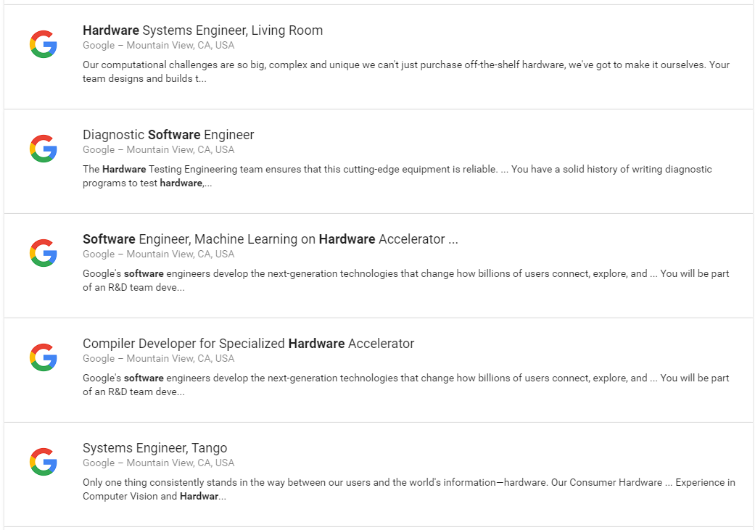
Software & Hardware Co-Design

Slide 7
Chapter 1
Digital Design and Computer Architecture, 2nd Edition
David Money Harris and Sarah L. Harris

Slide 8
Chapter 1 :: Topics
Background
The Game Plan
The Art of Managing Complexity
The Digital Abstraction
Number Systems
Logic Gates
Logic Levels
CMOS Transistors
Power Consumption

Slide 9
The Game Plan
Purpose of course:
Understand what’s under the hood of a computer
Learn the principles of digital design
Learn to systematically debug increasingly complex designs
Design and build a microprocessor

Slide 10
The Art of Managing Complexity
Abstraction
Discipline
The Three –Y’s
Hierarchy
Modularity
Regularity

Slide 11
Abstraction
Hiding details when they aren’t important

Slide 12
Discipline
Intentionally restrict design choices
Example: Digital discipline
Discrete voltages instead of continuous
Simpler to design than analog circuits – can build more sophisticated systems
Digital systems replacing analog predecessors:
i.e., digital cameras, digital television, cell phones, CDs

Slide 13
The Digital Abstraction
Most physical variables are continuous
Voltage on a wire
Frequency of an oscillation
Position of a mass
Digital abstraction considers discrete subset of values

Slide 14
Digital Discipline: Binary Values
Two discrete values:
1’s and 0’s
1, TRUE, HIGH
0, FALSE, LOW
1 and 0: voltage levels, rotating gears, fluid levels, etc.
Digital circuits use voltage levels to represent 1 and 0
Bit: Binary digit

Slide 15
The Three -Y’s
Hierarchy
A system divided into modules and submodules
Modularity
Having well-defined functions and interfaces
Regularity
Encouraging uniformity, so modules can be easily reused

Slide 16
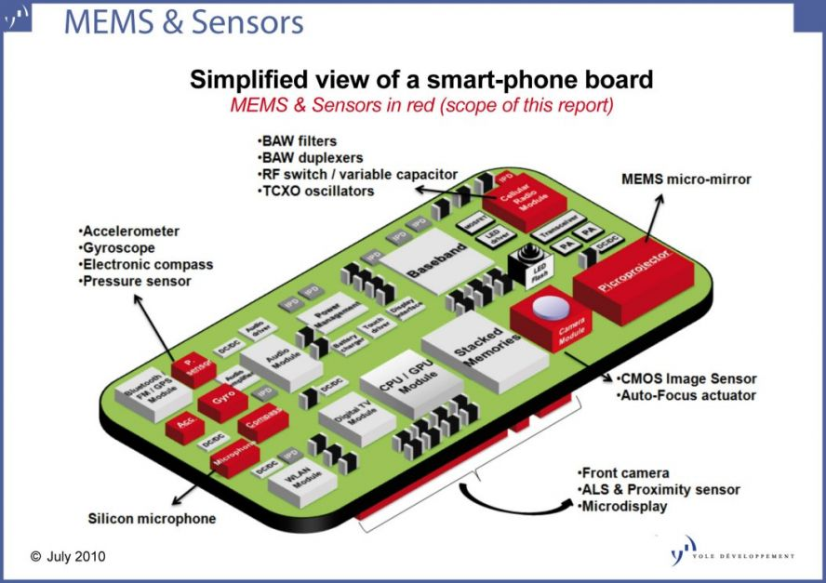
Source: https://www.prlog.org/10792126-mems-sensors-for-smartphones-report.html

Slide 17
Number Systems
Decimal numbers
Binary numbers

Slide 18
Number Systems
Decimal numbers
Binary numbers

Slide 19
Powers of Two
2⁰ =
2¹ =
2² =
2³ =
2⁴ =
2⁵ =
2⁶ =
2⁷ =
2⁸ =
2⁹ =
2¹⁰ =
2¹¹ =
2¹² =
2¹³ =
2¹⁴ =
2¹⁵ =

Slide 20
Powers of Two
2⁰ = 1
2¹ = 2
2² = 4
2³ = 8
2⁴ = 16
2⁵ = 32
2⁶ = 64
2⁷ = 128
Handy to memorize up to 2⁹
2⁸ = 256
2⁹ = 512
2¹⁰ = 1024
2¹¹ = 2048
2¹² = 4096
2¹³ = 8192
2¹⁴ = 16384
2¹⁵ = 32768

Slide 21
Number Conversion
Binary to decimal conversion:
Convert 10011₂ to decimal
Decimal to binary conversion:
Convert 47₁₀ to binary

Slide 22
Number Conversion
Decimal to binary conversion:
Convert 10011₂ to decimal
16×1 + 8×0 + 4×0 + 2×1 + 1×1 = 19₁₀
Decimal to binary conversion:
Convert 47₁₀ to binary
32×1 + 16×0 + 8×1 + 4×1 + 2×1 + 1×1 = 101111₂

Slide 23
Binary Values and Range
N-digit decimal number
How many values?
Range?
Example: 3-digit decimal number:
N-bit binary number
How many values?
Range:
Example: 3-digit binary number:

Slide 24
Binary Values and Range
N-digit decimal number
How many values? 10^{N}
Range? [0, 10^{N} - 1]
Example: 3-digit decimal number:
10³ = 1000 possible values
Range: [0, 999]
N-bit binary number
How many values? 2^{N}
Range: [0, 2^{N} - 1]
Example: 3-digit binary number:
2³ = 8 possible values
Range: [0, 7] = [000₂ to 111₂]

Slide 25
Hexadecimal Numbers
Hex Digit | Decimal Equivalent | Binary Equivalent
0 | 0
1 | 1
2 | 2
3 | 3
4 | 4
5 | 5
6 | 6
7 | 7
8 | 8
9 | 9
A | 10
B | 11
C | 12
D | 13
E | 14
F | 15

Slide 26
Hexadecimal Numbers
Hex Digit | Decimal Equivalent | Binary Equivalent
0 | 0 | 0000
1 | 1 | 0001
2 | 2 | 0010
3 | 3 | 0011
4 | 4 | 0100
5 | 5 | 0101
6 | 6 | 0110
7 | 7 | 0111
8 | 8 | 1000
9 | 9 | 1001
A | 10 | 1010
B | 11 | 1011
C | 12 | 1100
D | 13 | 1101
E | 14 | 1110
F | 15 | 1111

Slide 27
Hexadecimal Numbers
Base 16
Shorthand for binary

Slide 28
Hexadecimal to Binary Conversion
Hexadecimal to binary conversion:
Convert 4AF₁₆ (also written 0x4AF) to binary
Hexadecimal to decimal conversion:
Convert 0x4AF to decimal

Slide 29
Hexadecimal to Binary Conversion
Hexadecimal to binary conversion:
Convert 4AF₁₆ (also written 0x4AF) to binary
0100 1010 1111₂
Hexadecimal to decimal conversion:
Convert 4AF₁₆ to decimal
16²×4 + 16¹×10 + 16⁰×15 = 1199₁₀

Slide 30
Bits, Bytes, Nibbles…
Bits
Bytes & Nibbles
Bytes

Slide 31
Large Powers of Two
2¹⁰ = 1 kilo ≈ 1000 (1024)
2²⁰ =
2³⁰ =

Slide 32
Large Powers of Two
2¹⁰ = 1 kilo ≈ 1000 (1024)
2²⁰ = 1 mega ≈ 1 million (1,048,576)
2³⁰ = 1 giga ≈ 1 billion (1,073,741,824)

Slide 33
Estimating Powers of Two
What is the value of 2²⁴?
How many values can a 32-bit variable represent?

Slide 34
Estimating Powers of Two
What is the value of 2²⁴?
2⁴ × 2²⁰ ≈ 16 million
How many values can a 32-bit variable represent?
2² × 2³⁰ ≈ 4 billion

Slide 35
Addition
Decimal
Binary

Slide 36
Binary Addition Examples
Add the following 4-bit binary numbers
Add the following 4-bit binary numbers

Slide 37
Binary Addition Examples
Add the following 4-bit binary numbers
Add the following 4-bit binary numbers
Overflow!

Slide 38
Overflow
Digital systems operate on a fixed number of bits
Overflow: when result is too big to fit in the available number of bits
See previous example of 11 + 6

Slide 39
Exercise 1.66
A flying saucer crashes in a Nebraska cornfield. The FBI investigates the wreckage and finds an engineering manual containing an equation in the Martian number system: 325+42 = 411. If this equation is correct, how many fingers would you expect Martians to have?

Slide 40
Signed Binary Numbers
Sign/Magnitude Numbers
Two’s Complement Numbers

Slide 41
Sign/Magnitude Numbers
1 sign bit, N-1 magnitude bits
Sign bit is the most significant (left-most) bit
Positive number: sign bit = 0
Negative number: sign bit = 1
Example, 4-bit sign/mag representations of ± 6:
+6 =
- 6 =
Range of an N-bit sign/magnitude number:

Slide 42
Sign/Magnitude Numbers
1 sign bit, N-1 magnitude bits
Sign bit is the most significant (left-most) bit
Positive number: sign bit = 0
Negative number: sign bit = 1
Example, 4-bit sign/mag representations of ± 6:
+6 = 0110
- 6 = 1110
Range of an N-bit sign/magnitude number:
[-(2^{N-1}-1), 2^{N-1}-1]

Slide 43
Sign/Magnitude Numbers
Problems:
Addition doesn’t work, for example -6 + 6:
1110
+ 0110
10100 (wrong!)
Two representations of 0 (± 0):
1000
0000

Slide 44
Two’s Complement Numbers
Don’t have same problems as sign/magnitude numbers:
Addition works
Single representation for 0
Most Significant bit is the sign bit 0 if positive 1 if negative
For a binary number A
If A>0 or A=0 then two’s complement representation of A is A (no change)
If A< 0 then two’s complement of A is 2^{n}-A
Example
A=-6 +6=0110
2⁴ – 0110= 10000-0110 = 1010=-6

Slide 45
Two’s Complement Numbers
Msb has value of -2^{N-1}
Most positive 4-bit number:
Most negative 4-bit number:
The most significant bit still indicates the sign (1 = negative, 0 = positive)
Range of an N-bit two’s comp number:

Slide 46
Two’s Complement Numbers
Msb has value of -2^{N-1}
Most positive 4-bit number: 0111
Most negative 4-bit number: 1000
The most significant bit still indicates the sign (1 = negative, 0 = positive)
Range of an N-bit two’s comp number:
[-(2^{N-1}), 2^{N-1}-1]

Slide 47
“Taking the Two’s Complement”
Flip the sign of a two’s complement number
Method:
Invert the bits
Add 1
Example: Flip the sign of 3₁₀ = 0011₂

Slide 48
“Taking the Two’s Complement”
Flip the sign of a two’s complement number
Method:
Invert the bits
Add 1
Example: Flip the sign of 3₁₀ = 0011₂
1100
+ 1
1101 = -3₁₀

Slide 49
Two’s Complement Examples
Take the two’s complement of 6₁₀ = 0110₂
What is the decimal value of 1001₂?

Slide 50
Two’s Complement Examples
Take the two’s complement of 6₁₀ = 0110₂
1001
+ 1
1010₂ = -6₁₀
What is the decimal value of the two’s complement number 1001₂?
0110
+ 1
0111₂ = 7₁₀, so 1001₂ = -7₁₀

Slide 51
True or False
I can take 2s complement of a number as follows:
Examine the bits starting from the LSB
Let k be the index where the first “1” is found
Invert all bits to the left of k

Slide 52
Two’s Complement Addition
Add 6 + (-6) using two’s complement numbers
Add -2 + 3 using two’s complement numbers

Slide 53
Two’s Complement Addition
Add 6 + (-6) using two’s complement numbers
Add -2 + 3 using two’s complement numbers

Slide 54
Increasing Bit Width
Extend number from N to M bits (M > N) :
Sign-extension
Zero-extension

Slide 55
Sign-Extension
Sign bit copied to msb’s
Number value is same
Example 1:
4-bit representation of 3 = 0011
8-bit sign-extended value: 00000011
Example 2:
4-bit representation of -5 = 1011
8-bit sign-extended value: 11111011

Slide 56
Zero-Extension
Zeros copied to msb’s
Value changes for negative numbers
Example 1:
4-bit value = 0011₂ = 3₁₀
8-bit zero-extended value: 00000011 = 3₁₀
Example 2:
4-bit value = 1011 = -5₁₀
8-bit zero-extended value: 00001011 = 11₁₀

Slide 57
Number System Comparison
Number System | Range
Unsigned | [0, 2^{N}-1]
Sign/Magnitude | [-(2^{N-1}-1), 2^{N-1}-1]
Two’s Complement | [-2^{N-1}, 2^{N-1}-1]
For example, 4-bit representation:

Slide 58
Logic Gates
Perform logic functions:
inversion (NOT), AND, OR, NAND, NOR, etc.
Single-input:
NOT gate, buffer
Two-input:
AND, OR, XOR, NAND, NOR, XNOR
Multiple-input

Slide 59
Single-Input Logic Gates

Slide 60
Single-Input Logic Gates

Slide 61
Two-Input Logic Gates

Slide 62
Two-Input Logic Gates

Slide 63
More Two-Input Logic Gates

Slide 64
More Two-Input Logic Gates

Slide 65
Multiple-Input Logic Gates

Slide 66
Multiple-Input Logic Gates
Multi-input XOR: Odd parity

Slide 67
Questions
How many unique 2-input logic functions can we define?
How many unique k-input logic functions can we define?

Slide 68
Logic Levels
Discrete voltages represent 1 and 0
For example:
0 = ground (GND) or 0 volts
1 = V_{DD} or 5 volts
What about 4.99 volts? Is that a 0 or a 1?
What about 3.2 volts?

Slide 69
Logic Levels
Range of voltages for 1 and 0
Different ranges for inputs and outputs to allow for noise

Slide 70
What is Noise?

Slide 71
What is Noise?
Anything that degrades the signal
E.g., resistance, power supply noise, coupling to neighboring wires, etc.
Example: a gate (driver) outputs 5 V but, because of resistance in a long wire, receiver gets 4.5 V

Slide 72
The Static Discipline
With logically valid inputs, every circuit element must produce logically valid outputs
Use limited ranges of voltages to represent discrete values

Slide 73
Logic Levels

Slide 74
Noise Margins
NM_{H} = V_{OH} – V_{IH}
NM_{L} = V_{IL} – V_{OL}

Slide 75
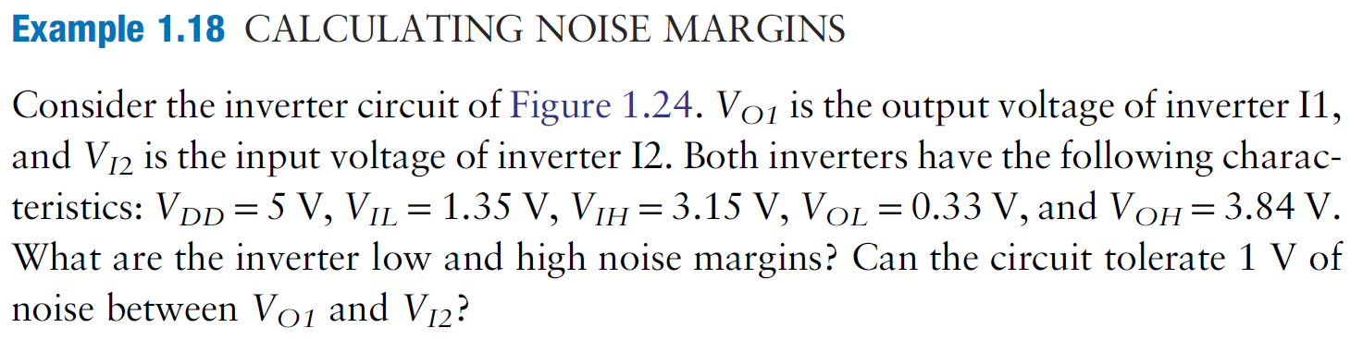
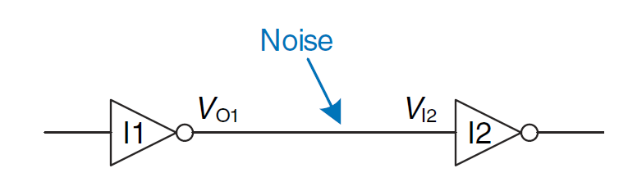
Exercise

Slide 76
V_{DD} Scaling
In 1970’s and 1980’s, V_{DD} = 5 V
V_{DD} has dropped
Avoid frying tiny transistors
Save power
3.3 V, 2.5 V, 1.8 V, 1.5 V, 1.2 V, 1.0 V, …
Be careful connecting chips with different supply voltages
Chips operate because they contain magic smoke
Proof:
if the magic smoke is let out, the chip stops working

Slide 77
Logic Family Examples
Logic Family | V_{DD} | V_{IL} | V_{IH} | V_{OL} | V_{OH}
TTL | 5 (4.75 - 5.25) | 0.8 | 2.0 | 0.4 | 2.4
CMOS | 5 (4.5 - 6) | 1.35 | 3.15 | 0.33 | 3.84
LVTTL | 3.3 (3 - 3.6) | 0.8 | 2.0 | 0.4 | 2.4
LVCMOS | 3.3 (3 - 3.6) | 0.9 | 1.8 | 0.36 | 2.7

Slide 78
Transistors
Logic gates built from transistors
3-ported voltage-controlled switch
2 ports connected depending on voltage of 3rd
d and s are connected (ON) when g is 1

Slide 79
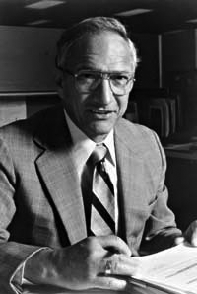
Robert Noyce, 1927-1990
Nicknamed “Mayor of Silicon Valley”
Cofounded Fairchild Semiconductor in 1957
Cofounded Intel in 1968
Co-invented the integrated circuit

Slide 80
Silicon
Transistors built from silicon, a semiconductor
Pure silicon is a poor conductor (no free charges)
Doped silicon is a good conductor (free charges)
n-type (free negative charges, electrons)
p-type (free positive charges, holes)

Slide 81
MOS Transistors
Metal oxide silicon (MOS) transistors:
Polysilicon (used to be metal) gate
Oxide (silicon dioxide) insulator
Doped silicon

Slide 82
Transistors: nMOS
Gate = 0
OFF (no connection between source and drain)
Gate = 1
ON (channel between source and drain)

Slide 83
Transistors: pMOS
pMOS transistor is opposite
ON when Gate = 0
OFF when Gate = 1

Slide 84
Transistor Function

Slide 85
Transistor Function
nMOS: pass good 0’s, so connect source to GND
pMOS: pass good 1’s, so connect source to V_{DD}

Slide 86
CMOS Gates: NOT Gate
A | P1 | N1 | Y
0
1

Slide 87
CMOS Gates: NOT Gate
A | P1 | N1 | Y
0 | ON | OFF | 1
1 | OFF | ON | 0

Slide 88
What is the function of this gate?

Slide 89
CMOS Gates: NAND Gate
A | B | P1 | P2 | N1 | N2 | Y
0 | 0
0 | 1
1 | 0
1 | 1

Slide 90
CMOS Gates: NAND Gate
A | B | P1 | P2 | N1 | N2 | Y
0 | 0 | ON | ON | OFF | OFF | 1
0 | 1 | ON | OFF | OFF | ON | 1
1 | 0 | OFF | ON | ON | OFF | 1
1 | 1 | OFF | OFF | ON | ON | 0

Slide 91
CMOS Gate Structure

Slide 92
NOR Gate
How do you build a three-input NOR gate?

Slide 93
NOR3 Gate

Slide 94
Other CMOS Gates
How do you build a two-input AND gate?

Slide 95
AND2 Gate

Slide 96
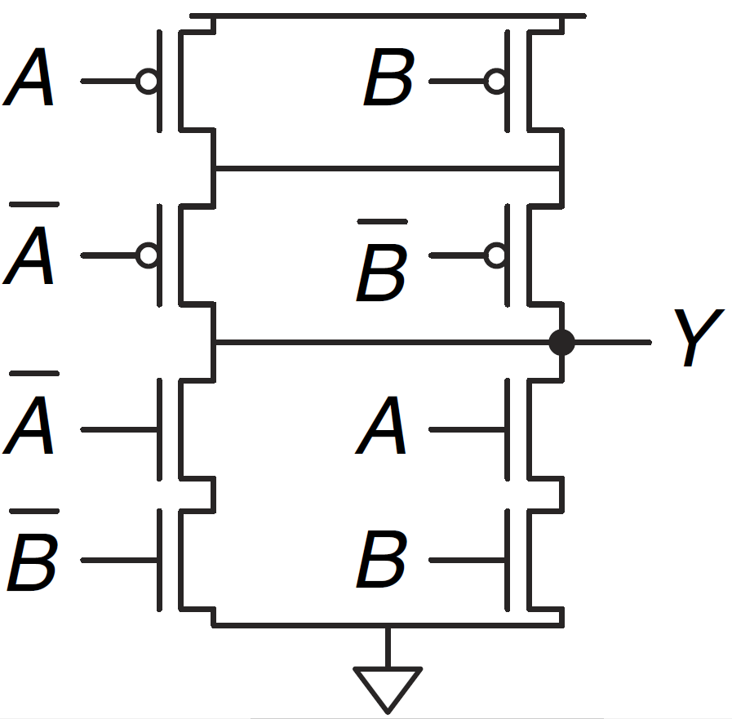
What is the function of this gate?

Slide 97
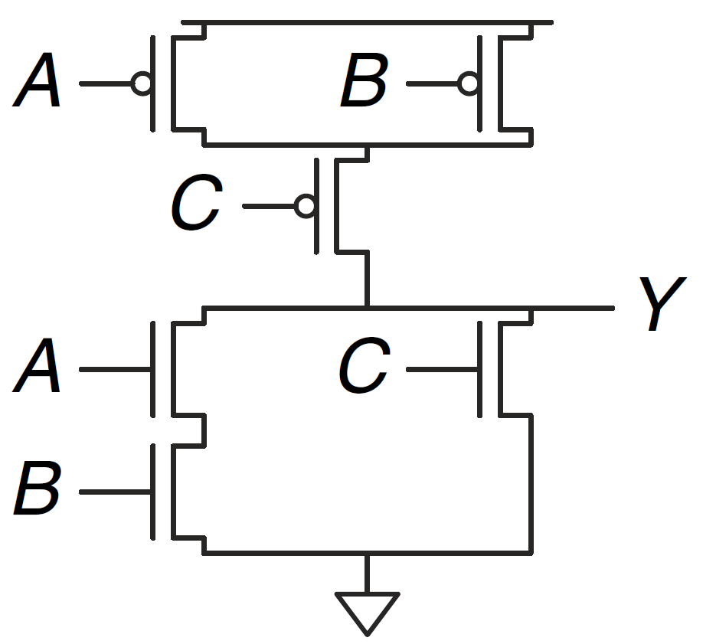
What is the function of this gate?

Slide 98
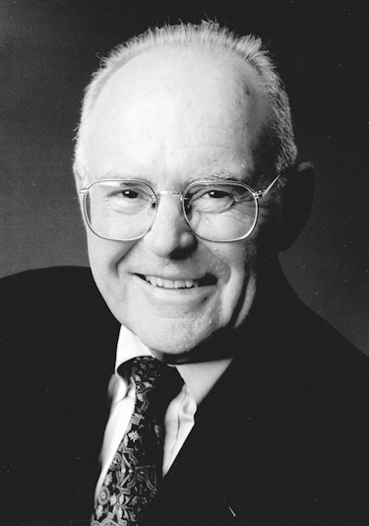
Gordon Moore, 1929-
Cofounded Intel in 1968 with Robert Noyce.
Moore’s Law: number of transistors on a computer chip doubles every year (observed in 1965)
Since 1975, transistor counts have doubled every two years.

Slide 99
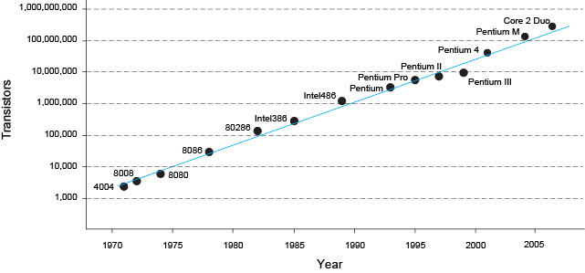
Moore’s Law
“If the automobile had followed the same development cycle as the computer, a Rolls-Royce would today cost $100, get one million miles to the gallon, and explode once a year . . .”
– Robert Cringley

Slide 100
Power Consumption
Power = Energy consumed per unit time
Dynamic power consumption
Static power consumption

Slide 101
Dynamic Power Consumption
Power to charge transistor gate capacitances
Energy required to charge a capacitance, C, to V_{DD} is CV_{DD}²
Circuit running at frequency f: transistors switch (from 1 to 0 or vice versa) at that frequency
Capacitor is charged f/2 times per second (discharging from 1 to 0 is free)
Dynamic power consumption:
P_{dynamic} = ½CV_{DD}²f

Slide 102
Static Power Consumption
Power consumed when no gates are switching
Caused by the quiescent supply current, I_{DD} (also called the leakage current)
Static power consumption:
P_{static} = I_{DD}V_{DD}

Slide 103
Power Consumption Example
Estimate the power consumption of a wireless handheld computer
V_{DD} = 1.2 V
C = 20 nF
f = 1 GHz
I_{DD} = 20 mA

Slide 104
Power Consumption Example
Estimate the power consumption of a wireless handheld computer
V_{DD} = 1.2 V
C = 20 nF
f = 1 GHz
I_{DD} = 20 mA
P = ½CV_{DD}²f + I_{DD}V_{DD}
= ½(20 nF)(1.2 V)²(1 GHz) +
(20 mA)(1.2 V)
= 14.4 W

