Slide 1
Chapter 2
Digital Design and Computer Architecture, 2nd Edition
David Money Harris and Sarah L. Harris

Slide 2
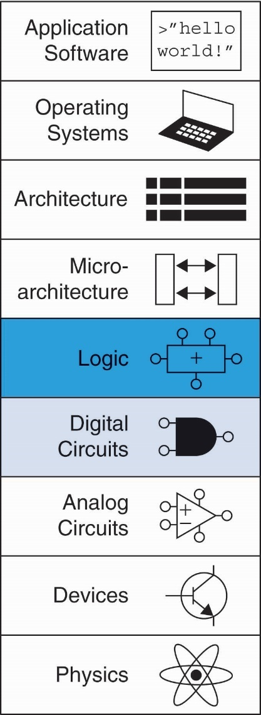
Chapter 2 :: Topics
Introduction
Boolean Equations
Boolean Algebra
From Logic to Gates
Multilevel Combinational Logic
X’s and Z’s, Oh My
Karnaugh Maps
Combinational Building Blocks
Timing

Slide 3
Introduction
A logic circuit is composed of:
Inputs
Outputs
Functional specification
Timing specification

Slide 4
Circuits
Nodes
Inputs: A, B, C
Outputs: Y, Z
Internal: n1
Circuit elements
E1, E2, E3
Each a circuit

Slide 5
Types of Logic Circuits
Combinational Logic
Memoryless
Outputs determined by current values of inputs
Sequential Logic
Has memory
Outputs determined by previous and current values of inputs

Slide 6
Rules of Combinational Composition
Every element is combinational
Every node is either an input or connects to exactly one output
The circuit contains no cyclic paths
Example:

Slide 7
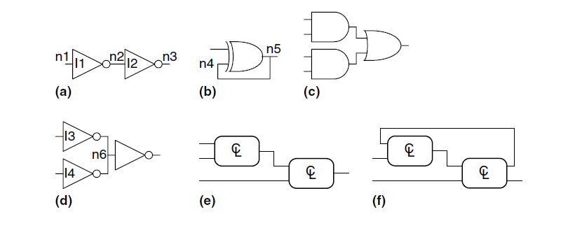
Exercise
Which of the circuits below are combinational?

Slide 8
Boolean Equations
Functional specification of outputs in terms of inputs
Example: S = F(A, B, C_{in})
C_{out} = F(A, B, C_{in})

Slide 9
Some Definitions
Complement: variable with a bar over it
A, B, C
Literal: variable or its complement
A, A, B, B, C, C
Implicant: product of 1 or more literals
ABC, AC, BC, B
Minterm: product that includes all input variables
ABC, ABC, ABC
Maxterm: sum that includes all input variables
(A+B+C), (A+B+C), (A+B+C)

Slide 10
Sum-of-Products (SOP) Form
All equations can be written in SOP form
Each row has a minterm
A minterm is a product (AND) of literals
Each minterm is TRUE for that row (and only that row)
Form function by ORing minterms where the output is TRUE
Thus, a sum (OR) of products (AND terms)
Y = F(A, B) =

Slide 11
Sum-of-Products Form
Sum-of-Products (SOP) Form
All equations can be written in SOP form
Each row has a minterm
A minterm is a product (AND) of literals
Each minterm is TRUE for that row (and only that row)
Form function by ORing minterms where the output is TRUE
Thus, a sum (OR) of products (AND terms)
Y = F(A, B) =

Slide 12
Sum-of-Products Form
Sum-of-Products (SOP) Form
All equations can be written in SOP form
Each row has a minterm
A minterm is a product (AND) of literals
Each minterm is TRUE for that row (and only that row)
Form function by ORing minterms where the output is TRUE
Thus, a sum (OR) of products (AND terms)
Y = F(A, B) = AB + AB = Σ(1, 3)

Slide 13
Product-of-Sums (POS) Form
All Boolean equations can be written in POS form
Each row has a maxterm
A maxterm is a sum (OR) of literals
Each maxterm is FALSE for that row (and only that row)
Form function by ANDing the maxterms for which the output is FALSE
Thus, a product (AND) of sums (OR terms)
Y = F(A, B) = (A + B)(A + B) = Π(0, 2)

Slide 14

Boolean Equations Example
You are going to the cafeteria for lunch
You won’t eat lunch (E)
If it’s not open (O) or
If they only serve corndogs (C)
Write a truth table for determining if you will eat lunch (E).

Slide 15
Boolean Equations Example
You are going to the cafeteria for lunch
You won’t eat lunch (E)
If it’s not open (O) or
If they only serve corndogs (C)
Write a truth table for determining if you will eat lunch (E).

Slide 16
SOP & POS Form
SOP – sum-of-products
POS – product-of-sums

Slide 17
SOP & POS Form
SOP – sum-of-products
POS – product-of-sums
Y = OC
= Σ(2)
Y = (O + C)(O + C)(O + C)
= Π(0, 1, 3)

Slide 18
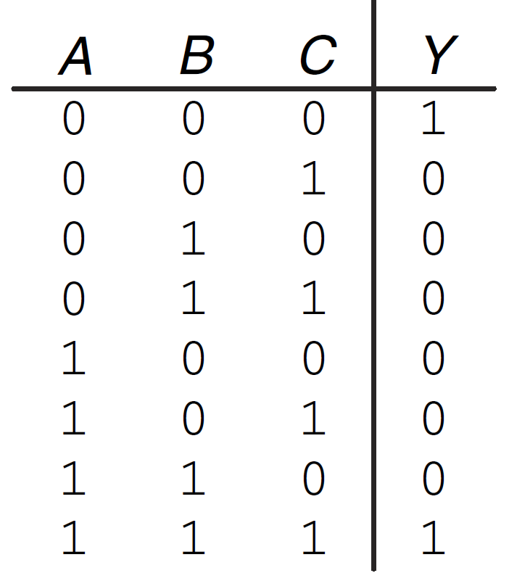
Exercise
Write a Boolean equation for the following truth table in SOP form

Slide 19
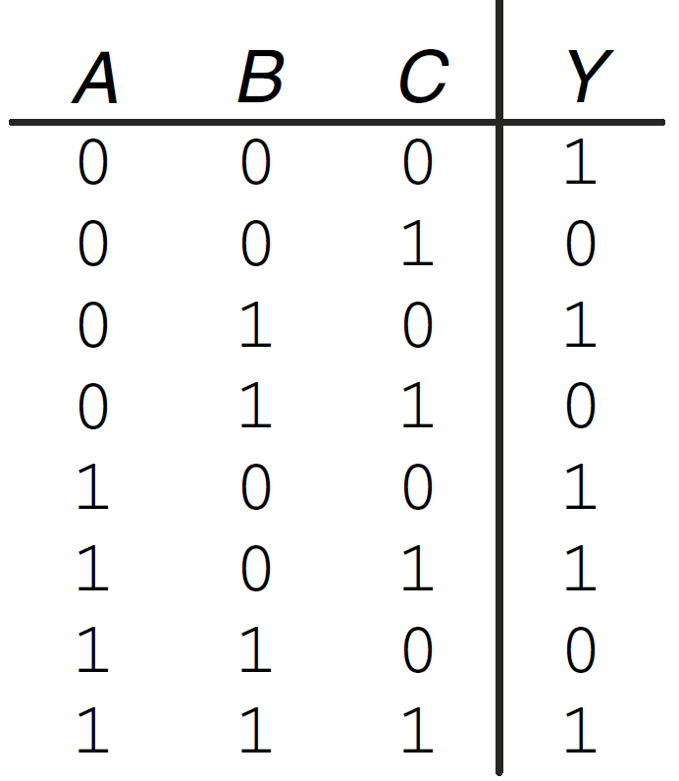
Exercise
Write a Boolean equation for the following truth table in POS form

Slide 20
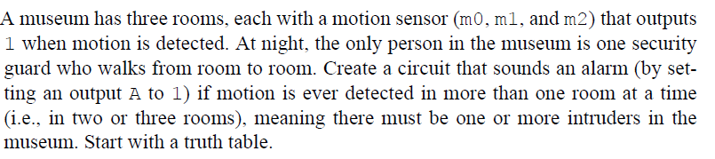
Exercise

Slide 21
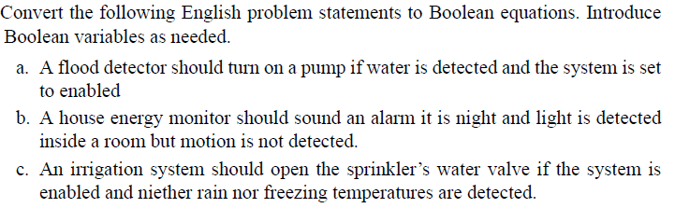
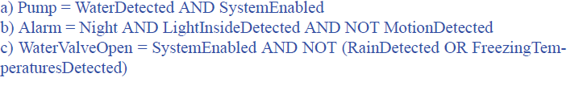
Exercise

Slide 22
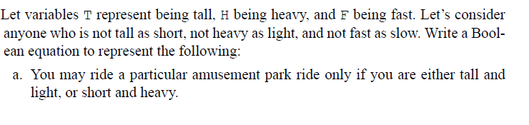
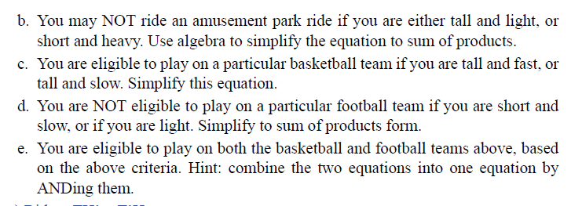
Exercise

Slide 23
Boolean Algebra
Axioms and theorems to simplify Boolean equations
Like regular algebra, but simpler: variables have only two values (1 or 0)
Duality in axioms and theorems:
ANDs and ORs, 0’s and 1’s interchanged

Slide 24
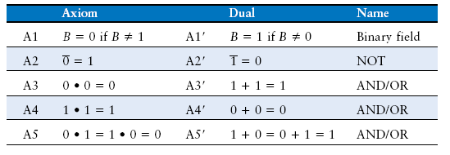
Boolean Axioms

Slide 25
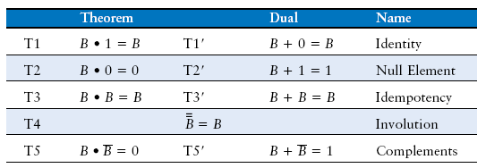
Theorems of One Variable

Slide 26
T1: Identity Theorem
B 1 = B
B + 0 = B

Slide 27
T1: Identity Theorem
B 1 = B
B + 0 = B

Slide 28
T2: Null Element Theorem
B 0 = 0
B + 1 = 1

Slide 29
T2: Null Element Theorem
B 0 = 0
B + 1 = 1

Slide 30
T3: Idempotency Theorem
B B = B
B + B = B

Slide 31
T3: Idempotency Theorem
B B = B
B + B = B

Slide 32
T4: Involution Theorem
B = B

Slide 33
T4: Involution Theorem
B = B

Slide 34
T5: Complement Theorem
B B = 0
B + B = 1

Slide 35
T5: Complement Theorem
B B = 0
B + B = 1

Slide 36
Boolean Theorems Summary

Slide 37
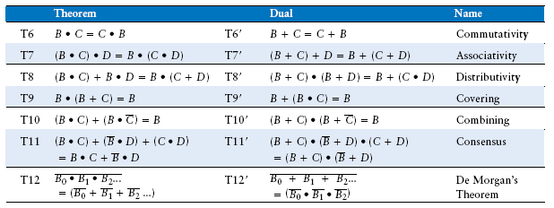
Boolean Theorems of Several Vars

Slide 38
Simplifying Boolean Equations
Example 1:
Y = AB + AB

Slide 39
Simplifying Boolean Equations
Example 1:
Y = AB + AB
= B(A + A) T8
= B(1) T5’
= B T1

Slide 40
Simplifying Boolean Equations
Example 2:
Y = A(AB + ABC)

Slide 41
Simplifying Boolean Equations
Example 2:
Y = A(AB + ABC)
= A(AB(1 + C)) T8
= A(AB(1)) T2’
= A(AB) T1
= (AA)B T7
= AB T3

Slide 42

Exercise
Minimize the following expression:

Slide 43
DeMorgan’s Theorem
Y = AB = A + B
Y = A + B = A B

Slide 44
Bubble Pushing
Backward:
Body changes
Adds bubbles to inputs
Forward:
Body changes
Adds bubble to output

Slide 45
Bubble Pushing
What is the Boolean expression for this circuit?

Slide 46
Bubble Pushing
What is the Boolean expression for this circuit?
Y = AB + CD

Slide 47
Bubble Pushing Rules
Begin at output, then work toward inputs
Push bubbles on final output back
Draw gates in a form so bubbles cancel

Slide 48
Bubble Pushing Example

Slide 49
Bubble Pushing Example

Slide 50
Bubble Pushing Example

Slide 51
Bubble Pushing Example

Slide 52
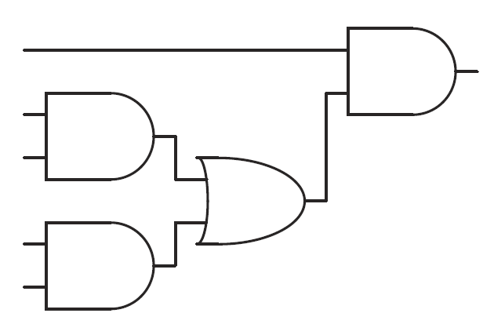
Bubble Pushing for CMOS
CMOS logic favors NAND/NOR over AND/OR
Convert the circuit above such that only NAND/NOR/INVs are used.

Slide 53
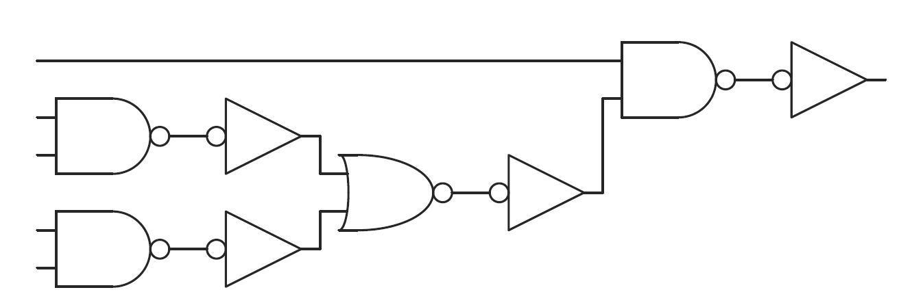
Bubble Pushing for CMOS
Inefficient!

Slide 54
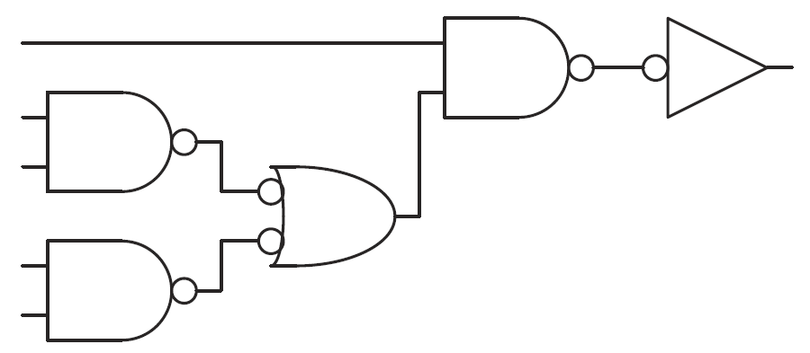
Bubble Pushing for CMOS

Slide 55
Functional Completeness: True or False?
We can implement any logic function using:
Only AND, OR, INVs
Only AND, INVs
Only NANDs
Only NORs
Only ANDs

Slide 56
Functional Completeness: True or False?
We can implement any logic function using:
Only AND, OR, INVs
Only AND, INVs
Only NANDs
Only NORs
Only ANDs
TRUE
TRUE
TRUE
TRUE
FALSE

Slide 57
From Logic to Gates
Two-level logic: ANDs followed by ORs
Example: Y = A BC + AB C + ABC

Slide 58
Circuit Schematics Rules
Inputs on the left (or top)
Outputs on right (or bottom)
Gates flow from left to right
Straight wires are best

Slide 59
Circuit Schematic Rules (cont.)
Wires always connect at a T junction
A dot where wires cross indicates a connection between the wires
Wires crossing without a dot make no connection

Slide 60
Multiple-Output Circuits
Example: Priority Circuit
Output asserted
corresponding to
most significant
TRUE input

Slide 61
Multiple-Output Circuits
Example: Priority Circuit
Output asserted
corresponding to
most significant
TRUE input

Slide 62
Priority Circuit Hardware

Slide 63
Don’t Cares

Slide 64
Contention: X
Contention: circuit tries to drive output to 1 and 0
Actual value somewhere in between
Could be 0, 1, or in forbidden zone
Might change with voltage, temperature, time, noise
Often causes excessive power dissipation
Warnings:
Contention usually indicates a bug.
X is used for “don’t care” and contention - look at the context to tell them apart

Slide 65
Floating: Z
Floating, high impedance, open, high Z
Floating output might be 0, 1, or somewhere in between
A voltmeter won’t indicate whether a node is floating
Tristate Buffer

Slide 66
Tristate Busses
Floating nodes are used in tristate busses
Many different drivers
Exactly one is active at
once

Slide 67
Karnaugh Maps (K-Maps)
Boolean expressions can be minimized by combining terms
K-maps minimize equations graphically
PA + PA = P

Slide 68
K-Map
Circle 1’s in adjacent squares
In Boolean expression, include only literals whose true and complement form are not in the circle
Y = AB

Slide 69
3-Input K-Map
1
0

Slide 70
3-Input K-Map
1
0
Y = AB + BC

Slide 71
K-Map Definitions
Complement: variable with a bar over it
A, B, C
Literal: variable or its complement
A, A, B, B, C, C
Implicant: product of literals
ABC, AC, BC, B
Prime implicant: implicant corresponding to the largest circle in a K-map

Slide 72
K-Map Rules
Every 1 must be circled at least once
Each circle must span a power of 2 (i.e. 1, 2, 4) squares in each direction
Each circle must be as large as possible
A circle may wrap around the edges
A “don't care” (X) is circled only if it helps minimize the equation
Goal: find the smallest number of largest-possible circles

Slide 73
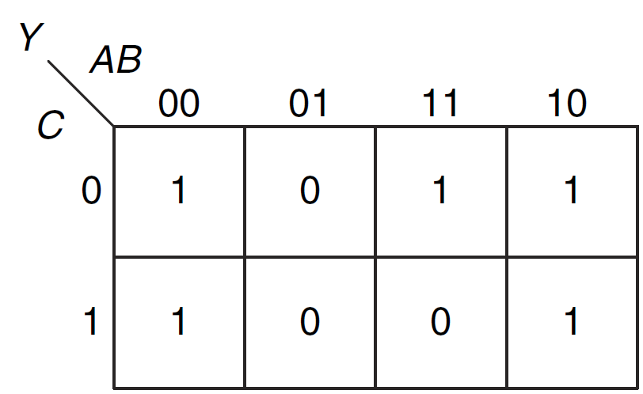
Exercise

Slide 74
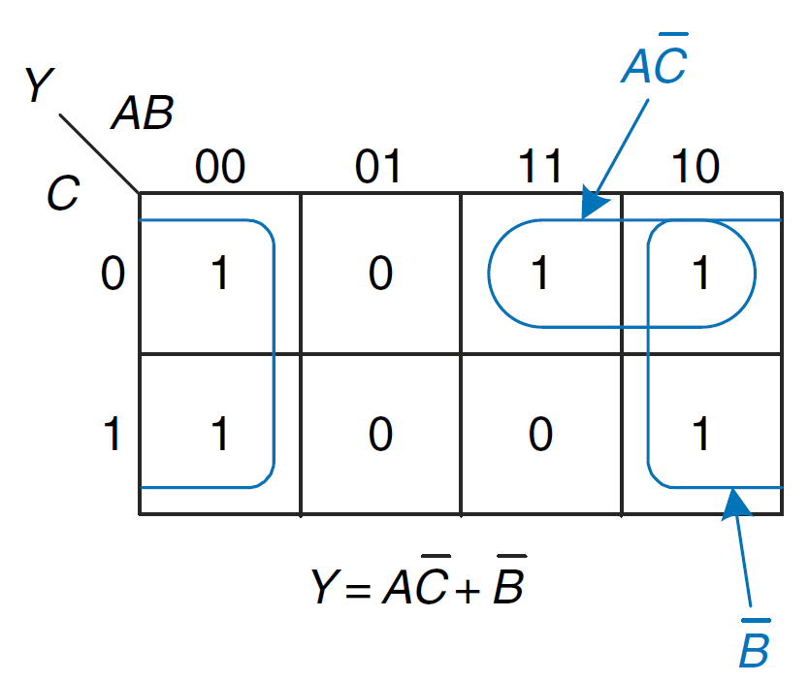
Solution

Slide 75
4-Input K-Map

Slide 76
4-Input K-Map

Slide 77
4-Input K-Map

Slide 78
K-Maps with Don’t Cares

Slide 79
K-Maps with Don’t Cares

Slide 80
K-Maps with Don’t Cares

Slide 81
Combinational Building Blocks
Multiplexers
Decoders

Slide 82
Multiplexer (MUX)
Selects between one of N inputs to connect to output
log₂N-bit select input – control input
Example: 2:1 Mux

Slide 83
Multiplexer Implementations
Logic gates
Sum-of-products form
Tristates
For an N-input MUX, use N tristates
Turn on exactly one to select the appropriate input

Slide 84
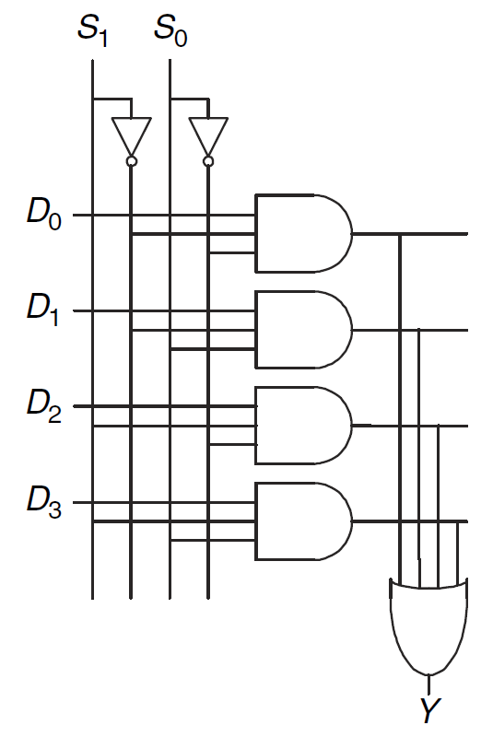
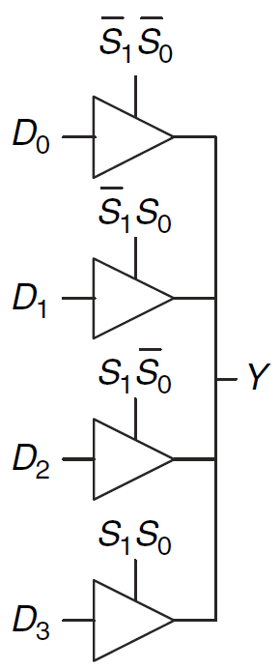
4:1 Mux Implementations

Slide 85
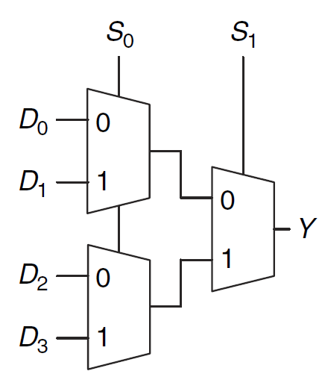
4:1 Mux Implementations
Implement a 4:1 Mux using 2:1 Muxes

Slide 86
Logic using Multiplexers
Using the MUX as a lookup table
2^{N}-to-1 MUX needed for n-inputs
Can we implement the same logic
with a 2-to-1 MUX?

Slide 87
Logic using Multiplexers
Reducing the size of the MUX
2^{N-1}-to-1 MUX needed for n-inputs

Slide 88
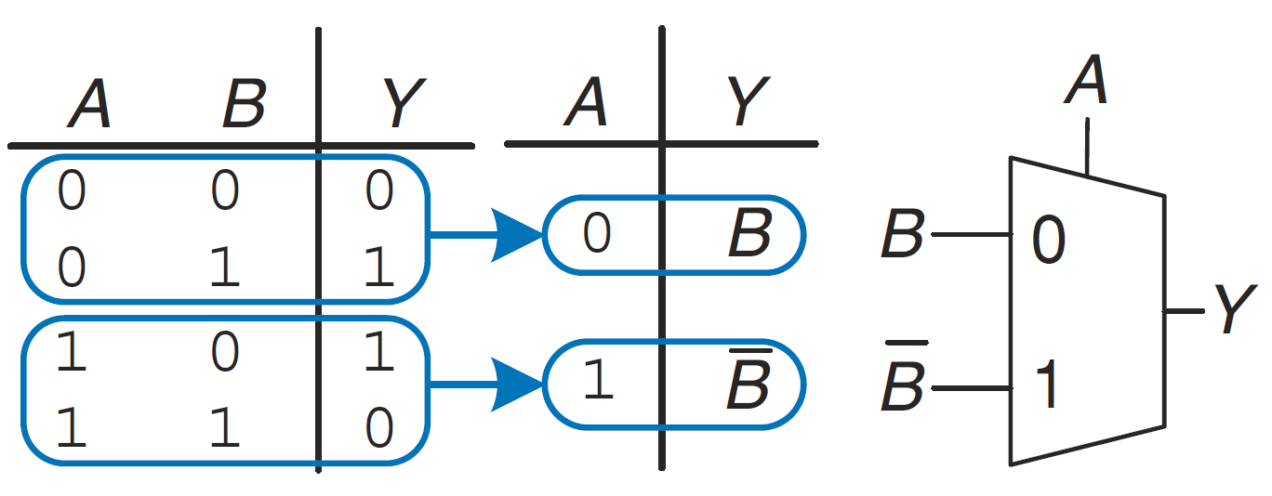
Exercise: Implement XOR using a 2:1 MUX

Slide 89
Exercise
Realize F(A,B,C) = Σ (1,3,6,7) using 4x1 Mux
A B C F
0 0 0 0
0 0 1 1
0 1 0 0
0 1 1 1
1 0 0 0
1 0 1 0
1 1 0 1
1 1 1 1
A B
C
C
0
1
C
C
0
1
4x1 mux F
Or, you may connect A to inputs and B and C to select inputs. Then A’ 0 1 2 3
A 4 5 6 7
0 A’ A 1

Slide 90
Exercise
Realize F(A, B, C, D)= S (1,2,3,4,8,11,12,15) using 8x1 mux
Use A,B,C as select inputs.
D’ 0 2 4 6 8 10 12 14
D 1 3 5 7 9 11 13 15
D 1 D’ 0 D’ D D’ D

Slide 91
System Verilog
Multiplexer Description
// 2x1 multiplexer
module mux2to1( input logic in1, in0, s,
output logic y);
assign y = s&in1 | ~s&in0;
endmodule
Using conditional assignment, we have a simpler statement:
assign y = s ? in1 : in0

Slide 92
Conditional Assignment
Four 2x1 muxes
module mux2(input logic [3:0] d0, d1,
input logic s,
output logic [3:0] y);
assign y = s ? d1 : d0;
endmodule
? : is also called a ternary operator because it
operates on 3 inputs: s, d1, and d0.

Slide 93
Implement an 8-bit mux2 using two 4-bit mux2s
SystemVerilog:
module mux2_8(input logic [7:0] d0, d1,
input logic s,
output logic [7:0] y);
mux2 lsbmux(d0[3:0], d1[3:0], s, y[3:0]);
mux2 msbmux(d0[7:4], d1[7:4], s, y[7:4]);
endmodule

Slide 94
Decoders
N inputs, 2^{N} outputs
“One-hot” outputs: only one output HIGH at once

Slide 95
Decoder Implementation

Slide 96
System Verilog Implementation of a 2:4 Decoder
module decoder2to4 ( input logic in1,in0,
output logic y3,y2,y1,y0) ;
assign y3 = in1 & in0 ;
assign y2 = in1 & ~in0 ;
assign y1 = ~in1 & in0 ;
assign y0 = ~in1 & ~in0 ;
endmodule

Slide 97
Logic Using Decoders
OR minterms

Slide 98
Timing
Delay between input change and output changing
How to build fast circuits?

Slide 99
Propagation & Contamination Delay
Propagation delay: t_{pd} = max delay from input to output
Contamination delay: t_{cd} = min delay from input to output

Slide 100
Propagation & Contamination Delay
Delay is caused by
Capacitance and resistance in a circuit
Speed of light limitation
Reasons why t_{pd} and t_{cd} may be different:
Different rising and falling delays
Multiple inputs and outputs, some of which are faster than others
Circuits slow down when hot and speed up when cold

Slide 101
Critical (Long) & Short Paths
Critical (Long) Path: t_{pd} = 2t_{pd_AND} + t_{pd_OR}
Short Path: t_{cd} = t_{cd_AND}

Slide 102
Glitches
When a single input change causes multiple output changes

Slide 103
Glitch Example
What happens when A = 0, C = 1, B falls?

Slide 104
Glitch Example (cont.)

Slide 105
Fixing the Glitch

Slide 106
Why Understand Glitches?
Glitches don’t cause problems when synchronous design conventions are used (see Chapter 3)
It’s important to recognize a glitch: in simulations or on oscilloscope
Can’t get rid of all glitches – simultaneous transitions on multiple inputs can also cause glitches

