Slide 1
Chapter 3
Digital Design and Computer Architecture, 2nd Edition
David Money Harris and Sarah L. Harris

Slide 2
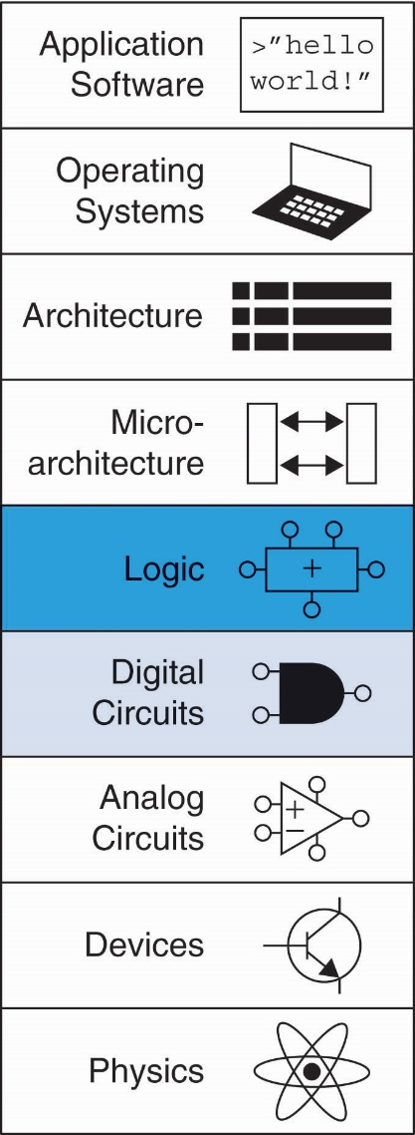
Chapter 3 :: Topics
Introduction
Latches and Flip-Flops
Synchronous Logic Design
Finite State Machines
Timing of Sequential Logic
Parallelism

Slide 3
Introduction
Outputs of sequential logic depend on current and prior input values – it has memory.
Some definitions:
State: all the information about a circuit necessary to explain its future behavior
Latches and flip-flops: state elements that store one bit of state
Synchronous sequential circuits: combinational logic followed by a bank of flip-flops

Slide 4
Sequential Circuits
Give sequence to events
Have memory (short-term)
Use feedback from output to input to store information

Slide 5
State Elements
The state of a circuit influences its future behavior
State elements store state
Bistable circuit
SR Latch
D Latch
D Flip-flop

Slide 6
Bistable Circuit
Fundamental building block of other state elements
Two outputs: Q, Q
No inputs

Slide 7
Bistable Circuit Analysis
Consider the two possible cases:
Q = 0:
then Q = 1, Q = 0 (consistent)
Q = 1:
then Q = 0, Q = 1 (consistent)
Stores 1 bit of state in the state variable, Q (or Q)
But there are no inputs to control the state

Slide 8
SR (Set/Reset) Latch
SR Latch
Consider the four possible cases:
S = 1, R = 0
S = 0, R = 1
S = 0, R = 0
S = 1, R = 1

Slide 9
SR Latch Analysis
S = 1, R = 0:
then Q = 1 and Q = 0
S = 0, R = 1:
then Q = 1 and Q = 0

Slide 10
SR Latch Analysis
S = 0, R = 0:
then Q = Q_{prev}
S = 1, R = 1:
then Q = 0, Q = 0

Slide 11
SR Latch Analysis
S = 0, R = 0:
then Q = Q_{prev}
Memory!
S = 1, R = 1:
then Q = 0, Q = 0
Invalid State
Q ≠ NOT Q

Slide 12
SR Latch Symbol
SR stands for Set/Reset Latch
Stores one bit of state (Q)
Control what value is being stored with S, R inputs
Set: Make the output 1
(S = 1, R = 0, Q = 1)
Reset: Make the output 0
(S = 0, R = 1, Q = 0)
Must do something to avoid
invalid state (when S = R = 1)

Slide 13
D Latch
Two inputs: CLK, D
CLK: controls when the output changes
D (the data input): controls what the output changes to
Function
When CLK = 1,
D passes through to Q (transparent)
When CLK = 0,
Q holds its previous value (opaque)
Avoids invalid case when
Q ≠ NOT Q

Slide 14
D Latch Internal Circuit

Slide 15
D Latch Internal Circuit

Slide 16
D Flip-Flop
Inputs: CLK, D
Function
Samples D on rising edge of CLK
When CLK rises from 0 to 1, D passes through to Q
Otherwise, Q holds its previous value
Q changes only on rising edge of CLK
Called edge-triggered
Activated on the clock edge

Slide 17
D Flip-Flop Internal Circuit
Two back-to-back latches (L1 and L2) controlled by complementary clocks
When CLK = 0
L1 is transparent
L2 is opaque
D passes through to N1
When CLK = 1
L2 is transparent
L1 is opaque
N1 passes through to Q
Thus, on the edge of the clock (when CLK rises from 0 1)
D passes through to Q

Slide 18
D Latch vs. D Flip-Flop

Slide 19
D Latch vs. D Flip-Flop

Slide 20
Registers

Slide 21
Enabled Flip-Flops
Inputs: CLK, D, EN
The enable input (EN) controls when new data (D) is stored
Function
EN = 1: D passes through to Q on the clock edge
EN = 0: the flip-flop retains its previous state

Slide 22
Resettable Flip-Flops
Inputs: CLK, D, Reset
Function:
Reset = 1: Q is forced to 0
Reset = 0: flip-flop behaves as ordinary D flip-flop

Slide 23
Resettable Flip-Flops
Two types:
Synchronous: resets at the clock edge only
Asynchronous: resets immediately when Reset = 1
Asynchronously resettable flip-flop requires changing the internal circuitry of the flip-flop
Synchronously resettable flip-flop?

Slide 24
Resettable Flip-Flops
Two types:
Synchronous: resets at the clock edge only
Asynchronous: resets immediately when Reset = 1
Asynchronously resettable flip-flop requires changing the internal circuitry of the flip-flop
Synchronously resettable flip-flop?

Slide 25
Settable Flip-Flops
Inputs: CLK, D, Set
Function:
Set = 1: Q is set to 1
Set = 0: the flip-flop behaves as ordinary D flip-flop

Slide 26
Sequential Logic
Sequential circuits: all circuits that aren’t combinational
A problematic circuit:

Slide 27
Sequential Logic
Sequential circuits: all circuits that aren’t combinational
A problematic circuit:
No inputs and 1-3 outputs
Astable circuit, oscillates
Period depends on inverter delay
It has a cyclic path: output fed back to input

Slide 28
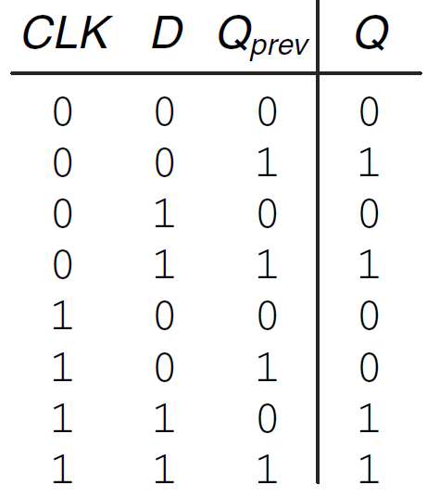
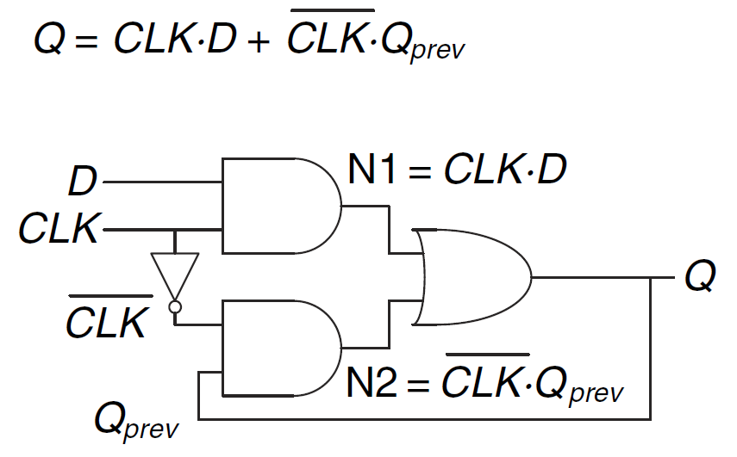
An Alternative D Latch Implementation Will it always work correctly?
Hint: Assume the inverter delay is very large!

Slide 29
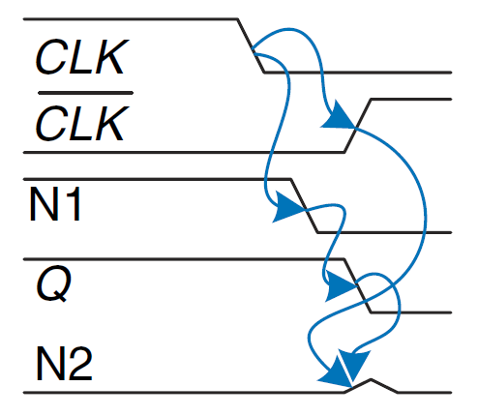
An Alternative D Latch Implementation Will it always work correctly?
Race condition: Assume Q=1 when CLK=1. Then CLK is switched to 0.
Assume INV delay is much larger than the delay of AND/OR gates.
Then Q will become 0 and will stay zero, but latch should have kept the
previous value when CLK=0. Incorrect functionality!

Slide 30
Asynchronous Circuit Design
Outputs directly fed back to inputs.
Potential race conditions!
Behavior of the circuit depends on which path is fastest
Seemingly identical circuits but with different gate delays may lead to different functionalities.
Circuit may only work at certain temperatures or voltages.
Solution: Break cycles by inserting registers -> Synchronous Design

Slide 31
Synchronous Sequential Logic Design
Breaks cyclic paths by inserting registers
Registers contain state of the system
State changes at clock edge: system synchronized to the clock
Rules of synchronous sequential circuit composition:
Every circuit element is either a register or a combinational circuit
At least one circuit element is a register
All registers receive the same clock signal
Every cyclic path contains at least one register
Two common synchronous sequential circuits
Finite State Machines (FSMs)
Pipelines

Slide 32
Finite State Machine (FSM)
Consists of:
State register
Stores current state
Loads next state at clock edge
Combinational logic
Computes the next state
Computes the outputs

Slide 33
Finite State Machines (FSMs)
Next state determined by current state and inputs
Two types of finite state machines differ in output logic:
Moore FSM: outputs depend only on current state
Mealy FSM: outputs depend on current state and inputs

Slide 34
FSM Example
Traffic light controller
Traffic sensors: T_{A}, T_{B} (TRUE when there’s traffic)
Lights: L_{A}, L_{B}

Slide 35
FSM Black Box
Inputs: CLK, Reset, T_{A}, T_{B}
Outputs: L_{A}, L_{B}

Slide 36
FSM State Transition Diagram
Moore FSM: outputs labeled in each state
States: Circles
Transitions: Arcs

Slide 37
FSM State Transition Diagram
Moore FSM: outputs labeled in each state
States: Circles
Transitions: Arcs

Slide 38
FSM State Transition Table
Current State | Inputs |  | Next State
S | T_{A} | T_{B} | S'
S0 | 0 | X
S0 | 1 | X
S1 | X | X
S2 | X | 0
S2 | X | 1
S3 | X | X

Slide 39
FSM State Transition Table
Current State | Inputs |  | Next State
S | T_{A} | T_{B} | S'
S0 | 0 | X | S1
S0 | 1 | X | S0
S1 | X | X | S2
S2 | X | 0 | S3
S2 | X | 1 | S2
S3 | X | X | S0

Slide 40
FSM Encoded State Transition Table
Current State |  | Inputs |  | Next State
S₁ | S₀ | T_{A} | T_{B} | S'₁ | S'₀
0 | 0 | 0 | X
0 | 0 | 1 | X
0 | 1 | X | X
1 | 0 | X | 0
1 | 0 | X | 1
1 | 1 | X | X
State | Encoding
S0 | 00
S1 | 01
S2 | 10
S3 | 11

Slide 41
FSM Encoded State Transition Table
Current State |  | Inputs |  | Next State
S₁ | S₀ | T_{A} | T_{B} | S'₁ | S'₀
0 | 0 | 0 | X | 0 | 1
0 | 0 | 1 | X | 0 | 0
0 | 1 | X | X | 1 | 0
1 | 0 | X | 0 | 1 | 1
1 | 0 | X | 1 | 1 | 0
1 | 1 | X | X | 0 | 0
State | Encoding
S0 | 00
S1 | 01
S2 | 10
S3 | 11
S'₁ = S₁ ⊕ S₀
S'₀ = S₁S₀T_{A} + S₁S₀T_{B}

Slide 42
FSM Output Table
Current State |  | Outputs
S₁ | S₀ | L_{A1} | L_{A0} | L_{B1} | L_{B0}
0 | 0
0 | 1
1 | 0
1 | 1
Output | Encoding
green | 00
yellow | 01
red | 10

Slide 43
FSM Output Table
Current State |  | Outputs
S₁ | S₀ | L_{A1} | L_{A0} | L_{B1} | L_{B0}
0 | 0 | 0 | 0 | 1 | 0
0 | 1 | 0 | 1 | 1 | 0
1 | 0 | 1 | 0 | 0 | 0
1 | 1 | 1 | 0 | 0 | 1
Output | Encoding
green | 00
yellow | 01
red | 10
L_{A1} = S₁
L_{A0} = S₁S₀
L_{B1} = S₁
L_{B0} = S₁S₀

Slide 44
FSM Schematic: State Register

Slide 45
FSM Schematic: Next State Logic

Slide 46
FSM Schematic: Output Logic

Slide 47
FSM Timing Diagram

Slide 48
FSM State Encoding
Binary encoding:
i.e., for four states, 00, 01, 10, 11
One-hot encoding
One state bit per state
Only one state bit HIGH at once
i.e., for 4 states, 0001, 0010, 0100, 1000
Requires more flip-flops
Often next state and output logic is simpler

Slide 49
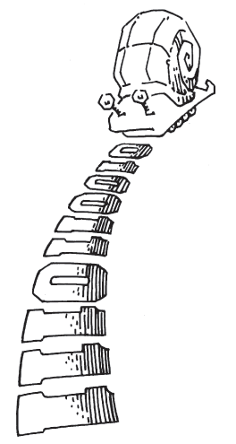
Moore vs. Mealy FSM
Alyssa P. Hacker has a snail that crawls down a paper tape with 1’s and 0’s on it. The snail smiles whenever the last two digits it has crawled over are 01. Design Moore and Mealy FSMs of the snail’s brain.

Slide 50
State Transition Diagrams
Mealy FSM: arcs indicate input/output

Slide 51
Moore FSM State Transition Table
Current State |  | Inputs | Next State
S₁ | S₀ | A | S'₁ | S'₀
0 | 0 | 0
0 | 0 | 1
0 | 1 | 0
0 | 1 | 1
1 | 0 | 0
1 | 0 | 1
State | Encoding
S0 | 00
S1 | 01
S2 | 10

Slide 52
Moore FSM State Transition Table
Current State |  | Inputs | Next State
S₁ | S₀ | A | S'₁ | S'₀
0 | 0 | 0 | 0 | 1
0 | 0 | 1 | 0 | 0
0 | 1 | 0 | 0 | 1
0 | 1 | 1 | 1 | 0
1 | 0 | 0 | 0 | 1
1 | 0 | 1 | 0 | 0
State | Encoding
S0 | 00
S1 | 01
S2 | 10
S₁’ = S₀A
S₀’ = A

Slide 53
Moore FSM Output Table
Current State |  | Output
S₁ | S₀ | Y
0 | 0
0 | 1
1 | 0

Slide 54
Moore FSM Output Table
Current State |  | Output
S₁ | S₀ | Y
0 | 0 | 0
0 | 1 | 0
1 | 0 | 1
Y = S₁

Slide 55
Mealy FSM State Transition & Output Table
Current State | Input | Next State | Output
S₀ | A | S'₀ | Y
0 | 0
0 | 1
1 | 0
1 | 1
State | Encoding
S0 | 00
S1 | 01

Slide 56
Mealy FSM State Transition & Output Table
Current State | Input | Next State | Output
S₀ | A | S'₀ | Y
0 | 0 | 1 | 0
0 | 1 | 0 | 0
1 | 0 | 1 | 0
1 | 1 | 0 | 1
State | Encoding
S0 | 00
S1 | 01

Slide 57
Moore FSM Schematic

Slide 58
Mealy FSM Schematic

Slide 59
Moore & Mealy Timing Diagram

Slide 60
FSM Design Procedure
Identify inputs and outputs
Sketch state transition diagram
Write state transition table
Select state encodings
For Moore machine:
Rewrite state transition table with state encodings
Write output table
For a Mealy machine:
Rewrite combined state transition and output table with state encodings
Write Boolean equations for next state and output logic
Sketch the circuit schematic

Slide 61
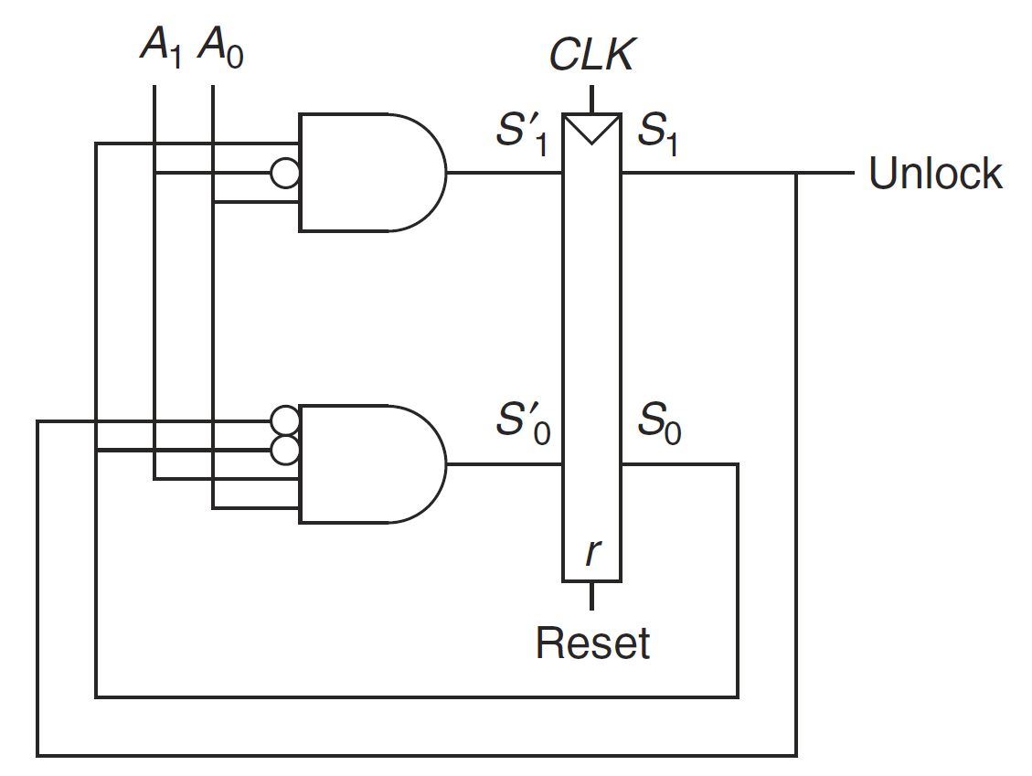
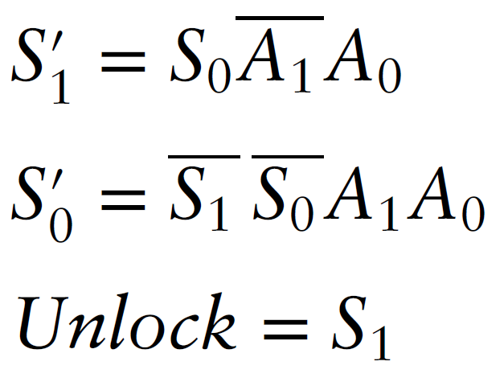
Deriving an FSM from its Circuit
What does this circuit do?

Slide 62
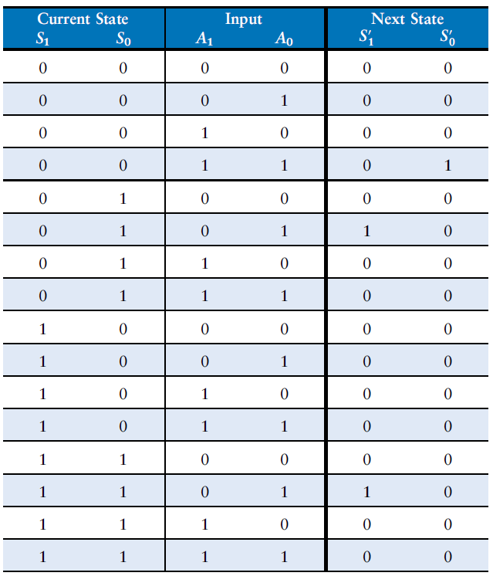
Next State Table
Observation 1: Next state is never 11
Observation 2: Next state after 10 is 00

Slide 63
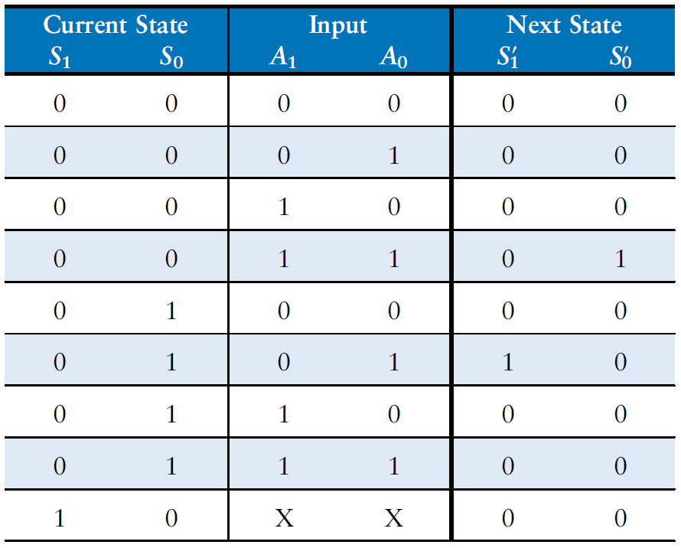
Reduced Next State Table

Slide 64
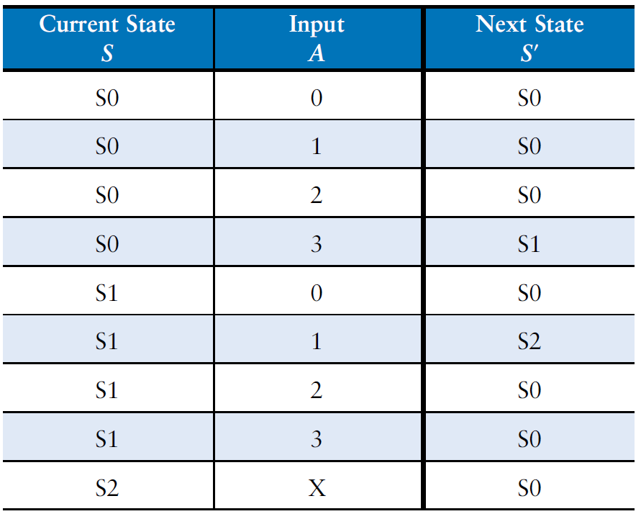
Symbolic Next State Table

Slide 65
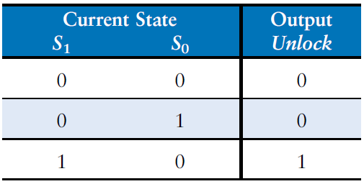
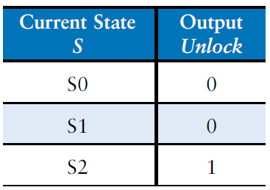
Output Table

Slide 66
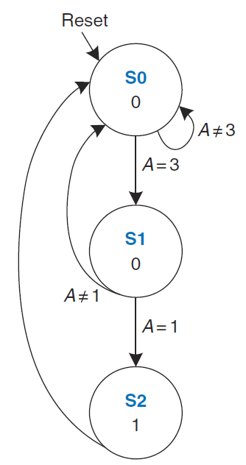
FSM and Functionality
Detects input sequence of 3 followed by 1, and outputs 1 (e.g. unlocks a door), and then restarts in the next cycle (e.g. locks the door again).

Slide 67
Controller Example: Button Press Synchronizer
bi
Button press
synchronizer
controller
bo
Want simple sequential circuit that converts button press to single cycle duration, regardless of length of time that button was actually pressed

Slide 68
Controller Example: Button Press Synchronizer (cont)
FSM inputs: bi; FSM outputs: bo
FSM
inputs
bi
bo
FSM
outputs
Step 2A: Set up architecture
Combinational
logic
bi
’
bi
n1
b
i
’
bi
’
n0
A
bi
B
bi
C
s1
s0
n1 = s1’s0bi + s1s0’bi
n0 = s1’s0’bi
bo = s1’s0bi’ + s1’s0bi = s1s0
a
bo=0
bo=1
bo=0
clk
State register
Step 1: Capture FSM
Combinational logic
bo
bi
n1
FSM inputs: bi; FSM outputs: bo
bi
’
bi
n0
bi
’
bi
’
00
bi
01
bi
10
s1
s0
bo=0
bo=1
bo=0
State register
Step 2B: Encode states
clk
Step 2C: Fill in truth table
Step 2D: Implement combinational logic
How about Mealy FSM?

Slide 69
FSM Example
Example 3.25
Daughter snail smiles whenever she slides over 1101 or the 1110 pattern
Draw state diagram and respective circuit

Slide 70
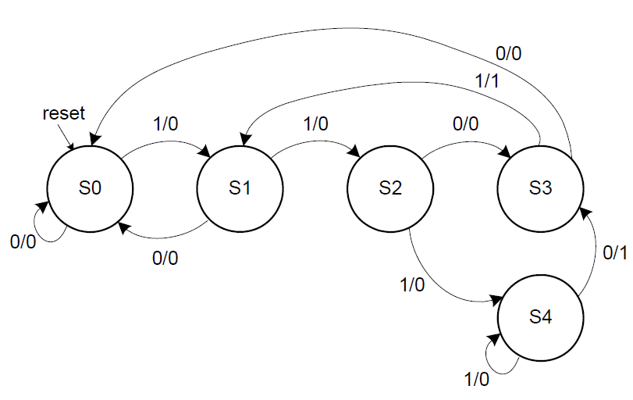
FSM Example (cont’d)

Slide 71
Common Mistakes when Capturing FSMs
Non-exclusive transitions
Incomplete transitions
a

Slide 72
Verifying Correct Transition Properties
Can verify using Boolean algebra
Only one condition true: AND of each condition pair (for transitions leaving a state) should equal 0 → proves pair can never simultaneously be true
One condition true: OR of all conditions of transitions leaving a state) should equal 1 → proves at least one condition must be true
Example
Answer:
a * a’b
= (a * a’) * b
= 0 * b
= 0
OK!
a
a + a’b
= a*(1+b) + a’b
= a + ab + a’b
= a + (a+a’)b
= a + b
Fails! Might not be 1 (i.e., a=0, b=0)
Q: For shown transitions, prove whether:
* Only one condition true (AND of each pair is always 0)
* One condition true (OR of all transitions is always 1)

Slide 73
Timing
Flip-flop samples D at clock edge
D must be stable when sampled
Similar to a photograph, D must be stable around clock edge
If not, metastability can occur

Slide 74
Input Timing Constraints
Setup time: t_{setup} = time before clock edge data must be stable (i.e. not changing)
Hold time: t_{hold} = time after clock edge data must be stable
Aperture time: t_{a} = time around clock edge data must be stable (t_{a} = t_{setup} + t_{hold})

Slide 75
Output Timing Constraints
Propagation delay: t_{pcq} = time after clock edge that the output Q is guaranteed to be stable (i.e., to stop changing)
Contamination delay: t_{ccq} = time after clock edge that Q might be unstable (i.e., start changing)

Slide 76
Dynamic Discipline
Synchronous sequential circuit inputs must be stable during aperture (setup and hold) time around clock edge
Specifically, inputs must be stable
at least t_{setup} before the clock edge
at least until t_{hold} after the clock edge

Slide 77
Dynamic Discipline
The delay between registers has a minimum and maximum delay, dependent on the delays of the circuit elements

Slide 78
Reminder: Propagation & Contamination Delays of Combinational Logic
Propagation delay: t_{pd} = max delay from input to output
Contamination delay: t_{cd} = min delay from input to output

Slide 79
Setup Time Constraint
Depends on the maximum delay from register R1 through combinational logic to R2
The input to register R2 must be stable at least t_{setup} before clock edge
T_{c} ≥

Slide 80
Setup Time Constraint
Depends on the maximum delay from register R1 through combinational logic to R2
The input to register R2 must be stable at least t_{setup} before clock edge
T_{c} ≥ t_{pcq} + t_{pd} + t_{setup}
t_{pd} ≤

Slide 81
Setup Time Constraint
Depends on the maximum delay from register R1 through combinational logic to R2
The input to register R2 must be stable at least t_{setup} before clock edge
T_{c} ≥ t_{pcq} + t_{pd} + t_{setup}
t_{pd} ≤ T_{c} – (t_{pcq} + t_{setup})

Slide 82
Hold Time Constraint
Depends on the minimum delay from register R1 through the combinational logic to R2
The input to register R2 must be stable for at least t_{hold} after the clock edge
t_{hold} <

Slide 83
Hold Time Constraint
Depends on the minimum delay from register R1 through the combinational logic to R2
The input to register R2 must be stable for at least t_{hold} after the clock edge
t_{hold} < t_{ccq} + t_{cd}
t_{cd} >

Slide 84
Hold Time Constraint
Depends on the minimum delay from register R1 through the combinational logic to R2
The input to register R2 must be stable for at least t_{hold} after the clock edge
t_{hold} < t_{ccq} + t_{cd}
t_{cd} > t_{hold} - t_{ccq}

Slide 85
Timing Analysis
Timing Characteristics
t_{ccq} = 30 ps
t_{pcq} = 50 ps
t_{setup} = 60 ps
t_{hold} = 70 ps
t_{pd} = 35 ps
t_{cd} = 25 ps
t_{pd} =
t_{cd} =
Setup time constraint:
T_{c} ≥
f_{c} =
Hold time constraint:
t_{ccq} + t_{cd} > t_{hold} ?

Slide 86
Timing Analysis
Timing Characteristics
t_{ccq} = 30 ps
t_{pcq} = 50 ps
t_{setup} = 60 ps
t_{hold} = 70 ps
t_{pd} = 35 ps
t_{cd} = 25 ps
t_{pd} = 3 x 35 ps = 105 ps
t_{cd} = 25 ps
Setup time constraint:
T_{c} ≥ (50 + 105 + 60) ps = 215 ps
f_{c} = 1/T_{c} = 4.65 GHz
Hold time constraint:
t_{ccq} + t_{cd} > t_{hold} ?
(30 + 25) ps > 70 ps ? No!

Slide 87
Timing Analysis
Add buffers to the short paths:
Timing Characteristics
t_{ccq} = 30 ps
t_{pcq} = 50 ps
t_{setup} = 60 ps
t_{hold} = 70 ps
t_{pd} = 35 ps
t_{cd} = 25 ps
t_{pd} =
t_{cd} =
Setup time constraint:
T_{c} ≥
f_{c} =
Hold time constraint:
t_{ccq} + t_{cd} > t_{hold} ?

Slide 88
Timing Analysis
Add buffers to the short paths:
Timing Characteristics
t_{ccq} = 30 ps
t_{pcq} = 50 ps
t_{setup} = 60 ps
t_{hold} = 70 ps
t_{pd} = 35 ps
t_{cd} = 25 ps
t_{pd} = 3 x 35 ps = 105 ps
t_{cd} = 2 x 25 ps = 50 ps
Setup time constraint:
T_{c} ≥ (50 + 105 + 60) ps = 215 ps
f_{c} = 1/T_{c} = 4.65 GHz
Hold time constraint:
t_{ccq} + t_{cd} > t_{hold} ?
(30 + 50) ps > 70 ps ? Yes!

Slide 89
Clock Skew
The clock doesn’t arrive at all registers at same time
Skew: difference between two clock edges
Perform worst case analysis to guarantee dynamic discipline is not violated for any register – many registers in a system!

Slide 90
Setup Time Constraint with Skew
In the worst case, CLK2 is earlier than CLK1
T_{c} ≥

Slide 91
Setup Time Constraint with Skew
In the worst case, CLK2 is earlier than CLK1
T_{c} ≥ t_{pcq} + t_{pd} + t_{setup} + t_{skew}
t_{pd} ≤

Slide 92
Setup Time Constraint with Skew
In the worst case, CLK2 is earlier than CLK1
T_{c} ≥ t_{pcq} + t_{pd} + t_{setup} + t_{skew}
t_{pd} ≤ T_{c} – (t_{pcq} + t_{setup} + t_{skew})

Slide 93
Hold Time Constraint with Skew
In the worst case, CLK2 is later than CLK1
t_{ccq} + t_{cd} >

Slide 94
Hold Time Constraint with Skew
In the worst case, CLK2 is later than CLK1
t_{ccq} + t_{cd} > t_{hold} + t_{skew}
t_{cd} >

Slide 95
Hold Time Constraint with Skew
In the worst case, CLK2 is later than CLK1
t_{ccq} + t_{cd} > t_{hold} + t_{skew}
t_{cd} > t_{hold} + t_{skew} – t_{ccq}

Slide 96
Violating the Dynamic Discipline
Asynchronous (for example, user) inputs might violate the dynamic discipline

Slide 97
Metastability
Bistable devices: two stable states, and a metastable state between them
Flip-flop: two stable states (1 and 0) and one metastable state
If flip-flop lands in metastable state, could stay there for an undetermined amount of time

