Slide 1
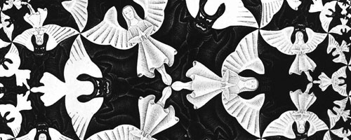
THE LUCIFER EFFECT
PHILIP ZIMBARDO
QUESTION: WHAT MAKES GOOD PEOPLE COMMIT EVIL?
What is evil?
General beliefs about origins of evil.
Zimbardo’s perspective.
Incidents of grave evil and similarities in them.
Stanford Prison Experiment.
What evil actually is.
SHAHRIYAR HUSEYNLI
MUHAMMAD ARHAM KHAN

Slide 2

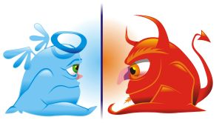
EVIL: POPULAR BELIEFS
Evil: intentionally behaving in ways that directly or indirectly pose harm to the innocent.
In short, “knowing better but doing worse”.
Popular cause: Human nature.
Bad Apples in Abu Ghraib incident.
Dichotomy between Good and Evil human.

Slide 3

ZIMBARDO’S PERSPECTIVE
Situational influences are important too.
Often, system and power are roots of evil.
Evil and Good co-exist within everyone:
Boundary is permeable.
External influence can make a person cross the boundary.
But, to what extent can individuals be influenced by external factors to commit evil?

Slide 4
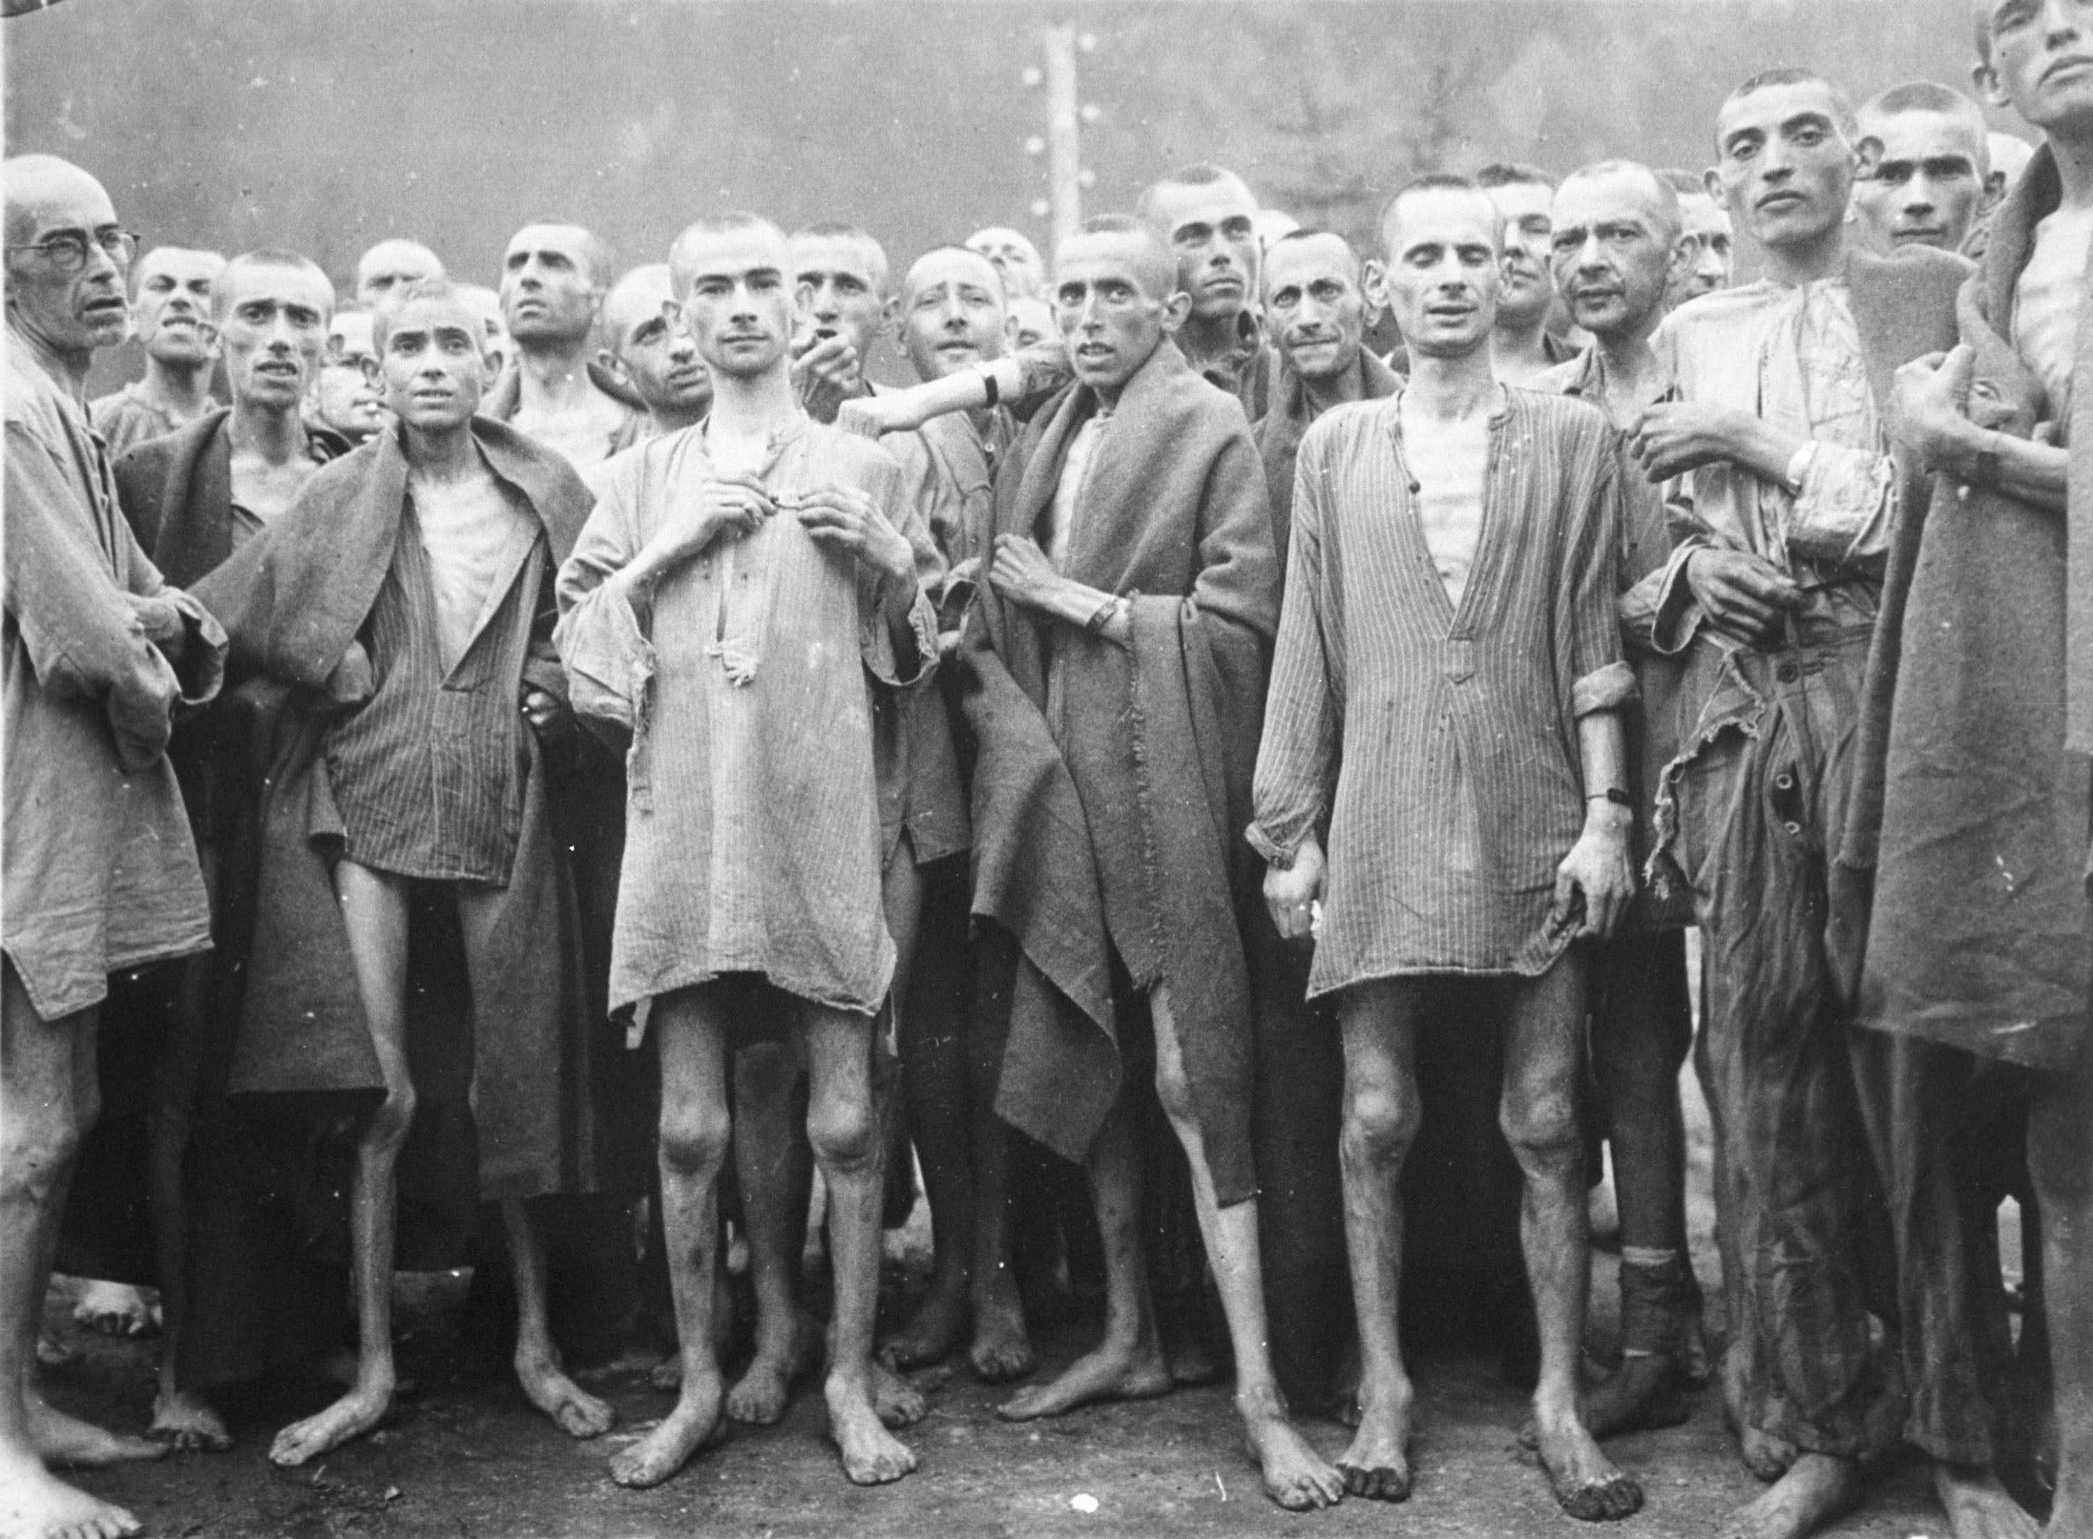
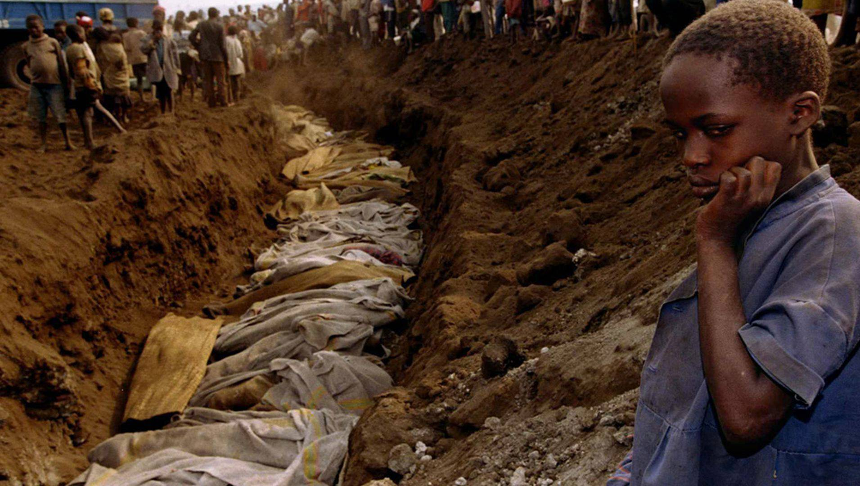
EVIL INCIDENTS OF HISTORY - 1
HOLOCAUST:
German authorities influenced “normal” citizens into carrying a mass-scale genocide against the enemy: Jews.
Normal people who were good in everyday life turned against their Jew friends.
Supported Nazi regime.
MASS KILLINGS IN RWANDA:
Hutu people were manipulated into believing Tutsi as enemy.
Citizens killed their friends, neighbors and acquaintances.
Pauline, a good Tutsi activist, turned against her own people.

Slide 5
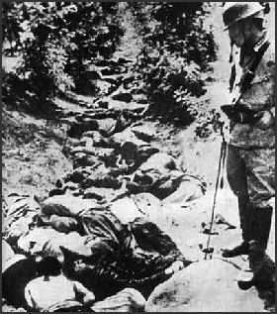
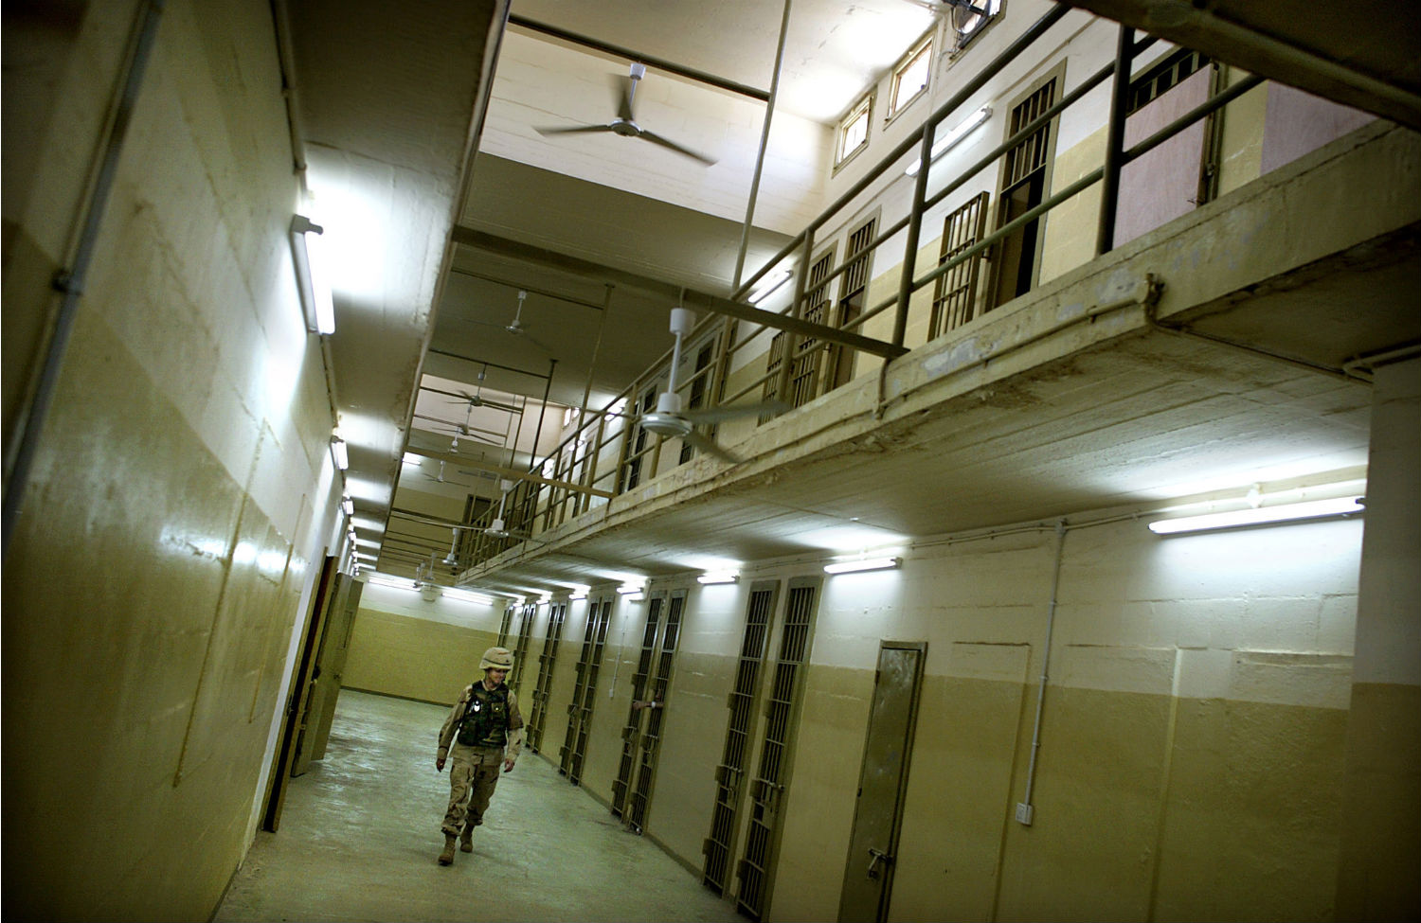
EVIL INCIDENTS OF HISTORY - 2
RAPES IN NANKING, CHINA
Japanese soldiers brutally raped Chinese citizens.
ABU GHRAIB INCIDENT:
Good soldiers inhumanely tortured the captives for “fun”.
Took “trophy photos” as if with animals.

Slide 6
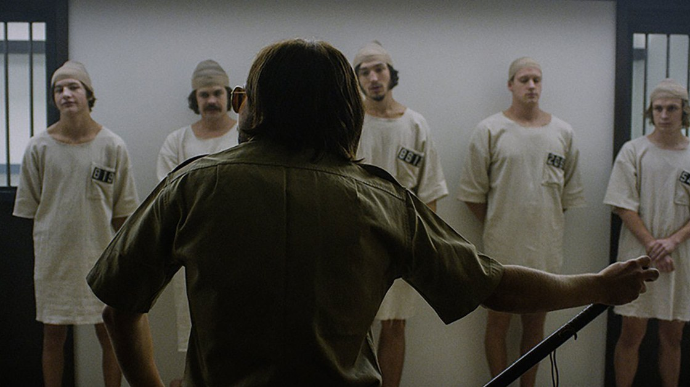
STANFORD PRISON EXPERIMENT
Zimbardo’s approach to see what good people do in evil environments
In short, he wanted to proof the LUCIFER EFFECT.
Realized, many parallels exist between the experiment and Abu Ghraib incident (people acted similarly).
Thus, this experiment illustrated power of situational forces over individual behavior.

Slide 7
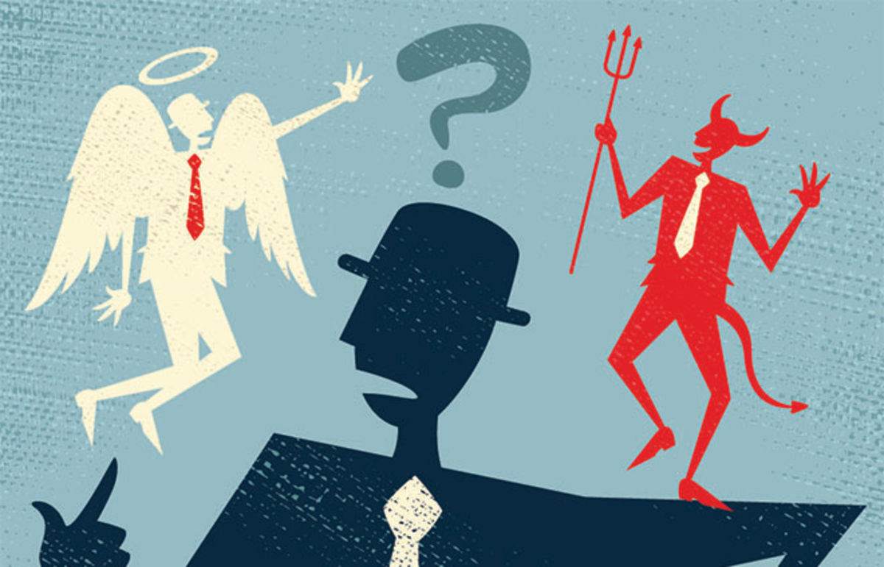
ARE MORALS PERMANENT?
But, where do one’s morals go when committing an influenced evil?
ALBERT BANDURA EXPERIMENT:
Labels to the opposite party matter.
Humans can selectively engage and disengage their moral standards
This experiment explained that it is possible for “Good” people to neglect their morals and commit evil.

Slide 8

MAJOR TAKEAWAYS…
Apples can be influenced by the apple barrel and its maker
Manipulating image and labels of victims may convince good ones to harm them. Examples:
People dehumanized in Abu Ghraib.
Jews presented as sub-humans and deserving candidates for torture in holocaust.
Tutsis, as a whole, were considered as threats and de-individualized.
Prisoners considered as test subjects in Stanford Prisoner experiment.
So, everyone can do evil.

Slide 9
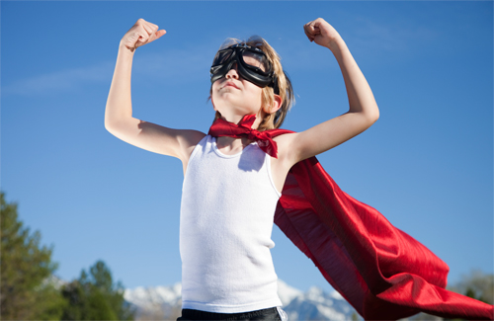
THE POSITIVE SIDE…
The idea that evil and good co-exist highlights the point that situations may transform normal people into heroes.
Human behavior influenced by situations,
In a given situation, one may turn evil while some may act heroically.

Slide 10
DISCUSSION, MAYBE?

