Slide 1


Slide 2
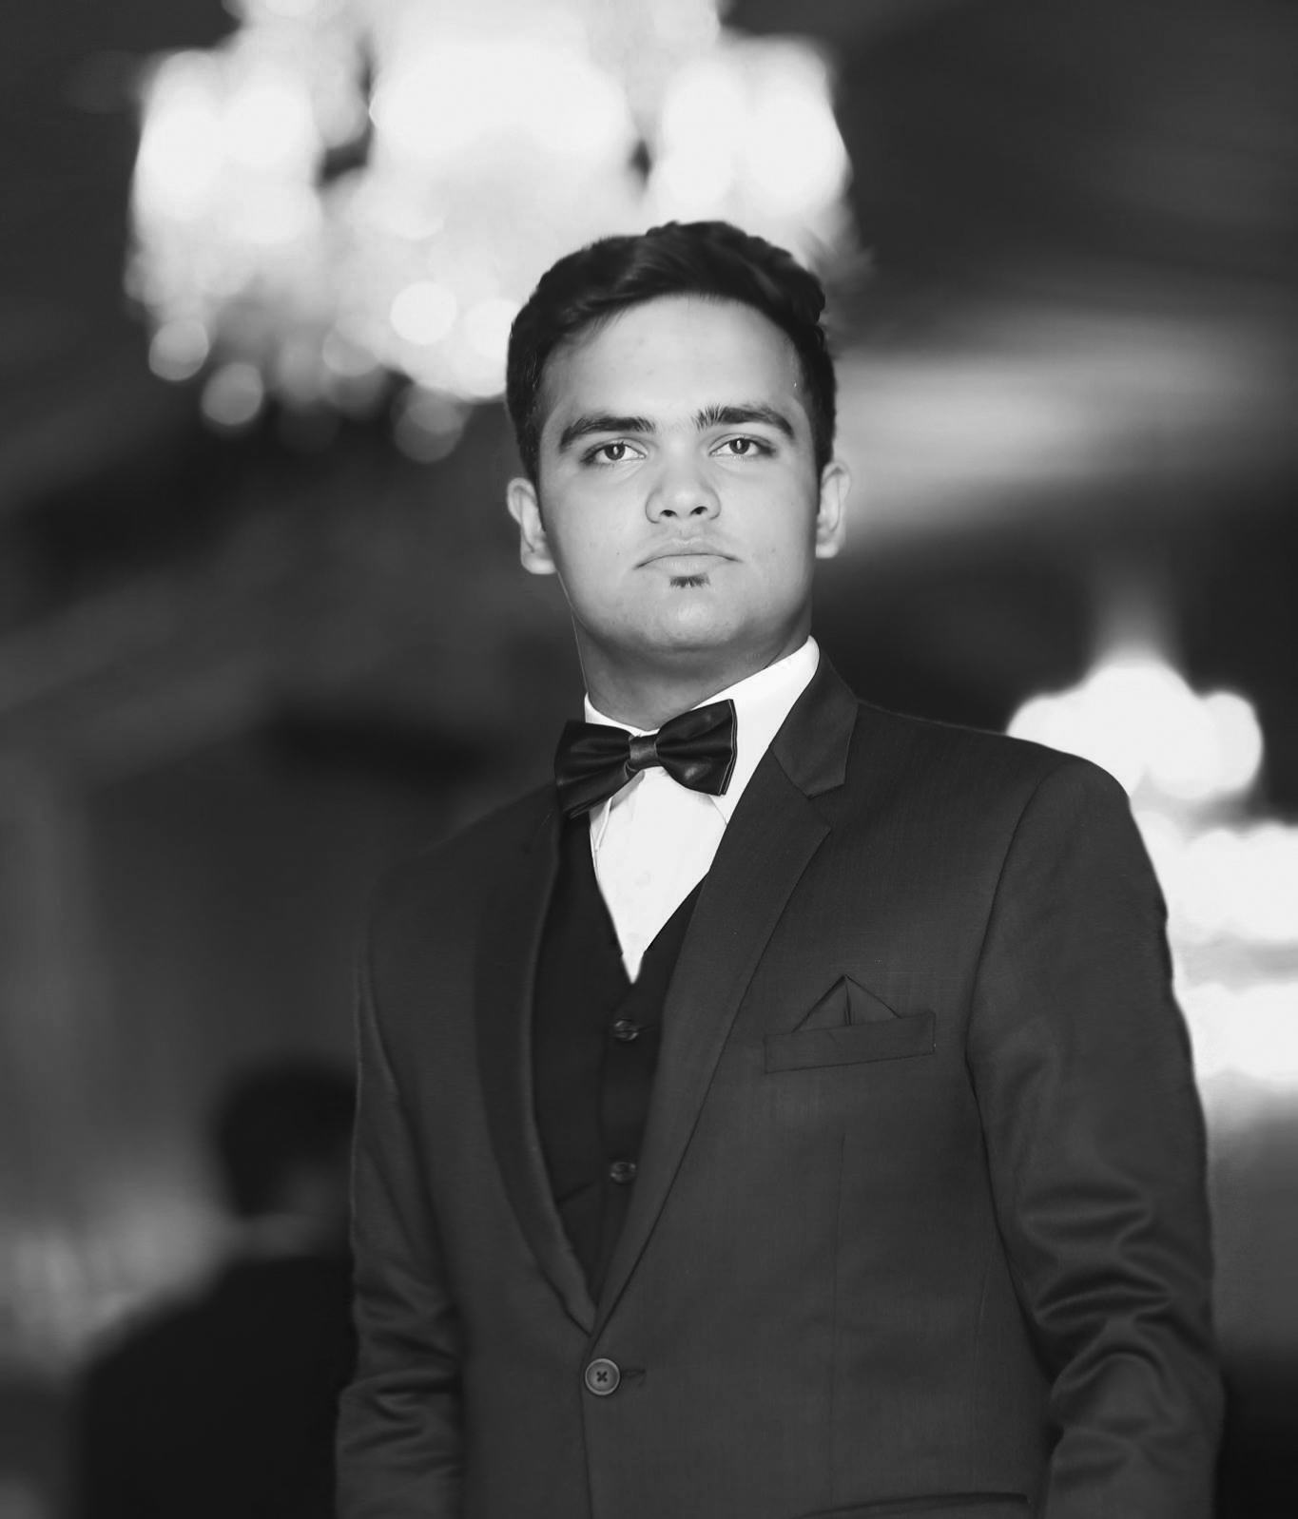
MUHAMMAD ARHAM KHAN

Slide 3
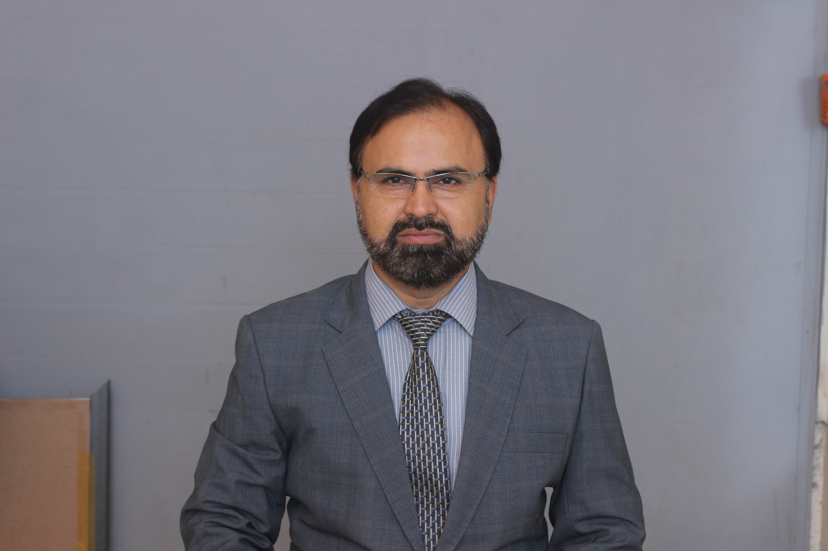
MUHAMMAD TASNEEM KHAN

Slide 4

ASMA TASNEEM

Slide 5
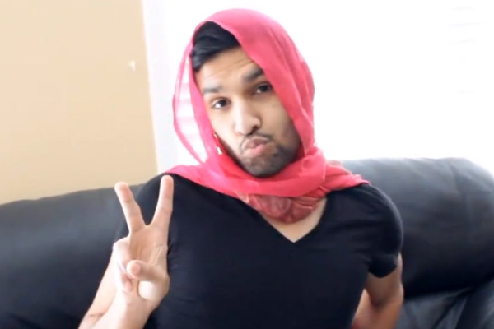
ZAID KHATOON

Slide 6
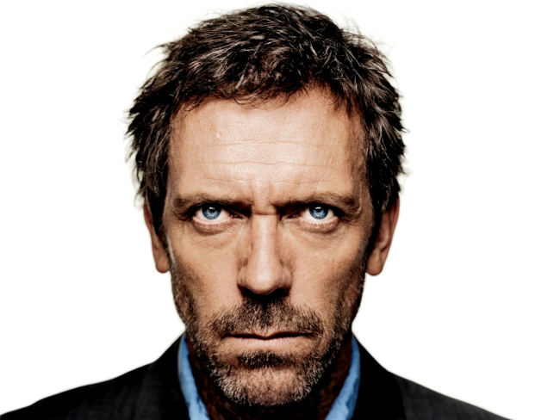
DR. MAJBOOR HOUSE

Slide 7
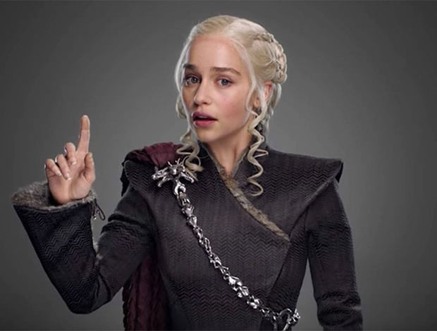
DAENERYS DRAGONWALA

Slide 8
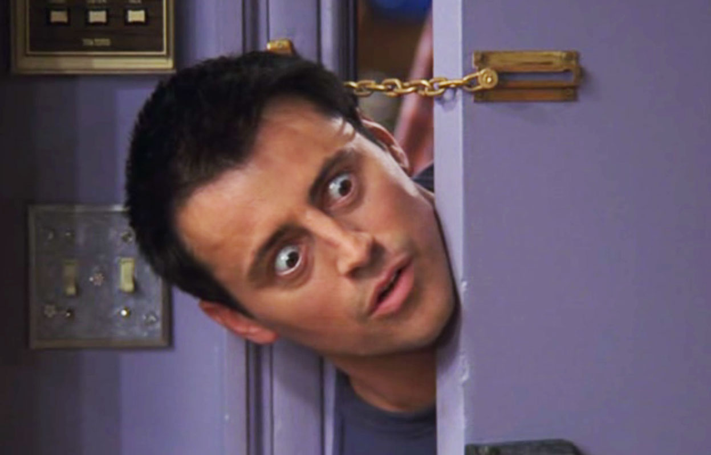
JOEY KHAN

Slide 9

EYLÜL KHAN

Slide 10
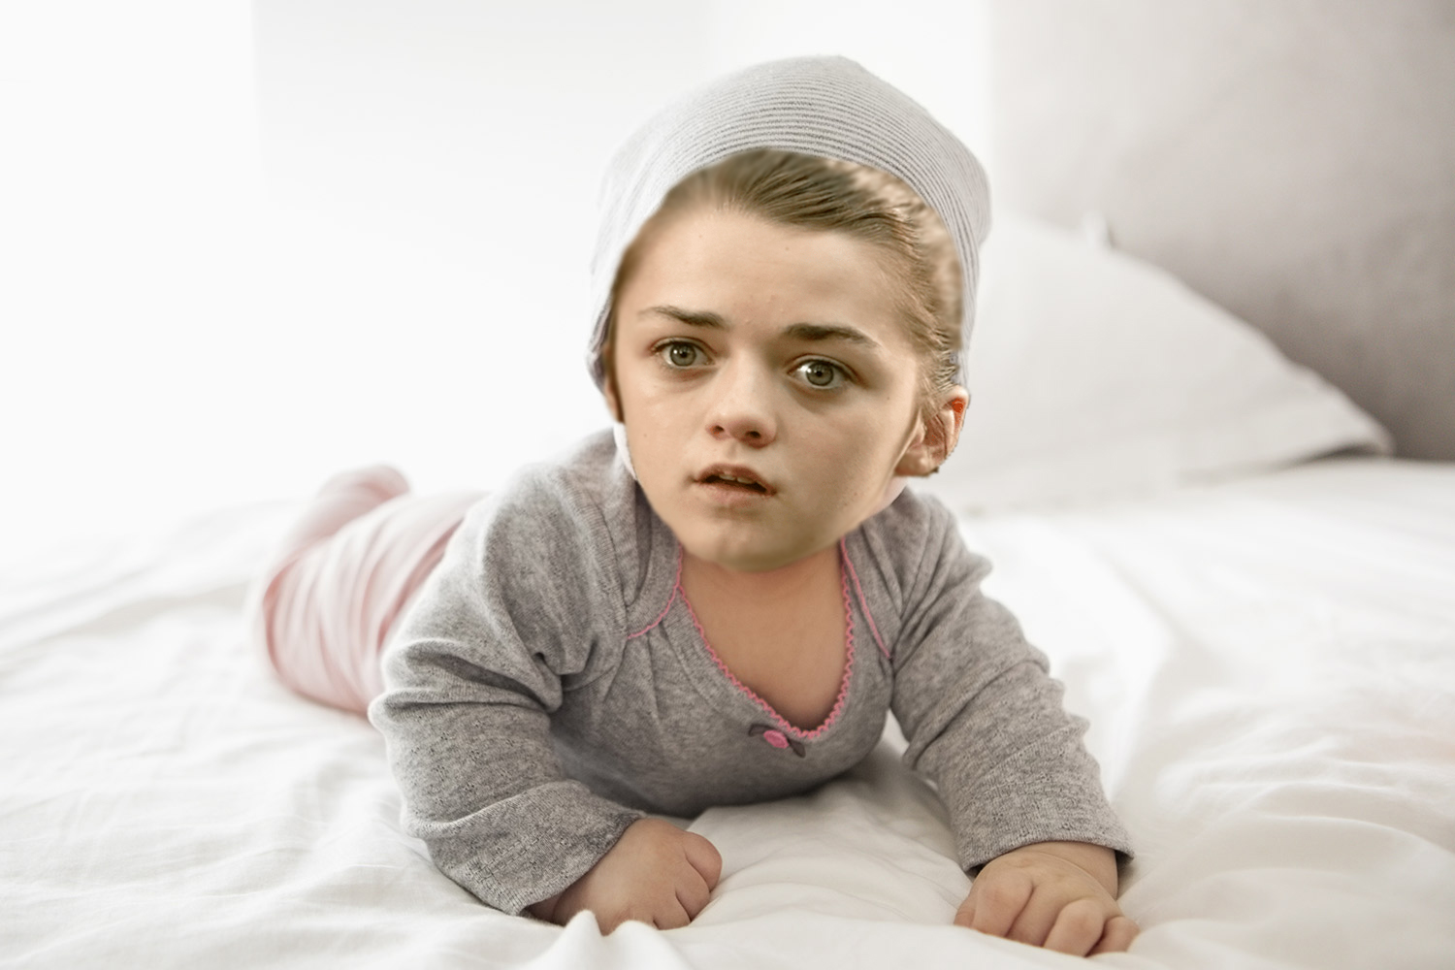
ARYA BINTE KHAN

Slide 11

PAPPU KHAN

Slide 12
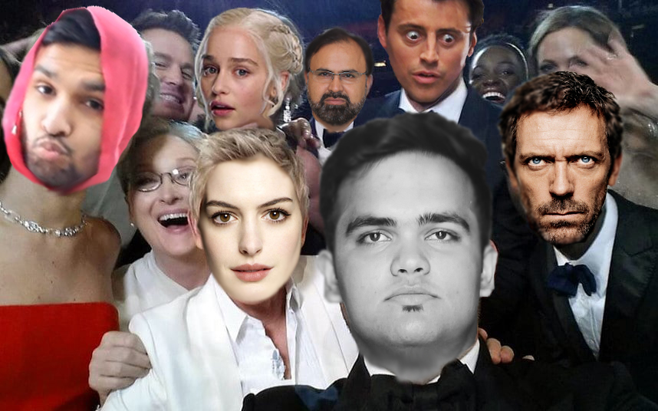
AiLEM….

Slide 13
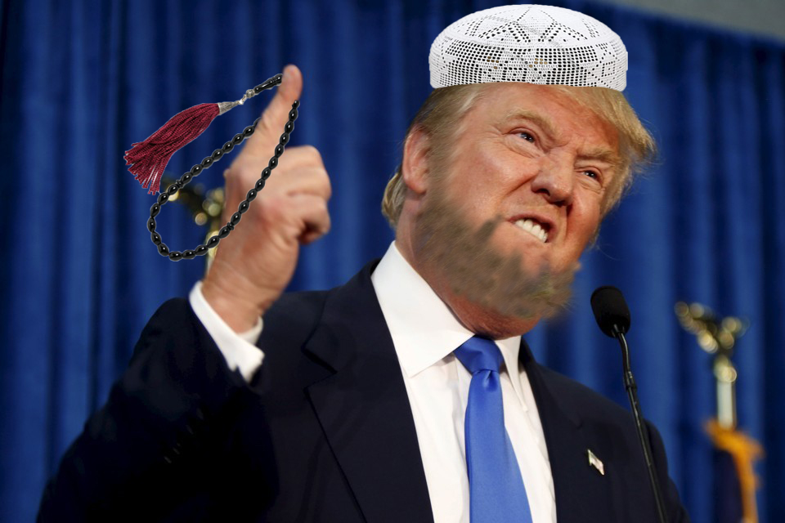
TRUMP KHAN ACHAKZAI

Slide 14
teşekkür ederim

