Slide 1
Predation events of Green-and-gold Tanager Tangara schrankii
Mario A. Loaiza-Muñoz¹ and Gustavo A. Londoño
¹Corresponding author : loaizamunoz01@gmail.com

Slide 2
Here are some predation events recorded by camera traps from Green-and-gold Tanager Tangara schrankii. If you need more information about this species and its reproductive biology, contact the authors.

Slide 3
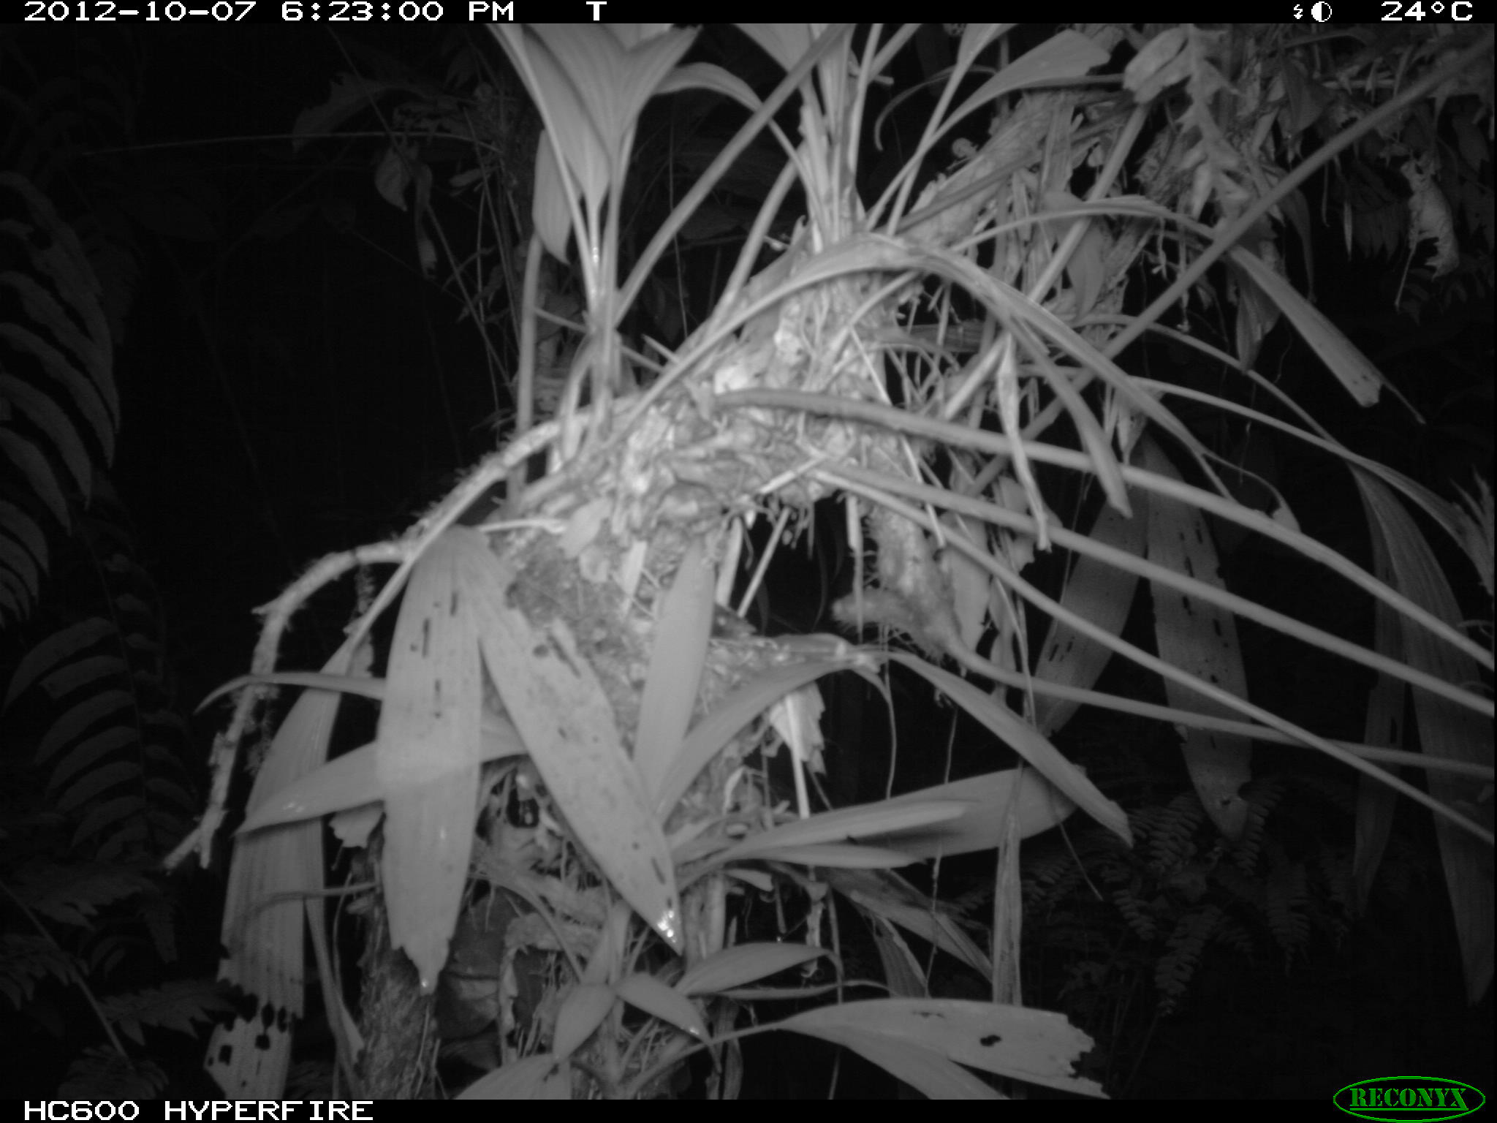
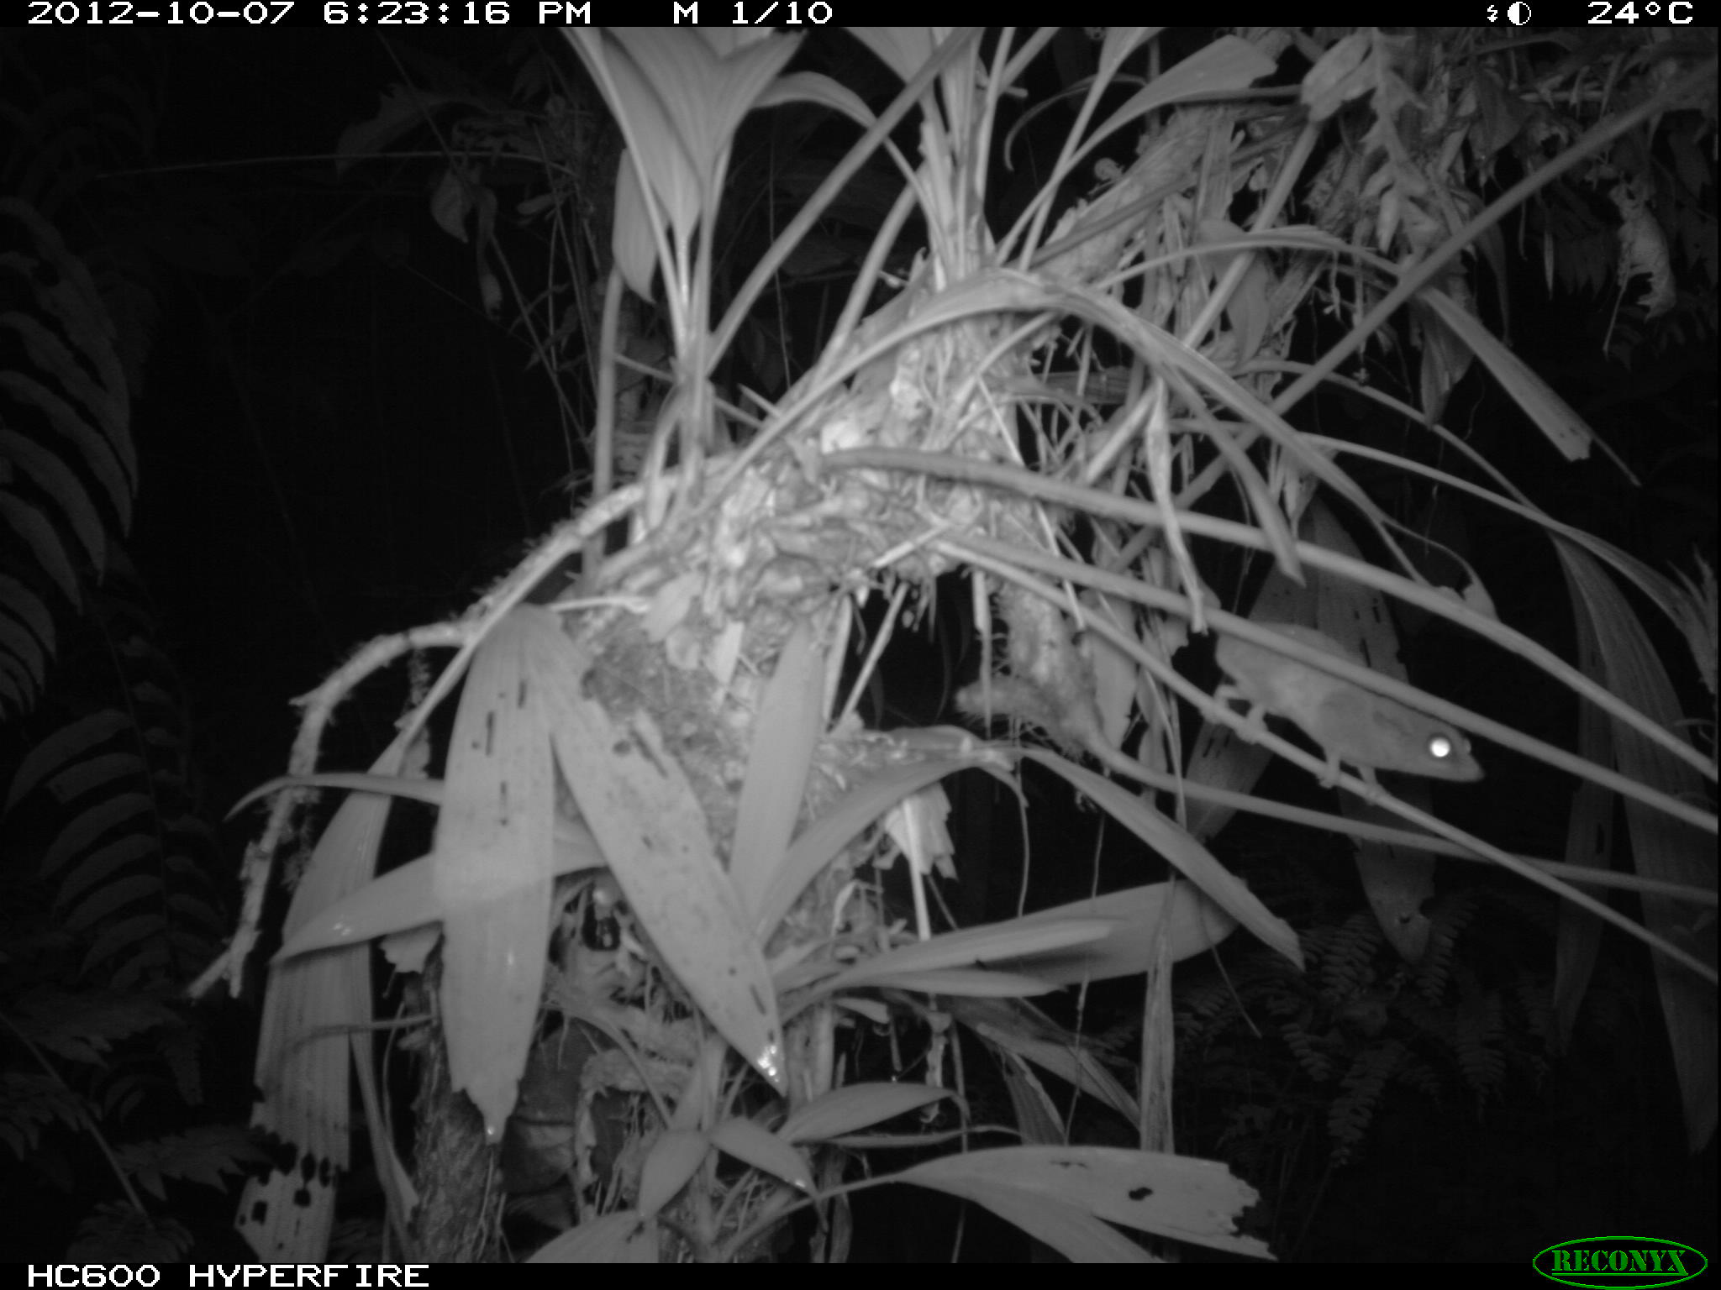
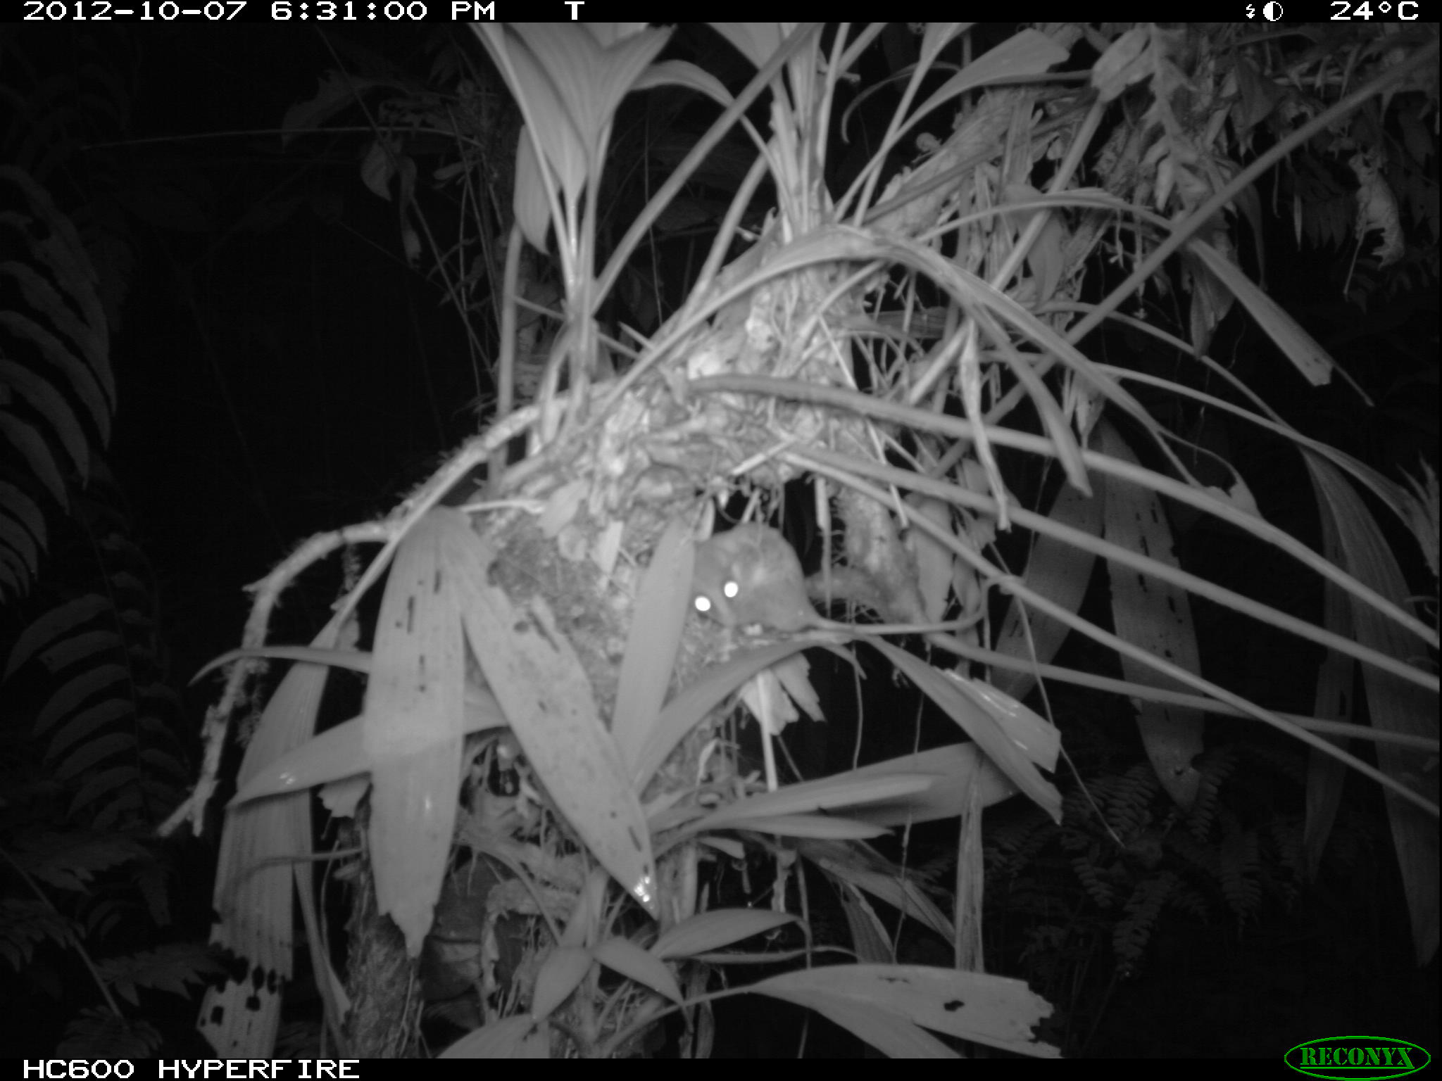
Nest id: Tangara_schrankii_P12_PCGJ12
This nest was found on October 5, 2012 in with eggs, on October 7 it was preyed on by an opossum.

Slide 4
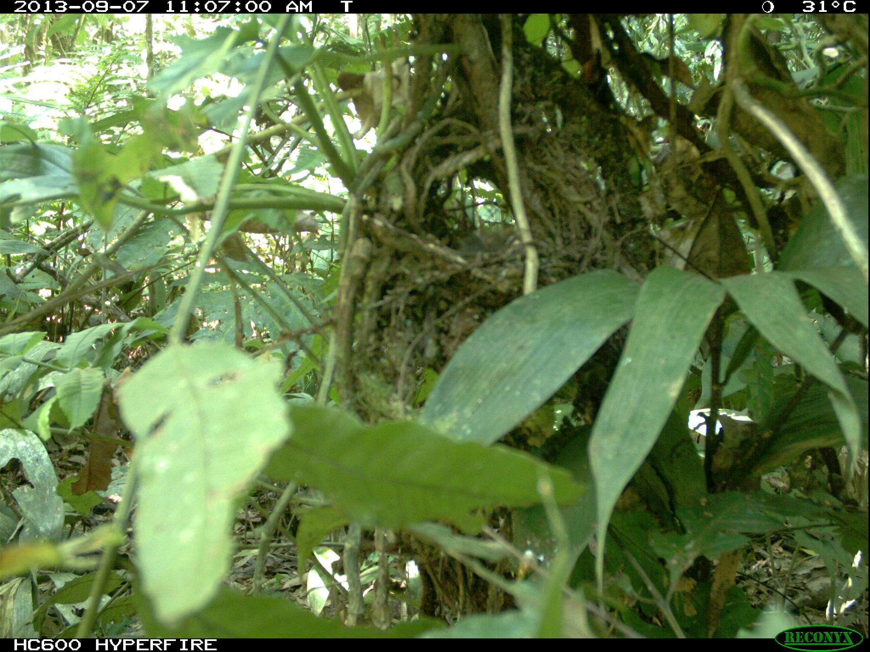
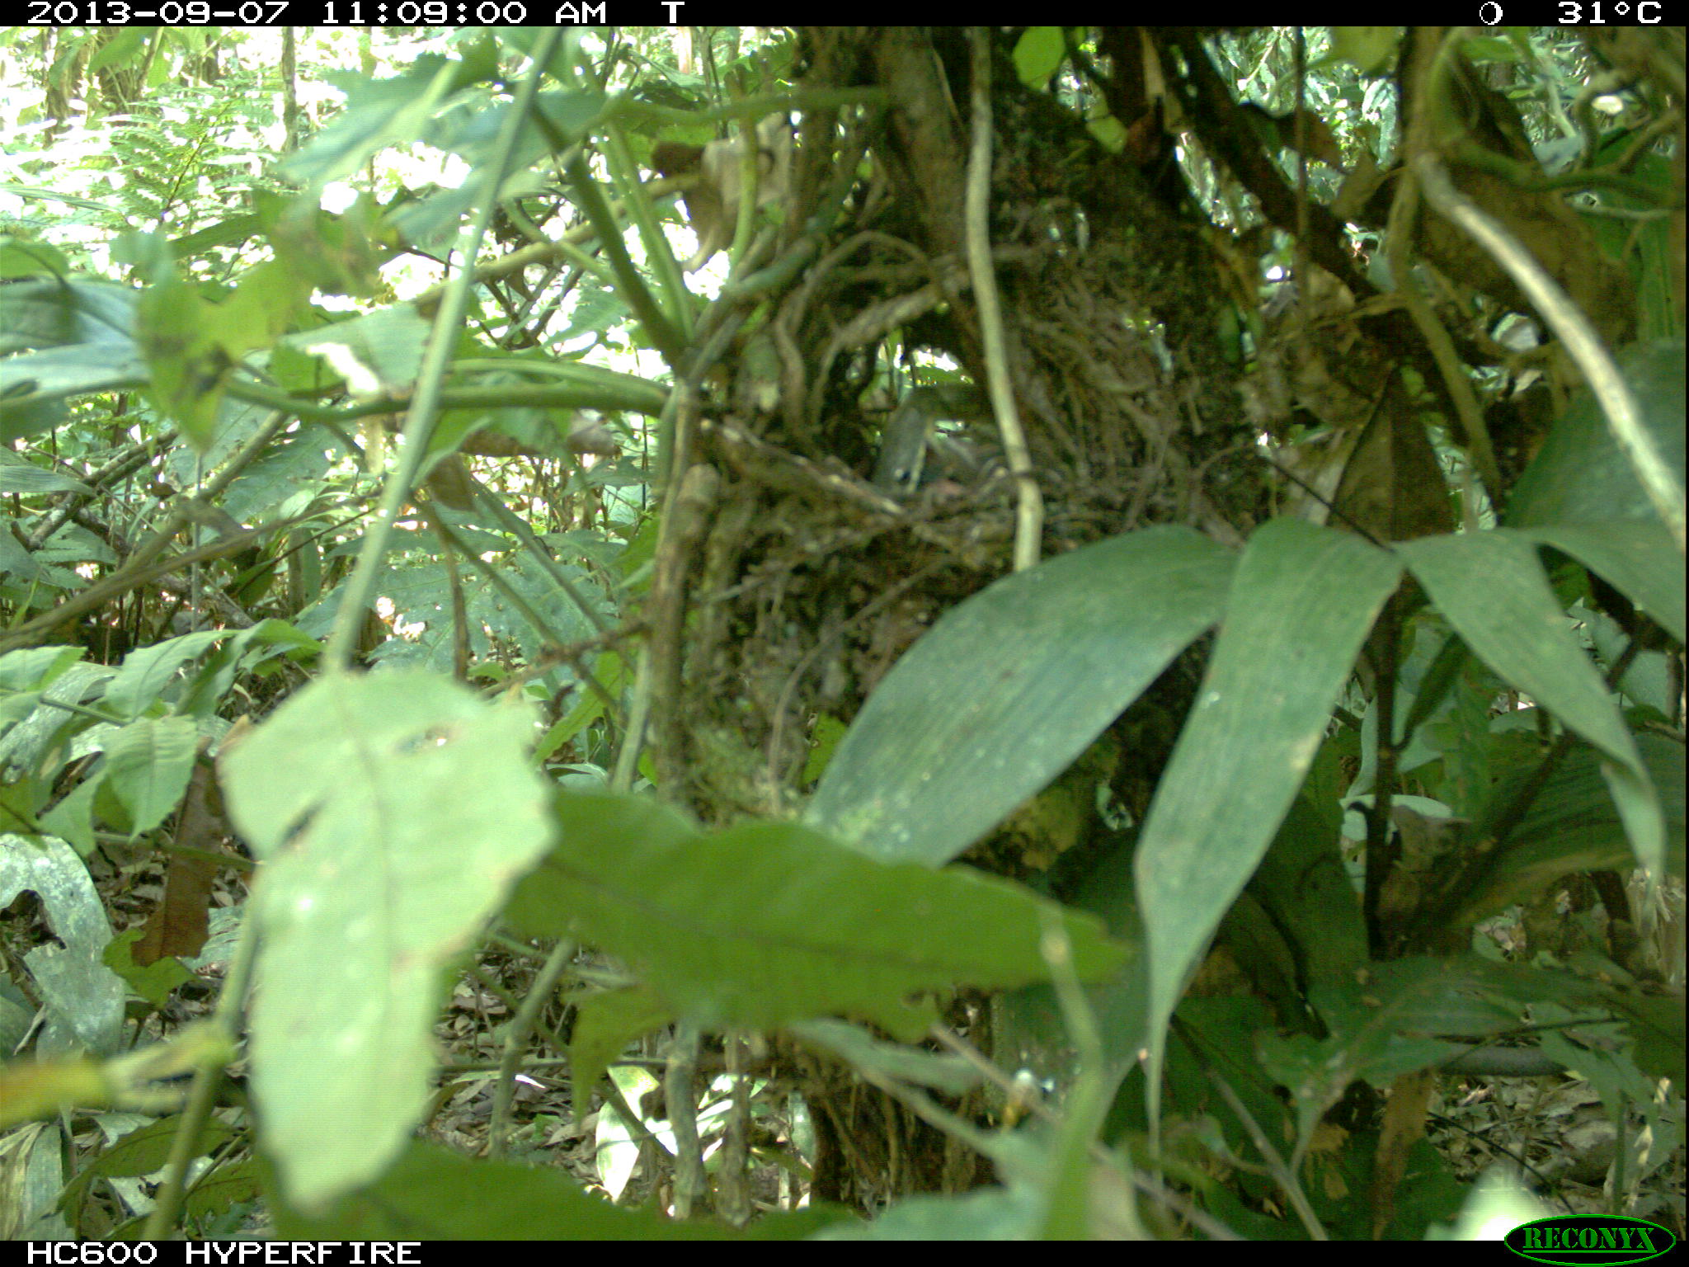
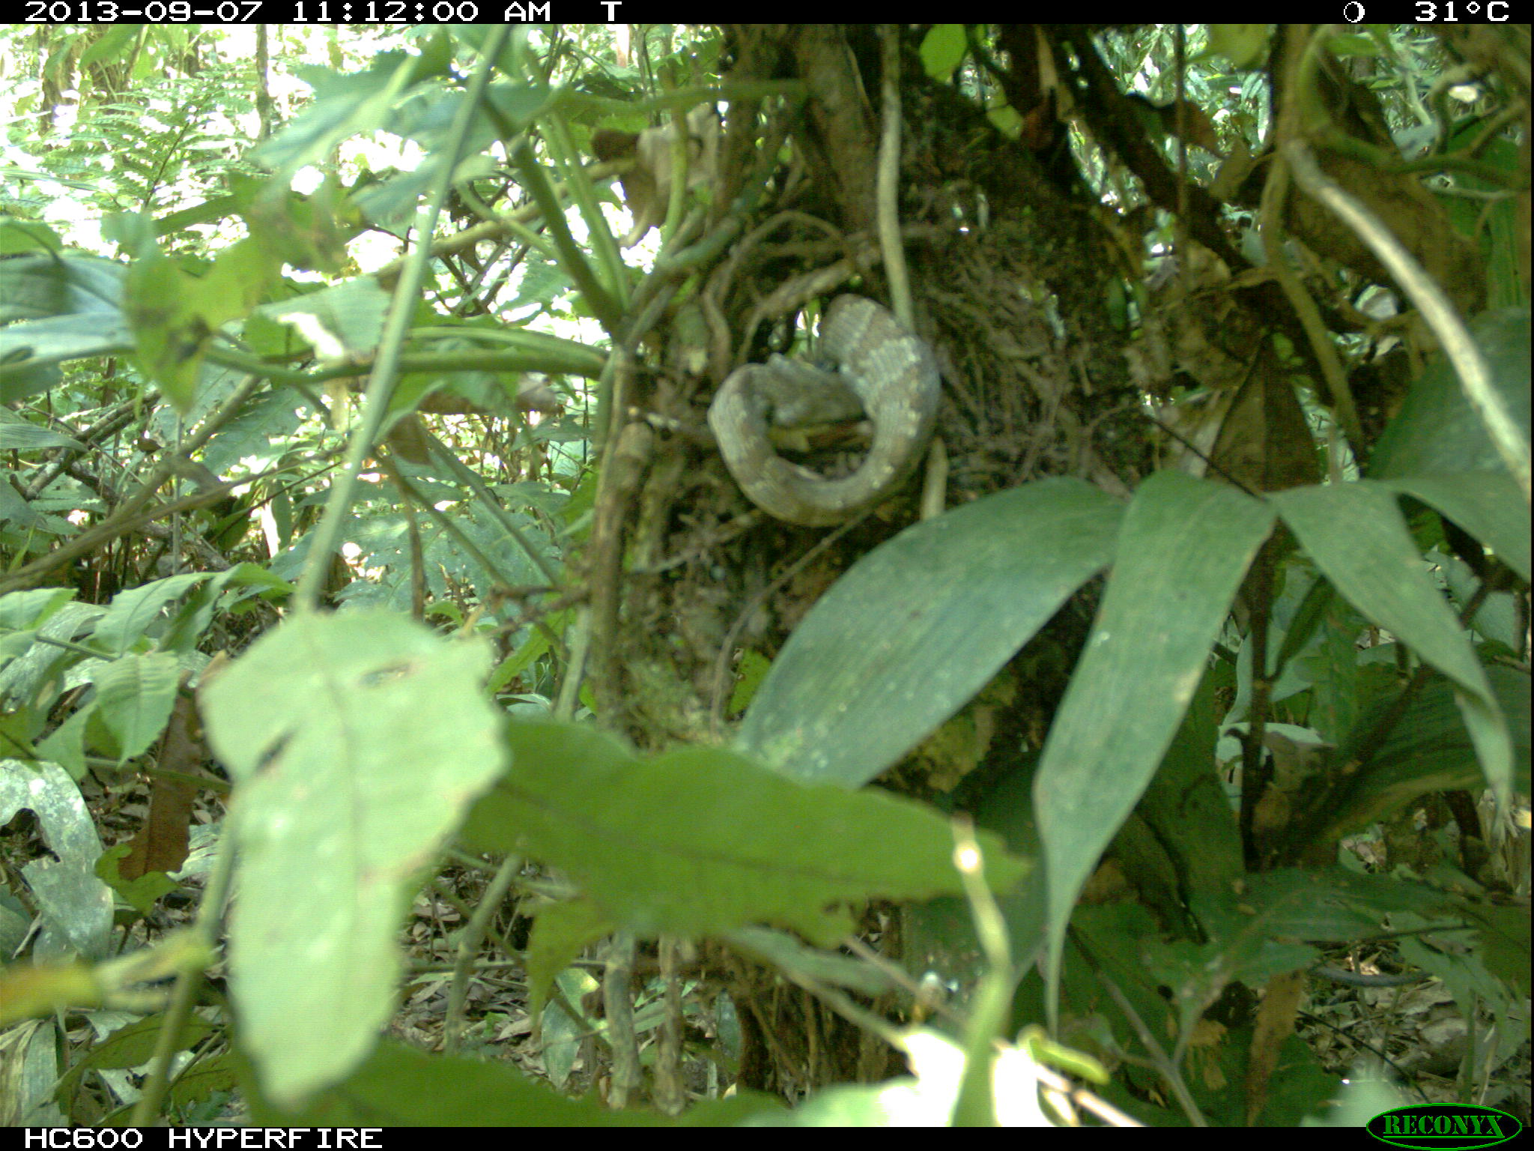
Nest id: Tangara_schrankii_P01_AJRC13
This nest was found on August 31, 2013 in with chicks of a few days old, on September 7 it was preyed on by a snake.

Slide 5
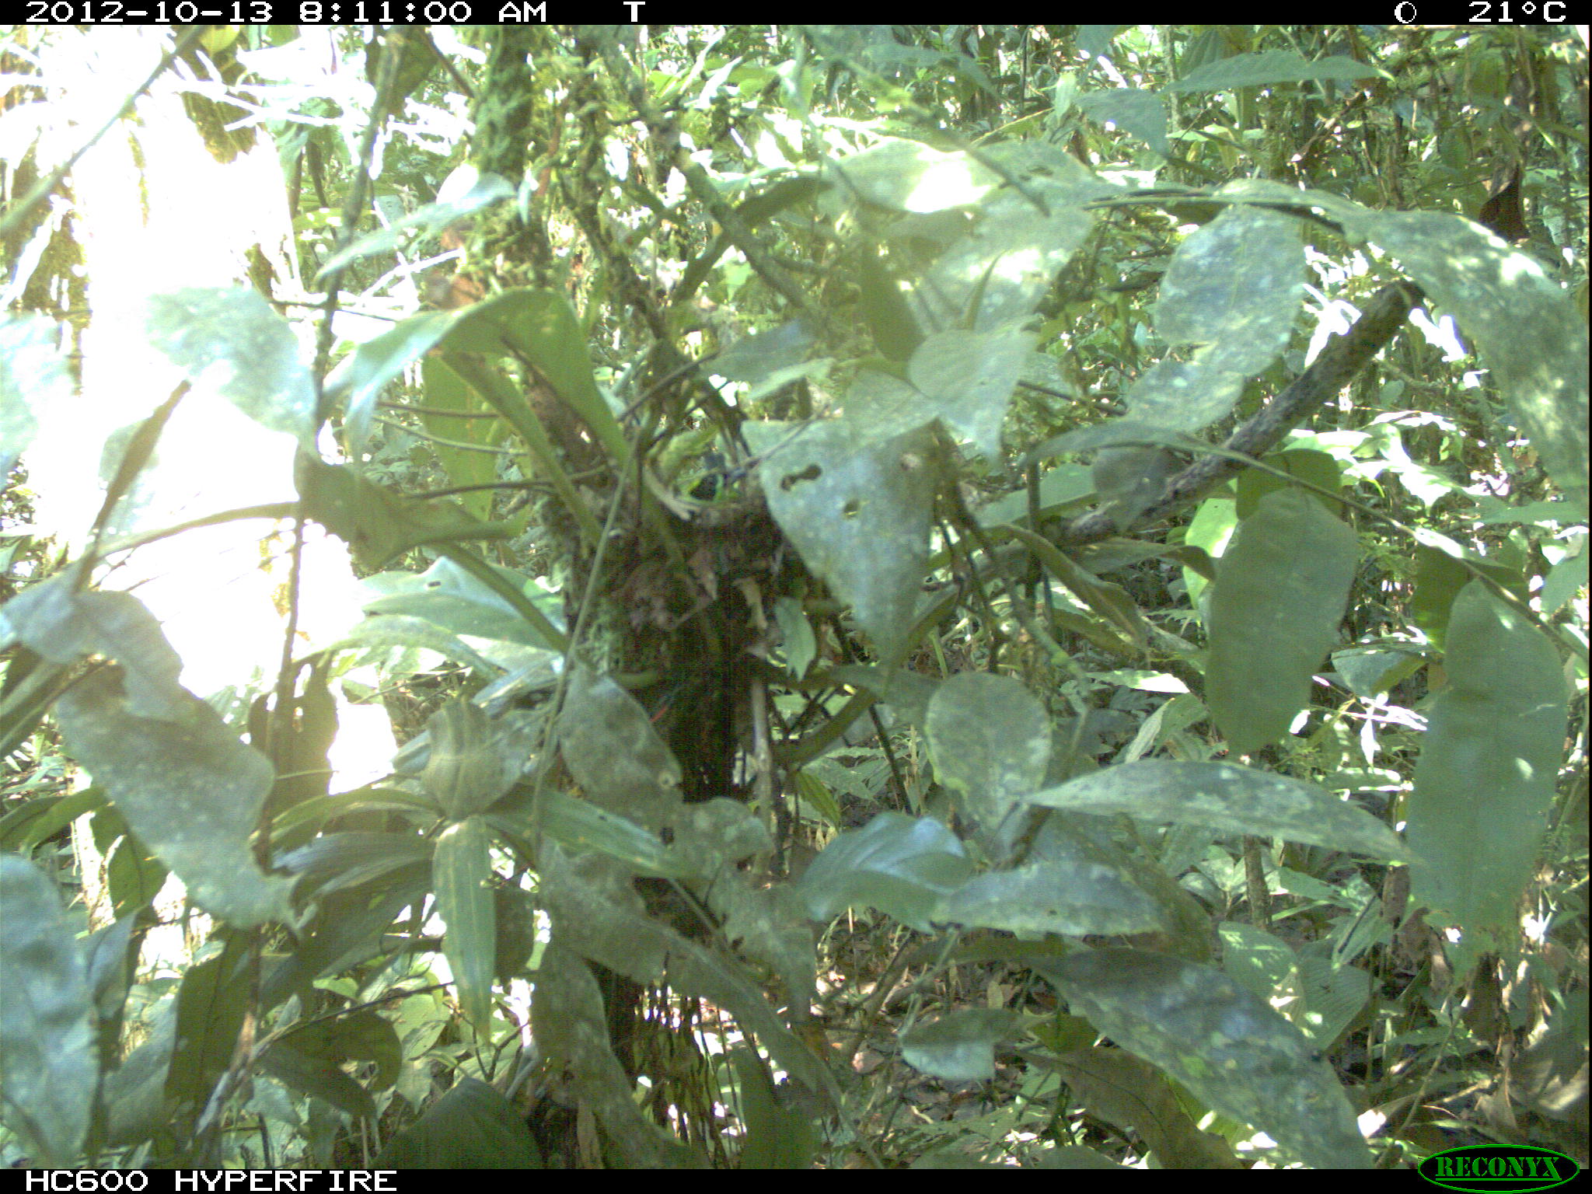
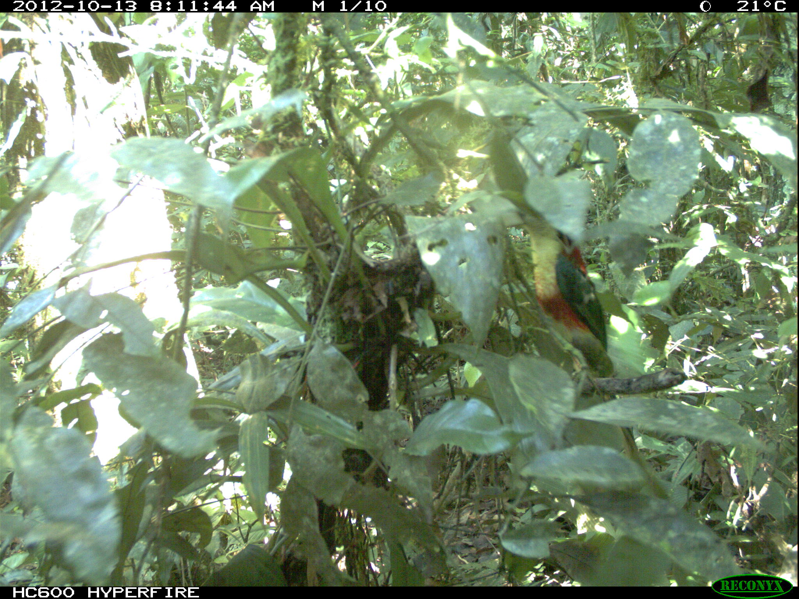
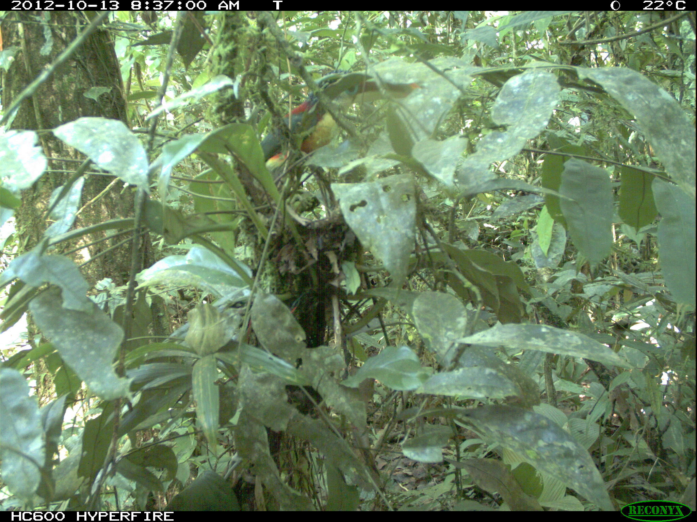
Nest id: Tangara_schrankii_P13_PCGJ12
This nest was found on October 10, 2013 in with egg, on October 13 it was preyed on by a Curl-crested Aracari
Pteroglossus beauharnaesii

