Slide 1
Employees’ Attrition
Munerah Al-Fayez

Slide 2
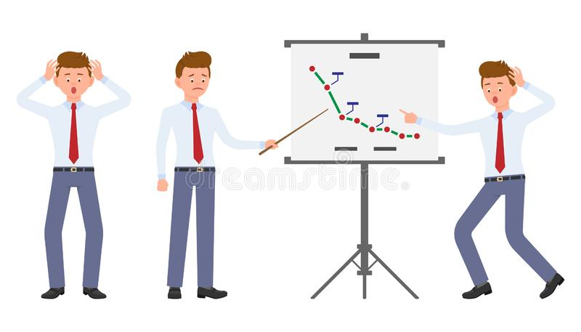
The Problem
4000 employee
15%
What changes they should make in their workplace, to get most of their employees to stay???

Slide 3
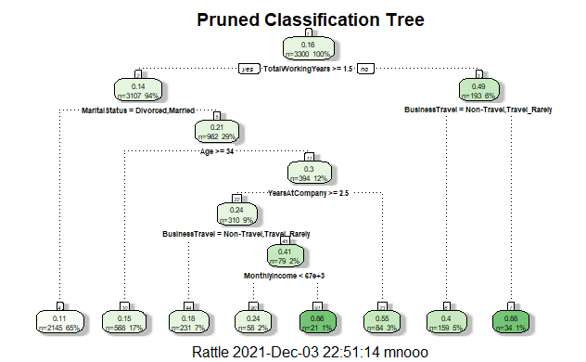
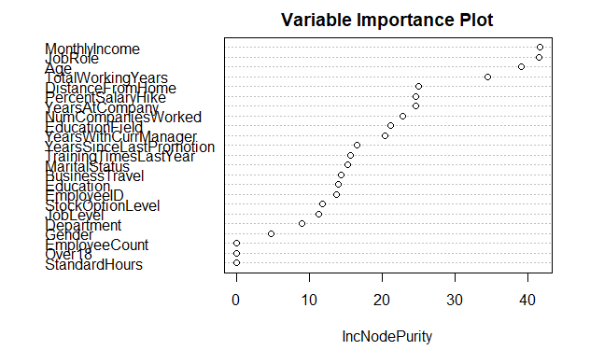
The Approach

Slide 4
Suggestions
Raise the salary for employees.
Detailed study about the relationship between job titles and employees leaving.
3. Why experienced employees whose ages above 33 tend to leave the company.
4. Select candidate employees who live nearby the company
https://www.kaggle.com/vjchoudhary7/hr-analytics-case-study

