Slide 1


Image Recognition with IBM Cloud Visual Recognition
Discover how IBM Cloud Visual Recognition is revolutionizing the way we analyze and understand images, unlocking a world of possibilities.

Slide 2
How IBM Cloud Visual Recognition Works
1
Data Collection
Images are collected from various sources, forming a diverse and comprehensive dataset.
2
Training the Model
The dataset is used to train the model, enabling it to recognize objects, scenes, and even individual characteristics.
3
Inference and Analysis
Images are uploaded to the cloud service, which applies the trained model to identify and analyze the visual content.

Slide 3

Pre-processing Images for Visual Recognition
1
Image Enhancement
2
Noise Reduction
Brightness, contrast, and sharpness adjustments are made to optimize the image quality.
Noise and irrelevant details are filtered out to ensure accurate recognition results.
3
Image Cropping
4
Resolution Optimization
Unnecessary background elements are removed to focus on the most relevant parts of the image.
Images are resized and optimized for efficient processing and analysis.

Slide 4
Customizing the Visual Recognition Models
General Model
Custom Model
Industry-Specific Models
Offers a wide range of pre-trained categories for general-purpose image recognition.
Allows the creation of custom models tailored to specific image recognition needs.
Designed for specialized domains, such as healthcare, retail, and automotive industries.

Slide 5
Application of Visual Recognition in Different Industries
Retail
Healthcare
Automated product tagging and inventory management, enabling efficient stock control.
Identification of diseases and abnormalities from medical images, aiding diagnosis and treatment.
Automotive
Education
Vehicle recognition and tracking for enhanced security and personalized customer experiences.
Assessment and grading automation, reducing administrative burden on educators.

Slide 6

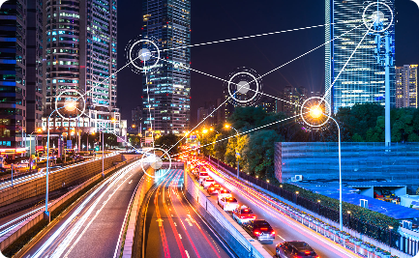

Future of Image Recognition with IBM Cloud Visual Recognition
Advancements in Technology
Integration with Smart Cities
Medical Breakthroughs
Visual recognition can aid in medical research, assisting in the discovery of new treatments and therapies.
Continued progress in AI and deep learning will enable even more accurate and sophisticated image recognition capabilities.
Visual recognition will play a crucial role in creating safer, more efficient, and sustainable cities.

Slide 7

Conclusion
IBM Cloud Visual Recognition is a game-changing technology that opens up endless possibilities in various domains. Embrace the power of visual data and unlock new insights.

