Slide 1

Image Recognition with IBM Cloud Visual Recognition
Discover the power behind IBM Cloud Visual Recognition and how it is revolutionizing the way we perceive images and their relevance in different industries.

Slide 2

Understanding Image Recognition and Its Importance
1
Enhancing Communication
2
Automation & Time-Saving
Images provide a universal language, allowing visual communication for people who don't speak the same language.
Identify and sort large collections of images to save tons of time and resources.
3
Data Insights
4
Reducing Errors & Bias
Gain deeper insights into trends, customer behavior, and preferences by studying and analyzing image content.
Minimize human bias and improve accuracy in decision making with the help of automated image analysis.

Slide 3

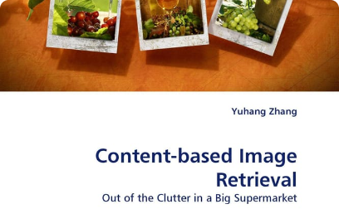
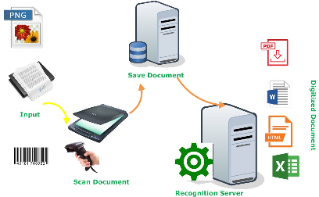
Features and Capabilities of IBM Cloud Visual Recognition
Facial Recognition
Content-Based Image Retrieval
Optical Character Recognition
Identify people's faces in images and infer their characteristics, such as age, gender, and emotion.
Find and sort images based on their visual content and features, such as color, texture, and shape.
Recognize text elements in images and extract them into editable and searchable formats.
Custom Training
Train the system to recognize custom image categories using your own dataset and feedback.

Slide 4
How IBM Cloud Visual Recognition Works
1
Image Input
Provide an image or a set of images to IBM Cloud Visual Recognition for analysis.
2
Feature Extraction
Extract relevant features and visual elements from the images, such as shapes, colors, and textures, using deep learning algorithms.
3
Classification & Object Detection
Identify objects and classify images based on their visual content, such as categories, tags, and captions.

Slide 5
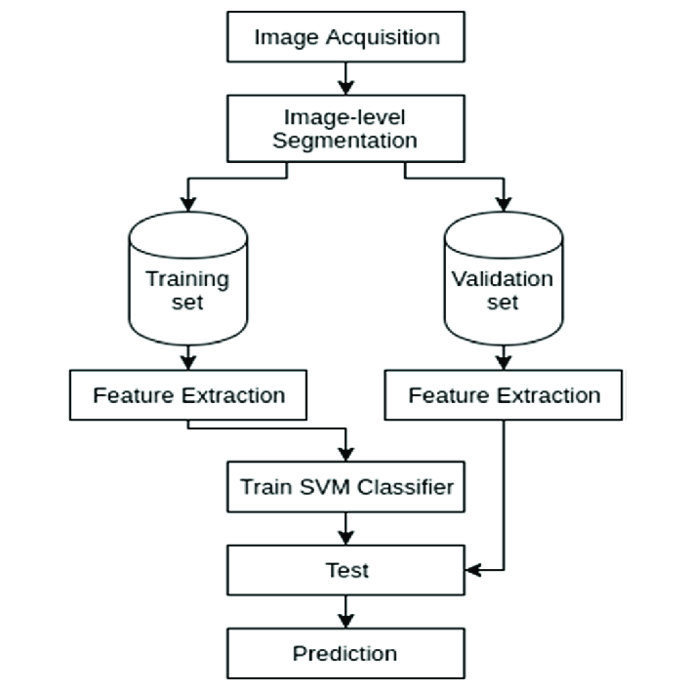
Block Diagram for Image Recognition

Slide 6
Technology Stack
IBM Cloud Visual Recognition uses a variety of cutting-edge technologies and frameworks to process, analyze, and understand images.
Platform
IBM Cloud
APIs
RESTful API, Watson Studio API
Frameworks
TensorFlow, PyTorch, Keras
Programming Languages
Python, Java, Node.js, Ruby
Tools
Jupyter Notebooks, Visual Recognition Studio

Slide 7
Use Cases
Retail & E-commerce
Media & Entertainment
Enhance product search and discovery, automate product tagging and categorization, and prevent fraud and counterfeiting.
Categorize and classify video content, automate video transcription and subtitling, and personalize user experiences based on image preferences.
Healthcare & Life Sciences
Industrial Automation
Identify diseases and medical conditions from medical images, improve medical diagnosis and prognosis, and enhance scientific research and discovery.
Automate quality control and inspection in manufacturing and production processes, detect defects and faults in products and equipment, and improve supply chain management.

Slide 8
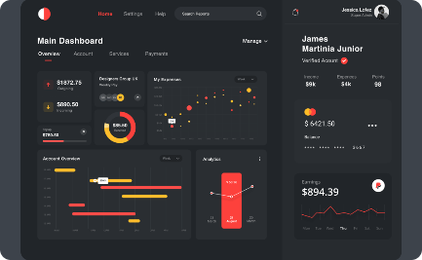

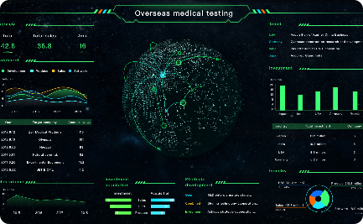
User Interface
Dashboard
Image Upload
Data Visualization
View and manage all your visual recognition projects, models, and datasets from a single, intuitive dashboard.
Upload and preprocess your images for analysis, set parameters and options, and monitor progress and results in real time.
Visualize and explore your image data with interactive charts, graphs, and heat maps, and gain insights and trends.

Slide 9
Development Process Part 1
1
Project Planning
Define the goals, scope, deliverables, and timeline of your visual recognition project, and align them with your business objectives.
Data Preparation
2
Collect, label, and preprocess your image dataset, and ensure that it reflects the diversity and variability of the real-world scenarios.
3
Model Creation
Choose a prebuilt model or create your own custom model using IBM Cloud Visual Recognition APIs, and train it on your dataset using deep learning techniques.
Evaluation & Improvement
4
Evaluate your model's performance and accuracy using metrics such as precision, recall, and F1 score, and refine it by adjusting parameters and adding more data.

Slide 10
Development Process Part 2
1
Deployment
Deploy your model to production, test it on real-world scenarios, and monitor its performance and feedback from users.
Integration & API
2
Integrate your model with your existing business processes, applications, and workflows, and expose it to other developers and users via RESTful APIs.
3
Continued Refinement
Continuously improve and refine your model by adding more data, updating algorithms, and incorporating feedback from users and stakeholders.
Maintenance & Management
4
Maintain and manage your model's performance, security, and scalability, and ensure that it aligns with your organization's policies, regulations, and values.

Slide 11
Conclusion
Future-Proof Technology
Customizable & Scalable
Impactful & Transformative
IBM Cloud Visual Recognition leverages advanced machine learning technologies and frameworks, ensuring that it remains relevant and reliable in the future.
IBM Cloud Visual Recognition allows you to create and customize models based on your specific needs and requirements, and scale them on demand as your data and business grow.
IBM Cloud Visual Recognition can have a profound impact on your business and industry, transforming the way you analyze, interpret, and act on visual data.
Experience the transformative power of IBM Cloud Visual Recognition today and unlock new possibilities for your business.

