Slide 1

Unlocking the Power of IBM Cloud Visual Recognition
Discover the ease of employing cutting-edge image recognition technology and take the first step in harnessing the power of IBM Cloud Visual Recognition.

Slide 2
Steps for Image Recognition
Detecting and classifying visual imagery, starting with the application of high-performance algorithms, requires the following steps:
1
Visual Input
2
Cognitive Application
3
Results Output
Input images to the Cloudant database, connected in a storage bucket.
Get the results on the web, in an application, or via an API or IoT devices etc., in response to the image query.
Use of machine learning models, custom classifiers, or text recognition to understand the contents of the visual elements.

Slide 3
Technologies used
Machine Learning
ML models are trained and fine-tuned using supervised learning strategies, using large datasets, to enable instant recognition of the visual input.
Custom Classifiers
The use of custom classifiers allows for identifying specific visual elements that may be unique to your use case
Text Recognition
The ability to apply OCR (Optical Character Recognition) technology enables the technology to recognize printed text on images and convert it into an editable format.

Slide 4
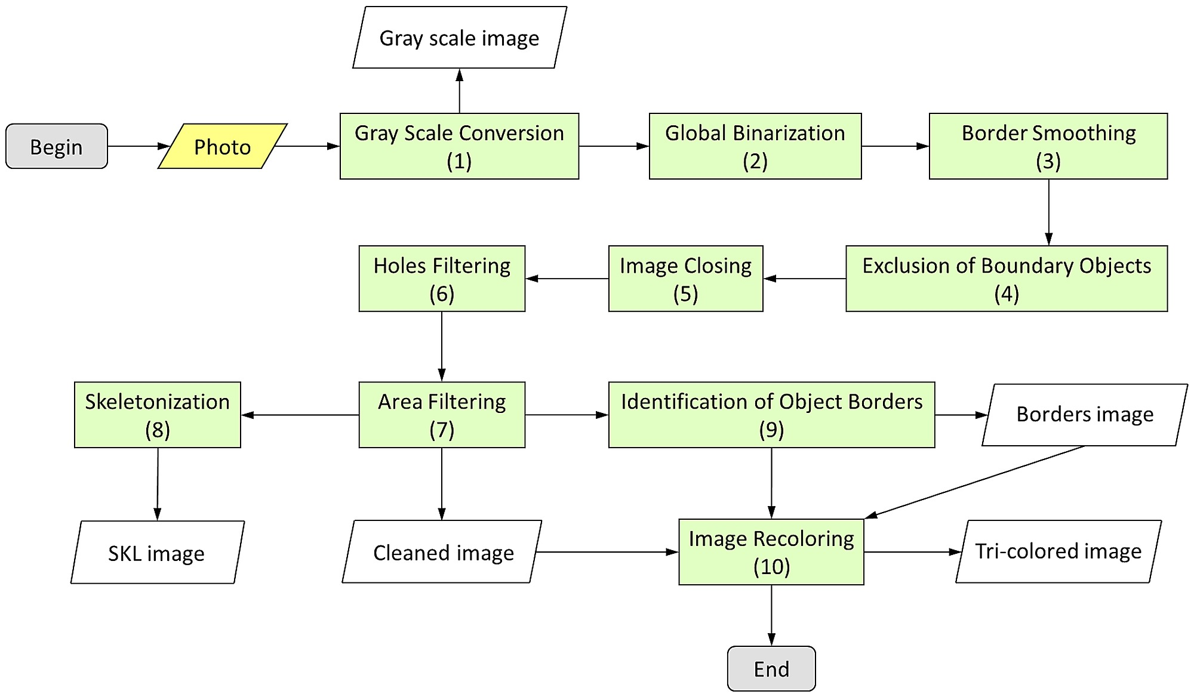
Flowchart for Image Recognition

Slide 5

Benefits of IBM Cloud Visual Recognition
IBM Cloud Visual Recognition technology provides numerous benefits to businesses looking to enhance their operations through intelligent image interpretation and analytics. These include:
Increased Insight
Improved Efficiency
Real-time analysis of visual data can provide useful insights and inform decision-making leading to better business outcomes.
Automated image analysis can streamline workflows and help to eliminate time-consuming manual processes.
Custom Solutions
Easily Scalable
Customizable classifiers can be created to meet the unique needs of a business or industry and be easily integrated into existing systems.
The IBM cloud infrastructure can accommodate increased traffic, offering flexible and scalable processing power to support the growth of your business.

Slide 6
Use Cases of IBM Cloud Visual Recognition
IBM Cloud Visual Recognition can be utilized in a variety of industry segments to help businesses improve operations, increase efficiency, and gain valuable insights. A few use cases are:
Retail
Healthcare
Manufacturing
Security
Travel and Tourism

Slide 7
Conclusion
IBM Cloud Visual Recognition is a versatile and powerful tool that utilizes state-of-the-art machine learning techniques to interpret and analyze visual data. Its ability to generate actionable insights and automate manual processes offers a significant value to businesses across many industries and segments. Start by exploring the technology and see how Visual Recognition can transform your business processes, elevate efficiency, and increase profitability.

