Slide 1
Title
Data-Driven Road Traffic Accident Analysis in India
Master title + candidate/guide/institute/2026
Notes:
Title. Say: multi-level analysis 2018-2024, 254 state-years, association not causation.

Slide 2
Problem
Counts without exposure; fragmented vintages; no microdata.
Notes:
Say: 487,707 accidents, 177,175 deaths (2024); severity 36.33 rising. NOT risk ranking.

Slide 3
Motivation
Evidence-linked analytics + reusable upload platform.
Notes:
Say: counts without exposure denominators; fragmented vintages. NOT policy claims.

Slide 4
Research Question
RQ1-RQ11 (observational framing).
Notes:
Say: prior work rarely combines reconciliation, geography, denominators.

Slide 5
Objectives
13 objectives (trends, geography, weather, causes, validation, ML, clustering, limits).
Notes:
RQ1-RQ11. Say: observational framing. NOT causal wording.

Slide 6
Research Framework
Discover-Veriy-Preserve-Audit-Harmonize-Analyze-Validate-Model-Synthesize.
Notes:
Objectives 1-13. Say: one line each as listed.

Slide 7
Data Sources
Benchmark 254 obs; history conditional; NCRB separate; IMD 236 matched; 7 modules; TN.
Notes:
Framework flow. Say each stage in order.

Slide 8
Data Validation
0 benchmark mismatches; 12/12 history; NCRB sections exact; TN sums exact.
Notes:
Data sources. Say: benchmark primary; NCRB separate vintage; IMD 236 matched/18 excluded.

Slide 9
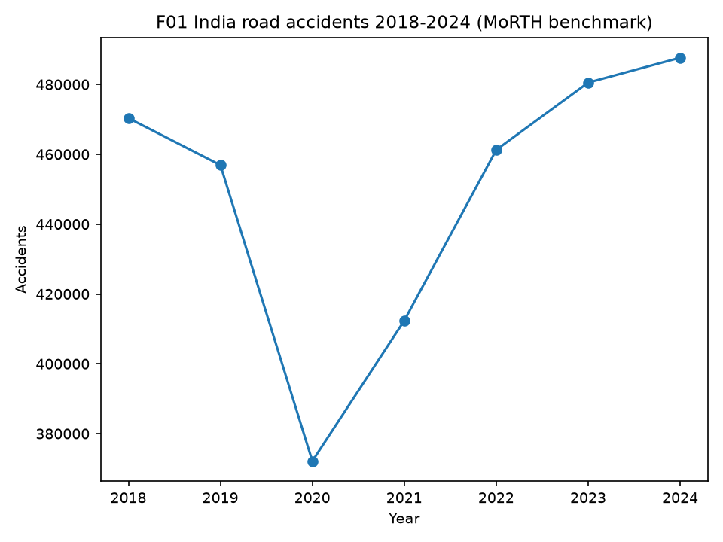
India-Level Trends
+3.7% acc / +12.4% fat; 2020 dip; slopes ns.
Notes:
Validation. Say: 0 benchmark mismatches; reconciliations exact.

Slide 10
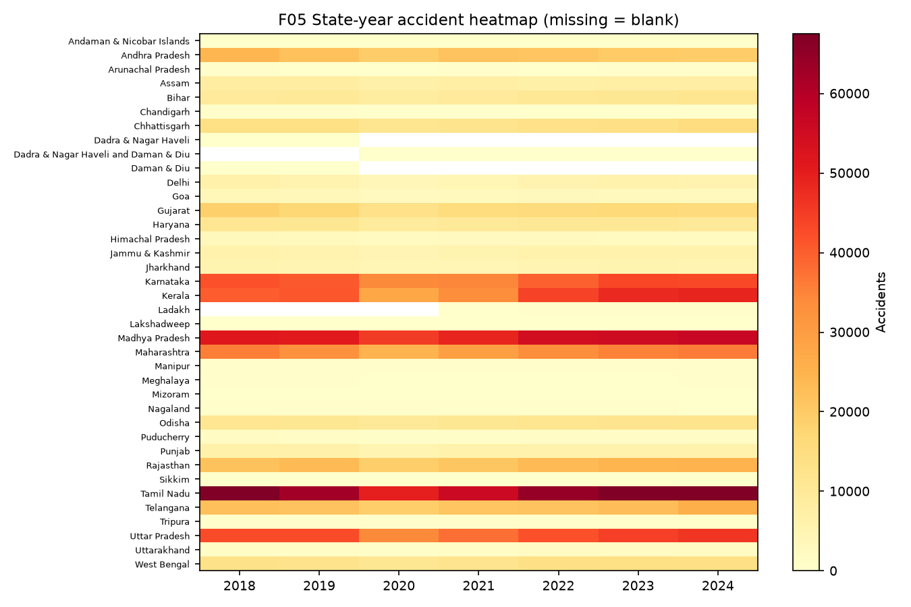
Geographical Analysis
38 entities; heterogeneity; no rankings.
Notes:
Trends +3.7%/+12.4%; 2020 dip; slopes ns. NOT risk rising (no denominator).

Slide 11
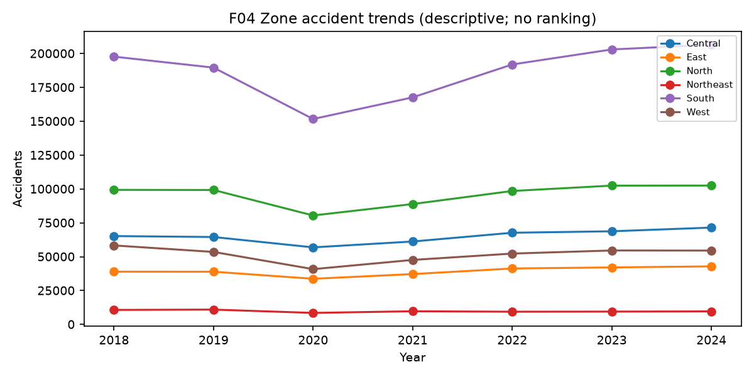
Zone Analysis
Friedman p=3.0e-4 descriptive; zone trends.
Notes:
Friedman p=3e-4 descriptive; NOT zone ranking.

Slide 12
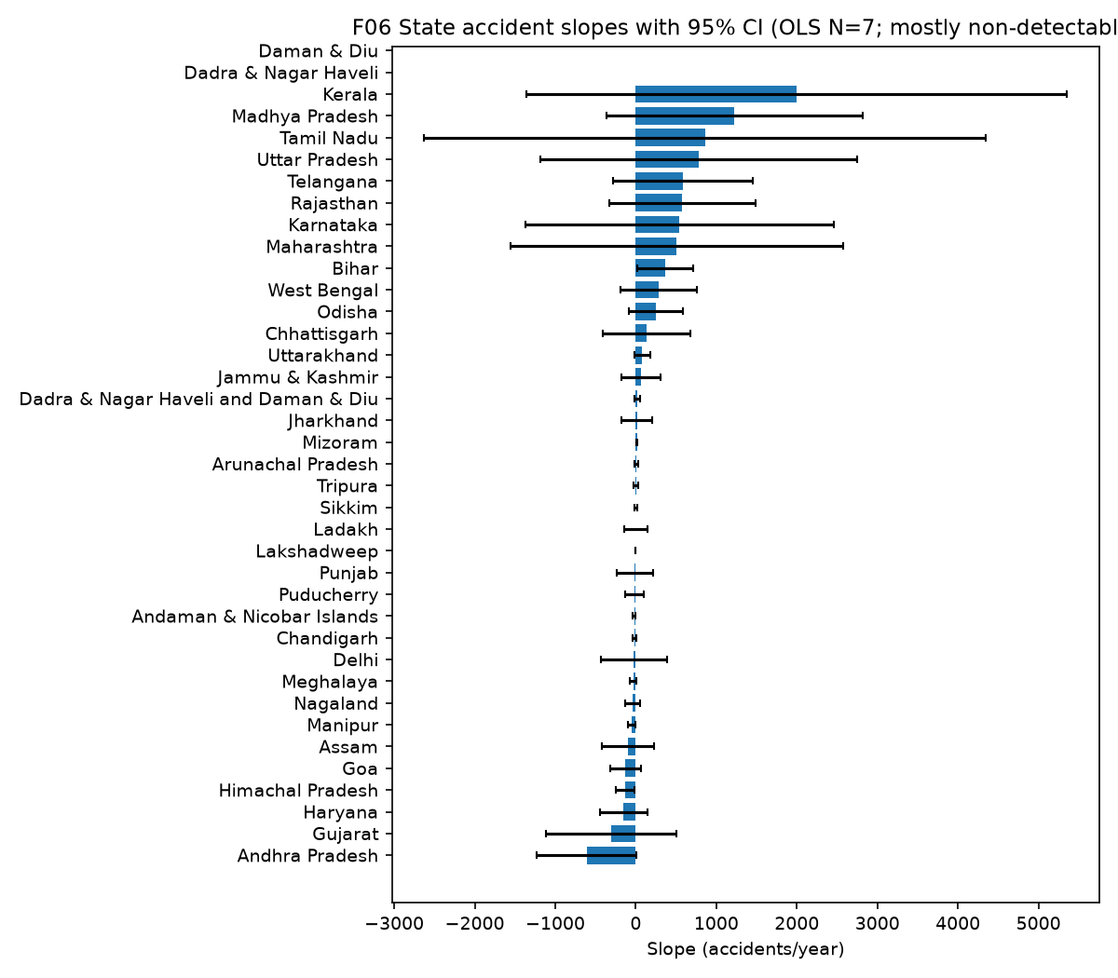
State Analysis
Slopes mostly non-detectable (N=7); CIs wide.
Notes:
Pooled r values + FDR; N=236; NOT heat/rain causes accidents.

Slide 13
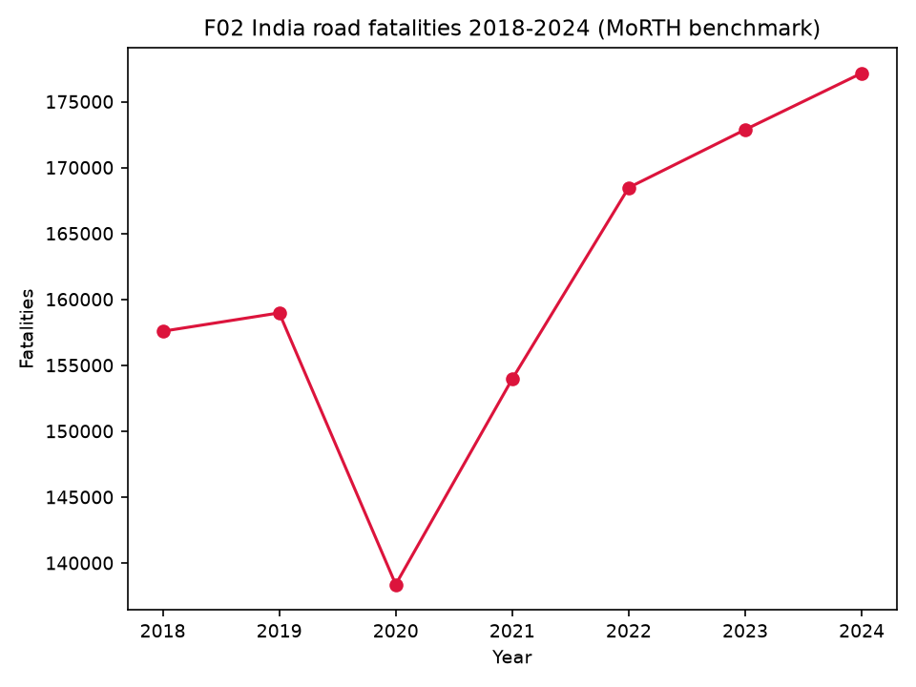
Temporal Analysis
Annual fluctuation; YoY table.
Notes:
Temporal granularity; hour/day unavailable in benchmark.

Slide 14
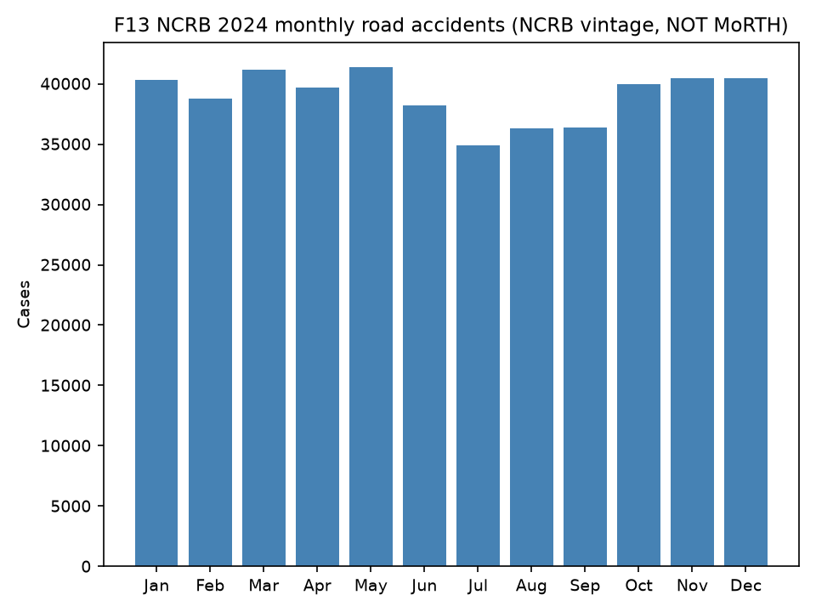
Seasonal/NCRB
May 8.84% / Jul 7.46% (NCRB vintage).
Notes:
NCRB May 8.84/Jul 7.46; separate vintage; NOT climate seasons.

Slide 15
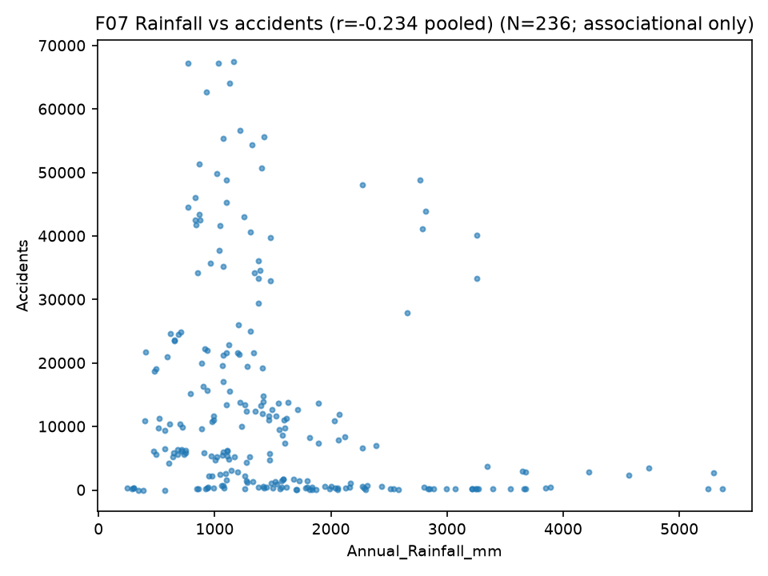
Weather Analysis
Rain -0.234/-0.376; Tmax +0.452/+0.498; never causal.
Notes:
Weather associations as listed; NOT causal.

Slide 16
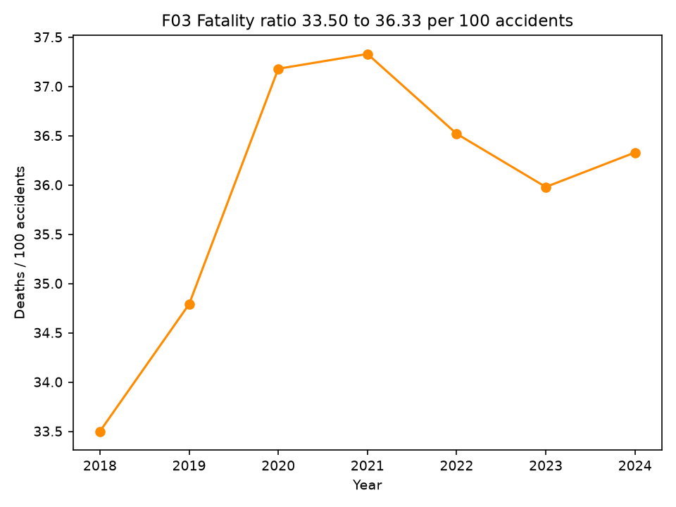
Severity Analysis
33.50 to 36.33 per 100 accidents.
Notes:
Severity shares; NOT X causes deaths or most dangerous.

Slide 17
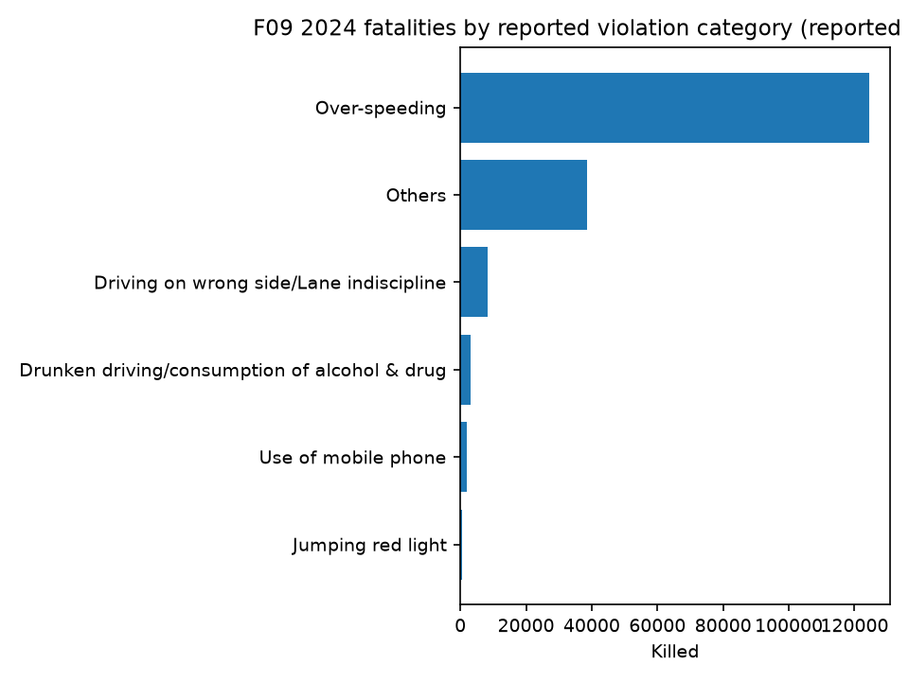
Violations/Causes
Over-speeding 70.3% of deaths (reported category).
Notes:
Methods + FDR; NOT p-hacked.

Slide 18
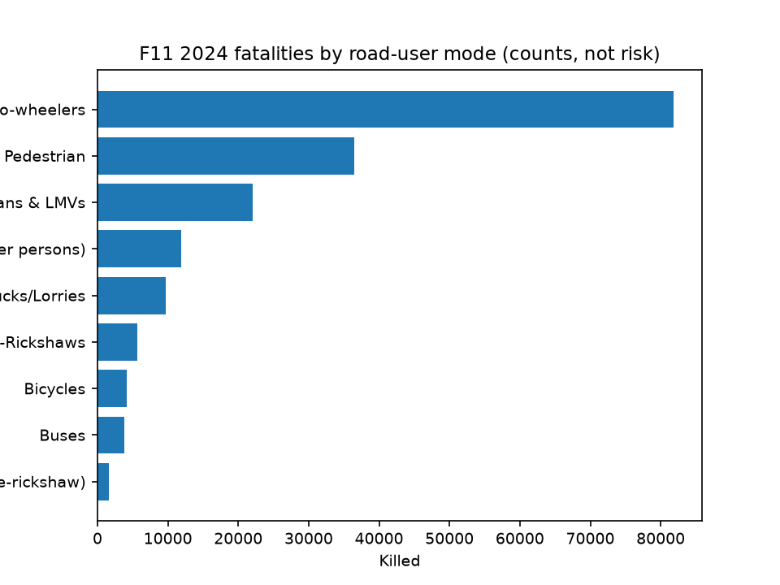
Collision/Road-User
Hit from Back leads; two-wheelers 46.2% (counts).
Notes:
Naive wins both targets (1038.6 vs 2148.6); null is the finding.

Slide 19
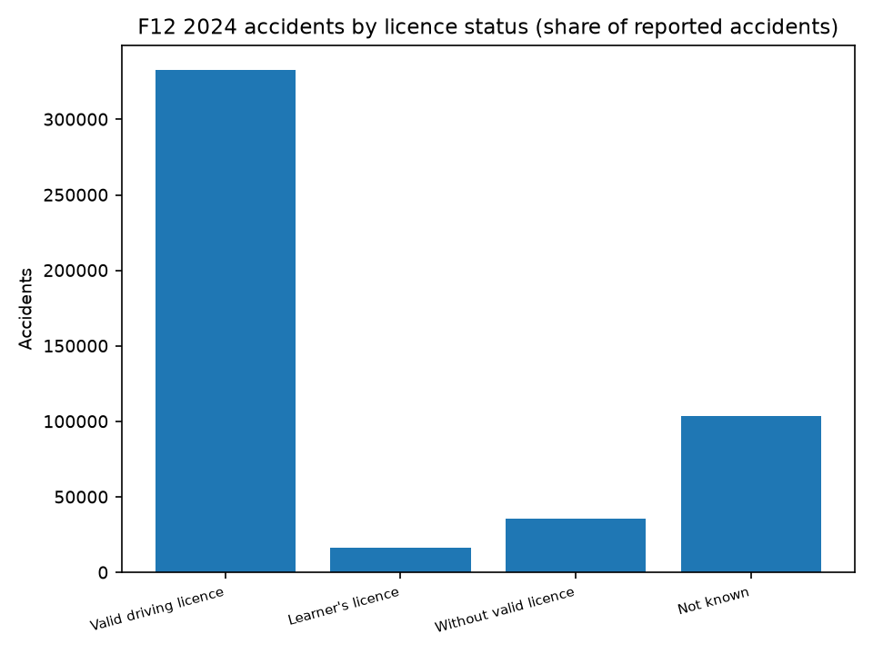
Licence/Safety
Valid licence 68.2%; no-helmet 54,122 toll (reported).
Notes:
K=2 by silhouette 0.356; NOT high-risk cluster.

Slide 20
Statistical Findings
OLS/CI, Pearson+Spearman, chi2, Friedman, BH-FDR.
Notes:
Statistics framework summary.

Slide 21
ML Methodology
Lag-only; train 2019-22 N=141; test 2023-24 N=72; naive baseline.
Notes:
ML method: train 2019-22 N=141, test 2023-24 N=72, lag-only, no test tuning.

Slide 22
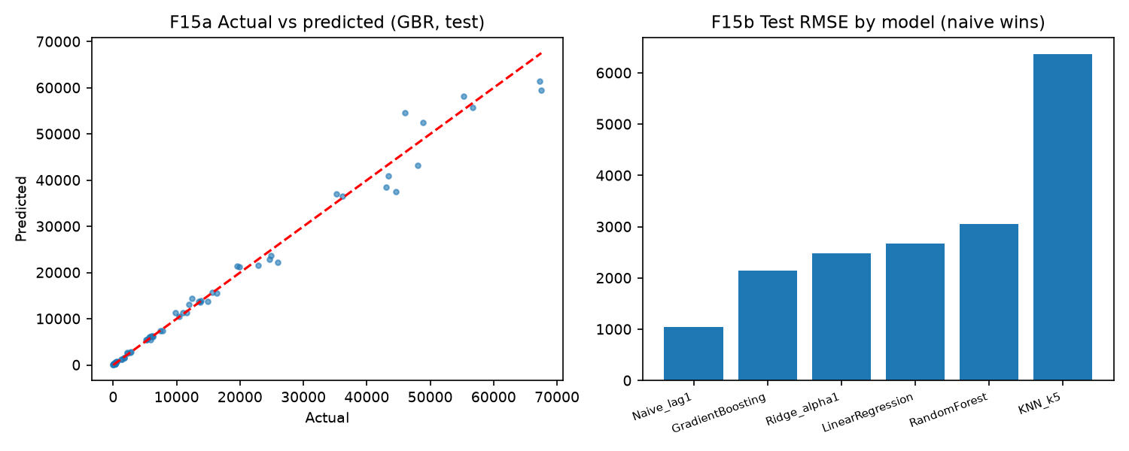
ML Results
Naive RMSE 1038.6/286.3 beats ALL trained (honest null).
Notes:
ML results: naive beats all; GBR overfit. Honest null.

Slide 23
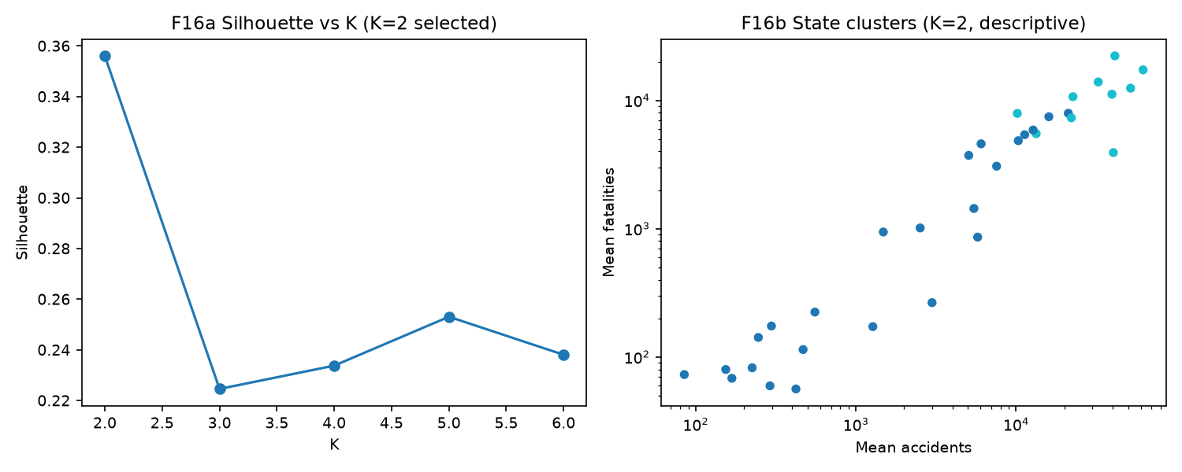
K-Means
K=2, silhouette 0.356, descriptive labels.
Notes:
K-means descriptive profiles; ARI stability.

Slide 24
Limitations + Contributions
Vehicle stock, microdata, N=213; 10 contributions.
Notes:
Binding gaps (vehicle stock, microdata); NOT future work fixes everything.

Slide 25
Conclusion + Vision
Counts are not risk; associations are not causes; analytical platform.
Notes:
Conclusion: counts are not risk, association is not cause, persistence beat models.

