Slide 1
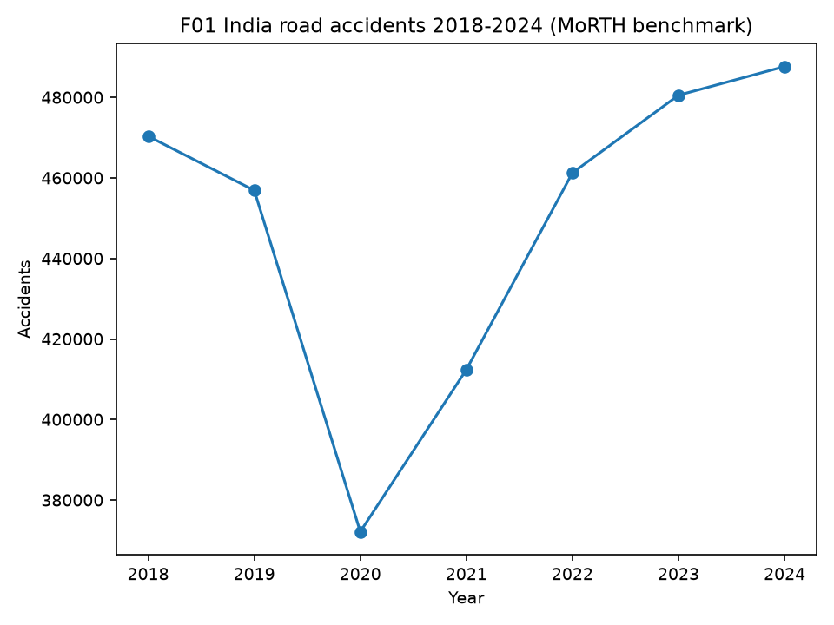
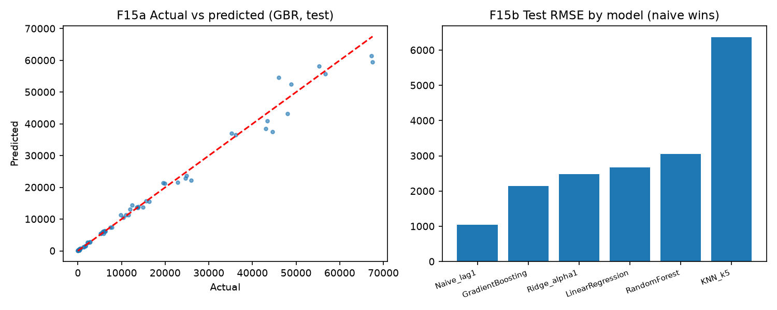
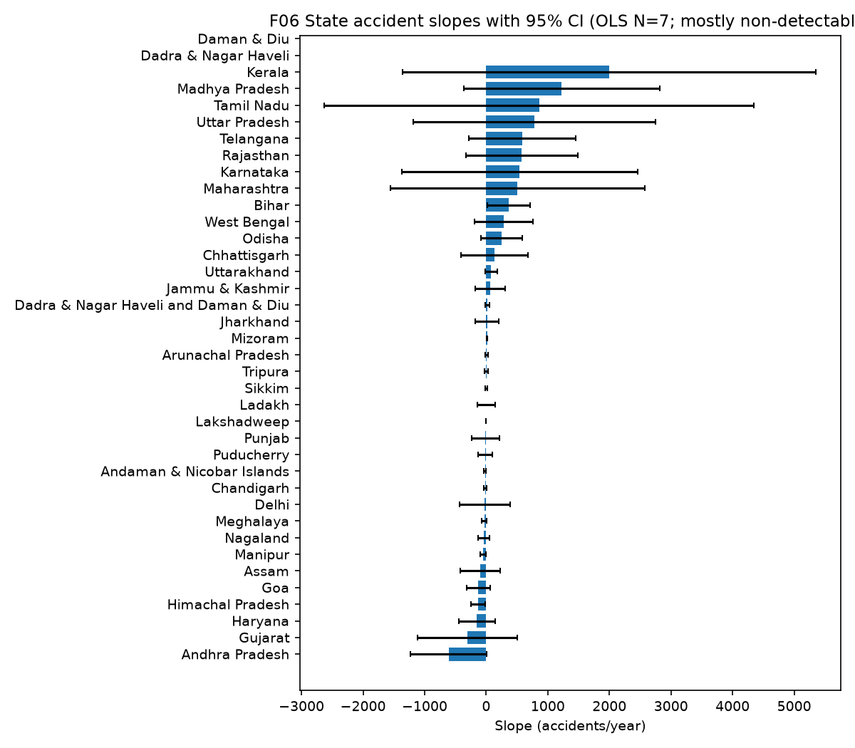

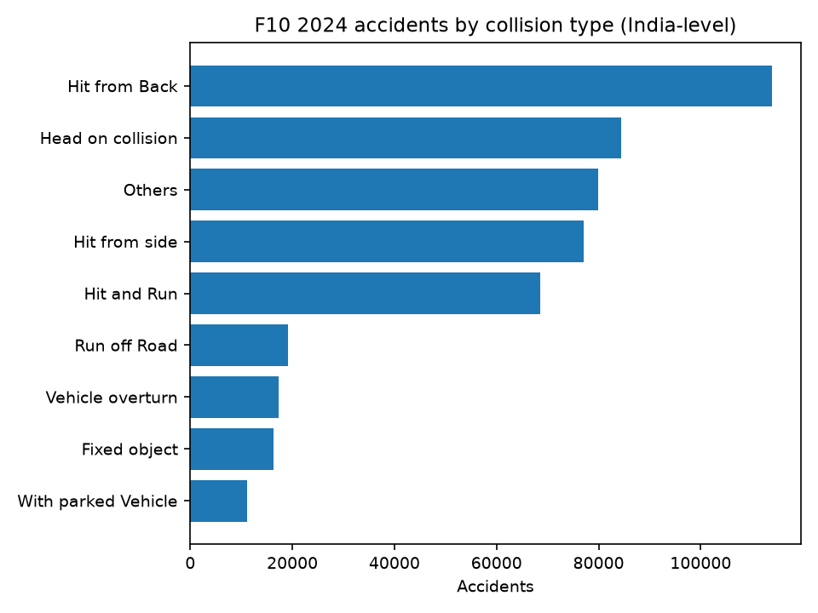
A Multi-Level Data-Driven Analysis of Road Traffic Accidents in India
Geographical, Temporal, Seasonal, Environmental and Severity Assessment | B.Tech ECE, Lovely Professional University | MoRTH 2018-2024
PROBLEM + QUESTION + DATA
KEY FINDINGS
ML + CLUSTERING + APP
Validated multi-level framework over 254 state-years (38 entities). RQ: how do geographical, temporal, seasonal, environmental and severity factors associate with accidents? Observational: association, not causation.
254 STATE-YEARS | 38 ENTITIES | 236 WEATHER MATCHED / 18 EXCLUDED
INDIA: 470,403>487,707 acc (+3.7%); 157,593>177,175 fat (+12.4%); ratio 33.50>36.33. 2020 dip+recovery. OLS slopes ns.
Friedman X2=25.29 p=3.0e-4 W=0.72 (zones differ, no ranking). States: acc 17+/15-/6~; fat 26+/10-/2~.
State-Year: train 2019-22 N=141, test 2023-24 N=72. 5 supervised models vs naive persistence.
NAIVE WINS: acc RMSE 1038.6, fat 286.3 beat ALL trained. GBR train R2~1.0 = overfit. Honest null.
2024: 487,707 ACCIDENTS | 177,175 FATALITIES | 471,441 INJURED (India-level)
MoRTH benchmark primary; NCRB 2024 monthly separate vintage; IMD rain/Tmax/Tmin; 7 supporting modules; TN districts; history 2014-17 CONDITIONAL.
WEATHER (N=236): rain r=-0.234/-0.376; Tmax +0.452/+0.498; Tmin +0.366/+0.340. Severity: null. Associations only.
NCRB 2024: May 8.84%, Jul 7.46%, X2=1276. Monthly distribution, not climate seasons.
K-MEANS (unsupervised): K=2, silhouette 0.356, sizes 17/6. Descriptive profiles only; never high-risk labels.
INDIA > 6 ZONES > STATES/UTs > TEMPORAL > WEATHER > CAUSE > SEVERITY > STATISTICS > ML/CLUSTERING > APP
APP: verified data > validation > analytics > stats > ML > GIS. Live platform below.
CONTRIBUTIONS: benchmark, harmonization, weather, nulls, provenance, platform.
Overspeeding 70.7% acc / 70.3% fat (reported category). Hit from Back most frequent; Hit-and-Run ratio ~0.50.
Two-wheelers 46.2%, pedestrians 20.6% of deaths (shares, not risk). Valid licence 68.2%. No-helmet 54,122; no-seatbelt 14,466.
Live Analytics Platform
LIMITS (REQUIRED): associations are not causes; counts are not risk; NCRB separate; history conditional; 2023-24 state injuries N/A; vehicle stock/AADT unavailable; ML did not beat naive baseline.
Primary: MoRTH 2018-2024 | Supporting: MoRTH 2024, NCRB ADSI 2024, IMD, PIB/Govt | Mirrors identified | https://morth-accident-analytics.onrender.com
Conclusion: reproducible multi-level framework; patterns identified with vintages separated and limits documented; foundation for accident-level/exposure/GIS integration.

