Slide 1
Week 5: Machine Learning Model Development
Beauty & Wellness AI Personalization and Customer Retention System
Prepared by: Malini S B
YuvaIntern – Data Science Internship

Slide 2
Project Objective
Continue Week 4 EDA and feature engineering
Train classifiers for a demonstration churn-risk label
Compare baseline and tree-based models
Document metrics, limitations and next steps

Slide 3
Dataset Overview
500 synthetic customer records
Profile, product category, ratings, purchases, recency, discounts and loyalty
Synthetic label: 0 = lower risk, 1 = higher risk
Synthetic data is for workflow demonstration only

Slide 4
Feature Engineering
Age group and recency segment
Purchase-frequency proxy
Discount × order-value interaction
Rating × log(1 + review count) interaction
High-value customer indicator

Slide 5
Preprocessing and Split
Stratified 80/20 train-test split
Numeric: median imputation + standardization
Categorical: most-frequent imputation + one-hot encoding
Preprocessing fitted inside the training pipeline
Customer ID and target excluded from predictors

Slide 6
Models Trained
Logistic Regression – baseline classifier
Random Forest – ensemble of decision trees
Both use the same train/test split and preprocessing design
Compare performance rather than assuming one model is better

Slide 7
Model Evaluation
Accuracy, Precision, Recall and F1-score
ROC-AUC for ranking quality
Confusion matrix for error counts
Choose thresholds based on business costs, not accuracy alone

Slide 8
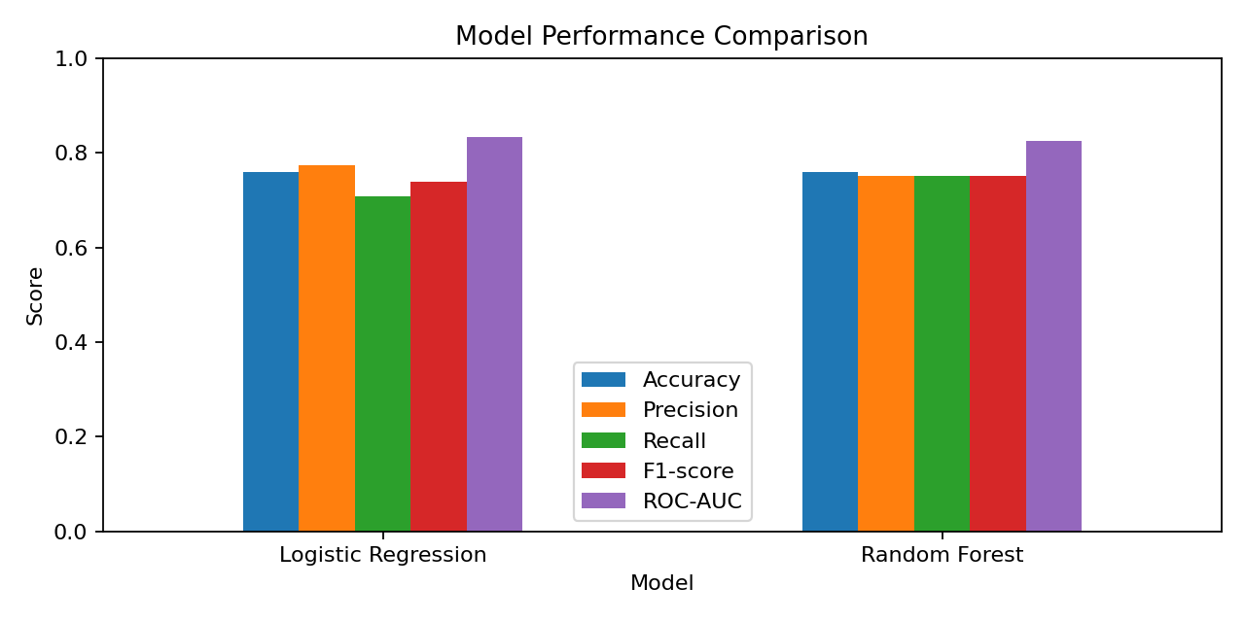
Performance Comparison

Slide 9
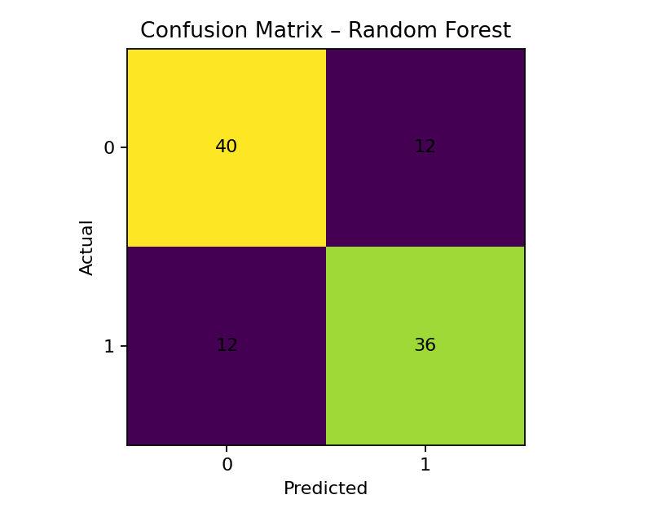
Confusion Matrix

Slide 10
Limitations and Future Work
Dataset and target are synthetic; metrics are illustrative only
Validate with approved anonymized real customer data
Define churn observation window and prediction horizon
Use time-based validation, fairness and privacy checks
Test retention campaigns with controlled experiments

Slide 11
Conclusion
Week 5 connects engineered features to supervised ML
Two classifiers trained and evaluated reproducibly
Model files, predictions, metrics and charts are saved
Next: validate on real data before operational use

