Slide 1




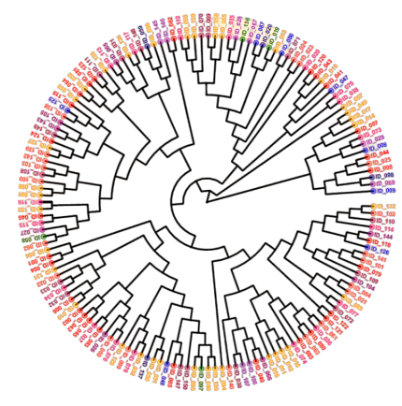






Study of the faecal microbiome of patients with metabolic syndrome and type 2 diabetes
Galicia
N = 79
Faeces
Sequencing
Taxa
Healthy vs MS
Healthy vs PreDT2
Healthy vs DT2
PreDT2 vs DT2
H
H
H
PreDT2
Bifidobacterium
Ligilactobacillus
Acidaminococcus
Bifidobacterium bifidum
Bifidobacterium
Ligilactobacillus
Acidaminococcus
Bifidobacterium longum
[Eubacterium] hallii group
[Eubacterium] ventriosum group
Dorea
Blautia faecis
Bacteroidetes
[Eubacterium] eligens group
Parabacteroides merdae
MS
PreDT2
DT2
DT2
Firmicutes
Blautia
Tyzzerella
Dorea
Blautia wexlerae
Dorea
Anaerostipes
Subdoligranulum
Dorea longicatena
Dorea
Anaerostipes
Subdoligranulum
Dorea longicatena
Dialister
Prevotella
Sutterella
Dialister invisus

