Slide 1

LAKIREDDY BALI REDDY COLLEGE OF ENGINEERING
ELECTRONICS AND COMMUNICATION ENGINEERING
IMPLEMENTATION AND ANALYSIS OF
6-TRANSISTOR SRAM CELL
PROJECT GUIDE TEAM MEMBERS
G. Venkata Rao B. Satya Suresh(20761A0471)
Associate Professor Ch. Mallikharjun Reddy(20761A0476)
P. Bhuvana Sri(20761A04A3)

Slide 2
CONTENTS
ABSTRACT
INTRODUCTION
LITERATURE REVIEW
METHODOLOGY
DESIGN ANALYSIS
CONCLUSIONS

Slide 3
ABSTRACT
Static Random-Access Memory (SRAM) stands as a vital component, offering swift and efficient on-chip data storage. It is made up of six transistors that are placed in a precise way to achieve stability and the capacity to read and write date. This 6-transistor SRAM cell plays a vital role, particularly in high-performance memory applications like cache memory. The main objective of this project is to focus on examining the performance, stability, and energy efficiency of the 6T SRAM cell. Extensive simulations are helpful to evaluate key performance parameters such as access time, write time, and power consumption. The primary aim is to identify any design limitations or flaws and propose potential enhancements.

Slide 4
Factors like noise tolerance, resistance to data corruption during read operations, and ease of writing data should be analysed under different conditions. As power consumption is a critical concern in modern semiconductor devices, we assess the energy efficiency of the 6T SRAM cell. This includes analyse the dynamic power under different operating scenarios. We will analyse its layouts and in addition to characterizing the 6T SRAM cell, we compare its performance and energy efficiency with other popular SRAM cell designs, such as 4T and 8T cells, to identify trade-offs and advantages.
KEYWORDS: 6T SRAM cell, 4T, 8T, Access time, Write time, Power consumption.

Slide 5
INTRODUCTION
The 6-transistor SRAM (6T SRAM) cell is a fundamental building block of static random-access memory (SRAM), widely employed in modern integrated circuits for on-chip data storage. Comprising six transistors arranged in a cross-coupled configuration, the 6T SRAM cell offers a balance of stability, speed, and efficiency. Its key components include two cross-coupled inverters for data storage and access transistors for read and write operations. The 6T SRAM cell is characterized by its ability to retain data without the need for constant refresh, making it a preferred choice for cache memories in high-performance computing applications. The design and optimization of 6T SRAM cells play a crucial role in shaping the performance and efficiency of memory subsystems within integrated circuits.

Slide 6
SNO | YEAR | TITLE | TECHNOLOGY USED | PARAMETERS ANALYSED
1 | 2021 | Design and Performance Comparison of 6-T SRAM Cell | 32nm CMOS, FinFET and CNTFET Technologies | average power delay leakage current read stability write-ability
2 | 2019 | Performance Analysis of 6T and 9T SRAM | 45nm CMOS technology | stability, leakage, process variations
3 | 2017 | Analysis of 6T SRAM cell in different technologies | 180nm, 90nm, and 45nm technology | Speed power dissipation static noise margin.
4 | 2016 | Design of low power 6T-SRAM cell and analysis for high-speed application. | 90nm technology | Static Noise Margin Data Retention Voltage Read Margin Write Margin

Slide 7
SNO | YEAR | TITLE | TECHNOLOGY USED | PARAMETERS ANALYSED
5 | 2015 | 6T SRAM Cell: Design And Analysis | 45nm and 180nm technologies | power consumption delay SNM.
6 | 2014 | A Comparative Analysis of 6 Transistor SRAM and 6T ROM Embedded SRAM. | power comparisons | LT SPICE Software
7 | 2022 | A comparative performance analysis of 6T & 9T SRAM integrated circuits | 180 nm Technologies | data stability power metrics Temperature variations
8 | 2012 | Implementation and desing of 6T-SRAM with read and write assists circuits | 65nm technology along with a comparison to 120nm technology | Power dissipation circuit layouts schematics simulation results

Slide 8
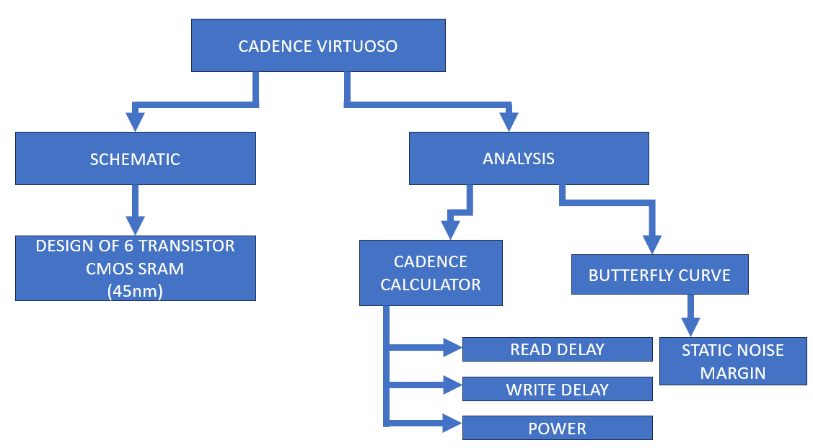
METHODOLOGY

Slide 9
Create a Library: Launch Virtuoso and initiate a new project. Set a name and location for your library. Determine the technology file (.tf) that specifies design rules and device models.
Example: gpdk45 library.
Draw Schematic: Access the schematic editor and create a new schematic. Utilize the component library to place devices (transistors, resistors, etc.).Connect devices with wires and add necessary labels.
Run Simulation: Choose the appropriate simulator (e.g., Spectre for analog, AMS Designer for mixed-signal). Analyze circuit behavior and observe waveforms.
Create Layout: Access the layout editor and create a new layout for each schematic. Place devices and route connections according to design rules.

Slide 10
DESIGN VERIFICATION:
Run Design Rule Check (DRC):Ensure layout matches to technology design rules.
Perform Layout Versus Schematic (LVS) Check: Verify layout connectivity matches schematic.
Perform Electrical Rule Check (ERC):Confirm layout electrical correctness.
DRC/LVS Fix and Final Layout
Address DRC/LVS Violations: Modify layout to resolve any violations.
Generate Final Layout: Produce the GDSII file for fabrication

Slide 11
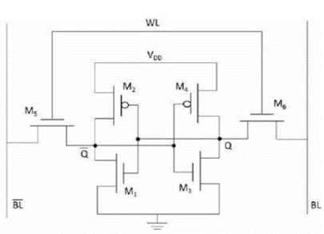
DESIGN ANALYSIS

Slide 12
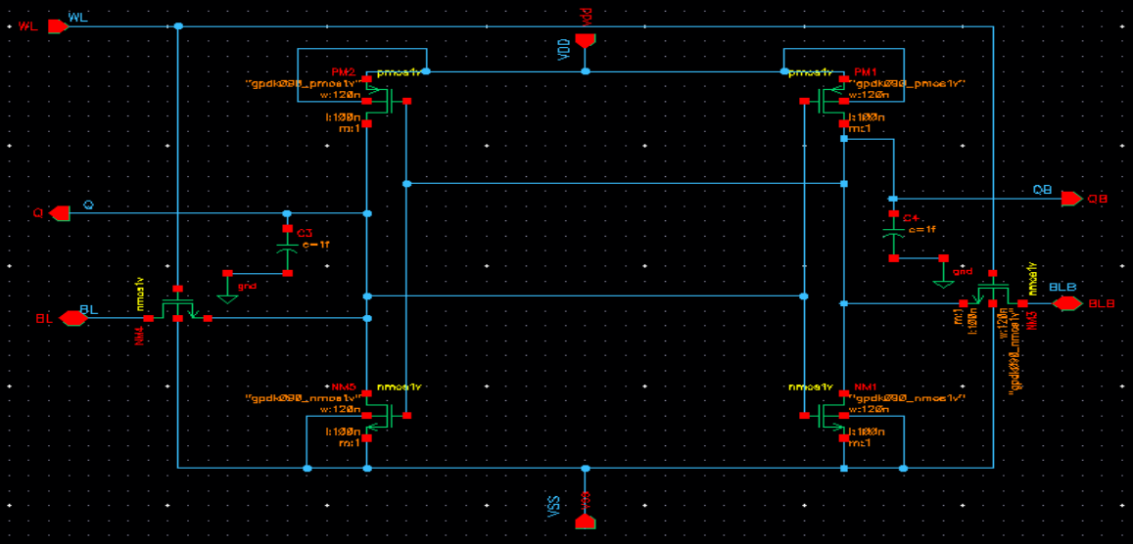

Slide 13
In the context of a 6-transistor SRAM (6T SRAM) cell, BL (Bitline) and BLB (Complementary Bitline), often referred to as BL BAR, are two crucial signals associated with the memory cell's read and write operations.
1. BITLINE (BL)
BL, or Bitline, is one of the two conductive pathways used for reading from or writing to the SRAM cell.
During a read operation, BL carries the sensed voltage, and during a write operation, the voltage on BL is manipulated to write data into the cell.
2.COMPLEMENTARY BITLINE (BLB OR BL BAR)
BLB, or Complementary Bitline (sometimes denoted as BL BAR), is the complementary signal to BL.
During a read operation, BLB carries the complement of the sensed voltage on BL. This complementary information is essential for the accurate determination of the stored bit.
During a write operation, the voltage on BLB is manipulated to complement the data being written onto BL, ensuring the correct state is stored in the SRAM cell.

Slide 14
READ OPERATION
During a read operation in a 6-transistor SRAM (6T SRAM) cell, the corresponding wordline is activated. The stored data is sensed through the bitlines, and a sense amplifier amplifies the voltage difference to determine the stored bit value ('0' or '1'). The read operation is a key factor in the overall efficiency and responsiveness of the 6T SRAM cell.
WRITE OPERATION
In a write operation of a 6-transistor SRAM (6T SRAM) cell, the wordline is activated, allowing input data to be written into the cell. The voltages on the bitlines are manipulated to set the cross-coupled inverters to the desired state corresponding to the data ('0' or '1'). This process ensures reliable data storage until the next read or write operation.

Slide 15
HOLD OPERATION
During the hold operation in a 6-transistor SRAM (6T SRAM) cell, the stored data is maintained without active read or write processes. The cross-coupled inverters sustain a stable state, ensuring data integrity during periods of inactivity.

Slide 16
CONCLUSION
At the end of the analysis, one has a thorough understanding of the design, operation, and optimization methods of 6T SRAM cells. Developments in semiconductor technology, particularly at smaller nodes like as 45nm, have presented both opportunities and problems for the performance of 6T SRAM cells. Further study in this area is necessary to meet the constantly changing demands of next-generation computer systems and maintain the long-term significance of 6T SRAM cells in the development of semiconductor technology.

Slide 17

ANY QUESTIONS

Slide 18

THANK YOU

