Slide 1
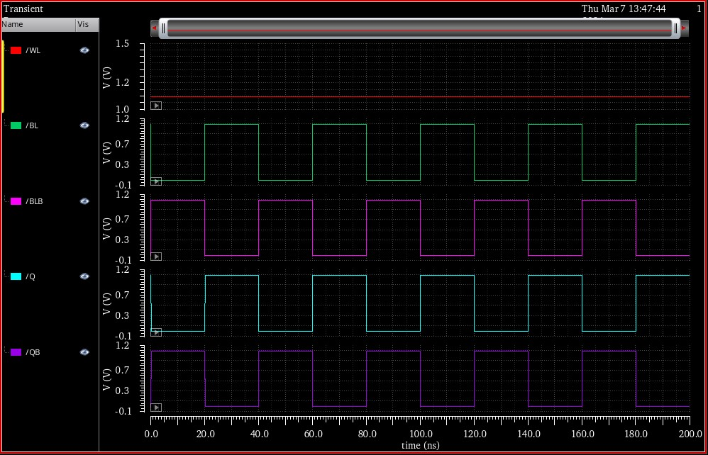

Slide 2
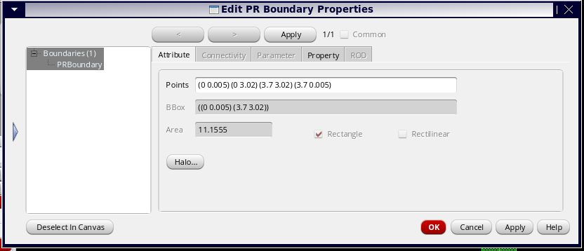

Slide 3
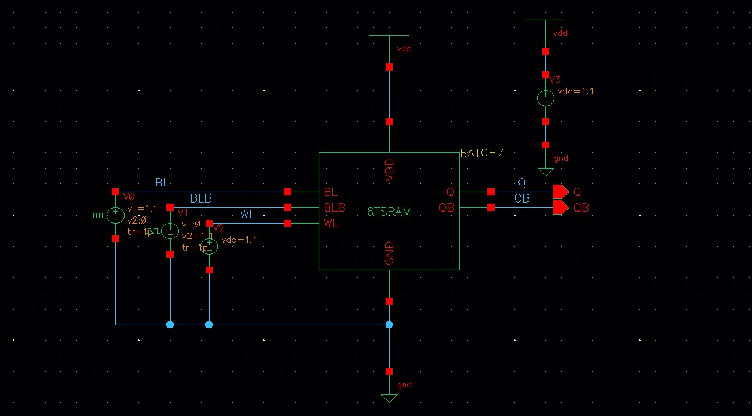

Slide 4
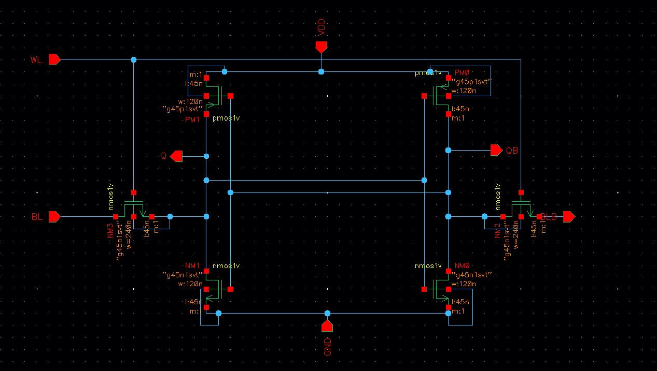

Slide 5
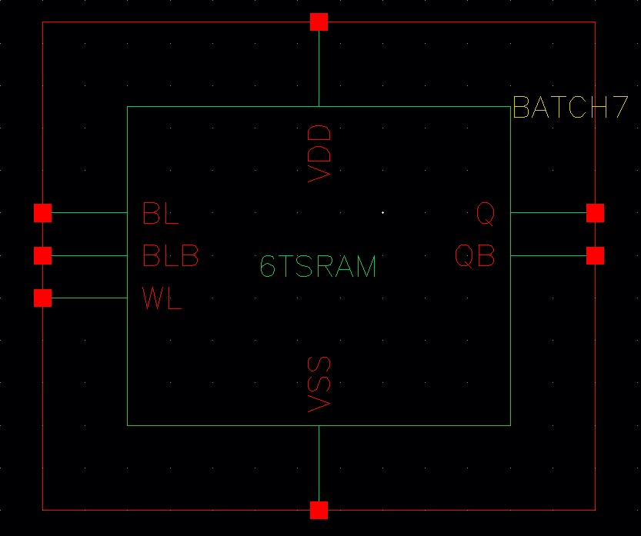

Slide 6
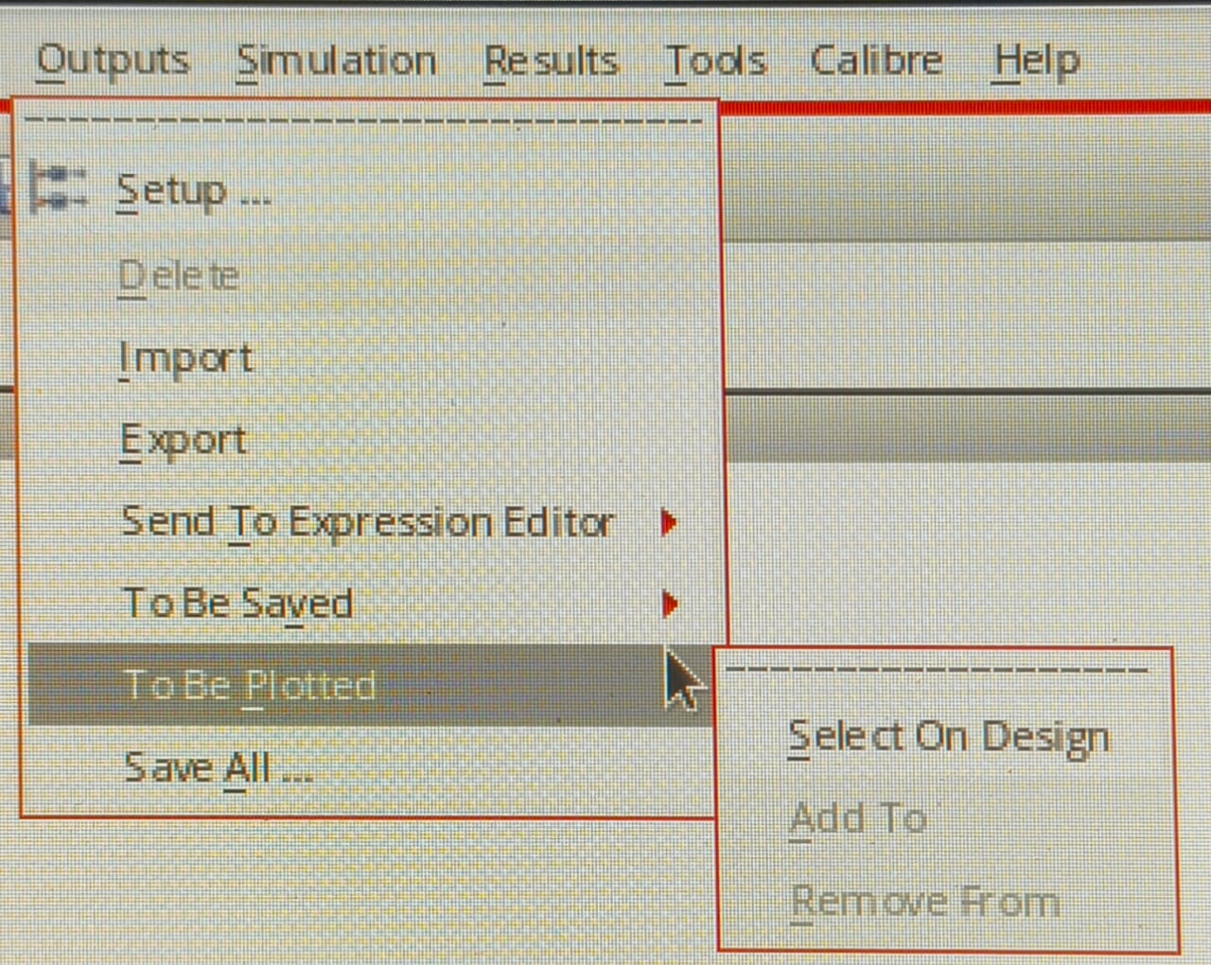

Slide 7
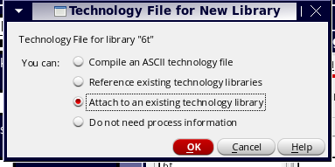

Slide 8
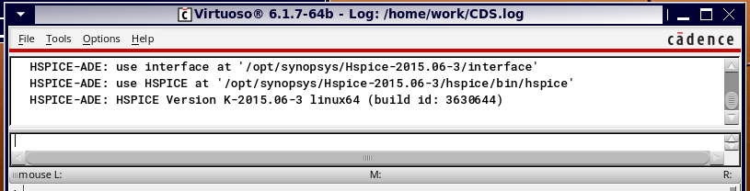

Slide 9
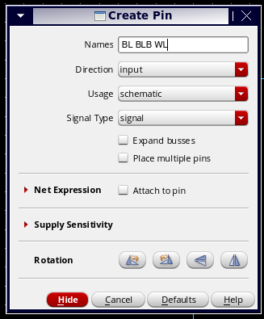

Slide 10
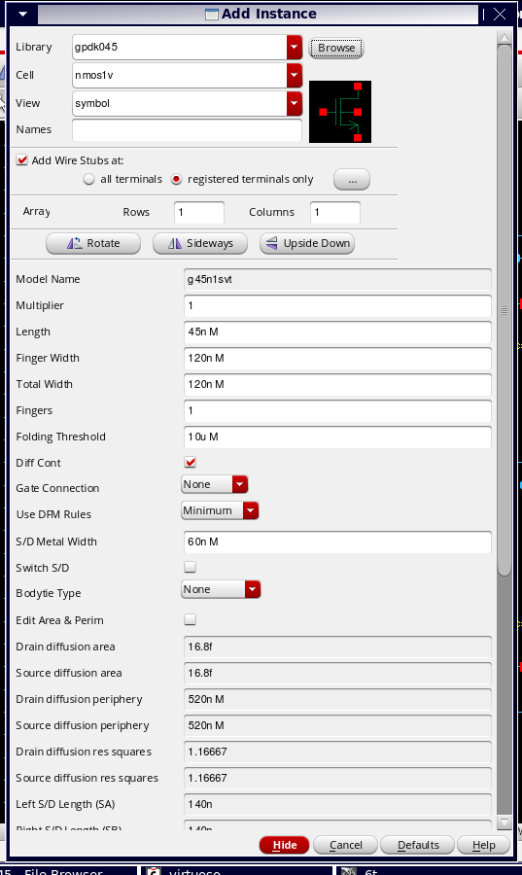

Slide 11
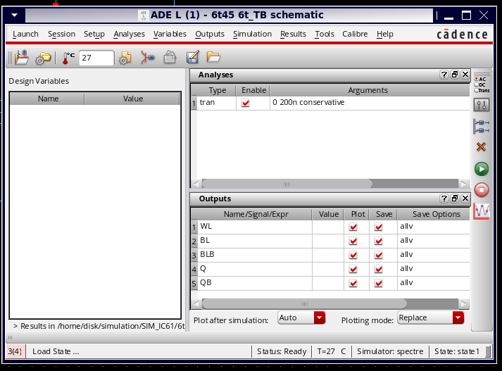

Slide 12
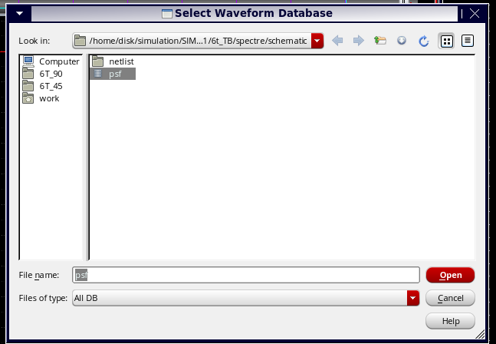

Slide 13
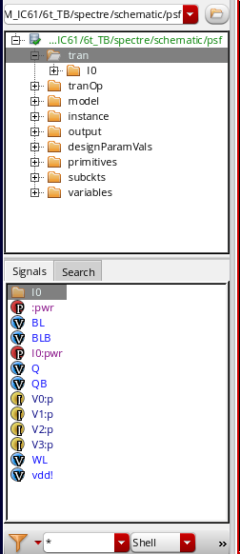

Slide 14
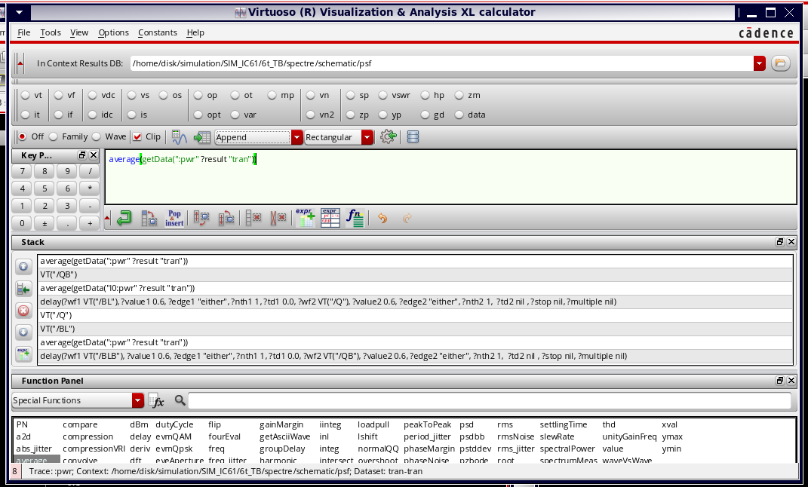

Slide 15
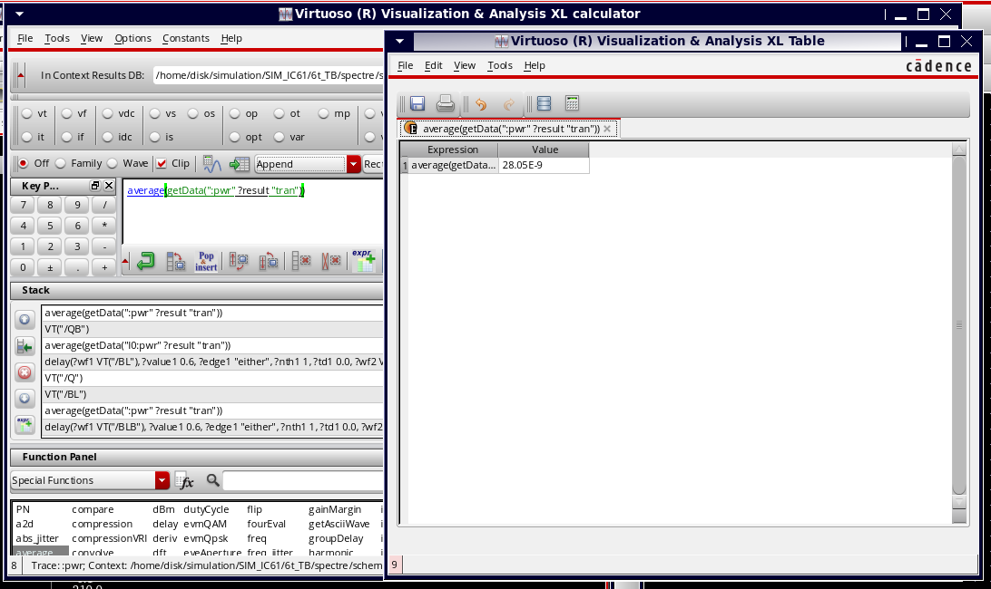

Slide 16
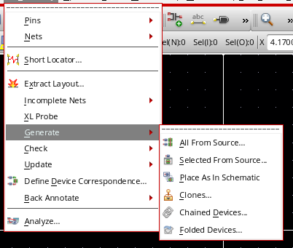

Slide 17
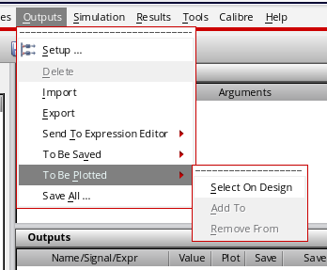

Slide 18
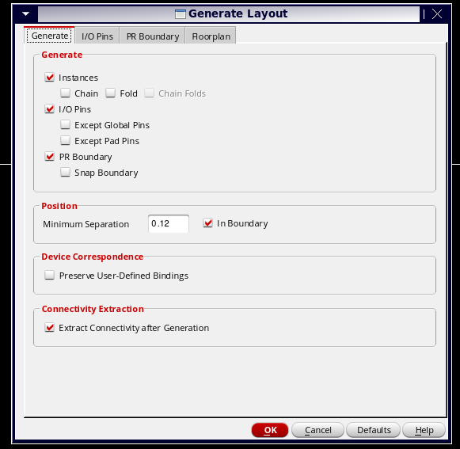

Slide 19
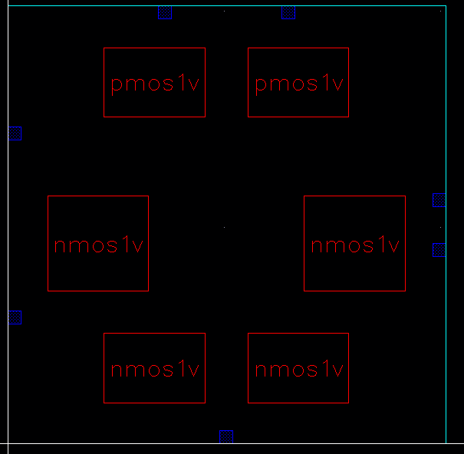

Slide 20
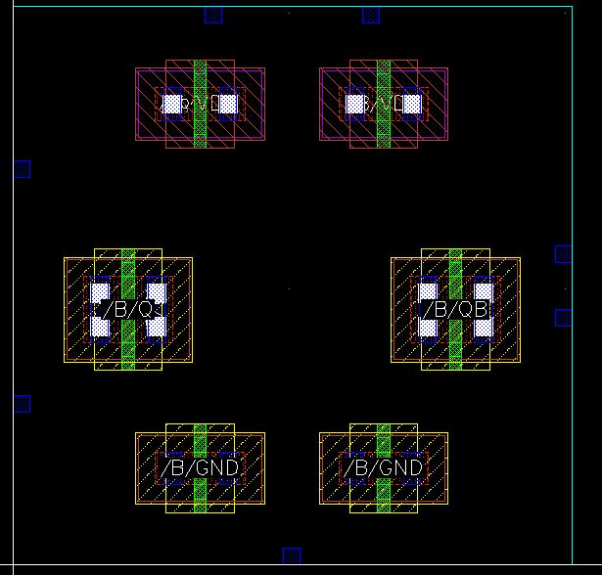

Slide 21
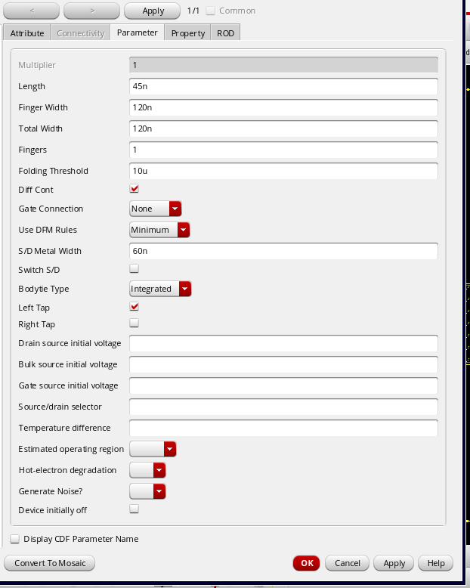

Slide 22
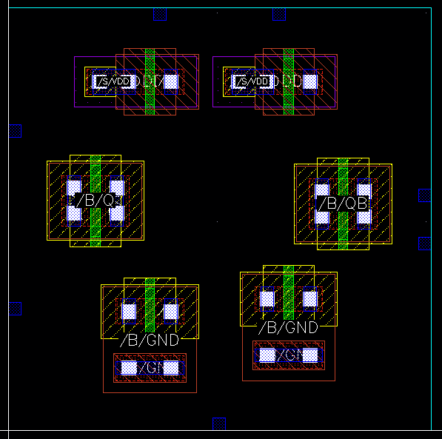

Slide 23
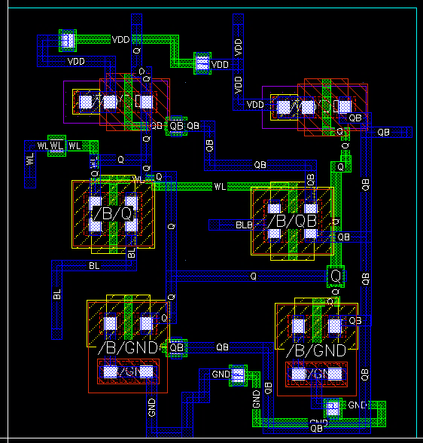

Slide 24
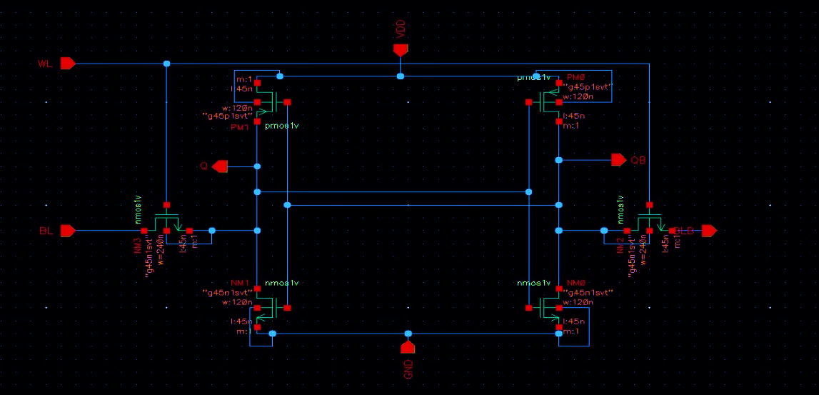
VDD= 1.1V
INPUT
P1
P2
OUTPUT
OUTPUT
N4
N3
INPUT
INPUT
N1
N2

Slide 25
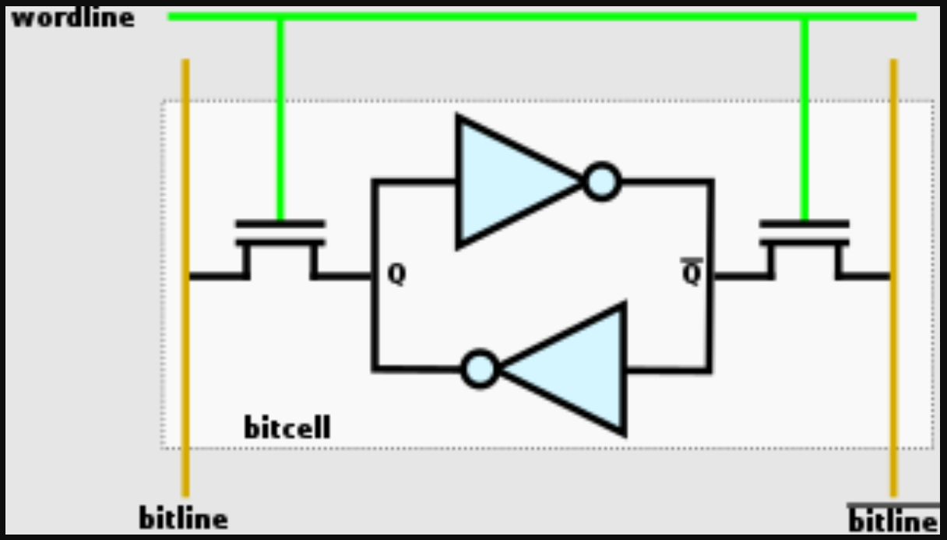

Slide 26
SNO | TRANSISTOR/PORT | SPECIFICATIONS
1 | P1, P2 | WIDTH = 120N
2 | N1, N2 | WIDTH = 120N
3 | N3, N4 | WIDTH = 240N
4 | BL ( V PULSE) (V1=1.1V, V2=0V) | DC VOLTAGE = 1.1v PERIOD = 40ns DELAY TIME = 1ps RISE TIME = 1ps FALL TIME = 1ps PULSE WIDTH = 20ns
5 | BLB(V PULSE) (V1=0V, V2=1.1V)
6 | WL ( VDC) | DC VOLTAGE = 1.1v

Slide 27
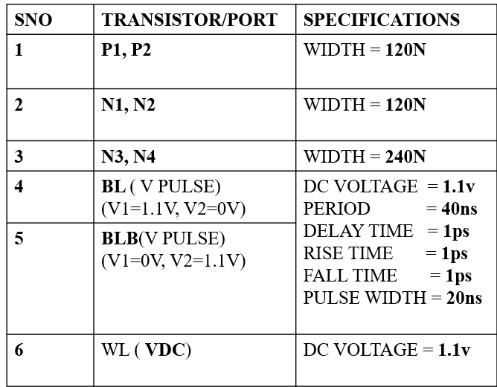

Slide 28
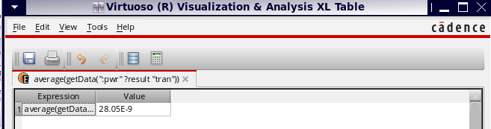
Ac 240n
Memory unit 120n

Slide 29
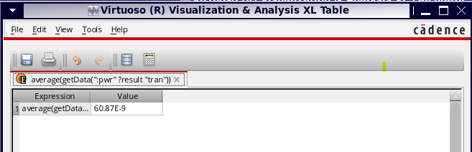
All 240n

Slide 30
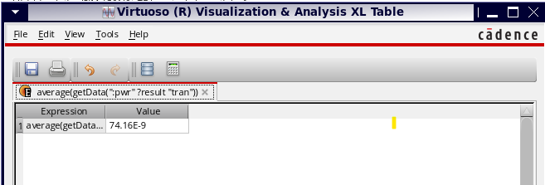
Acc 120n
Memory unit 240n

Slide 31
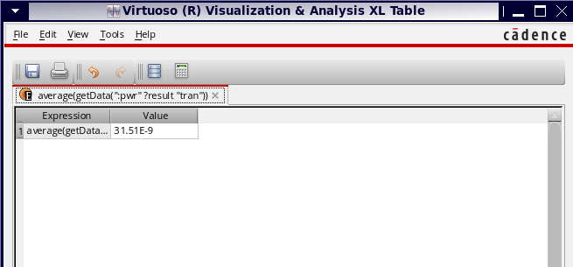
All 120n

Slide 33
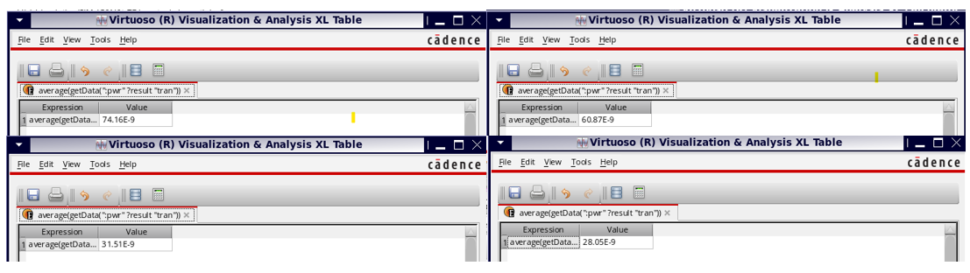

Slide 35
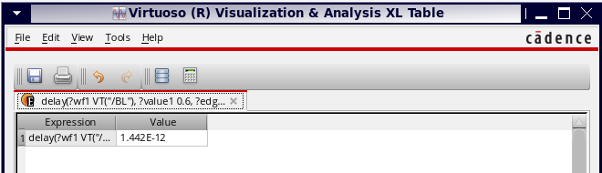
DELAY BL AND Q

Slide 36
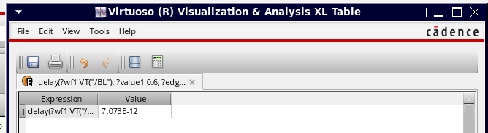
DELAY FOR BL AND QB

Slide 37
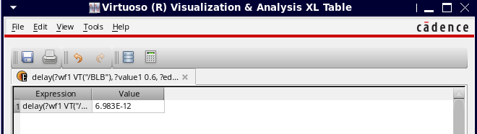
DELAY BLB AND AB

Slide 38
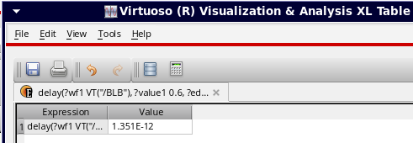
BL AND Q
BL AND Q
BLB AND Q
BLB AND QB

Slide 39
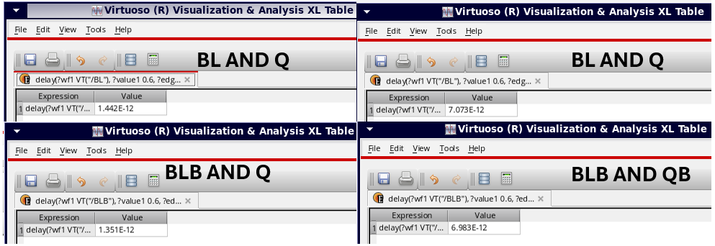

Slide 40
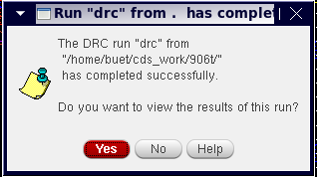

Slide 41
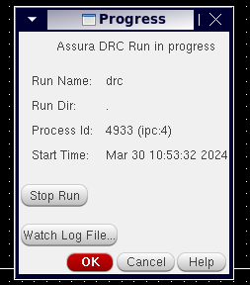

Slide 42
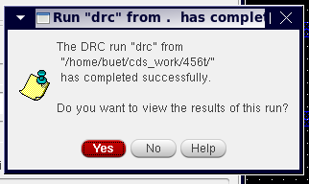

Slide 43
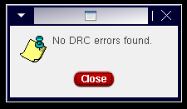

Slide 44
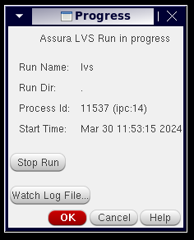

Slide 45
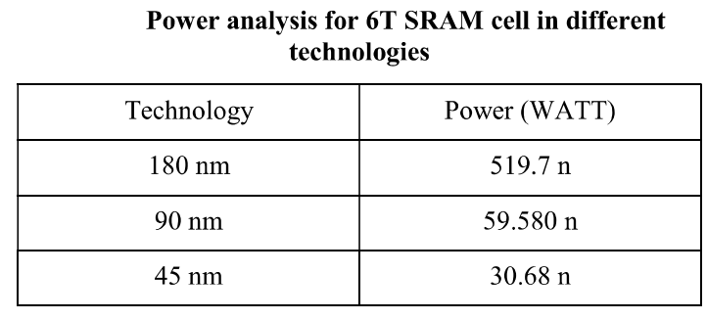


Technology (nm) | Power (nano watt)
180 | 519.7
90 | 59.580
45 | 30.68

Slide 46
SNO | PARAMETER | VALUE |  | TECHNOLOGY
1 | POWER (nano watts) | 28.05 |  | 45nm
2 | DELAY ( nano seconds) | BL vs Q | 1.442
 |  | BL vs QB | 7.073
 |  | BLB vs Q | 1.351
 |  | BLB vs QB | 6.983
3 | AREA (square nanometres) | 11.155

Slide 48
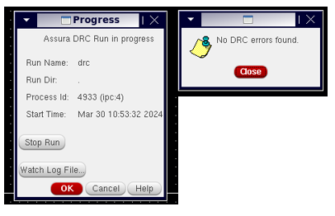

Slide 49
SNO | TECHNOLOGY (nm) | VOLTAGE |  | TRANSISTOR SIZE |  | SPECIFICATIONS
1 | 90 | V1(BL) | 1.8 | ACCESS TRANSISTORS | 240n | DC VOLTAGE | 1.1 V
 |  |  |  |  |  | PERIOD | 40n s
 |  |  |  |  |  | DELAY TIME | 1p s
 |  | V2(BL) | 0
 |  |  |  |  |  | RISE TIME | 1p s
 |  |  |  | CROSS CUPLED INVERTERS | 120n | FALL TIME | 1p s
 |  | V1(BLB) | 0
 |  |  |  |  |  | PULSE WIDTH | 20n s
 |  | V2(BLB) | 1.8
2 | 45 | V1(BL) | 1.1 | ACCESS TRANSISTORS | 240n | DC VOLTAGE | 1.1 V
 |  |  |  |  |  | PERIOD | 40n s
 |  |  |  |  |  | DELAY TIME | 1p s
 |  | V2(BL) | 0
 |  |  |  |  |  | RISE TIME | 1p s
 |  | V1(BLB) | 0
 |  |  |  | CROSS CUPLED INVERTERS | 120n | FALL TIME | 1p s
 |  | V2(BLB) | 1.1 |  |  | PULSE WIDTH | 20n s

Slide 50
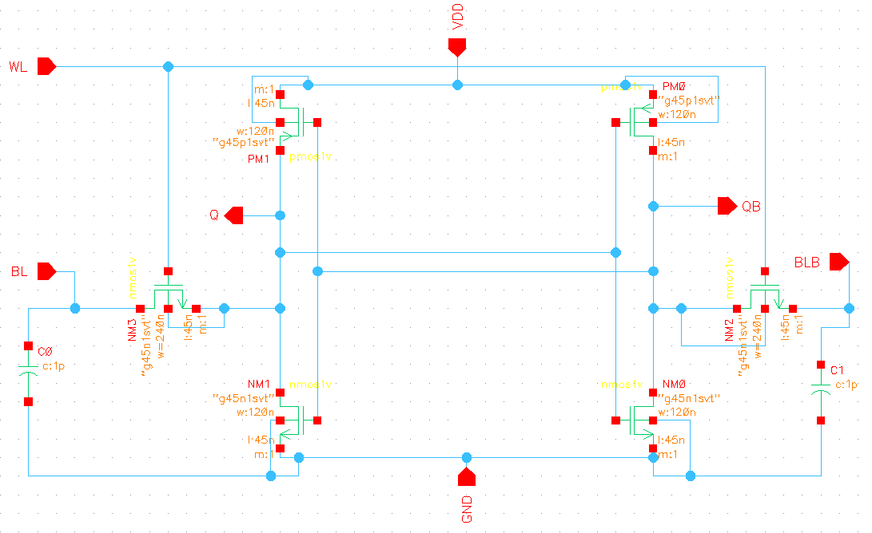

Slide 51
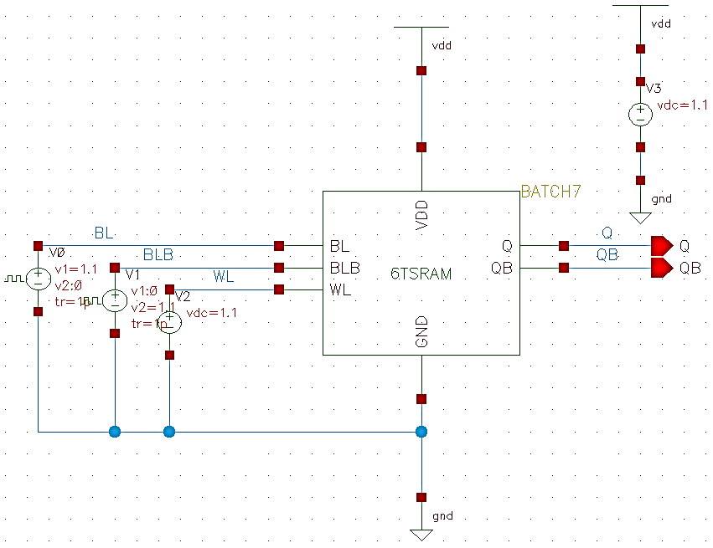

Slide 52
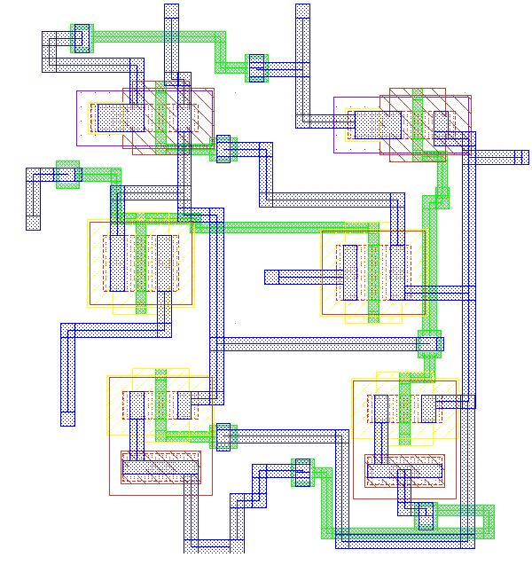

Slide 53
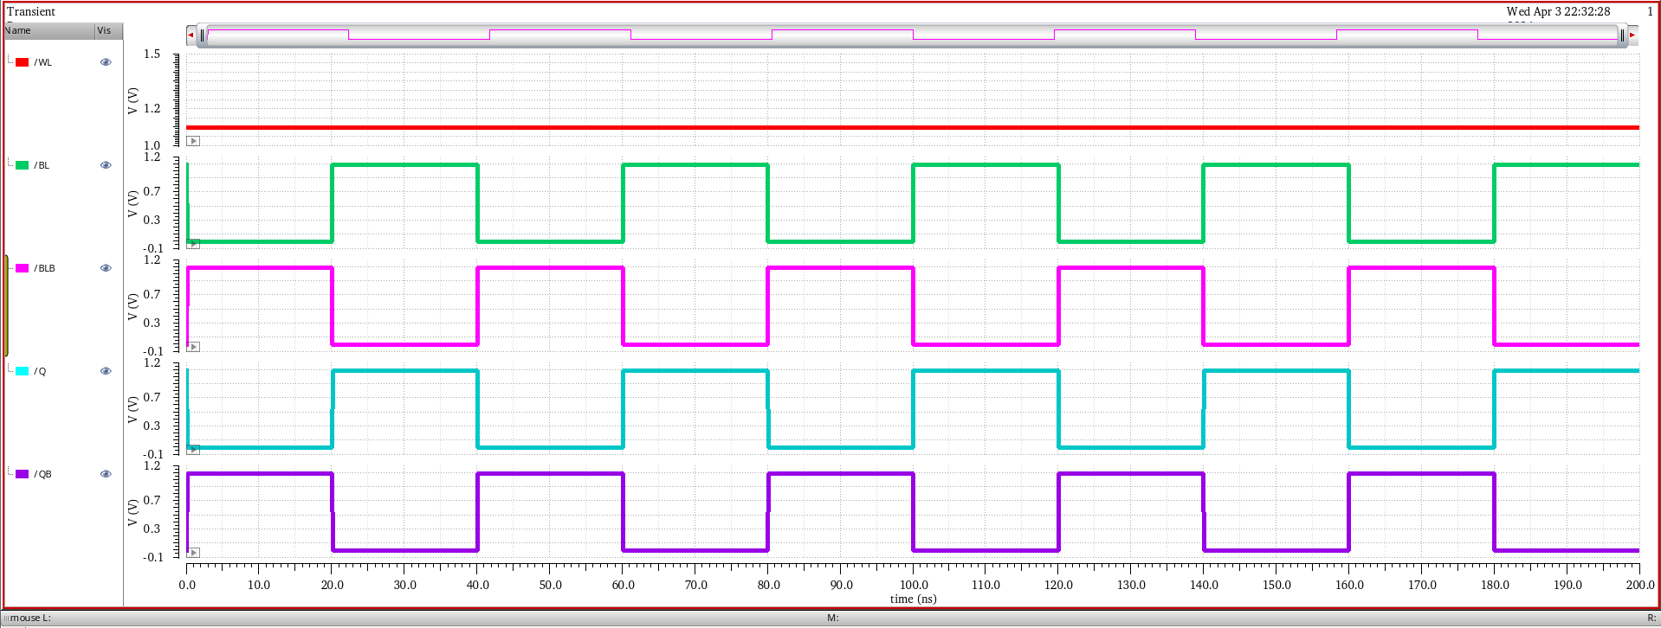

Slide 54
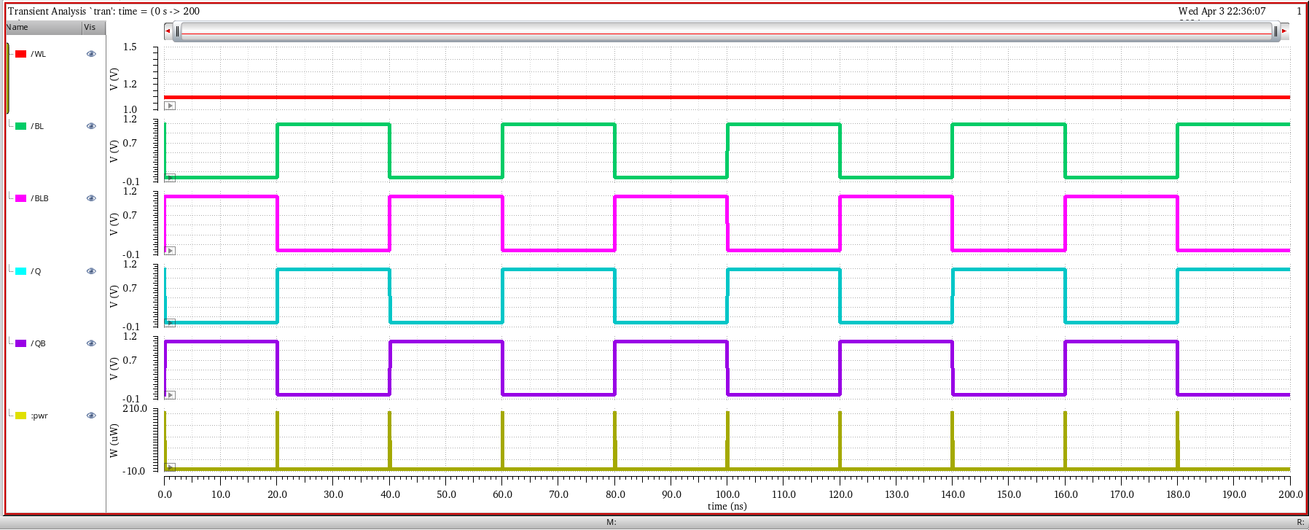

Slide 55
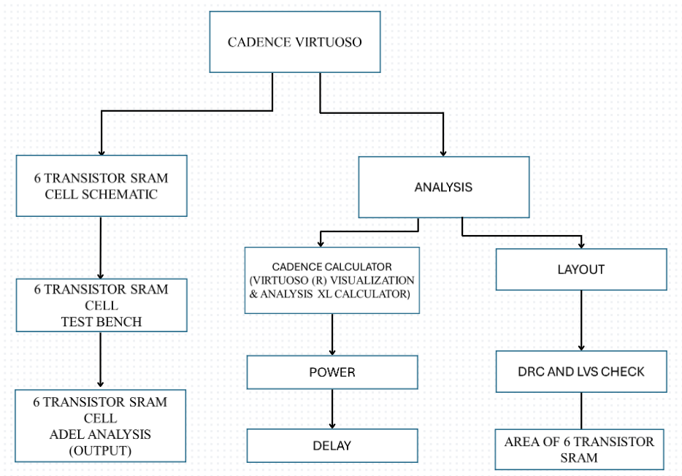

Slide 56


Slide 57


Slide 58


Slide 60
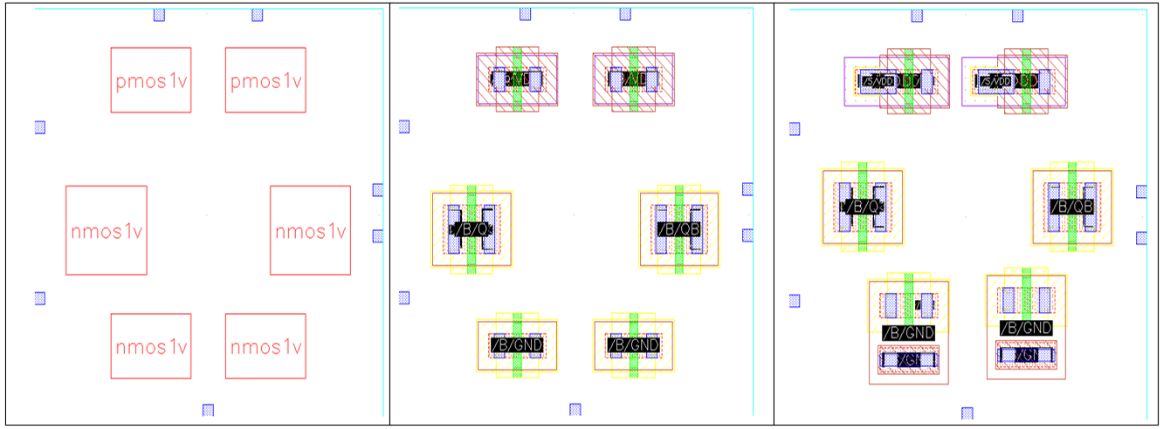

Slide 61


