Slide 1

LAKIREDDY BALI REDDY COLLEGE OF ENGINEERING
ELECTRONICS AND COMMUNICATION ENGINEERING
IMPLEMENTATION AND ANALYSIS OF
6 - TRANSISTOR SRAM CELL
PROJECT GUIDE TEAM MEMBERS (BATCH-7)
Dr. P. Lachi Reddy B. SATYA SURESH (20761A0471)
PROFESSOR CH. MALLIKHARJUN REDDY (20761A0476)
P. BHUVANA SRI (20761A04A3)

Slide 2
CONTENTS
ABSTRACT
INTRODUCTION
LITERATURE REVIEW
METHODOLOGY
DESIGN ANALYSIS
RESULTS
CONCLUSIONS

Slide 3
ABSTRACT
Static Random-Access Memory (SRAM) stands as a vital component, offering swift and efficient on-chip data storage. It is made up of six transistors that are placed in a precise way to achieve stability and the capacity to read and write date. This 6-transistor SRAM cell plays a vital role, particularly in high-performance memory applications like cache memory. The main objective of this project is to focus on examining the performance, stability, and energy efficiency of the 6T SRAM cell. Extensive simulations are helpful to evaluate key performance parameters such as access time, write time, and power consumption. The primary aim is to identify any design limitations or flaws and propose potential enhancements.

Slide 4
Factors like noise tolerance, resistance to data corruption during read operations, and ease of writing data should be analysed under different conditions. As power consumption is a critical concern in modern semiconductor devices, we assess the energy efficiency of the 6T SRAM cell. This includes analyse the dynamic power under different operating scenarios. We will analyse its layouts and in addition to characterizing the 6T SRAM cell, we compare its performance and energy efficiency with other popular SRAM cell designs, such as 4T and 8T cells, to identify trade-offs and advantages.
KEYWORDS: 6T SRAM cell, 4T, 8T, Access time, Write time, Power consumption.

Slide 5
INTRODUCTION
The 6-transistor SRAM (6T SRAM) cell is a fundamental building block of static random-access memory (SRAM), widely employed in modern integrated circuits for on-chip data storage. Comprising six transistors arranged in a cross-coupled configuration, the 6T SRAM cell offers a balance of stability, speed, and efficiency. Its key components include two cross-coupled inverters for data storage and access transistors for read and write operations. The 6T SRAM cell is characterized by its ability to retain data without the need for constant refresh, making it a preferred choice for cache memories in high-performance computing applications. The design and optimization of 6T SRAM cells play a crucial role in shaping the performance and efficiency of memory subsystems within integrated circuits.

Slide 6
SNO | YEAR | TITLE | TECHNOLOGY USED | PARAMETERS ANALYSED
1 | 2021 | Design and Performance Comparison of 6-T SRAM Cell | 32nm CMOS, FinFET and CNTFET Technologies | average power delay leakage current read stability write-ability
2 | 2019 | Performance Analysis of 6T and 9T SRAM | 45nm CMOS technology | stability, leakage, process variations
3 | 2017 | Analysis of 6T SRAM cell in different technologies | 180nm, 90nm, and 45nm technology | Speed power dissipation static noise margin.
4 | 2016 | Design of low power 6T-SRAM cell and analysis for high-speed application. | 90nm technology | Static Noise Margin Data Retention Voltage Read Margin Write Margin

Slide 7
SNO | YEAR | TITLE | TECHNOLOGY USED | PARAMETERS ANALYSED
5 | 2015 | 6T SRAM Cell: Design And Analysis | 45nm and 180nm technologies | power consumption delay SNM.
6 | 2014 | A Comparative Analysis of 6 Transistor SRAM and 6T ROM Embedded SRAM. | power comparisons | LT SPICE Software
7 | 2022 | A comparative performance analysis of 6T & 9T SRAM integrated circuits | 180 nm Technologies | data stability power metrics Temperature variations
8 | 2012 | Implementation and desing of 6T-SRAM with read and write assists circuits | 65nm technology along with a comparison to 120nm technology | Power dissipation circuit layouts schematics simulation results

Slide 8
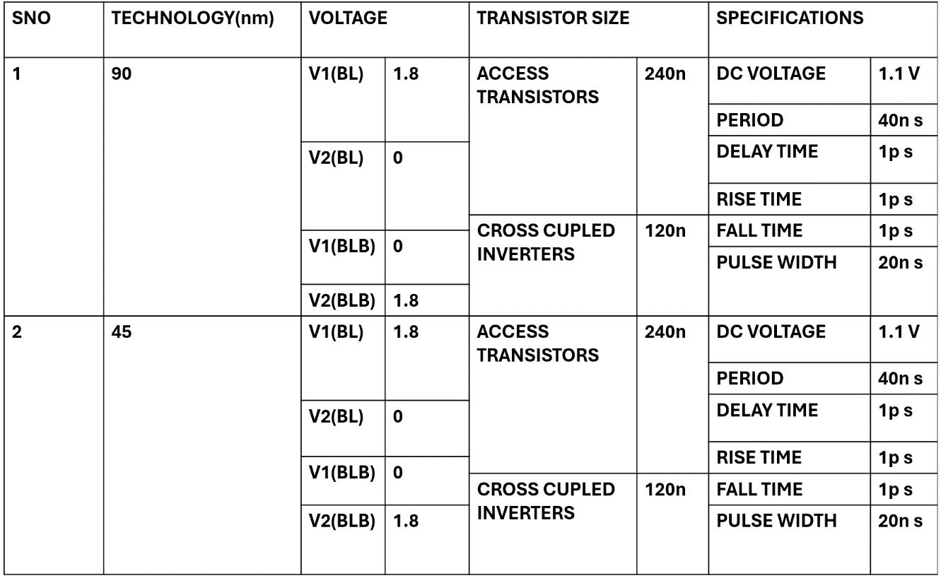
SPECIFICATIONS OF THE 6 TRANSISTOR SRAM

Slide 9
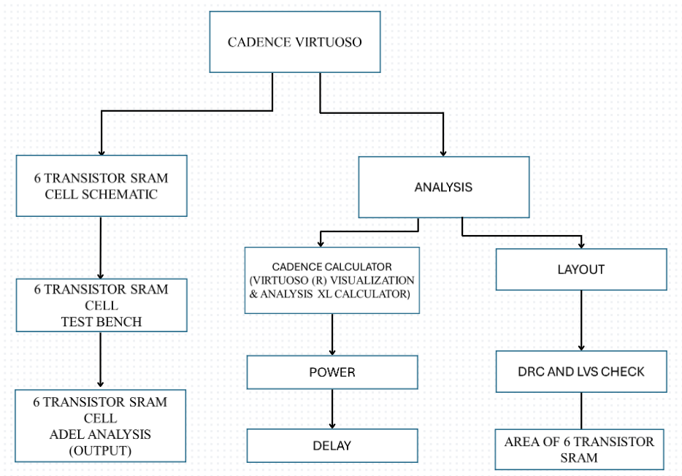
METHODOLOGY
FLOW DIAGRAM OF CADENCE TOOL

Slide 10
Create a Library: Launch Virtuoso and initiate a new project. Set a name and location for your library. Determine the technology file (.tf) that specifies design rules and device models.
Example: gpdk45 library.
Draw Schematic: Access the schematic editor and create a new schematic. Utilize the component library to place devices (transistors, resistors, etc.).Connect devices with wires and add necessary labels.
Run Simulation: Choose the appropriate simulator (e.g., Spectre for analog, AMS Designer for mixed-signal). Analyze circuit behavior and observe waveforms.
Create Layout: Access the layout editor and create a new layout for each schematic. Place devices and route connections according to design rules.

Slide 11
DESIGN VERIFICATION:
Run Design Rule Check (DRC):Ensure layout matches to technology design rules.
Perform Layout Versus Schematic (LVS) Check: Verify layout connectivity matches schematic.
Perform Electrical Rule Check (ERC):Confirm layout electrical correctness.
DRC/LVS Fix and Final Layout
Address DRC/LVS Violations: Modify layout to resolve any violations.
Generate Final Layout: Produce the GDSII file for fabrication

Slide 12
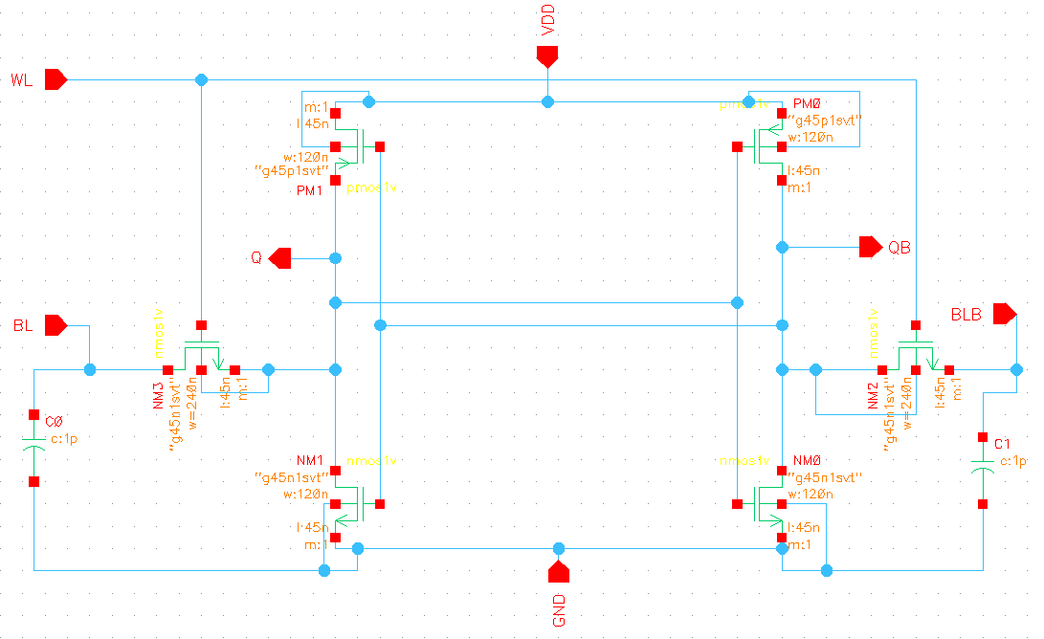
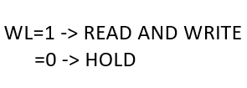
SCHEMATIC DESIGN OF 6 TRANSISTOR SRAM CELL
DESIGN ANALYSIS
SCHEMATIC OF 6 TRANSISTOR SRAM

Slide 13
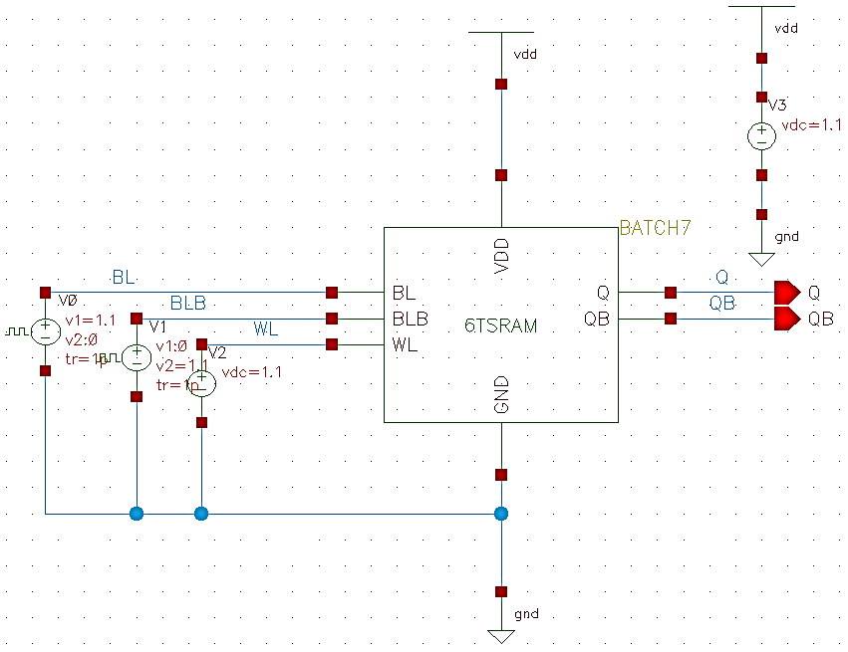
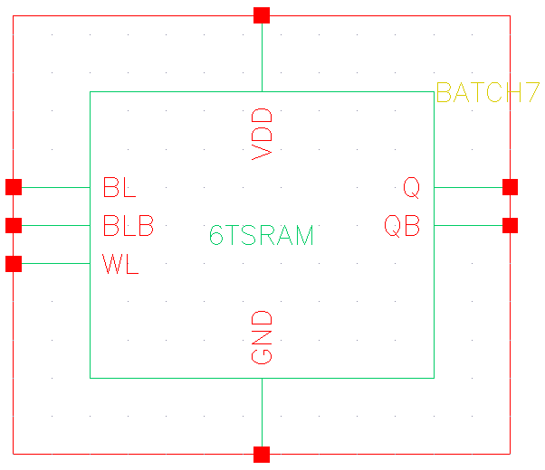
TEST BENCH OF 6 TRANSISTOR SRAM CELL
SYMBOL OF 6 TRANSISTOR SRAM
TEST BENCH FOR 6 TRANSISTOR SRAM SCHEMATIC

Slide 14
WORD LINE (WL) ACTIVATION:
When the word line (WL) is set high (WL=1), it activates the access transistors within the SRAM cell.
READ AND WRITE OPERATIONS:
With the word line high, both read and write operations can occur.
During a read operation, the stored data is accessed without altering it.
During a write operation, new data is written into the cell, potentially changing the stored information.
BITLINE (BL) AND COMPLEMENTARY BITLINE (BLB) BEHAVIOR:
When BL (Bitline) is high (BL=1), BLB (Complementary Bitline) should be low (BLB=0), indicating a '1' is being read or written.
Conversely, when BL is low (BL=0), BLB should be high (BLB=1), indicating a '0'.
INNER INVERTERS AS MEMORY UNIT:
The behavior of the inner inverters, acting as the memory unit, depends on the voltages applied to BL and BLB.
When the appropriate voltage configuration is applied, the cross-coupled inverters store the desired bit of information ('0' or '1').
OUTPUT BEHAVIOR:
During a read operation, if the stored data (Q) is low ('0'), then its complement (QBAR) should be high ('1').
Conversely, if the stored data (Q) is high ('1'), then its complement (QBAR) should be low ('0').

Slide 15
In the context of a 6-transistor SRAM (6T SRAM) cell, BL (Bitline) and BLB (Complementary Bitline), often referred to as BL BAR, are two crucial signals associated with the memory cell's read and write operations.
1. BITLINE (BL)
BL, or Bitline, is one of the two conductive pathways used for reading from or writing to the SRAM cell.
During a read operation, BL carries the sensed voltage, and during a write operation, the voltage on BL is manipulated to write data into the cell.
2.COMPLEMENTARY BITLINE (BLB OR BL BAR)
BLB, or Complementary Bitline (sometimes denoted as BL BAR), is the complementary signal to BL.
During a read operation, BLB carries the complement of the sensed voltage on BL. This complementary information is essential for the accurate determination of the stored bit.
During a write operation, the voltage on BLB is manipulated to complement the data being written onto BL, ensuring the correct state is stored in the SRAM cell.

Slide 16
READ OPERATION
During a read operation in a 6-transistor SRAM (6T SRAM) cell, the corresponding wordline is activated. The stored data is sensed through the bitlines, and a sense amplifier amplifies the voltage difference to determine the stored bit value ('0' or '1'). The read operation is a key factor in the overall efficiency and responsiveness of the 6T SRAM cell.
WRITE OPERATION
In a write operation of a 6-transistor SRAM (6T SRAM) cell, the wordline is activated, allowing input data to be written into the cell. The voltages on the bitlines are manipulated to set the cross-coupled inverters to the desired state corresponding to the data ('0' or '1'). This process ensures reliable data storage until the next read or write operation.
HOLD OPERATION
During the hold operation in a 6-transistor SRAM (6T SRAM) cell, the stored data is maintained without active read or write processes. The cross-coupled inverters sustain a stable state, ensuring data integrity during periods of inactivity.

Slide 17
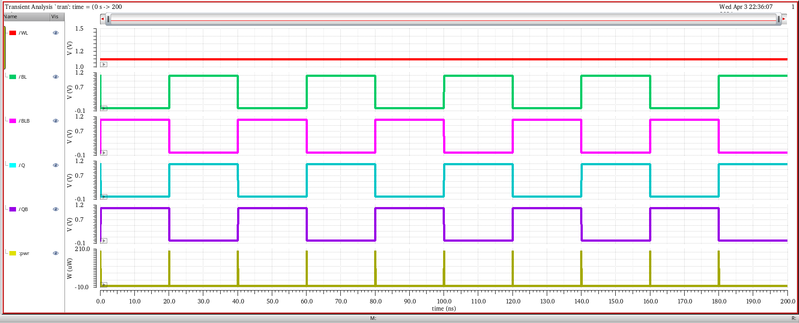
RESULTS
POWER
SIMULATION RESULTS OF 6T SRAM
READ OPERATION

Slide 18
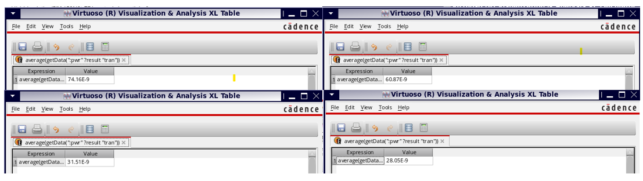
POWER CONSUMPTION RESULTS FOR DIFFERENT TRANSISTOR RATIOS

Slide 19
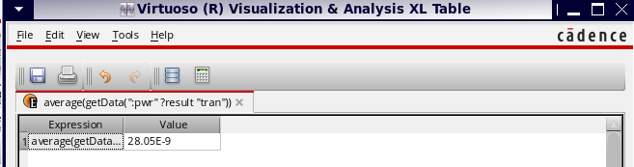
FINGER WIDTH AND TOTAL WIDTH OF ACCESS TRANSISTORS AS 240N AND FOR INNER CROSS-COUPLED INVERTERS, AS 120N.

Slide 20
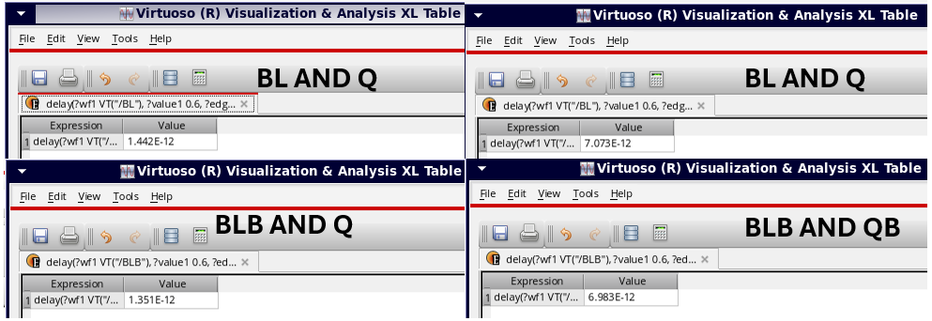
PROPAGATION DELAY

Slide 21
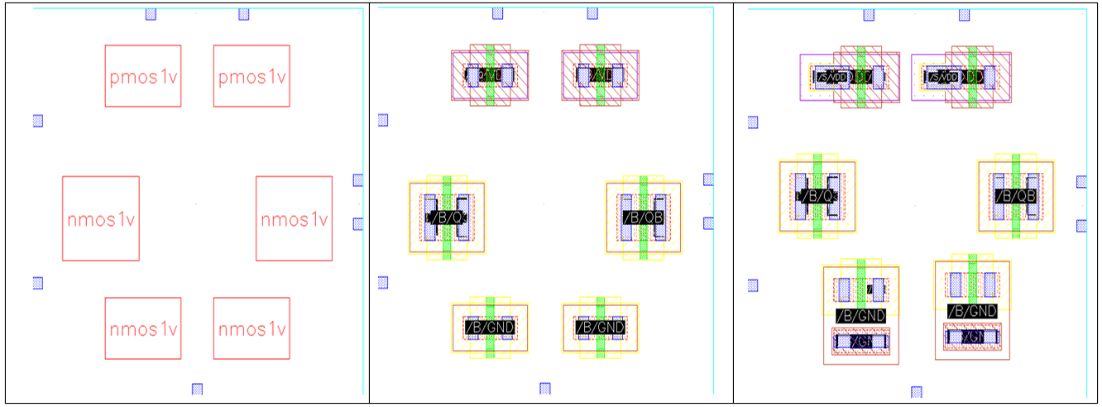
BLOCKS OF 6T SRAM LAYOUT

Slide 22
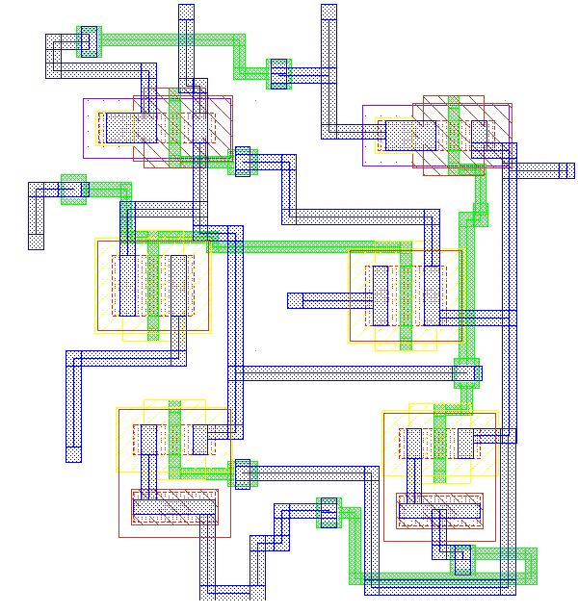
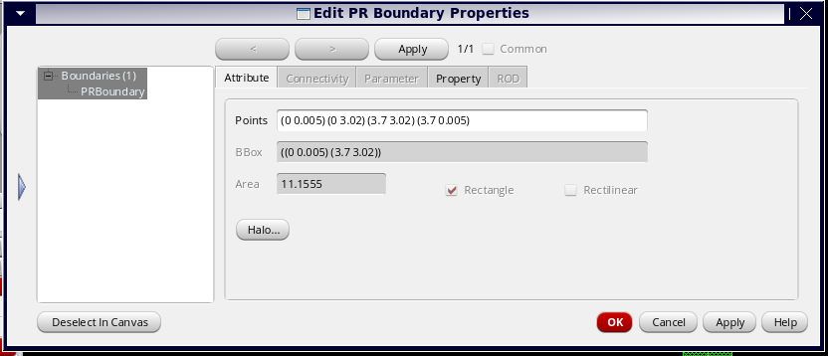
AREA OF 6T SRAM LAYOUT
LAYOUT FOR 6 TRANSISTOR SRAM CELL

Slide 23
We have analysed the outputs of the 6-transistor SRAM in 45nm technology. We obtained the outputs of the 6T SRAM read operations, including BL, BLB, Q, and QB, and we have submitted these outputs. Additionally, we have calculated the overall Power Consumption, Propagation Delay, and Area of 6t SRAM Layout of the 6T SRAM cell in 45nm technology, Power Consumption which is approximately 28n watts and Propagation Delay with delay values ranging from 1.442 nanoseconds to 7.073 nanoseconds for different signal pairs and Furthermore, the layout design of the SRAM cell, conducted using Cadence Layout XL, resulted in an area requirement of 11.155 square nanometers. We compared the results of 45nm and 90nm technology in terms of power consumption and simulation outcomes. Our analysis revealed that 45nm technology exhibits lower power consumption compared to 90nm technology.

Slide 24
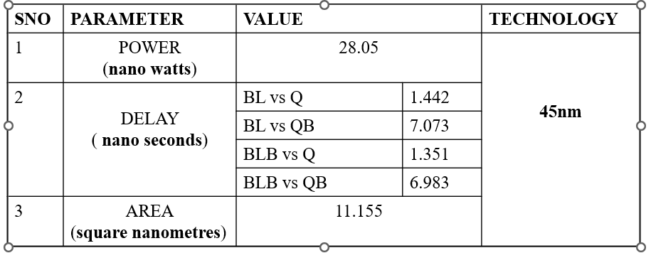
FINAL RESULTS OF 6 TRANSISTOR SRAM CELL IN 45 NANO METER TECHNOLOGY

Slide 25
CONCLUSION
In conclusion, the analysis of the 6-transistor SRAM using Cadence software in the 45-nanometer technology generation reveals important insights into its performance characteristics. The power consumption of the SRAM cell varied between 28.05n watts and 74.169n watts across different simulations and parameter configurations. Notably, the lowest power consumption observed was 28.05n watts, indicating improved power efficiency under specific parameter settings. Additionally, delay characterization provided valuable information on the timing behavior of the SRAM cell, with delay values ranging from 1.442 nanoseconds to 7.073 nanoseconds for different signal pairs. These measurements offer insights into the speed and efficiency of data access operations within the SRAM cell. Furthermore, the layout design of the SRAM cell, conducted using Cadence Layout XL, resulted in an area requirement of 11.155 square nanometers. This comprehensive analysis underscores the importance of optimizing design parameters to achieve a balance between power efficiency, performance, and layout area in 45-nanometer technology for 6-transistor SRAM designs.

Slide 26

ANY QUESTIONS

Slide 27

THANK YOU

