Slide 1

LAKIREDDY BALI REDDY COLLEGE OF ENGINEERING
Electronics and Communication Engineering
IMPLEMENTATION AND ANALYSIS OF
6 - TRANSISTOR SRAM CELL
PROJECT GUIDE TEAM MEMBERS (BATCH-7)
Dr. P. Lachi Reddy B. SATYA SURESH (20761A0471)
PROFESSOR CH. MALLIKHARJUN REDDY (20761A0476)
P. BHUVANA SRI (20761A04A3)

Slide 2
CONTENTS
ABSTRACT
INTRODUCTION
LITERATURE REVIEW
METHODOLOGY
DESIGN ANALYSIS
RESULTS
CONCLUSIONS

Slide 3
ABSTRACT
SRAM (Static Random-Access Memory) is crucial for fast on-chip data storage.
The 6T SRAM cell consists of six transistors arranged precisely for stability and efficient read/write operations.
It's particularly vital in high-performance applications like cache memory.
This project aims to assess the performance, stability, and energy efficiency of the 6T SRAM cell.
Simulations will evaluate key parameters such as access time, write time, and power consumption.
Goals include identifying design limitations, proposing enhancements, and analyzing factors like noise tolerance and data corruption resistance.
Energy efficiency, a critical concern, will be evaluated by analyzing dynamic power under various operating scenarios.
Layout analysis will be conducted to optimize performance and stability.
Comparison with other SRAM cell designs like 4T and 8T cells will highlight trade-offs and advantages.

Slide 4
INTRODUCTION
The 6T SRAM cell is a core component of static random-access memory (SRAM), used extensively in modern integrated circuits.
It consists of six transistors arranged in a cross-coupled configuration.
Key features include stability, speed, and efficiency, achieved through balanced design.
Components include two cross-coupled inverters for data storage and access transistors for read/write operations.
Unlike dynamic RAM, 6T SRAM retains data without constant refreshing.
Preferred for cache memories in high-performance computing due to its reliability.
Design and optimization of 6T SRAM cells significantly impact the performance and efficiency of memory subsystems in ICs.

Slide 5
LITERATURE SURVEY
SNO | TITLE | TECHNOLOGY USED | PARAMETERS ANALYSED
1 | Design and Performance Comparison of 6-T SRAM Cell 2021 | 32nm CMOS, FinFET and CNTFET Technologies | average power delay leakage current read stability write-ability
2 | Performance Analysis of 6T and 9T SRAM 2019 | 45nm CMOS technology | stability, leakage, process variations
3 | Analysis of 6T SRAM cell in different technologies 2017 | 180nm, 90nm, and 45nm technology | Speed power dissipation static noise margin.
4 | Design of low power 6T-SRAM cell and analysis for high-speed application. 2016 | 90nm technology | Static Noise Margin Data Retention Voltage Read Margin Write Margin

Slide 6
SNO | TITLE | TECHNOLOGY USED | PARAMETERS ANALYSED
5 | 6T SRAM Cell: Design And Analysis 2015 | 45nm and 180nm technologies | power consumption delay SNM.
6 | A Comparative Analysis of 6 Transistor SRAM and 6T ROM Embedded SRAM. 2014 | power comparisons | LT SPICE Software
7 | A comparative performance analysis of 6T & 9T SRAM integrated circuits 2022 | 180 nm Technologies | data stability power metrics Temperature variations
8 | Implementation and desing of 6T-SRAM with read and write assists circuits 2012 | 65nm technology along with a comparison to 120nm technology | Power dissipation circuit layouts schematics simulation results
9 | In-Memory Multi-Bit Multiplication and Accumulation in 6T SRAM Array | 90nm | Delay energy usage
10 | Analysis of radiation-hardening techniques for 6T SRAMs with structured layouts | 180nm | Area

Slide 7
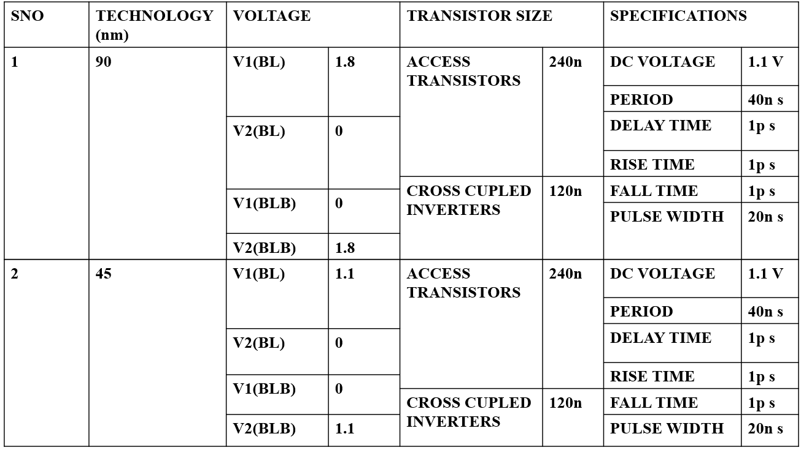
SPECIFICATIONS OF THE 6 TRANSISTOR SRAM

Slide 8
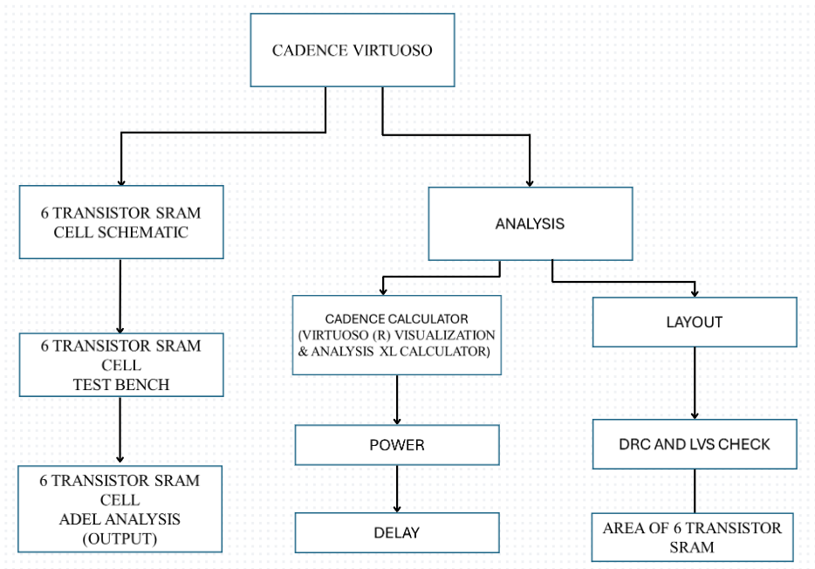
METHODOLOGY
FLOW DIAGRAM OF CADENCE TOOL

Slide 9
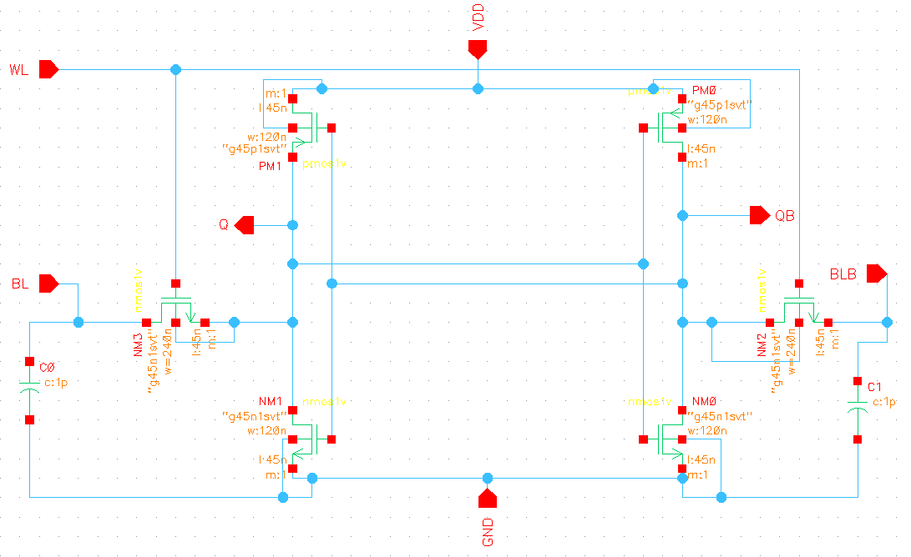
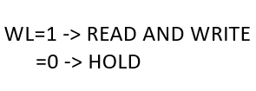
SCHEMATIC DESIGN OF 6 TRANSISTOR SRAM CELL
DESIGN ANALYSIS
SCHEMATIC OF 6 TRANSISTOR SRAM

Slide 10
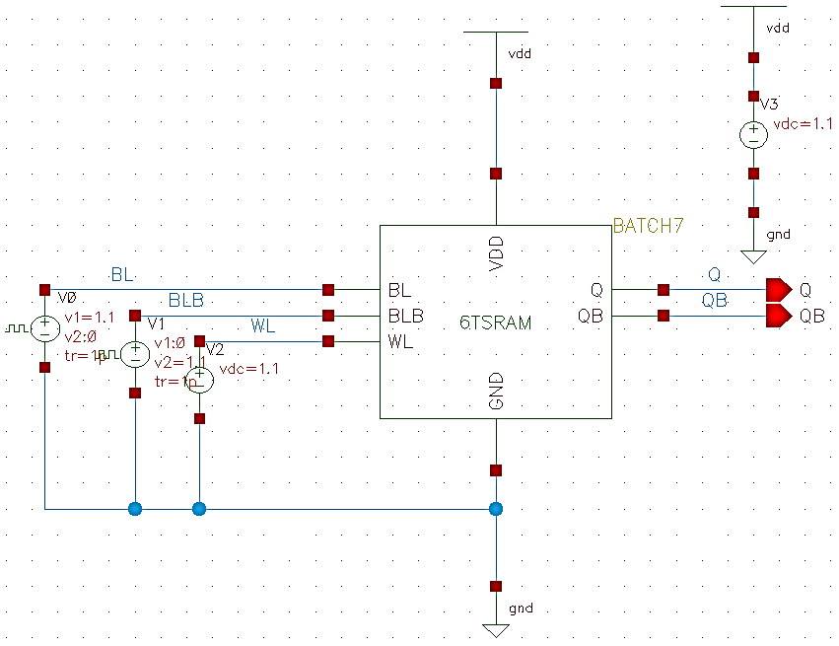
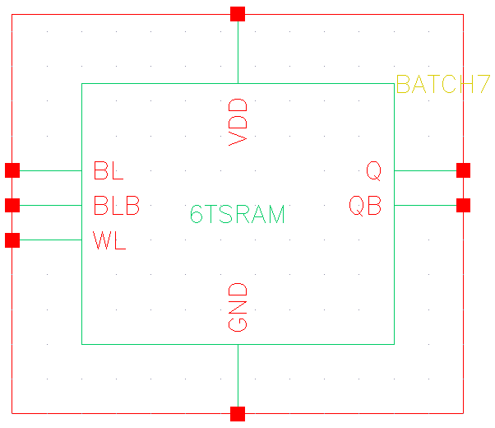
TEST BENCH OF 6 TRANSISTOR SRAM CELL
SYMBOL OF 6 TRANSISTOR SRAM
TEST BENCH FOR 6 TRANSISTOR SRAM SCHEMATIC

Slide 11
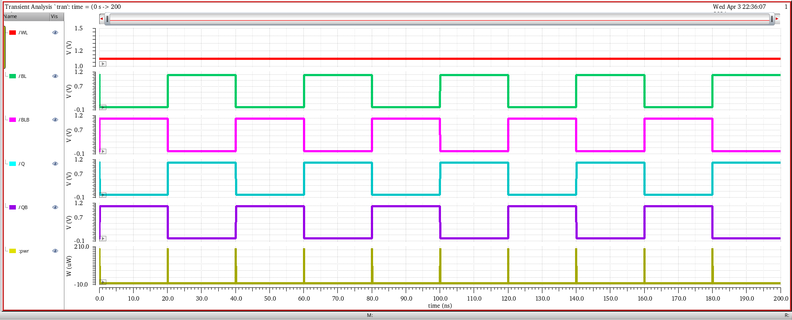
RESULTS
POWER
SIMULATION RESULTS OF 6T SRAM
READ OPERATION

Slide 12
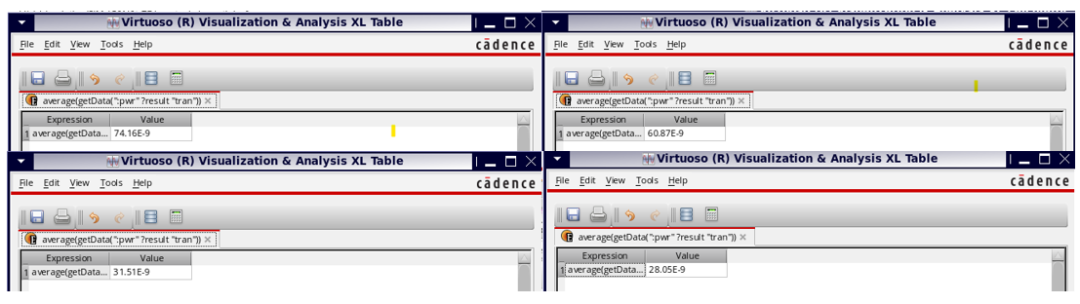
POWER CONSUMPTION RESULTS FOR DIFFERENT TRANSISTOR RATIOS

Slide 13
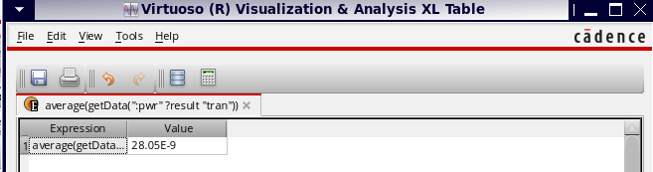
FINGER WIDTH AND TOTAL WIDTH OF ACCESS TRANSISTORS AS 240N AND FOR INNER CROSS-COUPLED INVERTERS, AS 120N.

Slide 14
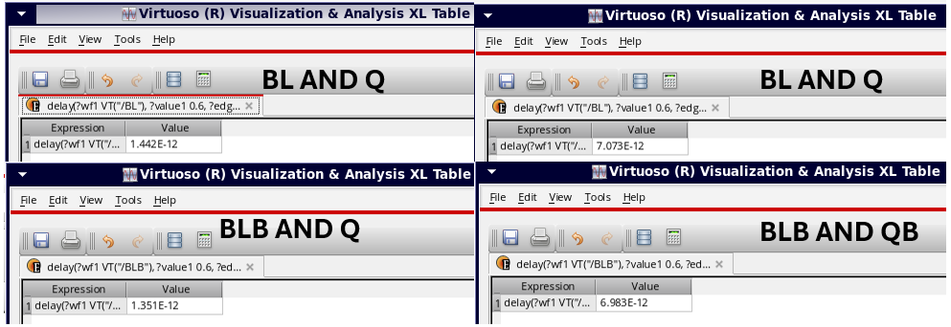
PROPAGATION DELAY

Slide 15
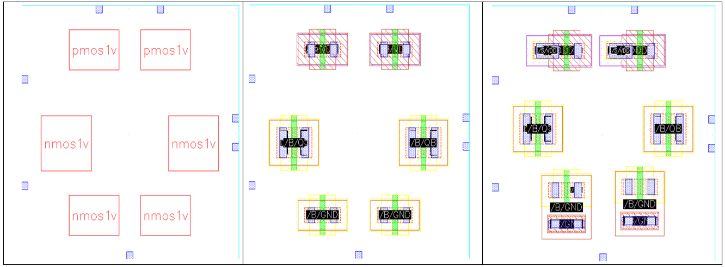
BLOCKS OF 6T SRAM LAYOUT

Slide 16
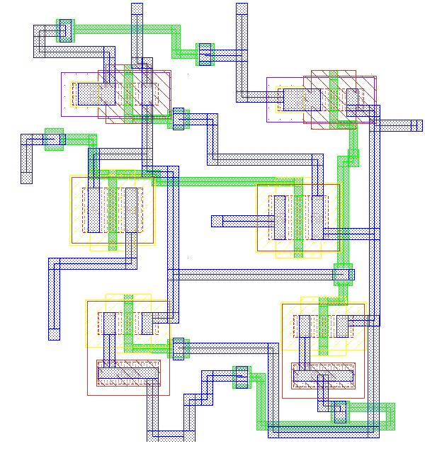
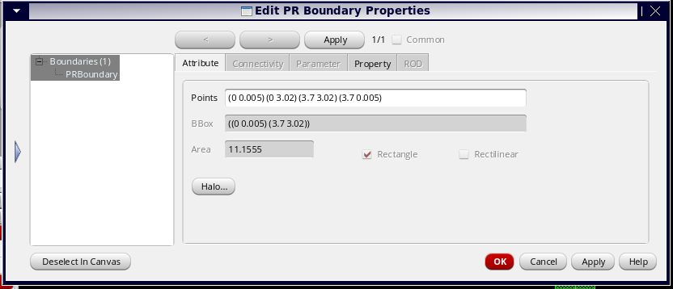
AREA OF 6T SRAM LAYOUT
LAYOUT FOR 6 TRANSISTOR SRAM CELL

Slide 17
We have analysed the outputs of the 6-transistor SRAM in 45nm technology.
We obtained the outputs of the 6T SRAM read operations, including BL, BLB, Q, and QB, and we have submitted these outputs.
Power Consumption which is approximately 28n watts and Propagation Delay with delay values ranging from 1.442 nanoseconds to 7.073 nanoseconds for different signal pairs.
The layout design of the SRAM cell, conducted using Cadence Layout XL, resulted in an area requirement of 11.155 square nanometers.

Slide 18
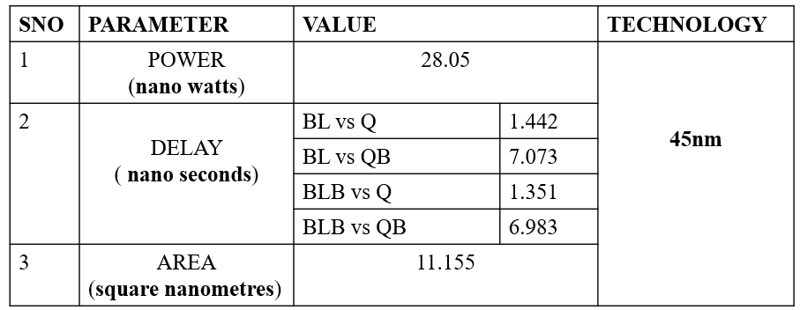
FINAL RESULTS OF 6 TRANSISTOR SRAM CELL IN 45 NANO METER TECHNOLOGY

Slide 19
CONCLUSION
The power consumption of the SRAM cell varied between 28.05n watts and 74.169n watts across different simulations and parameter configurations.
Notably, the lowest power consumption observed was 28.05n watts, indicating improved power efficiency under specific parameter settings.
Additionally, delay characterization provided valuable information on the timing behavior of the SRAM cell, with delay values ranging from 1.442 nanoseconds to 7.073 nanoseconds for different signal pairs.
Furthermore, the layout design of the SRAM cell, conducted using Cadence Layout XL, resulted in an area requirement of 11.155 square nanometers.

Slide 20
INTERNSHIP
ON
VLSI DESIGN FOR TESTABILITY (DFT)

Slide 21
CONTENTS
Design-for-test
Why Dft
Test pattern generator (tpg)
Bist Simple Architecture
Advantages
Conclusion

Slide 22
DESIGN-FOR-TEST
Add controllability Observability to Circuit.
Ease the test process.
More support for test automation.
Test Cost Reduction.
DFT techniques are design efforts specifically employed to ensure that a device in testable.
Testers has to be engaged early in the product cycle.
The product must be open for design changes to meet the testing requirements.
In general, DFT is achieved by employing extra H/W.
Conflict between design engineers and test engineers.
Balanced between amount of DFT and gain achieved.

Slide 23
WHY DFT
To increase Productivity.
Shorter time-to-market Reduced design cycle Reduced cost.
To improve Quality.
Reduced Defects per million (DPM)Improved quality of test.

Slide 24
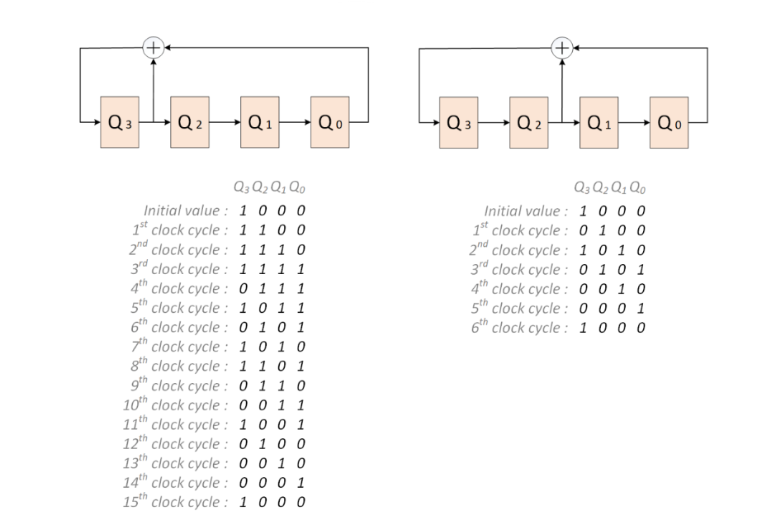
TEST PATTERN GENERATOR (TPG)
It generates the test patterns required to sensitize the faults and propagate the effect to the outputs .

Slide 25
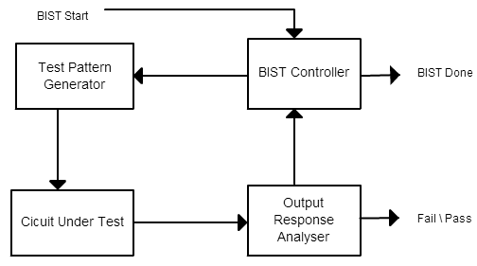
BIST SIMPLE ARCHITECTURE

Slide 26
ADVANTAGES
1.Improved Fault Coverage: Testability features integrated into the VLSI design facilitate the detection and diagnosis of faults during manufacturing testing. This leads to higher fault coverage, ensuring that most defects are identified before the product reaches the customer.
2.Reduced Test Time and Cost: Testability features allow for the implementation of efficient testing methodologies, reducing both test time and cost. Built-in self-test (BIST) and scan-based testing techniques, for example, can significantly reduce the time and resources required for testing.
3.Increased Manufacturing Yield: By enabling comprehensive testing and early detection of defects, VLSI design for testability contributes to higher manufacturing yield. This means fewer defective parts and higher overall product quality, which is crucial for meeting customer expectations and reducing costs associated with rework or returns.
4.Scalability and Flexibility: Testability features can be designed to scale with the complexity of the circuit and the requirements of the application. This ensures that testing remains effective even as designs become more intricate, and it provides flexibility to adapt testing strategies to different product variants or configurations.
5.Compliance with Quality Standards: Many industries have stringent quality standards and regulations that products must meet. VLSI design for testability helps ensure compliance with these standards by providing robust testing capabilities that verify the functionality and reliability of the integrated circuits.

Slide 27
CONCLUSION
The internship in VLSI Design for Testability (DFT) has provided invaluable insights into semiconductor manufacturing, enhancing my understanding of IC testing methodologies. From implementing scan chains to exploring BIST circuits, the experience has equipped me with practical skills and knowledge essential for success in the field. I am grateful for the opportunity and look forward to applying my learnings to contribute to the advancement of semiconductor technology.

Slide 28

THANK YOU

