Slide 1
WELCOME TO MY PROJECT
NAME: MAMATAJ MAHAL
DEPT.: COMPUTER SCIENCE & ENGINEERING
SEMESTER: 9th
ID: 13131032

Slide 2
Banking management system:
Our features:
Online banking system.
User’s get information to our bank from our website.
Users can easily contact with us.

Slide 3
Use Tools & Language:
XAMMP as a local server.
Browser for running our webpage.
Sublime text 2
Language HTML,PHP,J-QUERY.CSS etc.

Slide 4
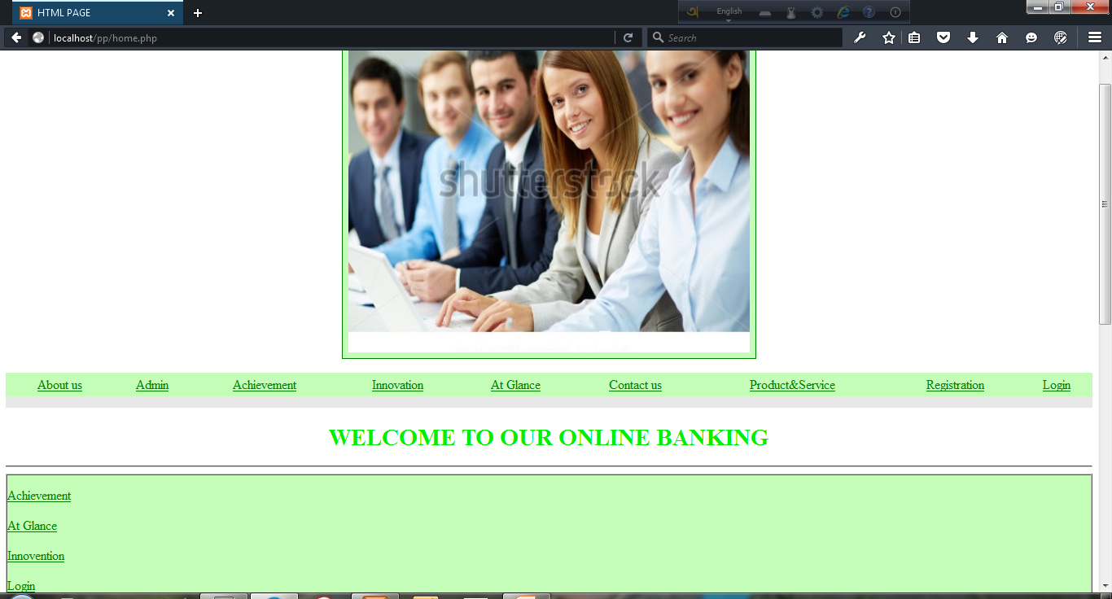

Slide 5
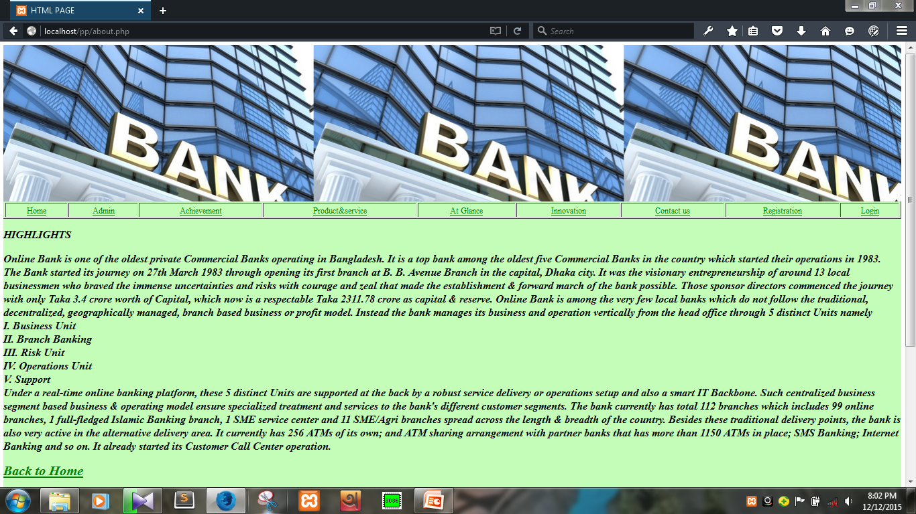

Slide 6
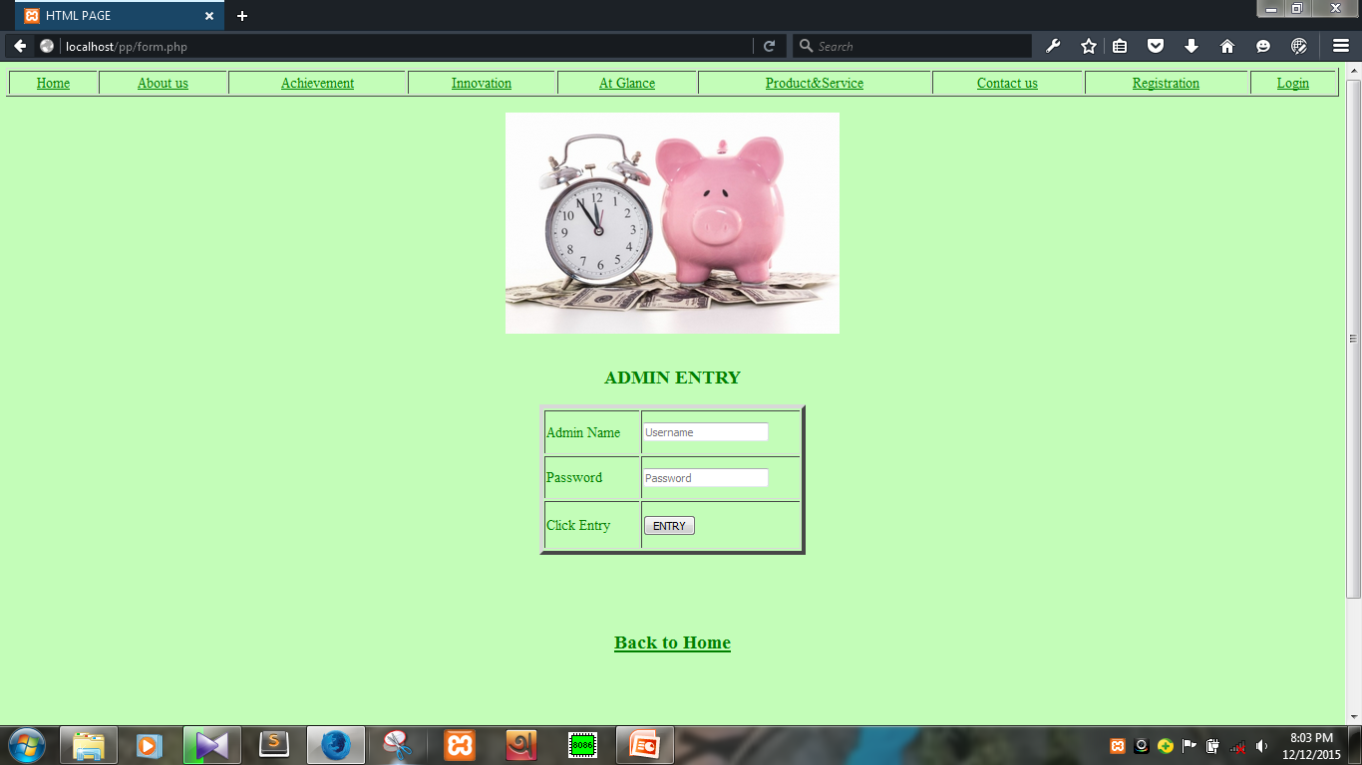

Slide 7
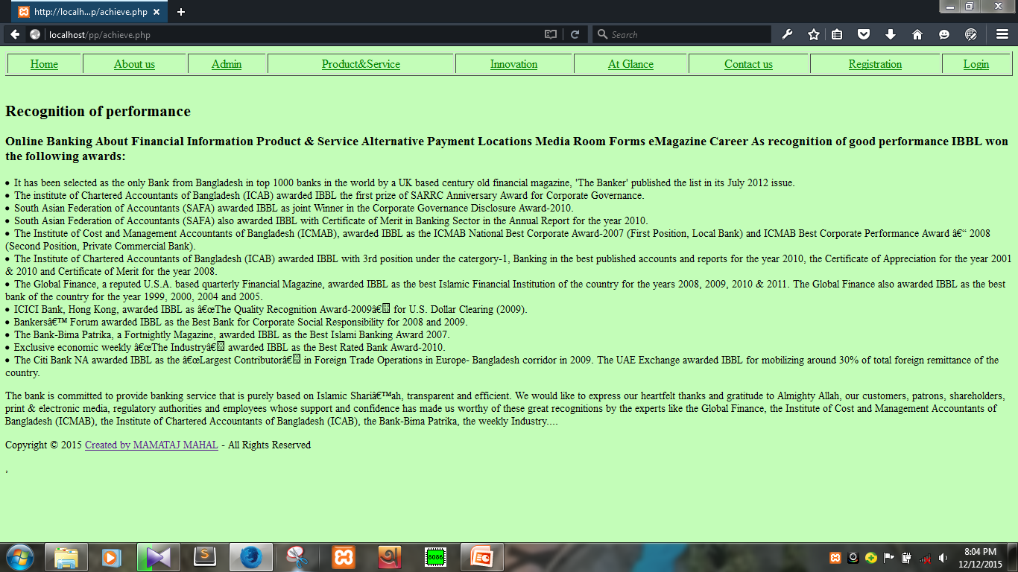

Slide 8
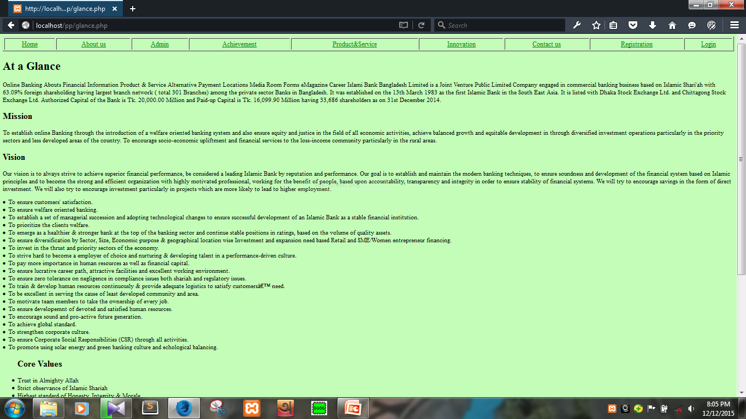

Slide 9
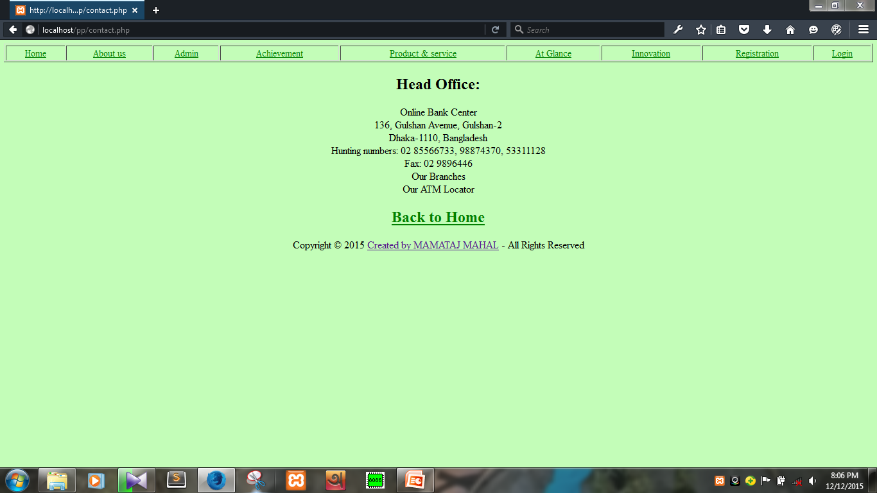

Slide 10
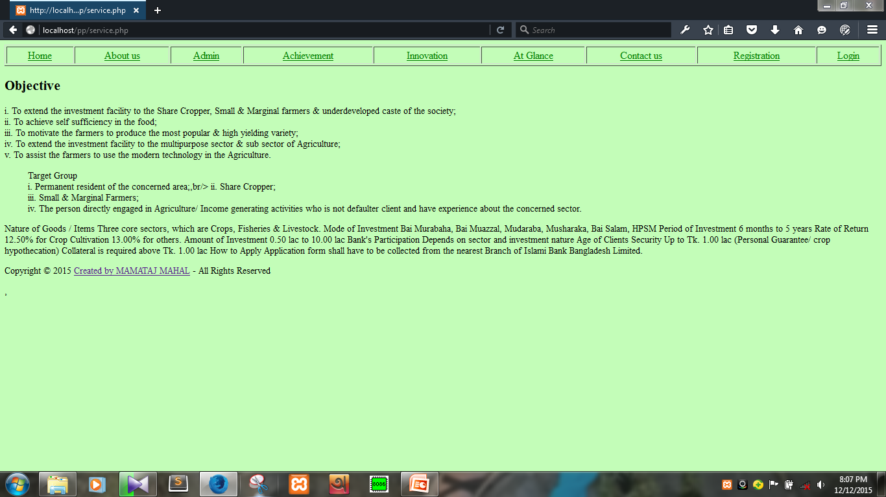

Slide 11
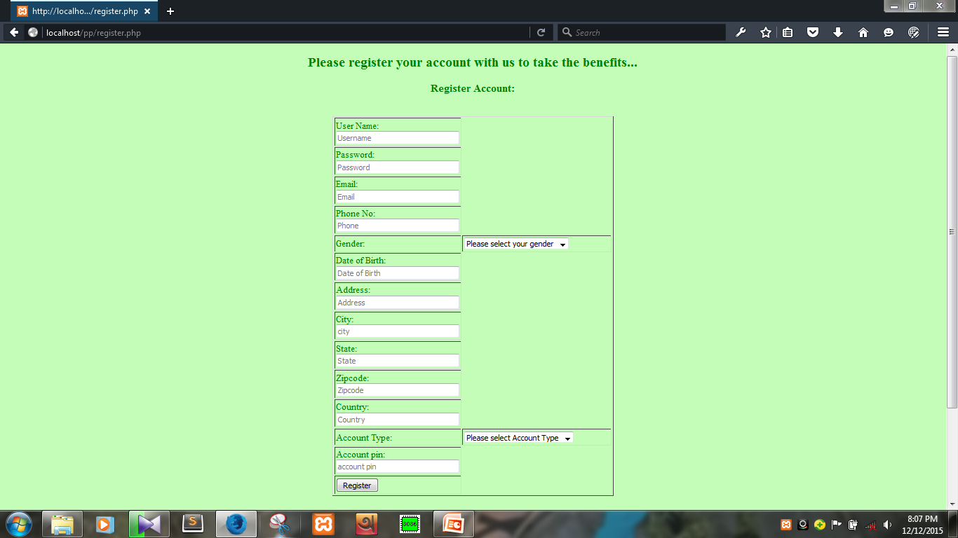

Slide 12
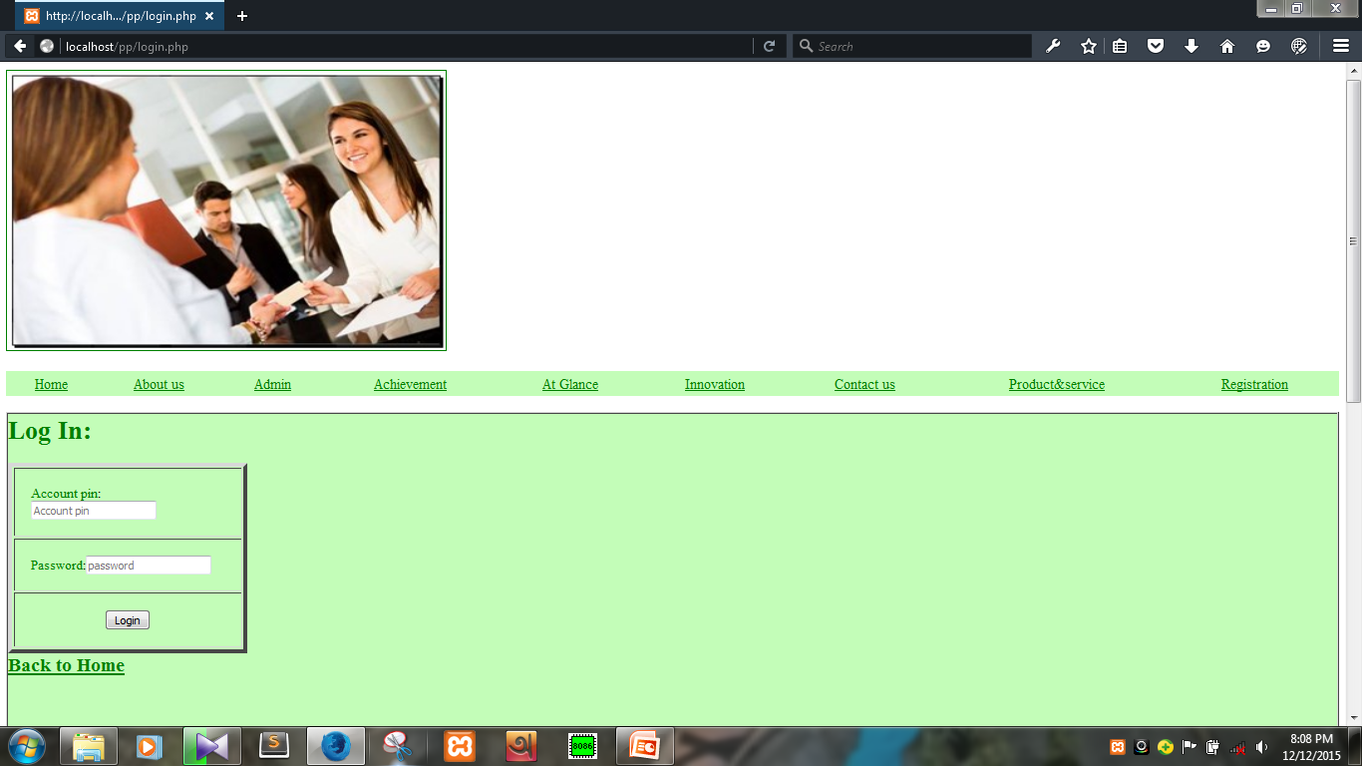

Slide 13
Future Of This Project:
User’s Friendly.
Users can transfer their money easily any time from any where.

Slide 14
MY PROJECT IS READY TO SHOW…….
http://localhost/website/

Slide 15
THANKS TO ALL FOR WATCHING MY PROJECT…

