Slide 1
Project Presentation
on
EduElevate
by
Manan Arora
2110990834
Supervised By: Dr. Gifty Gupta
Department of Computer Science and Engineering
Chitkara University, Punjab

Slide 2
Problem Statement
In today’s digital learning landscape, both students and instructors face significant challenges:
Students often struggle to find affordable, high-quality courses with a structured and distraction-free learning environment.
Instructors lack easy-to-use platforms that allow full control over their content and pricing without high platform fees or technical complexity.
Existing platforms either limit customization, charge high commissions, or are too complex for educators to use effectively.

Slide 3
Key Objectives
Empower Instructors: Allow educators to create, manage, and sell video-based courses with complete control over content and pricing.
Simplify Learning for Students: Provide students with an intuitive interface to browse, purchase, and learn from courses at their own pace.
Ensure Secure Access: Implement secure signup/login flows with OTP verification and JWT-based session handling to ensure a safe user environment.
Enable Role-Based Experience: Deliver customized features based on user roles (Instructor or Student), improving engagement and functionality.
Enhance Accessibility: Make quality education affordable and accessible by eliminating platform barriers and streamlining the user journey.

Slide 4
Key Features
For Teachers
• Course Creation & Management Easily create, update, or delete courses with custom pricing, titles, and video content.
• Full Control Over Content Upload high-quality video lectures and structure them into chapters as per your teaching flow.
• Progress Tracking View how many students have enrolled in your course and monitor their progress.
• Flexible & Transparent Pricing Set your own course prices and keep most of the revenue with minimal platform commission.

Slide 5
For Students
• Affordable Course Access Discover and purchase video-based courses at student-friendly prices.
• Structured Learning Path Navigate through well-organized course chapters for a step-by-step learning experience.
• On-Demand Video Lectures Watch lectures anytime, anywhere with unlimited access after enrollment.
• Track Your Progress Keep an eye on how much of the course you've completed through a clean progress bar.

Slide 6




Technologies Used
Frontend: React.js
Backend: Node.js
Session Handling – Express.js
Database: MongoDB
Android Development: React native
API Integration and Testing : Json Web Token (JWT), Postman
Payment Gateway API- Secure transaction using Razor pay
Video Hosting using Cloudinary

Slide 7
Security and Authentication
User Authentication
Secure sign-up and login using JWT (JSON Web Tokens)
Credentials (e.g., passwords) are hashed using libraries like bcrypt
Token-based access ensures stateless and scalable sessions

Slide 8
Security and Authentication
Role-Based Access Control (RBAC)
Users are assigned roles: Student or Instructor
Access to routes and UI elements is restricted based on user role
Prevents unauthorized access to protected features (e.g., course creation)

Slide 9
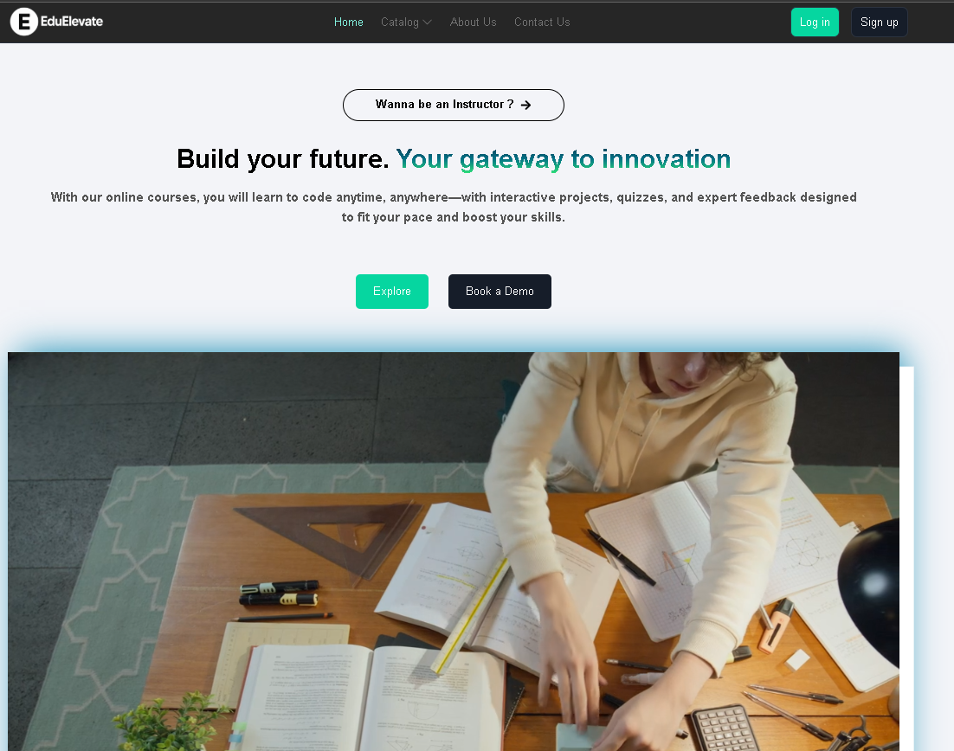
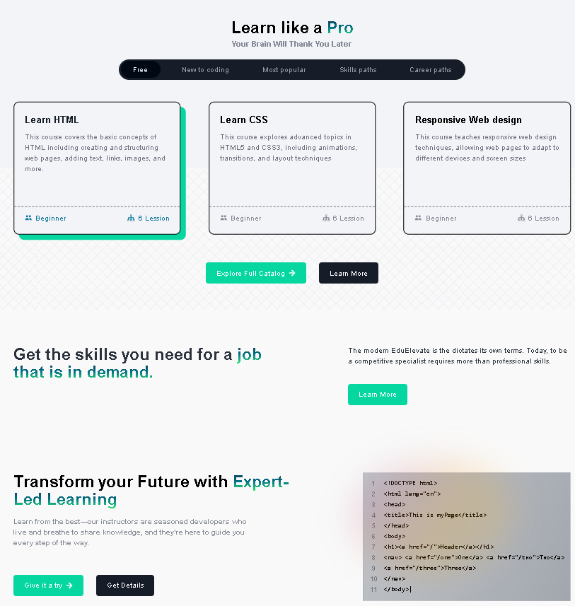
Snapshots
Home page

Slide 10
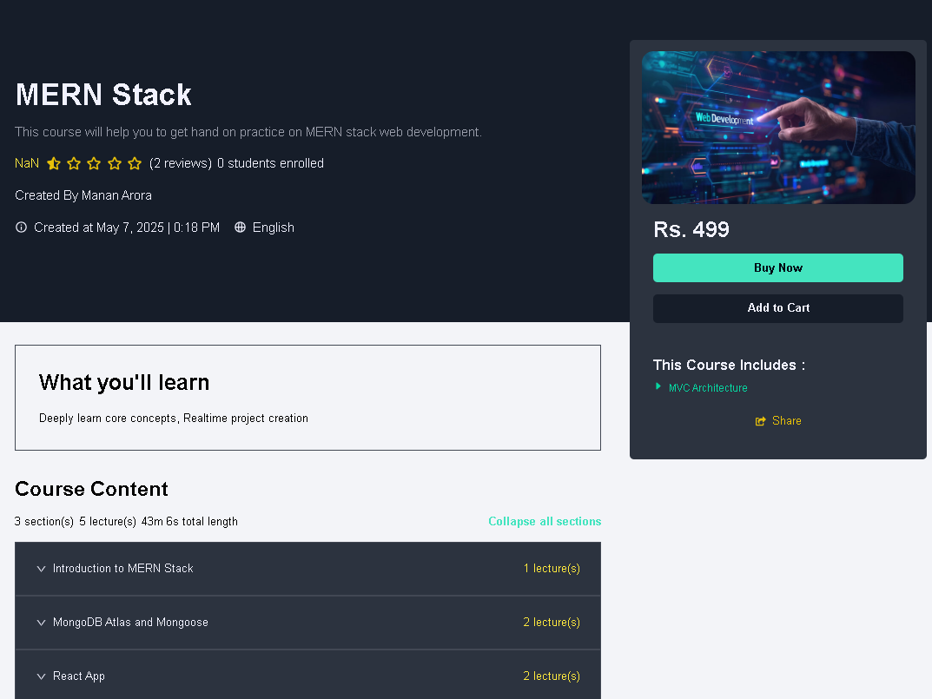
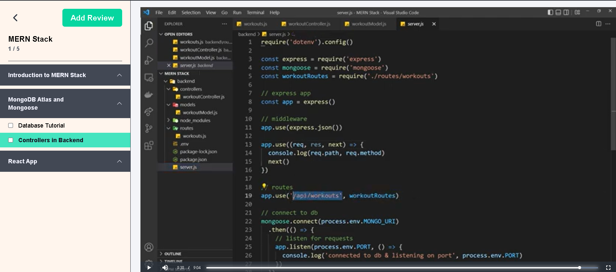
Course Details
Video Lectures

Slide 11
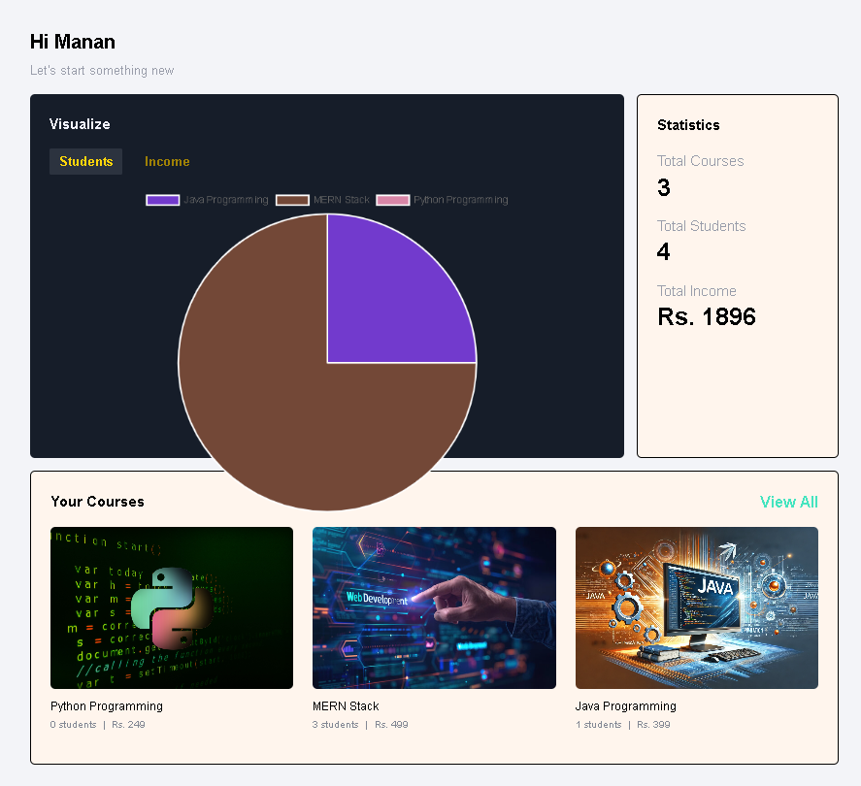
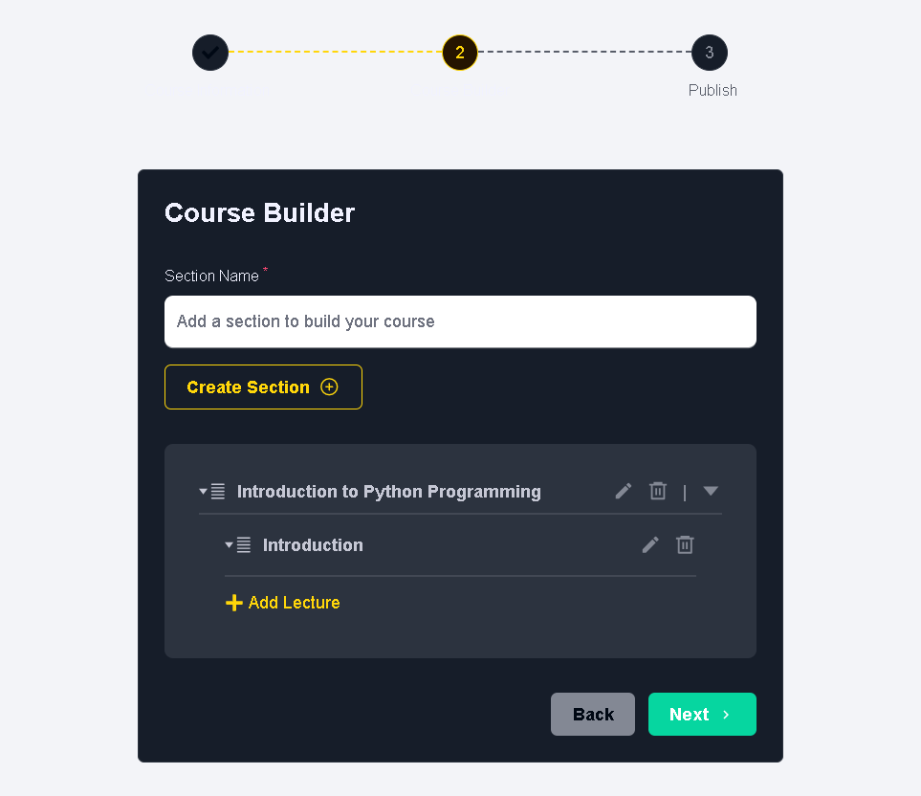
Instructor Dashboard
Course Builder

Slide 12
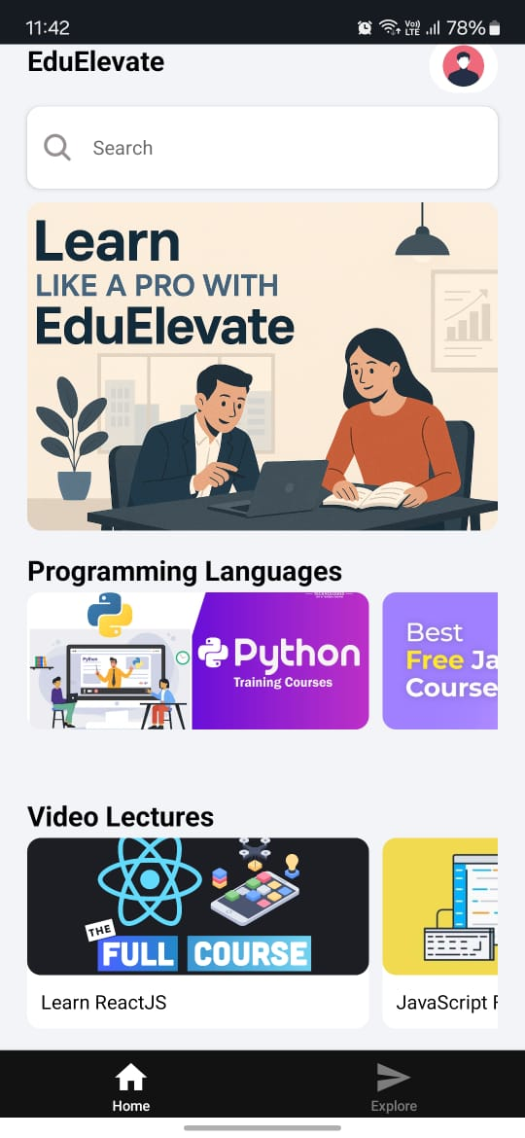
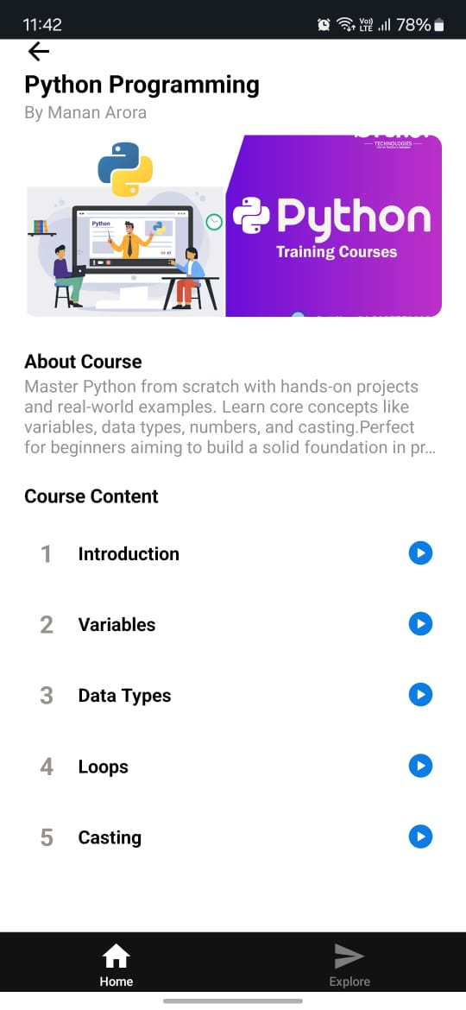
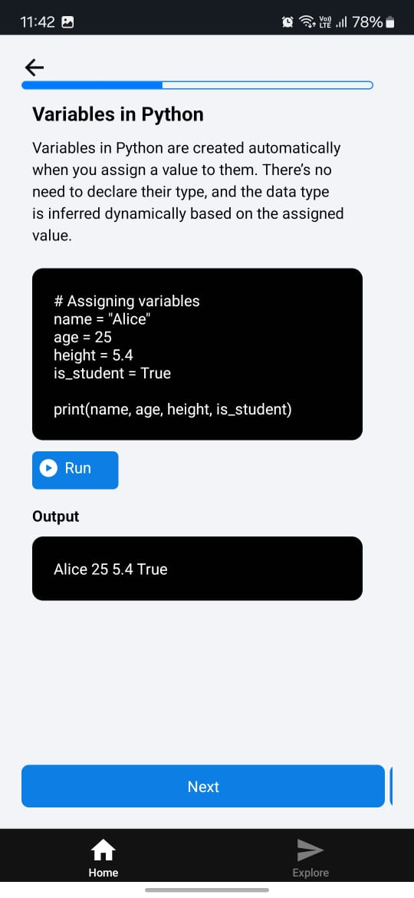
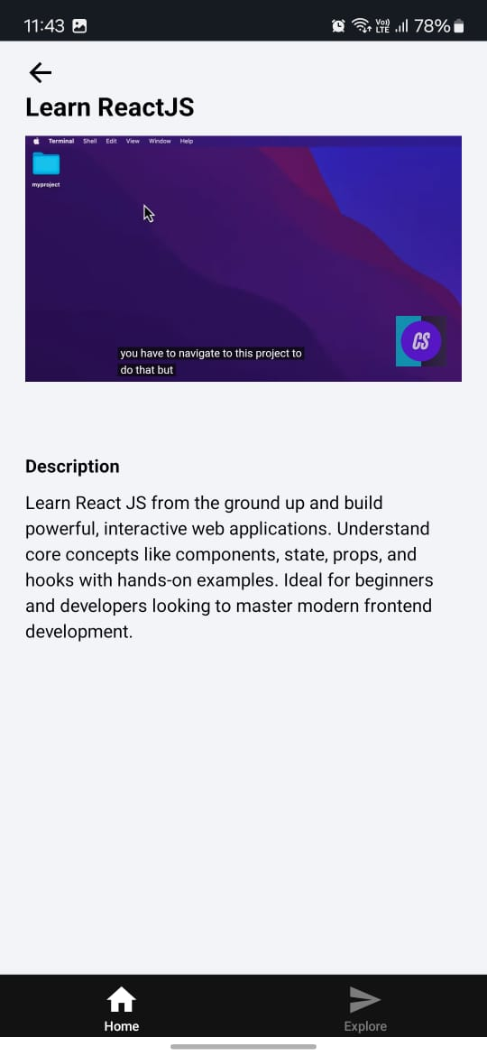
Android App Snapshots
Home page
Course Modules
Course Content
Video lectures

Slide 13
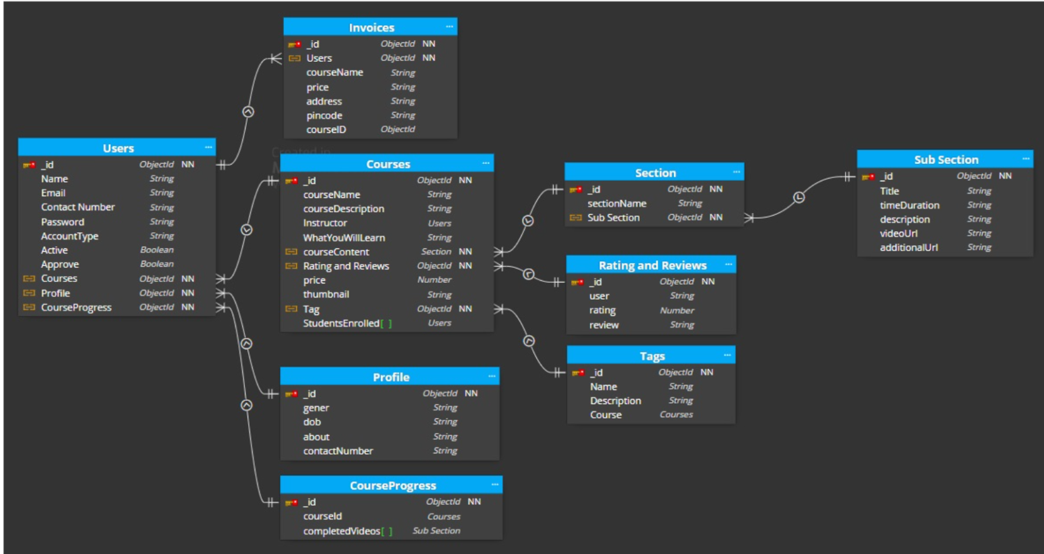
Database Schema

Slide 14
Use Cases
Use Case Id | Actor | Goal | Steps
UC01 | Student/Instructor | Sign up on EduElevate | Fill Form -> Submit -> Verify email ->Account created
UC02 | Student/Instructor | Login to EduElevate | Enter credentials -> Authenticate-> Access dashboard
UC03 | Student | Browse available courses | Click catalog->Choose category -> View course details
UC04 | Student | Enrol in a course | Select course-> Click Buy -> Payment-> Enrolled
UC05 | Instructor | Upload a new course | Fill course form-> Upload videos-> Submit for approval
UC06 | Student | Leave a course review | Open course-> Add review-> Submit
UC07 | Student/Instructor | Reset forgotten password | Click “forgot password” -> Enter email-> Receive otp-> set new password
.

Slide 15
Conclusion
The EduElevate project successfully demonstrates the development of a full-fledged edtech platform using the MERN stack and associated technologies. The platform allows instructors to create and manage courses, while students can explore, purchase, and track their learning progress. It integrates secure authentication, payment processing through Razorpay, and media uploads via Cloudinary. The use of modern tools like React.js, Tailwind CSS, and MongoDB helped ensure responsive design, modular structure, and robust data handling.

Slide 16
THANK
YOU

