Slide 1

Employee Data Analysis using Excel
STUDENT NAME: G. M. MANASA
REGISTER NO: F136B02C01D967A852241802BE3AF06B(312203207)
DEPARTMENT: B.COM( ACCOUNTING AND FINANCE)
COLLEGE: PRINCE SHRI VENKATESWARA ARTS AND SCIENCE COLLEGE
1
Notes:
1

Slide 2



PROJECT TITLE
Employee Performance Analysis using Excel
2

Slide 3



AGENDA
Problem Statement
Project Overview
End Users
Our Solution and Proposition
Dataset Description
Modelling Approach
Results and Discussion
Conclusion
3/21/2024 Annual Review
3

Slide 4

PROBLEM STATEMENT
A large dataset of employee information in Excel, including personal details, job roles, performance metrics, and attendance records. Despite having this data, we face challenges in efficiently analyzing and leveraging this information for decision-making.
4

Slide 5

PROJECT OVERVIEW
It is a summary of employee dataset analysis the performance of various employees by consulting the various factors like employee type current emploi rating employee status and business unit gender and raw labels and future starts and there achievements said to be the employee performance analysis in order to check the trains and different categories like high medium low performance level of the employees
5

Slide 6


Slide 7
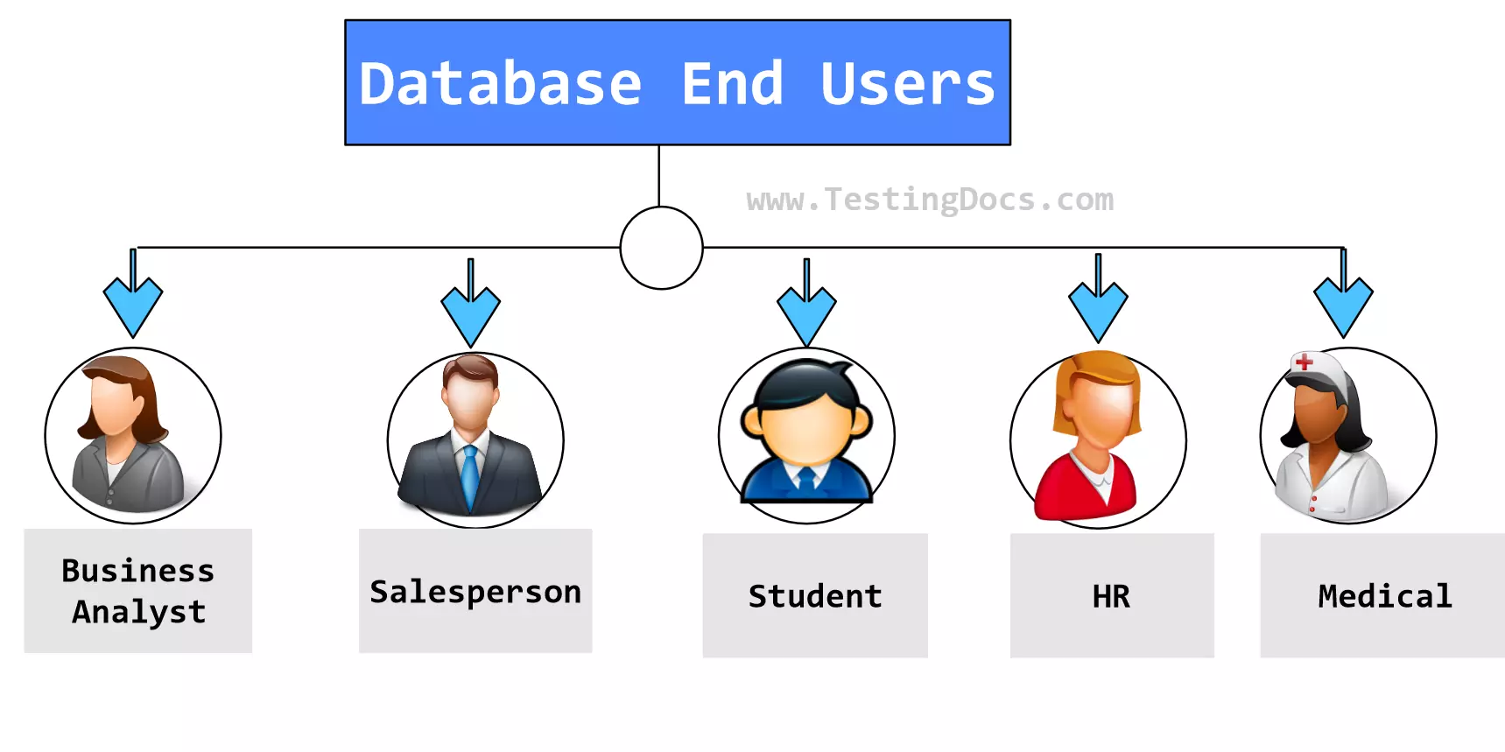

WHO ARE THE END USERS?
Employer
Employee
Organisation
7

Slide 8

OUR SOLUTION AND ITS VALUE PROPOSITION
Conditional Formatting – Missing Filter – Remove Formulae – Performance Pivot – Summary Gragh – Data Visualization
8

Slide 9
Dataset Description
Employee dataset – Kaggle 26 Features Employee ID - DE5B5E0E981696191474813EBC226A7F Name – Text Performance Level – Very High , High , Medium , Low Gender – Male , Female Employee Ratings

Slide 10

THE "WOW" IN OUR SOLUTION
Performance level IFS(Z8-5,"VERY HIGH" 28 -4,"HIGH",28>-3,"MED", TRUE, "LOW")
3/21/2024 Annual Review
10

Slide 11
MODELLING
Data collection :
1). Department 2). Division 3). Job Function 4). Employee Classification
DATA CLEANING :
1). Start date 2). End date
PERFORMANCE LEVEL :
1). Very high 2). High 3). Medium 4). Low
11

Slide 12
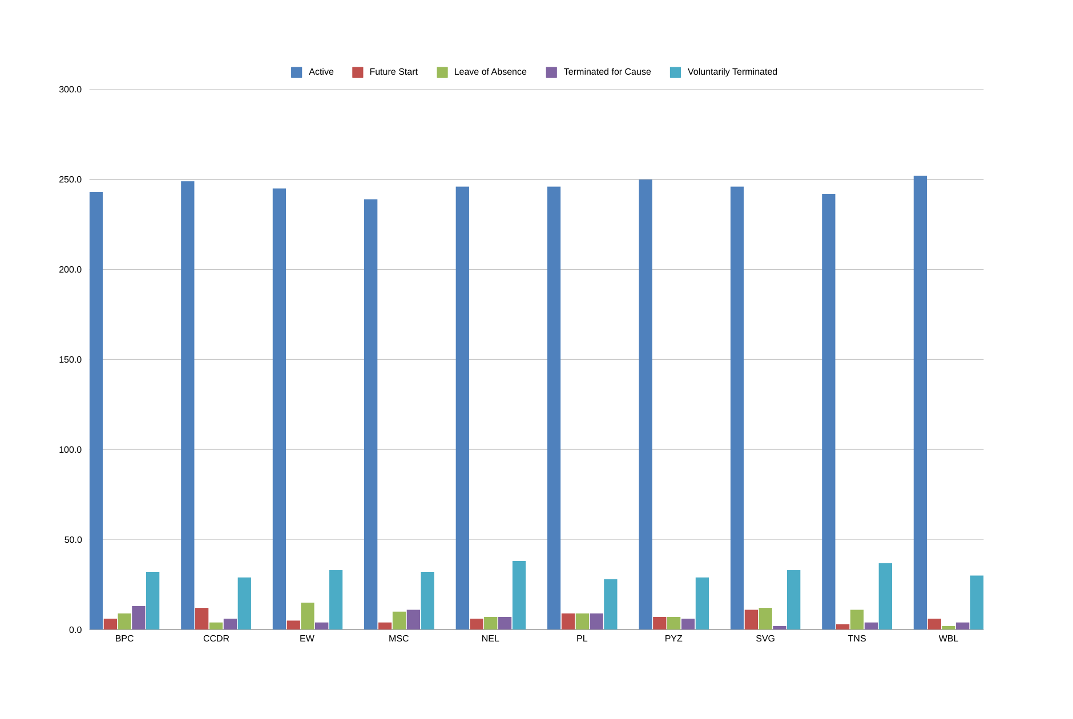
RESULTS
12

Slide 13
conclusion
In summary, a comprehensive conclusion for a data analysis in a research study involves a strategic synthesis of key finding of the performance level of an each employee specifically and their implications, contribution to the organisation as a brief .

