Slide 1
Review on Sentiment Analysis
Navadeep Reddy 2010030313
Shashikanth 2010030494
Manoj 2010030503
Rohit 2010030439
Under the Guidance of
Subhranginee Das
Associate Professor
Computer Science and Engineering Department
KL Hyderabad Off Campus, Aziz Nagar ,Hyderabad

Slide 2
Overview
Abstract
Introduction
Literature Review
Problem Statement
Objectives of the Project
Proposed Methodology
Implementation
Results
References

Slide 3
Abstract
The proliferation of user-generated content on the World Wide Web, particularly on social media platforms, has led to an abundance of unstructured data. This data, rich in users’ views, emotions, and opinions on a wide array of topics, presents a unique opportunity for sentiment analysis. This project focuses on the application of sentiment analysis on Twitter data, aiming to organize and understand the sentiments expressed in tweets.
A comparative study was conducted to identify the most efficient machine learning model for sentiment analysis in English. The models tested included Naïve Bayes, Logistic Regression, Stochastic Gradient Descent (SGD), and Support Vector Machine (SVM). Data for the study was collected using Twitter’s API and was subsequently preprocessed and analyzed using Natural Language Processing techniques.
The trained model was then employed to analyze the sentiment of the provided sentences, thereby demonstrating its practical application in understanding and interpreting the sentiment of tweets. This study contributes to the growing field of sentiment analysis, providing valuable insights into the effective analysis of user-generated content on social media platforms.

Slide 4
Introduction
Sentiment analysis examines people’s feelings in written language. It’s used in many areas because people’s comments and reviews reflect their emotions toward products and services. Methods like Natural Language Processing (NLP) help computers understand human language. Machine Learning (ML) includes various techniques forlearning from data quickly.
Machine learning algorithms like Naive Bayes and Logistic Regression are commonly used for classification tasks. Data collection is growing rapidly, with data doubling every two years. Data mining helps find patterns in large datasets, like those from Twitter.
This study focuses on classifying sentiment in tweets using NLP and ML algorithms.Different models will be compared based on their performance metrics. Finding the best classifier is important for accurately assessing people’s emotions. Sentiment analysis plays a crucial role in various fields, including marketing and understanding people’s changing needs. It requires a quality training set and semantic analysis for accurate results.

Slide 5
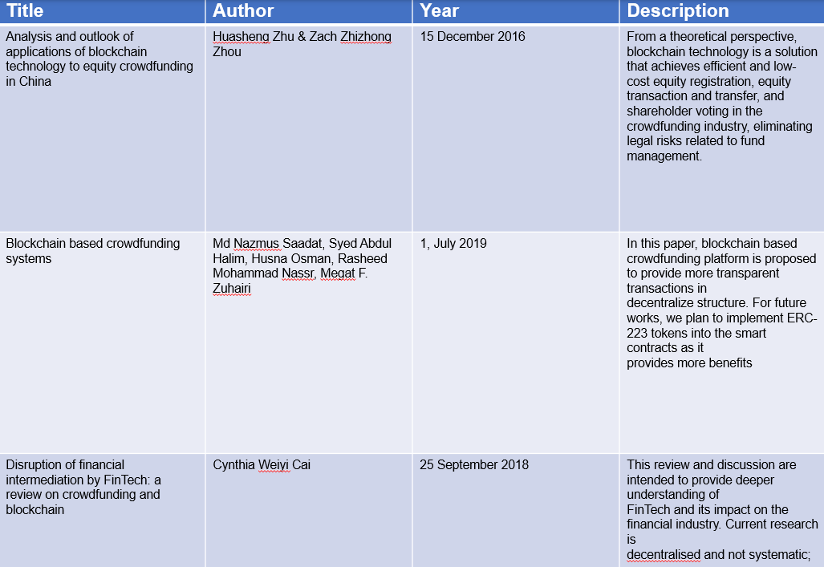
Literature Review

Slide 6
Problem Statement
With the exponential growth of social media platforms, a vast amount of unstructured data is generated daily. The objective of this project is to identify the most efficient machine learning model for sentiment analysis of tweets in English. The models under consideration include Naïve Bayes, Logistic Regression, Stochastic Gradient Descent (SGD), and Support Vector Machine (SVM). The data for the study will be collected using Twitter’s API, preprocessed, and analyzed using Natural Language Processing techniques.
The ultimate goal is to train a model that can accurately analyze the sentiment of a given sentence, thereby providing valuable insights into public opinion on various topics. This project aims to contribute significantly to the field of sentiment analysis, particularly in the context of social media data.

Slide 7
Objectives of the Project
Data Collection: Utilize Twitter’s API to gather a substantial dataset of tweets in English for sentiment analysis.
Data Preprocessing: Implement Natural Language Processing techniques to preprocess the collected data, making it suitable for analysis.
Model Comparison: Conduct a comparative study of various machine learning models, including Naïve Bayes, Logistic Regression, Stochastic Gradient Descent (SGD), and Support Vector Machine (SVM), to identify the most efficient model for sentiment analysis of tweets.
Model Training: Train the identified model using the preprocessed data, tuning it to accurately analyze the sentiment of tweets.
Sentiment Analysis: Apply the trained model to new data to analyze the sentiment of tweets, thereby gaining insights into public opinion on various topics.

Slide 8
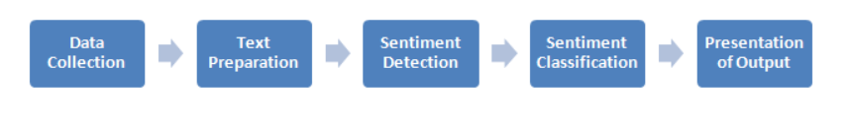
Proposed Methodology

Slide 9
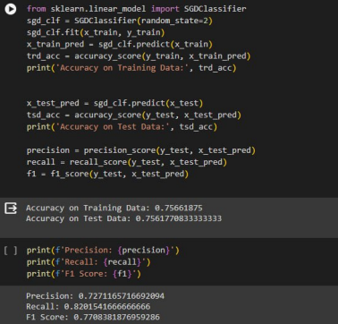
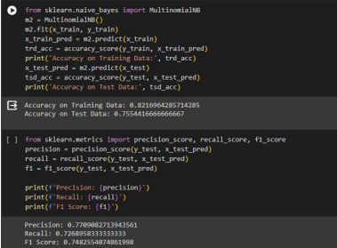
Implementation

Slide 10
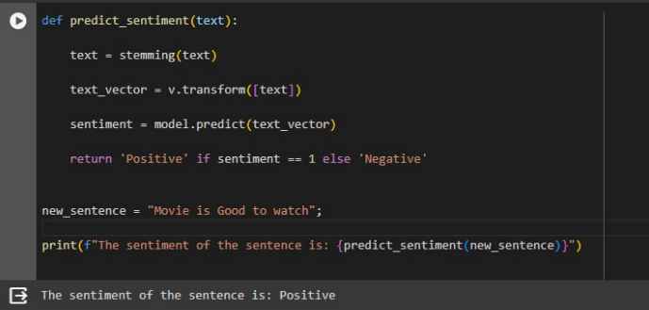
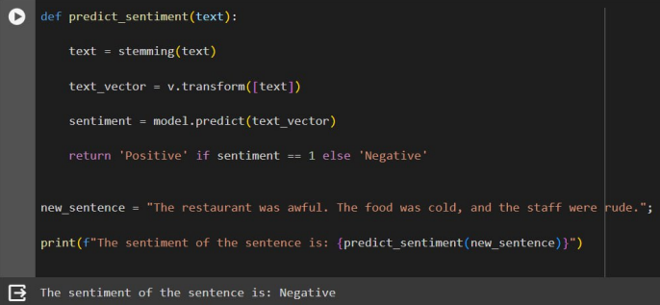
Results

Slide 11
References
Varsha Sahayak, Vijaya Shete and Apashabi Pathan, “Sentiment Analysis on Twitter Data”, (IJIRAE) ISSN: 2349-2163, January 2015.
Peiman Barnaghi, John G. Breslin and Parsa Ghaffari, “Opinion Mining and Sentiment Polarity on Twitter and Correlation between Events and Sentiment”, 2016 IEEE Second International Conference on Big Data Computing Service and Applications.
Mondher Bouazizi and Tomoaki Ohtsuki, “Sentiment Analysis: from Binary to Multi-Class Classification”, IEEE ICC 2016 SAC Social Networking, ISBN 978-1- 4799-6664-6.
Nehal Mamgain, Ekta Mehta, Ankush Mittal and Gaurav Bhatt, “Sentiment Analysis of Top Colleges in India Using Twitter Data”, (IEEE) ISBN -978-1-5090-0082-1, 2016.

Slide 12
Thank you and Any Queries

