Slide 1
Top Module
Sorting 256 to 4
Input 256 bits
256 bits splits
into
8 X 32 bits
Every 32 bit
Splits into
8 X 4 bits

Slide 2
Bitonic Sorting Technique using TCAM
Sorting of 32 to 4 bit
( Sorting 32 to 4 )
clk
rst
xmask
search_key
32 Bit Input
Sorting
8 X 4 bits
IDLE
Controller
LOAD
SORT
BYTE_SORT
sorted address

Slide 3
TCAM Based Sorter – 32 to 4 bit
0
0
0
TCAM
0
TCAM
0
TCAM
TCAM
TCAM
0
TCAM
1
4
2
2
1
1
2
1
1
TCAM
1
TCAM
2
TCAM
TCAM
TCAM
2
TCAM
3
5
3
3
3
3
4
2
4
TCAM
4
TCAM
4
TCAM
TCAM
TCAM
4
TCAM
5
6
6
6
5
5
6
3
5
TCAM
5
TCAM
6
TCAM
TCAM
TCAM
6
TCAM
7
7
7
7
7
7
1st clock
2nd clock
3rd clock

Slide 4
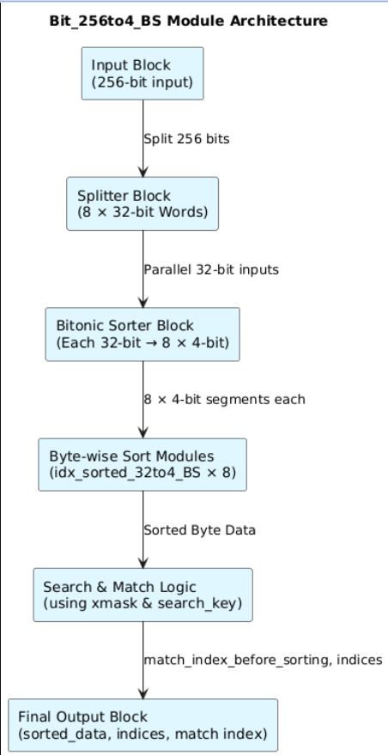
Architecture

