Slide 1
ADDRESS BOOK MANAGEMENT SYSTEM
MANIBAALAKRISHNAN S – 192211171
BATHMANABHA R - 192211943

Slide 2
Introduction
The Address Book project is a simple yet effective application designed to manage personal contact information.
The primary purpose of the system is to enable users to easily add, search, update, and delete contact details.
The application is built with a focus on simplicity, user-friendliness, and ensuring reliable storage and retrieval of contact data.
By offering these functionalities, the project addresses the need for an organized and accessible way to manage personal or professional contacts.

Slide 3
Project Objectives
Contact Management: Simple system for adding, updating, searching, and deleting contacts.
Data Persistence: Save and load contacts reliably for future use.
User-Friendly Interface: Intuitive text-based design for easy navigation.
Error Handling: Robust mechanisms to detect and manage errors smoothly.
Maintainability: Modular design for easy updates and future enhancements.

Slide 4
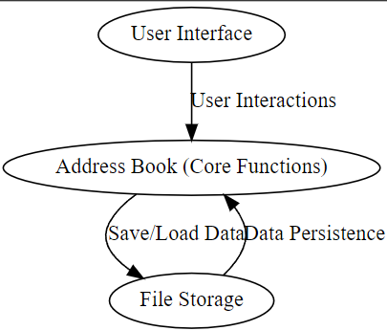
System Architecture
This architecture diagram shows the flow of the Address Book system. The User Interface (UI) interacts with the Core Functions (AB) like adding, updating, searching, and deleting contacts. The File Storage (FS) ensures data persistence by saving and loading contact information from the file system.

Slide 5
Pseudo Code
BEGIN AddressBook
DECLARE list_of_contacts AS an empty list
FUNCTION add_contact(name, phone, email)
CREATE new_contact with name, phone, email
ADD new_contact to list_of_contacts
END FUNCTION
FUNCTION search_contact(name)
FOR each contact IN list_of_contacts
IF contact.name == name THEN
DISPLAY contact details
END IF
END FOR
END FUNCTION
FUNCTION update_contact(name, new_phone, new_email)
FOR each contact IN list_of_contacts
IF contact.name == name THEN
UPDATE contact.phone and contact.email with new_phone, new_email
END IF
END FOR
END FUNCTION
FUNCTION delete_contact(name)
FOR each contact IN list_of_contacts
IF contact.name == name THEN
REMOVE contact from list_of_contacts
END IF
END FOR
END FUNCTION
FUNCTION display_all_contacts()
FOR each contact IN list_of_contacts
DISPLAY contact details
END FOR
END FUNCTION
END AddressBook

Slide 6
Design and Implementation
Design:
The Address Book system is designed using an object-oriented approach.
Key components include the Contact class (which holds details like name, phone, and email) and the AddressBook class (which manages contact operations).
The design follows a modular structure, with functions for adding, updating, searching, deleting, and displaying contacts.
Data is stored in a list, which provides an efficient way to manage contacts in memory.
Implementation:
The system is implemented in C++, leveraging classes and objects for managing contact information.
The user interacts with the system through a simple command-line interface, where they can perform various actions such as adding, viewing, updating, and deleting contacts.
Contact details are saved to and loaded from a text file to ensure data persistence across sessions.
Error handling mechanisms are integrated to provide feedback in case of invalid inputs or unsuccessful operations.

Slide 7
Key Features
Add New Contacts: Allows users to input and store contact details, including name, phone number, and email address.
Search Contacts: Users can search for specific contacts by name and retrieve their information quickly.
Update Contacts: Enables modification of existing contact information, such as updating phone numbers or emails.
Delete Contacts: Provides the functionality to remove contacts from the address book.
Display All Contacts: Displays a complete list of all saved contacts, allowing users to view and manage their address book easily.
Data Persistence: Contact information is saved to a file, ensuring data is retained between sessions.
Error Handling: Robust mechanisms for detecting invalid inputs, such as non-existent contacts, and providing meaningful error messages.

Slide 8
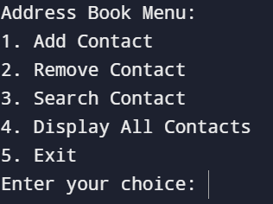
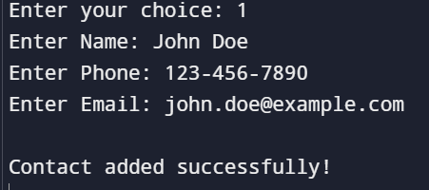
User Interface
Text-Based Interface: Designed for simplicity and ease of use, the Address Book application operates through a straightforward command-line interface.
Main Menu: Provides options for users to add, search, update, delete, and display contacts. Users can navigate through these options using simple text commands.
Input Prompts: Users are prompted to enter contact details such as name, phone number, and email in a clear and structured format.
Output Display: Results of operations, such as search results or error messages, are displayed clearly to guide users through their tasks.

Slide 9
Error Handling
Invalid Input: Ensures inputs are valid (e.g., non-empty fields, correct format) and provides error messages for invalid data.
File Errors: Checks for file access issues and displays messages if file operations fail.
Contact Not Found: Alerts users if a contact cannot be found during search or update operations.
Edge Cases: Manages duplicate contacts and non-existent deletions with appropriate error messages.
User Guidance: Offers clear feedback to help users correct errors and continue using the application.

Slide 10
Testing and Validation
Unit Testing: Tests individual functions (e.g., add, search) to ensure they work correctly.
Integration Testing: Ensures all components (UI, core functions, file operations) work together without issues.
Validation Cases: Confirms the application handles various scenarios and edge cases properly.
Error Handling Testing: Checks that error messages and handling mechanisms function as intended.
User Acceptance Testing (UAT): Real users test the system to ensure it meets their needs and provides feedback for final improvements.

Slide 11
Result
The Address Book project successfully delivers a streamlined and efficient system for managing contact information. It provides a robust solution for adding, searching, updating, and deleting contacts through a user-friendly text-based interface. The implementation ensures data persistence by saving contact details to a file, which is reliably loaded upon subsequent sessions. The system's error handling mechanisms address various issues, including invalid inputs and file access problems, enhancing overall usability.
The project has met its core objectives of facilitating efficient contact management while providing a clear and simple interface. Future enhancements are planned to expand functionality, including advanced search options, a graphical user interface, cloud integration, and mobile application support, further improving the system's versatility and user experience.

Slide 12
Conclusion
The Address Book project effectively delivers a simple and reliable tool for managing contacts. It meets key objectives with features like adding, searching, updating, and deleting contacts, ensuring smooth operation and data persistence. Future enhancements will build on this foundation, adding advanced features and expanding accessibility.

Slide 13
Future Enhancements
Advanced Search: Add filters for phone numbers, emails, and addresses.
GUI Development: Upgrade to a graphical interface for a better user experience.
Cloud Integration: Store contacts in the cloud for multi-device access and backup.
Mobile App: Develop apps for iOS and Android for on-the-go management.
Enhanced Security: Implement encryption and authentication for data protection.
Import/Export: Support data transfer in formats like CSV and vCard.

Slide 14
Resources
Programming Languages: C++ for system implementation.
Development Tools: Integrated Development Environment (IDE) used for coding and debugging.
Libraries: Standard C++ libraries for file handling and data management.
Documentation: Online resources and textbooks on C++ programming and software design principles.
Version Control: Tools like Git for managing code versions and collaboration.
Testing Frameworks: Unit testing frameworks for verifying functionality and integration.
User Feedback: Insights from peers and mentors to improve system design and usability.

Slide 15
Questions & answers
“The best way to predict the future is to create it.” — Peter Drucker

