Slide 1
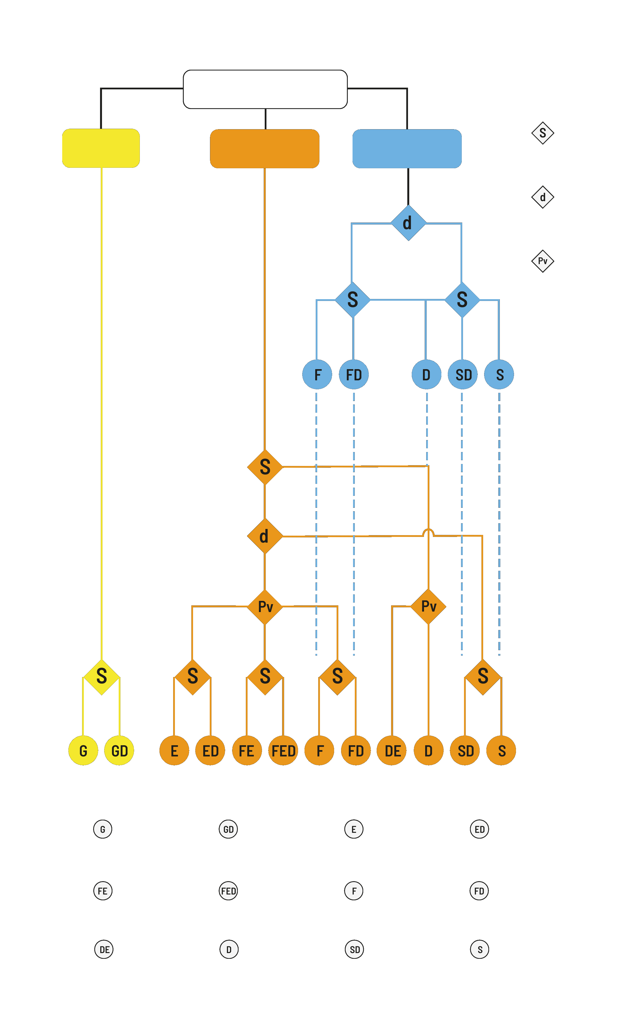

SUBSTANCES
GAS
LIQUIDS
SOLIDS
= Solubility (%massic)
≤ d_{seawater}
> d_{seawater}
ARMINES – IMT MINES ALES
= density
= vapour pressure
< 10 %
10-99 %
>99 %
10-99 %
< 10 %
> 5 %
SEBC classification
≤ 5 %
> d_{seawater}
≤ d_{seawater}
> 3 kPa
< 0.3 kPa
0.3 -3 kPa
> 10 kPa
10 kPa
≤ 10 %
_
> 0,1 %
≤ 0,1%
> 10 %
≤ 1%
< 0,1 %
≤ 0,1 %
> 1 %
> 0,1 %
> 0,1 %
= gas
= gas, dissolver
= evaporator
= evaporator, dissolver
= floater, evaporator,
= floater, evaporator, dissolver
= floater
= floater, dissolver
= dissolver, evaporator
= dissolver
= sinker, dissolver
= sinker

