Slide 1
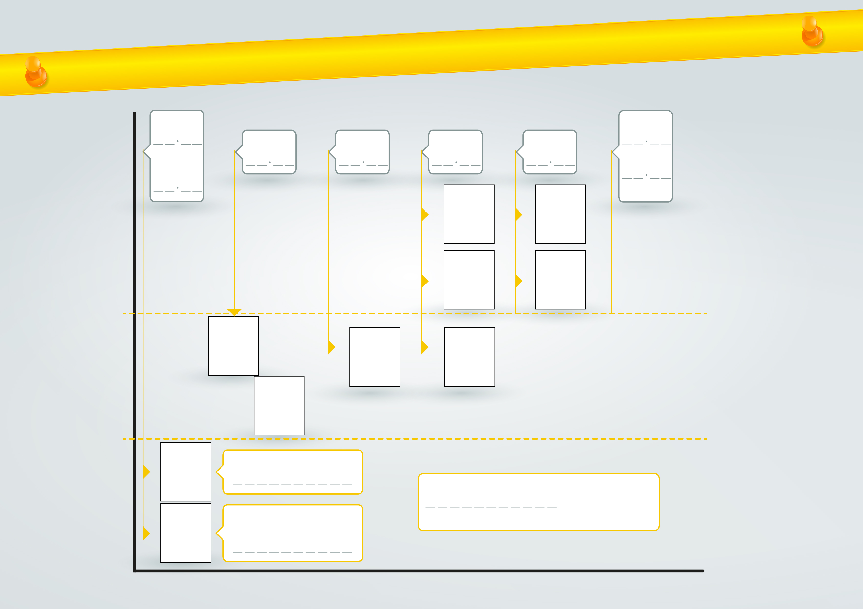


Reconstruction of the facts of the NIOVELIUS case
Day.Month
Day.Month
Time
Time
Time
Time
Time
Time
Figure
Figure
Destination
IN PROGRESS
Figure
EMERGENCY RESPONSE
Figure
Figure
Figure
cOMPLETED
Figure
Figure
Type of ship
Location of the ship
EVEnt
OF THE ISLAND OF BATZ
Figure
Name of the rescue centre receiving the distress message
Number (figures) / unity
ARMINES – IMT MINES ALES

