Slide 1
Sales Performance Analysis Dashboard (Using Tableau)
A Data Analytics Project

Slide 2
Objective
To analyze and visualize sales performance across various dimensions (region, category, customer segment) using interactive dashboards in Tableau.

Slide 3
Dataset Used
Sample Superstore Dataset
Available within Tableau or downloadable online.
Fields include:
- Order Date, Sales, Profit, Category, Sub-Category
- Customer Segment, Region, Quantity, Discount

Slide 4
Key Metrics & KPIs
- Total Sales: Total revenue generated
- Total Profit: Total net gain
- Profit Margin: Profit / Sales
- Orders: Number of transactions
- Top Products: Best-performing products by sales

Slide 5
Dashboard Features
1. Sales Trend Over Time – Monthly/Quarterly trend
2. Regional Performance – Sales by Region (Map or Bar)
3. Category vs. Sub-Category Analysis
4. Top 10 Products by Sales/Profit
5. Customer Segment Performance

Slide 6
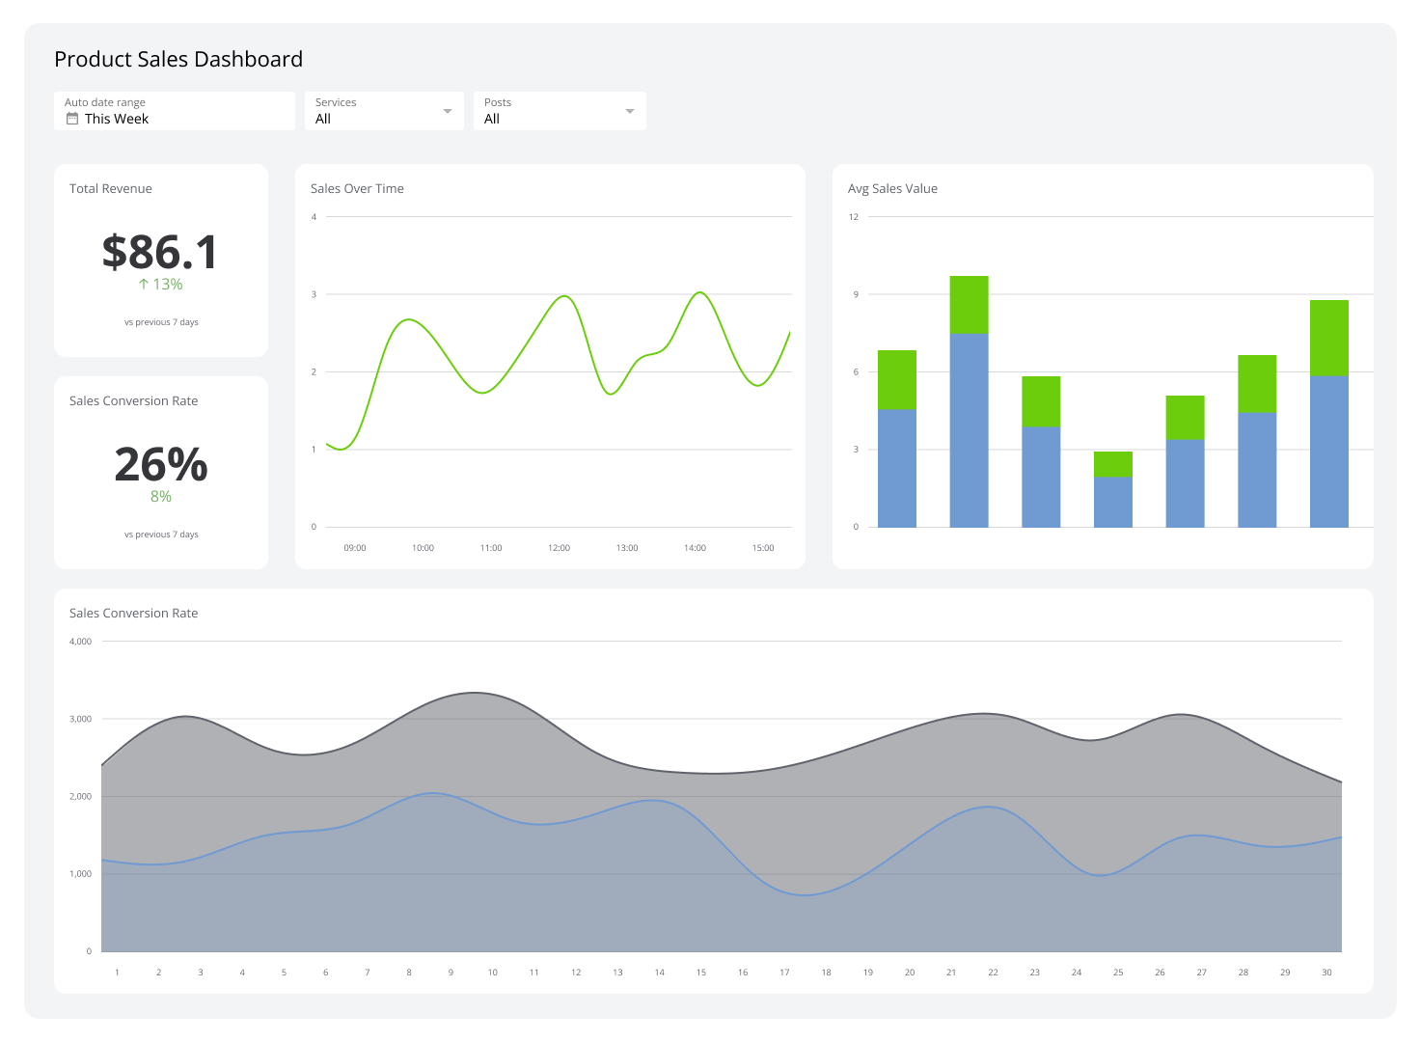
Dashboard Screenshot - Sales Trend

Slide 7
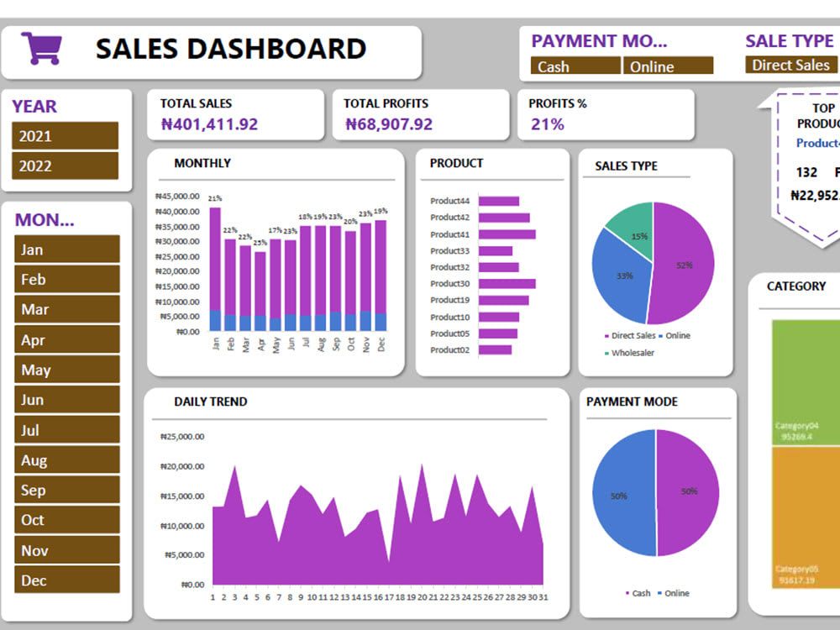
Dashboard Screenshot - Regional Performance
Insert screenshot of Tableau Regional Performance dashboard here.

Slide 8
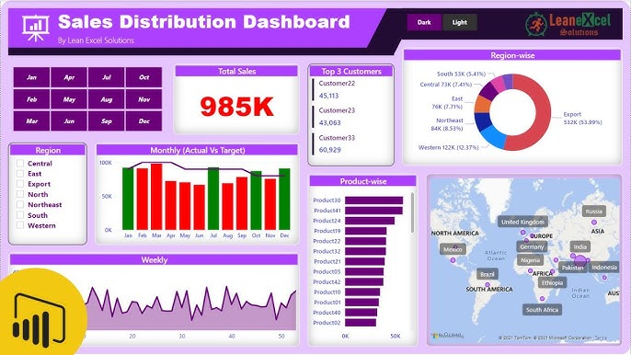
Dashboard Screenshot - Top Products
Insert screenshot of Tableau Top Products dashboard here.

Slide 9
