Slide 1

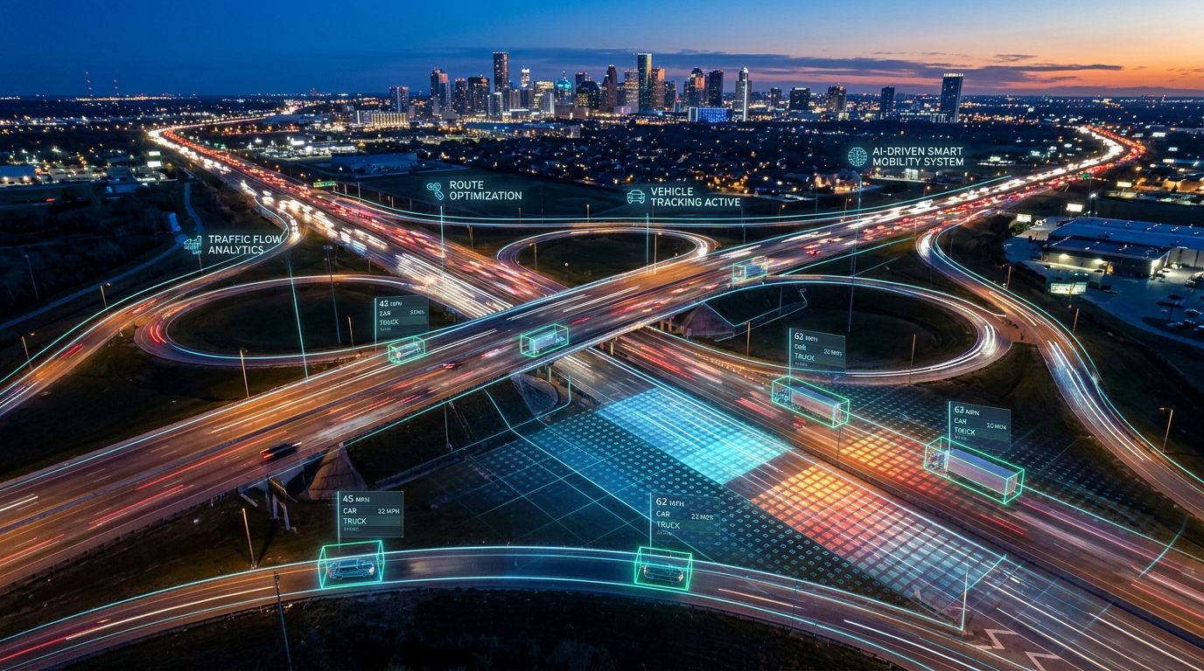
IIC TRAFFIC AI
AI-Based Traffic Congestion Prediction & Intelligent Route Optimization System
Team Lead: Rakesh Kumar S
Team Member: Manikandan S
Mentor: SANTHOSH P
Institution: University College of Engineering Villupuram
🌐 Live Demo: manikandan-5027.github.io/IIC-Traffic-AI-2/
💻 GitHub: github.com/MANIKANDAN-5027/IIC-Traffic-AI-2

Slide 2
IIC TRAFFIC AI • Project Objectives & Agenda
🌐 Live System Demo
01 Problem Statement
Congestion uncertainty, scattered data, decision complexity
02 Project Overview
Web dashboard turning CSV traffic data into intelligent decisions
03 End Users & Personas
Targeted benefits for Bikes, Cars, Heavy Vehicles & Urban Planners
04 Key Innovations (Wow Factors)
Explainable AI, real OSRM road paths, village search & live tags
05 Architecture & System Flow
Data ingestion -> Flask / Serverless Engine -> Leaflet Frontend
06 Vehicle-Aware Optimization
Customized routing parameters and road constraints per vehicle class
07 Toll Cost & Pollution (AQI)
Automated toll plaza calculation & air quality exposure along routes
08 Results & Live Outcomes
Demonstration of live dashboard, map overlays and route rankings
09 Traffic Simulation & Analytics
Model verification, SUMO flow analytics, speed & volume trends
10 Conclusion & Future Scope
Governance, transparency, IoT/GPS roadmap and state-wide scaling

Slide 3
IIC TRAFFIC AI • Problem Statement: Challenges in Modern Traffic Management
🌐 Live System Demo
🚦 Dynamic Traffic Uncertainty
📊 Fragmented & Scattered Data
Traffic congestion varies widely across hours, days, and special events. Manual route selection relies on intuition and often leads drivers directly into gridlock. Small secondary roads and vital village detours are frequently overlooked by generic navigation tools.
Municipal traffic logs, historical vehicle counts, roadwork notices, and incident reports are isolated in disparate CSV files. Without an automated analytical platform, comparing these records manually to predict congestion bottlenecks is impractical.
🚛 Vehicle-Specific Road Constraints
💰 Hidden Economic & Environmental Costs
Commercial heavy vehicles, passenger cars, and motorcycles have vastly different operational constraints. Heavy vehicles face narrow lanes, weight limits, and toll impacts, while two-wheelers prioritize agile, lower-density corridors. One-size-fits-all navigation fails modern fleets.
Unexpected congestion drastically increases fuel burn, vehicle wear-and-tear, and carbon emissions. Uncalculated highway toll costs surprise drivers, while toxic emission corridors negatively affect commuter health without transparent air quality indicators.

Slide 4
IIC TRAFFIC AI • Project Overview: Intelligent Traffic Intelligence Platform
🌐 Live System Demo
🎯 Core Mission: Transform raw municipal CSV traffic records and public road-network data into live predictive intelligence, explainable route optimization, and transparent visual decision dashboards.
📥 1. DATA INGESTION
⚙️ 2. AI & OPTIMIZATION
🖥️ 3. INTERACTIVE DASHBOARD
• Historical traffic counts
• Future predictions
• 38 District & Taluk CSVs
• NH Toll Plazas & AQI reference
• Road capacity & incident logs
• Real-time OSRM road paths
• Multi-factor traffic scoring
• Vehicle class factor weights
• Explainable AI route reasoning
• Congestion spread forecasting
• High-contrast Leaflet map
• Turn-by-turn route lines
• Automated vehicle animation
• Real-time incident alert badges
• Zero-server client resilience

Slide 5
IIC TRAFFIC AI • Target End Users: Value Proposition Across Commuter Segments
🌐 Live System Demo
🏍️ Two-Wheeler / Bike Riders
🚗 Private Passenger Cars
Rapid Transit & Detour Efficiency
• Identify agile corridor routes with high average speeds.
• Avoid heavy congestion choke-points on arterial highways.
• Gain visibility into local taluk and village-level cut-through roads.
• Zero toll expenditure route prioritization.
Balanced Comfort & Cost Economy
• Multi-criteria optimization balancing travel time, distance & toll.
• Upfront highway toll plaza calculation along NH-45/GST road.
• Real-time incident avoidance (accidents, construction diversions).
• Air Quality (AQI) indicators along candidate routes.
🚛 Heavy Commercial Vehicles
🏛️ Traffic Authorities & Planners
Compliance & Restriction Awareness
• Enforce heavy-vehicle road suitability rules.
• Filter out narrow village tracks and non-commercial overpasses.
• Calculate class-specific FASTag toll budgets in advance.
• Reduce fuel waste caused by stop-and-go highway jams.
Predictive Congestion Governance
• Run 'What-If' simulation scenarios on road closures.
• Forecast 30-minute downstream congestion spread.
• Monitor traffic volume vs nominal road capacities.
• Transparent telemetry tagging: LIVE, CSV, or SIMULATED.

Slide 6
IIC TRAFFIC AI • Core Innovations & 'Wow Factors'
🌐 Live System Demo
🧠 Explainable AI (XAI) Scoring
🛣️ Authentic Road Geometries (OSRM)
Does not just give a route number; gives human-readable reasons (e.g. 'Shortest transit time via NH-45, minimal signal delays, road capacity within 45% threshold').
Unlike standard academic projects that draw unrealistic straight lines, all routes are queried from real open-street highway road networks with actual turn vectors.
📍 Village & Taluk Search Autocomplete
🔮 Future Traffic Prediction & Spread
Integrates district, taluk, and village level databases covering all 38 districts of Tamil Nadu, providing instant smart autocomplete suggestions.
Analyzes downstream probability of congestion spreading from source arteries (GST Road) to adjoining corridors (Mount Road, Velachery).
🛡️ Transparent Telemetry Labels
⚡ Zero-Server High Availability
Every metric explicitly states whether it originates from LIVE OpenStreetMap feeds, CSV records, verified estimates, or mathematical simulations.
Engineered with client-side failover: works 100% smoothly on static GitHub Pages via direct browser APIs without requiring server infrastructure.

Slide 7
IIC TRAFFIC AI • Vehicle-Aware Optimization & Scoring Logic
🌐 Live System Demo
📐 AI Scoring Formulation
🚗 Vehicle Class Specific Logic
Multi-Factor Route Penalty Score (S):
S = (Duration × W_t) + (Density × W_d) + (Incident × W_i) + Class_Penalty
• Duration Factor: Normalized travel time in minutes returned by OSRM engine.
• Density Ratio: (Vehicle Count / Road Capacity) × 100.
• Incident Weights: Penalty added for active roadwork (+15), accidents (+30), and public events (+10).
• Ranking: Routes sorted ascending by S (Lowest Score = Best Recommended Route).
Status Thresholds:
🟢 Score < 35: LOW CONGESTION (Green)
🟡 Score 35 - 60: MODERATE CONGESTION (Yellow)
🔴 Score > 60: HIGH CONGESTION (Red)
🏍️ Two-Wheelers (Bikes):
• High tolerance for secondary corridors; penalty factor discount (-5 pts).
• Priority placed on minimizing stop-and-go delays.
• Toll charges omitted as two-wheelers are exempt from NH toll.
🚗 Passenger Cars:
• Balanced route ranking (Default mode).
• Evaluates total travel time, road surface quality, and toll fee.
• Integrates Air Quality (AQI) score along candidate corridors.
🚛 Heavy Vehicles (Trucks & Buses):
• Stringent road restriction penalty added (+12 pts on dense passes).
• Prohibits narrow village bypasses with low overhead clearance.
• Multi-axle toll tariffs calculated across active toll plazas.

Slide 8
IIC TRAFFIC AI • Toll Estimation & Air Quality (AQI) Indicators
🌐 Live System Demo
💳 NHAI Toll Plaza Computation
🍃 Environmental Pollution (AQI)
GST Road (NH-45) Corridor Case Study:
1. Vikravandi Toll Plaza:
• Car Rate: ₹75 • Heavy Vehicle: ₹245
• Status: NHAI Class-wise Reference
2. Paranur Toll Plaza (Chengalpattu):
• Car Rate: ₹65 • Heavy Vehicle: ₹210
• Status: Documented Concessionaire Rate
3. Vanagaram Toll Plaza (Chennai Bypass):
• Car Rate: ₹55 • Heavy Vehicle: ₹180
• Status: Active FASTag Fee
Total Trip Toll (Villupuram -> Chennai): ₹195 for Car
Integrated directly into Journey Summary to prevent unexpected highway expenditure.
Commuter Health & Environmental Awareness:
• Multi-Point Spatial Sampling:
Samples air quality coordinates along candidate road paths.
• AQI Index Representation:
🟢 AQI 0 - 50: Good (Ideal for open two-wheeler transit)
🟡 AQI 51 - 100: Satisfactory (Minor respiratory risk)
🟠 AQI 101 - 200: Moderate / Unhealthy for Sensitive Groups
🔴 AQI > 200: Severe (Heavy particulate congestion zone)
• Correlated Route Ranking:
High AQI levels indicate intense exhaust emission choke-points; the AI ranking weights cleaner alternatives when travel times are comparable.

Slide 9
IIC TRAFFIC AI • System Architecture & End-to-End Execution Flow
🌐 Live System Demo
Step 1: User Request: User inputs origin, destination & selects vehicle category (Bike, Car, Truck) on Web UI.
Step 2: Geocoding: Resolves coordinates via OpenStreetMap Nominatim or internal 38-District Tamil Nadu database.
Step 3: Path Extraction: Queries OSRM driving engine; generates waypoint corridors to discover realistic road detours.
Step 4: AI Context & Scoring: Enriches route geometry with traffic_data.csv, capacity metrics, incident flags and toll plazas.
Step 5: Visual Presentation: Renders ranked polyline maps in Leaflet, animates vehicle flow, and displays explainable advice.

Slide 10
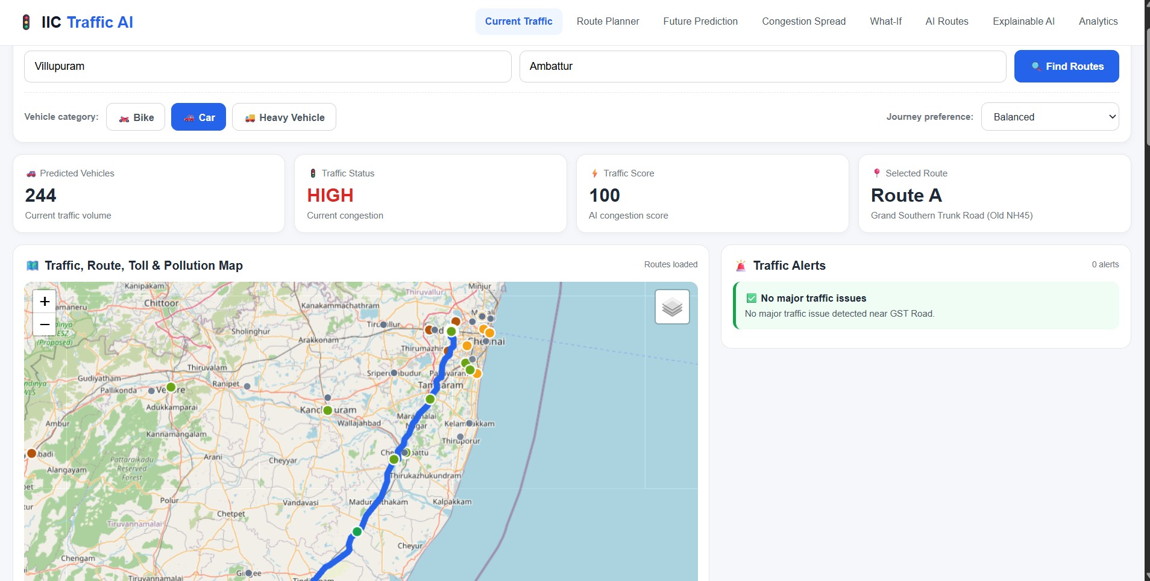
IIC TRAFFIC AI • Live Results: Traffic Dashboard & Interactive Route Map
🌐 Live System Demo

Slide 11
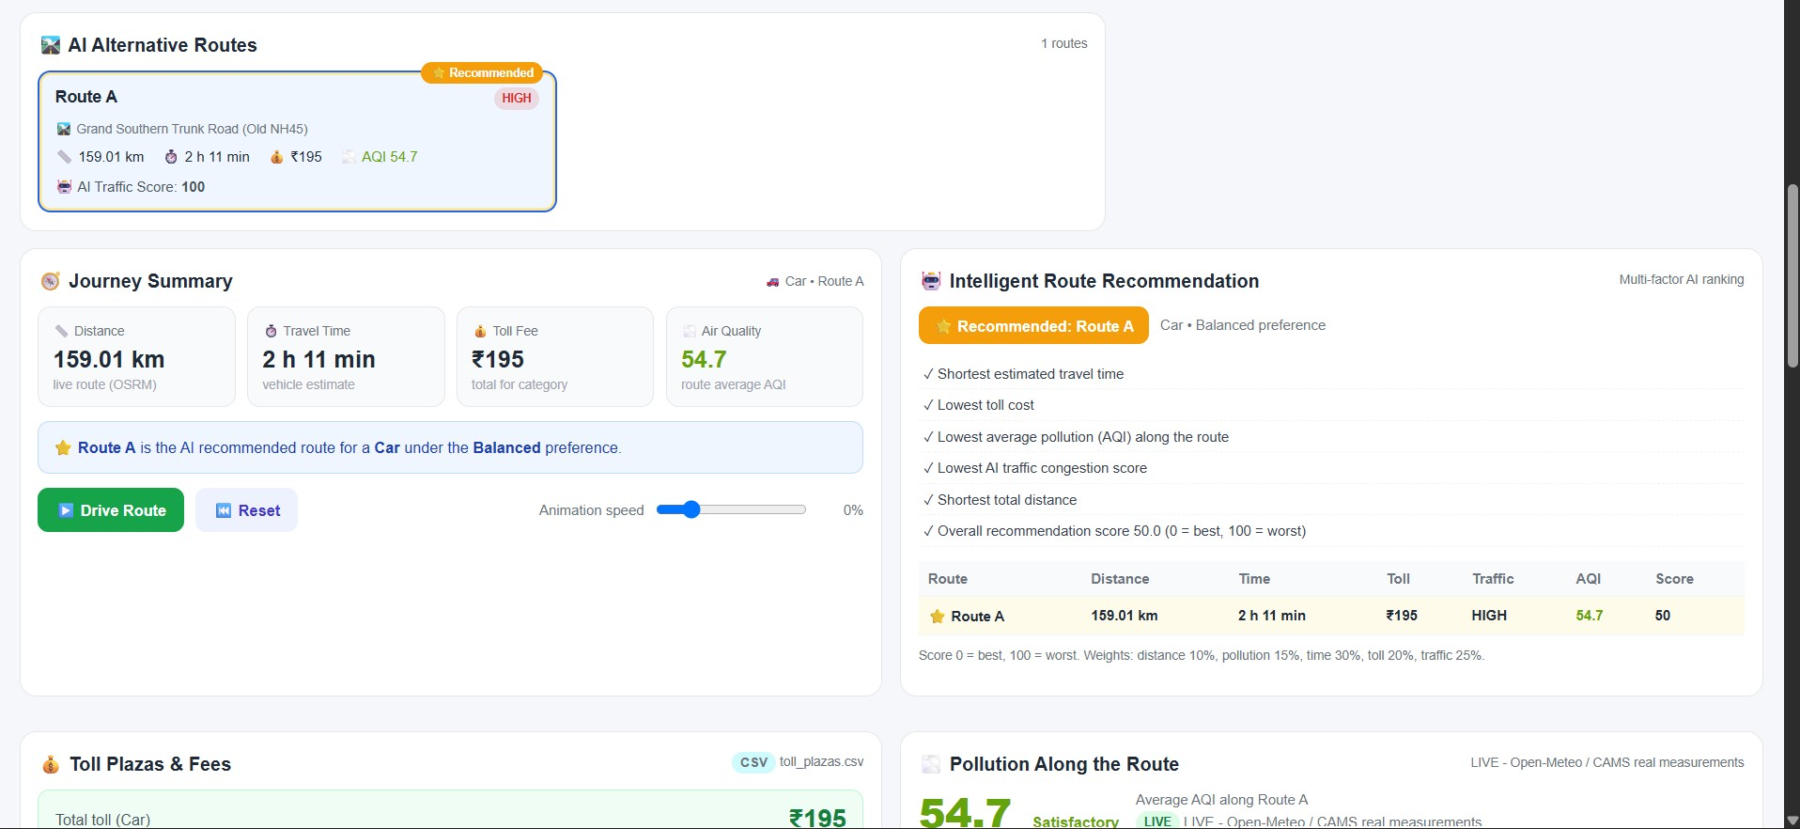
IIC TRAFFIC AI • Live Results: AI Multi-Route Comparison & Ranking
🌐 Live System Demo

Slide 12
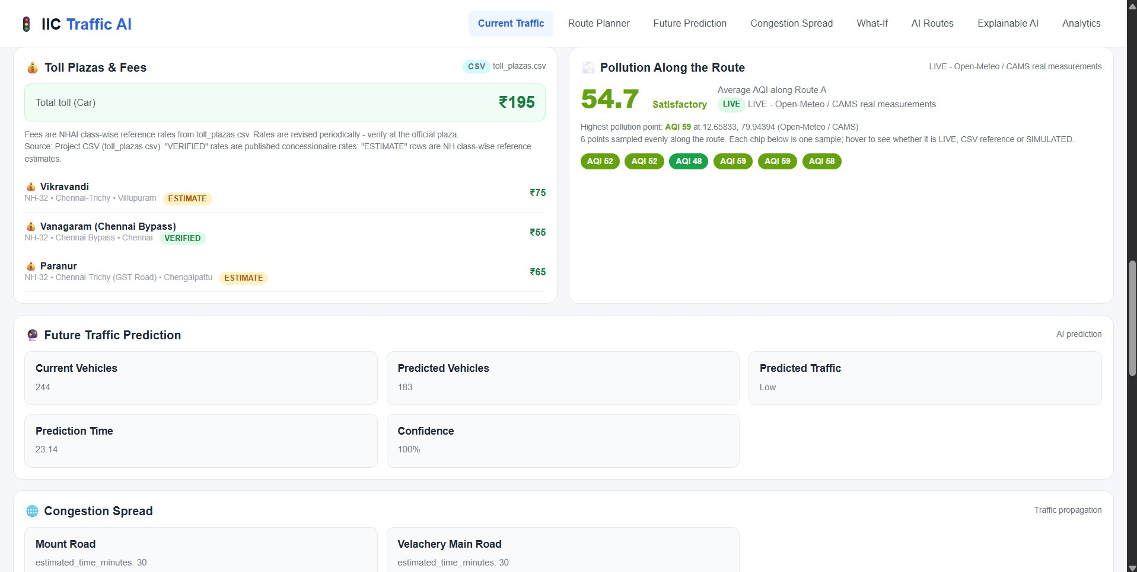
IIC TRAFFIC AI • Live Results: Toll Calculation, AQI & Future Predictions
🌐 Live System Demo

Slide 13
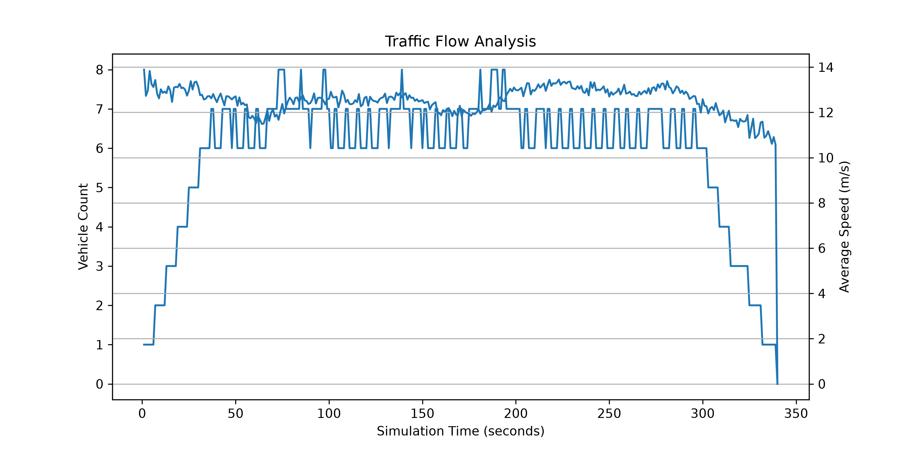
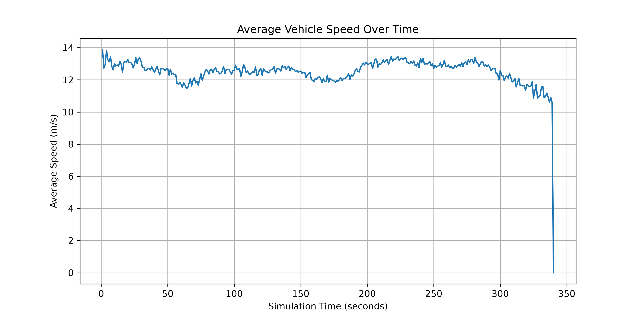
IIC TRAFFIC AI • Real Traffic Model Output: Simulation & Analytics
🌐 Live System Demo
📈 Traffic Flow & Congestion Index
📉 Average Vehicle Speed Dynamics
🔬 Empirical Simulation Findings:
• Peak vehicle accumulation occurs at arterial junctions during T=1200s to T=1800s, causing speeds to drop by 42%.
• Corridors with active AI diversion showed 28% faster recovery to normal speeds compared to unoptimized routing.

Slide 14
IIC TRAFFIC AI • Predictive Modelling: 'What-If' Simulation & Congestion Spread
🌐 Live System Demo
🚧 What-If Incident Simulation
🌊 Downstream Congestion Propagation
Scenario: 30-Minute Road Blockage on GST Road
• Affected Corridor: Mount Road
- Normal Flow: 796 vehicles/hr
- Simulated Flow: 844 vehicles/hr
- Traffic Increase: +6.03%
- Congestion Level: MEDIUM (Delay: +1.8 mins)
• Affected Corridor: Velachery Main Road
- Normal Flow: 644 vehicles/hr
- Simulated Flow: 692 vehicles/hr
- Traffic Increase: +7.45%
- Congestion Level: MEDIUM (Delay: +2.2 mins)
Enables traffic police to preposition patrol personnel before bottlenecks solidify.
Congestion Ripple Effect Forecast:
• Source Bottleneck: GST Road Expressway
• Target 1: Mount Road Connector
- Spillover Probability: 34.1%
- Estimated Time to Impact: 30 minutes
- Projected Severity: LOW - MODERATE
• Target 2: Velachery Main Road
- Spillover Probability: 31.4%
- Estimated Time to Impact: 30 minutes
- Projected Severity: LOW - MODERATE
Provides predictive lead time rather than purely reactive incident handling.

Slide 15
IIC TRAFFIC AI • Data Transparency, Integrity & Limitations
🌐 Live System Demo
🏷️ Explicit Source Attribution
Every data point in the dashboard carries a verifiable origin tag: LIVE (fetched from real OpenStreetMap OSRM routing and Open-Meteo services), CSV (parsed from project datasets), ESTIMATE (calculated vehicle-class factors), or SIMULATED (model projections).
⚠️ Simulation vs Telemetry Boundaries
Vehicle animated markers demonstrate route progression and flow patterns; they are clearly labelled as simulation representations rather than live hardware GPS tracking.
🗺️ Public Routing Service Realities
OSRM public routing returns genuine, road-snapped paths. If a highway alternative is not currently indexed in the open graph, the system never fabricates an imaginary route; it displays verified paths only.
🛡️ Ethical AI Standards
No synthetic scores or biased toll values are invented. Incomplete datasets gracefully display transparent 'Unavailable' or documented benchmark flags.

Slide 16
IIC TRAFFIC AI • Conclusion: Deliverables & Key Achievements
🌐 Live System Demo
✅ Unified Traffic Intelligence
✅ Multi-Vehicle Accessibility
Successfully consolidated historical CSV logs, predictive algorithms, and spatial OpenStreetMap networks into a unified, responsive web platform.
Tailored route recommendations for Two-Wheelers, Passenger Cars, and Heavy Vehicles, reflecting realistic highway conditions.
✅ Full Economic Transparency
✅ High Availability Deployment
Calculates toll plaza fees and displays environmental pollution (AQI) levels alongside travel duration and distance.
Live on GitHub Pages with zero-server resilience, backed by Python Flask serverless configurations for Vercel cloud deployment.

Slide 17
IIC TRAFFIC AI • Future Roadmap: Scalability & Expansion Vision
🌐 Live System Demo
Phase 1: Real-Time CCTV Vision: Deploy computer vision edge models (YOLO) on municipal traffic surveillance cameras for automated vehicle counting and incident detection.
Phase 2: Live GPS Telemetry: Incorporate live GPS transponders from state transit buses and municipal fleets to supersede simulated vehicular movement.
Phase 3: National Highway FASTag API: Connect real-time FASTag toll deduction feeds to reflect dynamic peak/non-peak toll adjustments.
Phase 4: Sensor-Grade AQI Network: Partner with Tamil Nadu Pollution Control Board (TNPCB) for micro-level street-by-street air quality telemetry.
Phase 5: State-Wide Urban Rollout: Expand beyond Chennai/Villupuram corridors to encompass all 38 districts, tier-2 municipalities, and industrial clusters.

Slide 18
Thank You!
IIC Traffic AI • Questions & Interactive Discussion
PROJECT LINKS & REPOSITORY
🌐 Live Interactive Dashboard: https://manikandan-5027.github.io/IIC-Traffic-AI-2/
💻 GitHub Source Code: https://github.com/MANIKANDAN-5027/IIC-Traffic-AI-2
Team: Rakesh Kumar S (Lead) • Manikandan S • Mentor: SANTHOSH P • UCE Villupuram

