Slide 1



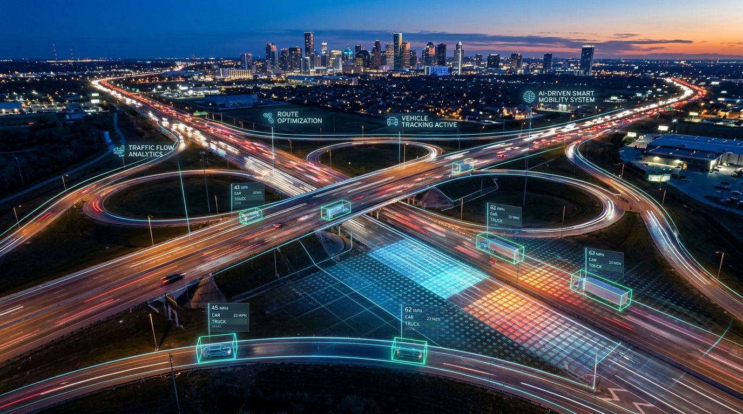

IIC TRAFFIC AI
AI-Based Traffic Congestion Prediction and Intelligent Route Optimization System
AI
Team Lead Name
Rakesh Kumar S
Team Members
Manikandan S
AI
AI
AI
AI
AI
AI
AI
AI
AI
Mentor : SANTHOSH P
College Name – University College of Engineering Villupuram
AI
🌐 Live Demo: manikandan-5027.github.io/IIC-Traffic-AI-2/
💻 GitHub: github.com/MANIKANDAN-5027/IIC-Traffic-AI-2

Slide 2
Project Objectives
Problem Statement
Project Overview – Introduction
End Users
01
02
03
Wow Factors in Project
Modelling / Block Diagram / Flow of Project
Technology Stack
04
05
06
Result / Outcomes
Conclusion
Future Perspective
07
08
09

Slide 3
Problem Statement
1. Traffic Uncertainty
Congestion changes by place and time.
Manual route choice may waste time.
Small roads and villages may be overlooked.
2. Scattered Data
CSV files contain traffic and location records.
Manual comparison is time-consuming.
Traffic values need clear presentation.
3. Route Decisions
Different vehicle types need suitable routes.
Toll costs and pollution affect decisions.
Users need clear route recommendations.
Project Goal: Turn available CSV traffic data into understandable predictions, route comparisons and map-based decisions.

Slide 4
Project Overview - Introduction
🔗 Live System: manikandan-5027.github.io
IIC Traffic AI is a web dashboard for traffic analysis and route guidance. It turns CSV traffic data into predictions, route comparisons and map-based decisions.
INPUT
Traffic data • Future prediction • Route optimisation • Location CSVs
Display current and future traffic outputs
PROCESS
CSV validation • Traffic scoring • Route comparison • Visualisation
Analyse congestion and what-if scenarios
Search district, taluk, village and locations
Compare available alternative routes
Add Bike, Car and Heavy Vehicle categories
OUTPUT
Dashboard • Map routes • Alerts • Analytics • Recommendations
Show toll / pollution only when data is supported

Slide 5




End Users
Bike Riders
– Compare travel time and suitable road access.
Traffic Analysts
– Study congestion, alerts and what-if scenarios.
Car Drivers
– Compare distance, duration, congestion and toll.
Heavy-Vehicle Operators
– Check routes with verified road restrictions.
Bike Rider
Car Driver
Heavy-Vehicle Operator
Traffic Analyst

Slide 6





Wow Factors in Project
Explainable AI Scoring – Shows the reasons behind route scoring.
Vehicle-Aware Routing – Bike, Car and Heavy Vehicle categories.
Village-Level Search – District, taluk, village and point-to-point search.
Traffic Prediction & What-if – Current status, future records and congestion scenarios.
Alert Awareness – Traffic, roadwork, accident and event alerts where data exists.
Transparent Data Labels – LIVE, CSV, ESTIMATE or SIMULATED tags on results.
Explainable AI
Vehicle-Aware Routing
Village Search
Traffic Prediction
Alert Awareness
Data Labels

Slide 7
Vehicle Categories & Route Optimization
1. Bike
Suitable road access.
Travel-time comparison.
2. Car
Distance and duration comparison.
Congestion comparison.
Toll comparison.
3. Heavy Vehicle
Apply verified road restrictions when available.
Show only routes actually returned by the routing engine.
Route Flow: Start location → Destination → Routing service → Score available routes → Recommend best option
Public routing services may return limited alternatives; routes are never invented.

Slide 8
Toll Cost & Pollution Indicators
1. Toll Calculation
Identify toll plazas along the route.
Show vehicle-category price.
Calculate total toll cost.
Mark unverified prices as estimates.
2. Pollution / AQI
Display AQI when a reliable source is connected.
Highlight areas only when supported by data.
Show source and timestamp.
3. Data Labels
LIVE DATA
CSV DATA
ESTIMATE
SIMULATED – never labelled as live.
Principle: Use verified data where available; clearly label estimates and simulations.

Slide 9
Modelling/Block Diagram/Flow of Project
CSV DATASETS
FLASK BACKEND – IIC TRAFFIC AI
WEB DASHBOARD
HTML • CSS • JavaScript
Charts and controls
Traffic data
Load CSV & Validate
API Endpoints
Prediction data
Traffic Score & Alerts
Route Ranking
INTERACTIVE MAP
Route data
Leaflet • OpenStreetMap
Routes and markers
Location data
External services: Nominatim geocoding • OSRM routing (if available)
User selects locations and vehicle category → backend analyses available data → dashboard displays results.

Slide 10
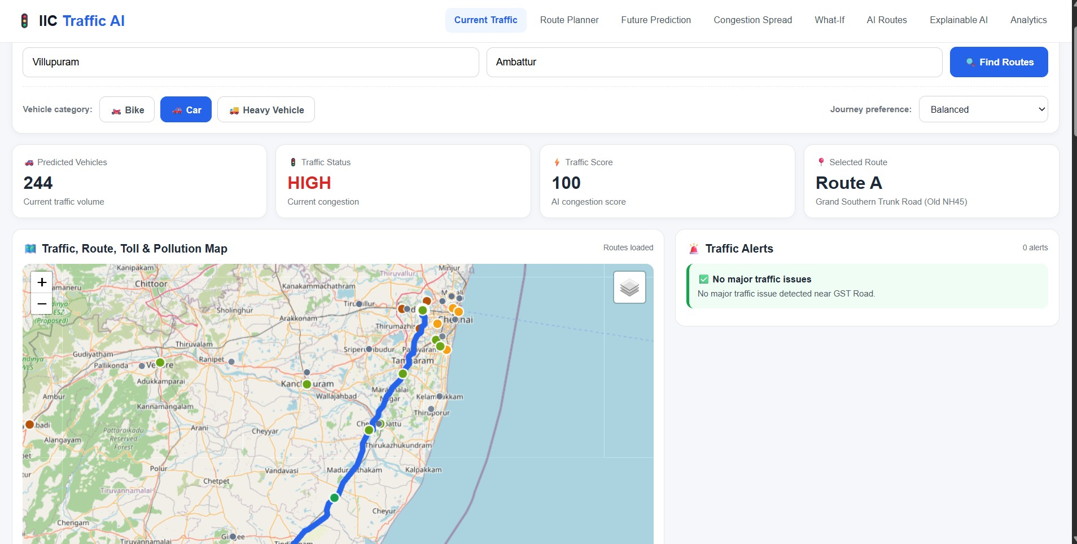
Result/Outcomes
🚀 Open Live Dashboard
TRAFFIC DASHBOARD & ROUTE MAP

Slide 11
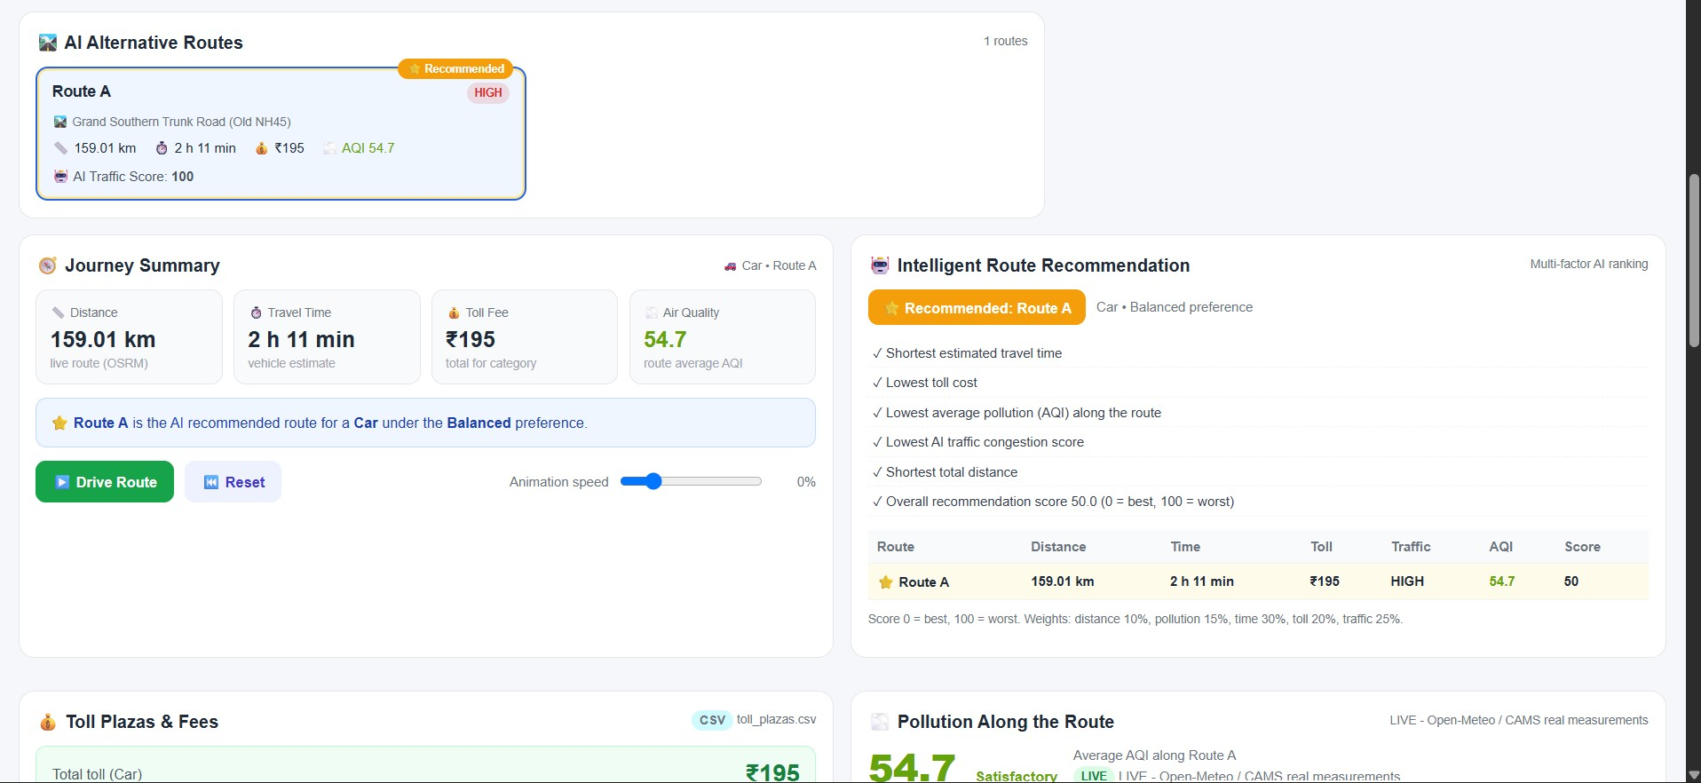
Result/Outcomes
🛣️ Explore Live Routes
AI ROUTE RECOMMENDATION

Slide 12
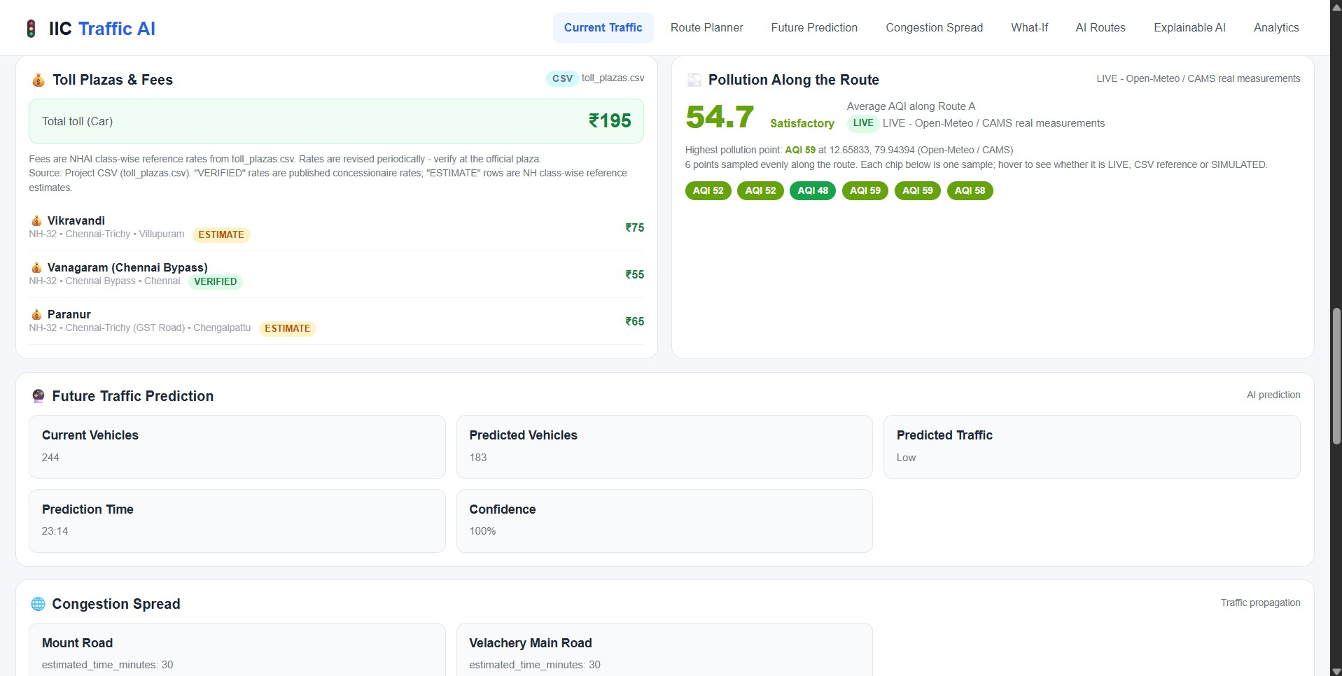
Result/Outcomes
TOLL, POLLUTION & FUTURE PREDICTION

Slide 13
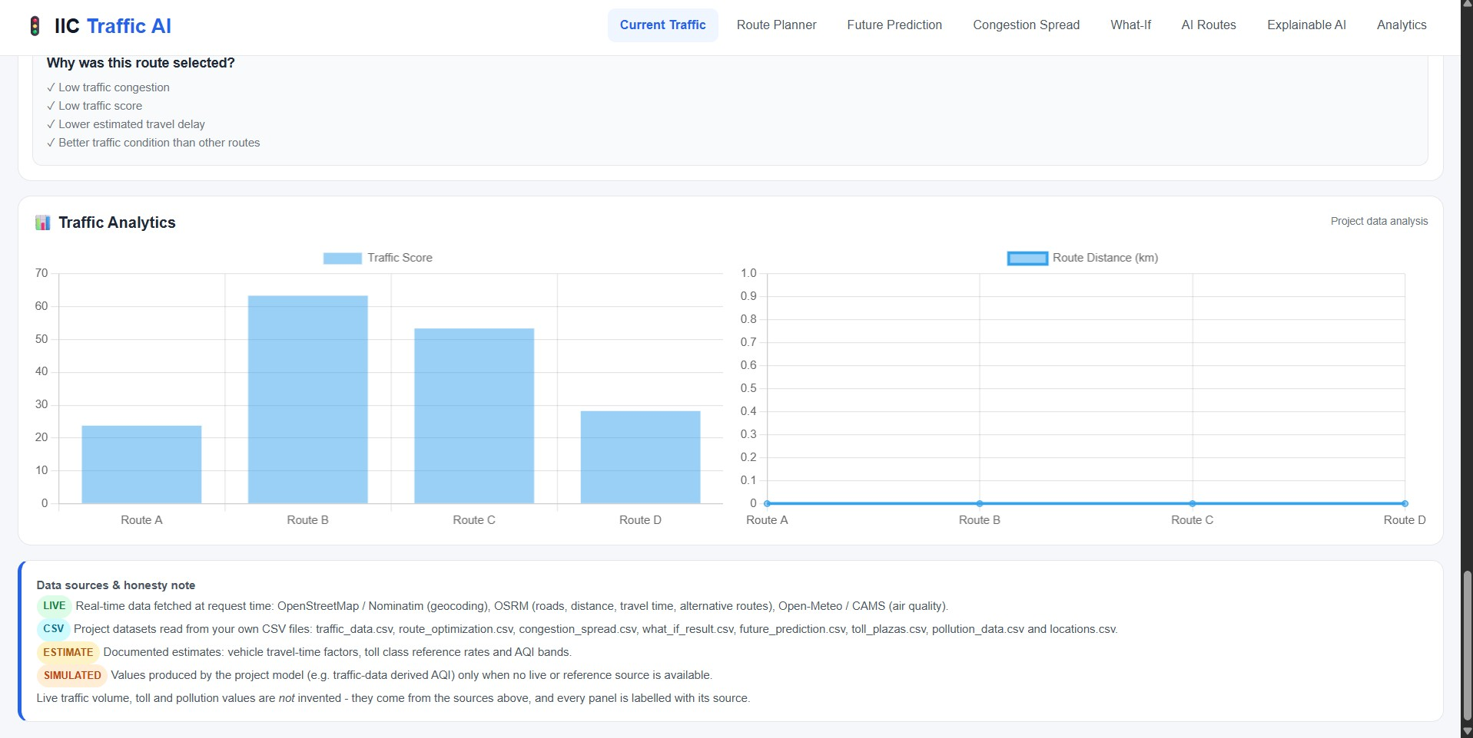
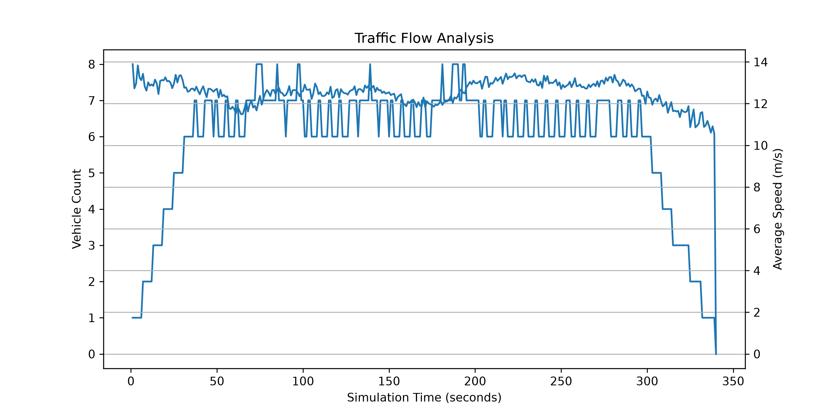
Result/Outcomes
TRAFFIC ANALYTICS & DATA SOURCES
Real Model Analytics Output (SUMO & Flow Simulation):

Slide 14
Data Transparency & Limitations
1. Traffic Data
CSV predictions are not automatically live traffic measurements.
Vehicle movement is a simulation unless connected to real GPS/device data.
2. Routing & Coverage
Alternative routes depend on the routing engine; every possible road cannot be guaranteed.
Village coverage depends on CSV records or successful geocoding.
3. Toll & Pollution
Toll charges require verified plaza and vehicle-category pricing data.
AQI needs a reliable source; otherwise label it unavailable or sample.
Rule: Always show data source, timestamp and live / CSV / estimated status.

Slide 15
Conclusion
IIC TRAFFIC AI
Integrates traffic records and prediction outputs.
Supports location search and map visualisation.
Helps compare available routes and traffic scores.
Creates a base for vehicle-specific routing.
Labels data as LIVE, CSV, ESTIMATE or SIMULATED for transparency.
Future Goal: A transparent, vehicle-aware route assistant for Chennai and surrounding areas.

Slide 16






Future perspective
Verified Toll Pricing – Verify toll prices by vehicle class.
Live AQI – Connect a trusted live AQI provider.
Real GPS Tracking – Replace simulated movement with real GPS/device data.
Live Traffic Feeds – Integrate live traffic feeds.
Village Coverage – Expand and validate village-road coverage.
Verified Toll Pricing
Live AQI Provider
Real GPS Tracking
Live Traffic Feeds
Village-Road Coverage
Vehicle-Aware Assistant
Future Goal : A transparent, vehicle-aware route assistant for Chennai and surrounding areas.

Slide 17
Thank You !!
IIC Traffic AI – Questions & Discussion
PROJECT LINKS & REPOSITORY
🌐 Live Web Application: https://manikandan-5027.github.io/IIC-Traffic-AI-2/
💻 GitHub Source Code: https://github.com/MANIKANDAN-5027/IIC-Traffic-AI-2

