Slide 1

Hospital Management
Database System
Capstone Project – Review I
Presented by:
25B11AI006 – A MANI KRISHNAN - AIML
25B11AI218 - CH VENKATA KOUSHIK- AIML
26B61AI002- MADDIPATI BHUVANA VENKATA JASWANTH- AIML
25B11AI116 - B SRI RAM KISHAN- AIML
Academic Year: 2026-2027
Under the esteemed guidance of Dr P Kishorekumar Associate Professor Department of AIML Aditya University

Slide 2












Outline
1
Introduction
6
Relationships & Cardinality
2
Problem Statement
7
Relational Database Schema
3
Objectives
8
ER Diagram
4
System Scope
9
Team Responsibilities & GitHub
5
Entities & Attributes
1
0
Conclusion
HOSPITAL MANAGEMENT SYSTEM • CAPSTONE REVIEW – I
2

Slide 3
1. Introduction
Hospitals handle large amounts of information related to patients, doctors, departments, appointments, admissions, treatments, prescriptions, medicines, rooms, and billing.
A database provides a structured and efficient way to organise and manage these interconnected hospital records.
The proposed Hospital Management System models the major hospital entities
and their relationships using a relational database approach.
The project focuses on designing the database structure, including entities, attributes, Primary Keys, Foreign Keys, relationships, and the ER diagram.
2

Slide 4
2. Problem Statement
Hospitals need to manage large amounts of information related to patients, doctors, departments, appointments, admissions, treatments, prescriptions, medicines, rooms, and billing.
Managing these records separately can lead to data duplication, inconsistency, difficulty in retrieving information, and errors in maintaining patient records.
The project aims to design a relational Hospital Management Database System that connects these records through well-defined entities, relationships, Primary Keys, and Foreign Keys.
The system will provide a structured database design to efficiently store, manage, and retrieve hospital-related information.
3

Slide 5
3. Objectives
Identify the major entities involved in hospital management.
Identify suitable attributes for each entity.
Establish relationships between the identified entities.
Design an Entity–Relationship (ER) diagram.
Convert the ER model into a relational database schema.
Identify suitable Primary Keys and Foreign Keys.
Reduce data duplication and maintain data consistency.
Provide an organized database structure for efficient hospital record management.
4

Slide 6


4. System Scope
PATIENT
Patient details and contact information.
DOCTOR
Doctor profile, specialization and department.
DEPARTMENT
Department name and hospital location.
APPOINTMENT
Patient–doctor appointment date and time.
ADMISSION
Patient admission, room allocation and status.
ROOM
Room number, type and availability/status.
TREATMENT
Patient treatment, diagnosis and cost.
PRESCRIPTION
Prescription, dosage and doctor/patient reference.
MEDICINE
Medicine name, category, price and stock.
BILLING
Patient bill, amount, date and payment status.
6

Slide 7
5.1 Entities and Attributes
Ten entities identified for the proposed database
Entity | Key attributes
DOCTOR | Doctor_ID (PK) • Name • Specialization • Phone • Department_ID (FK)
PATIENT | Patient_ID (PK) • Name • Age • Gender • Mobile • Address
DEPARTMENT | Department_ID (PK) • Department_Name • Location
ADMISSION | Admission_ID (PK) • Patient_ID (FK) • Room_ID (FK) • Admission_Date • Status
APPOINTMENT | Appointment_ID (PK) • Patient_ID (FK) • Doctor_ID (FK) • Date • Time
ROOM | Room_ID (PK) • Room_Number • Room_Type • status

Slide 8
5.2 Entities and Attributes
Ten entities identified for the proposed database
Entity | Key attributes
TREATMENT | Treatment_ID (PK) • Patient_ID (FK) • Doctor_ID (FK) • Treatment Name • Cost
MEDICINE | Medicine_ID (PK) • Medicine Name • Category • Price
PRESCRIPTION | Prescription_ID (PK) • Patient_ID (FK) • Doctor_ID (FK) • Date • Dosage
BILLING | Bill_ID (PK) • Patient_ID (FK) • Amount • Bill Date • Payment Status

Slide 9
6.1 Relationships and Cardinality
Relationship |  | Cardinality | Meaning
DOCTOR | DEPARTMENT | 1 : M | Many doctors belong to one department.
DOCTOR | APPOINTMENT | 1 : M | One doctor can have many appointments
PATIENT | APPOINTMENT | 1 : M | One patient can have many appointments.
PATIENT | ADMISSION | 1 : M | One patient can have many admission records.
ROOM | ADMISSION | 1 : M | A room can be associated with many admissions over time.
PATIENT | TREATMENT | 1 : M | One patient can have many treatments.
DOCTOR | TREATMENT | 1 : M | One doctor can provide many treatments.
7

Slide 10





6.2 Relationships and Cardinality
Relationship | Cardinality | Meaning
PATIENT PRESCRIPTION | 1 : M | One patient can have many prescriptions.
DOCTOR PRESCRIPTION | 1 : M | One doctor can issue many prescriptions.
MEDICINE PRESCRIPTION | 1 : M | One medicine can appear in many prescription records.
PATIENT BILLING | 1 : M | One patient can have many bills.
ADMISSION BILLING | 1 : M | An admission can be associated with billing.
DEPARTMENT ROOM | 1 : M | One department can contain many rooms.
7

Slide 11
7.1Relational Database Schema
DOCTOR | Doctor(Doctor_ID, Name, Specialization, Phone, Department_ID) | PK: Doctor_ID | FK: Department_ID
PATIENT | Patient(Patient_ID, Name, Age, Gender, Mobile, Address) | PK: Patient_ID
DEPARTMENT | Department(Department_ID, Department_Name, Location) | PK: Department_ID
ADMISSION | Admission(Admission_ID, Patient_ID, Room_ID, Admission_Date, Status) | PK: Admission_ID | FK: Patient_ID, Room_ID
APPOINTMENT | Appointment(Appointment_ID, Patient_ID, Doctor_ID, Date, Time) | PK: Appointment_ID | FK: Patient_ID, Doctor_ID
ROOM | Room(Room_ID, Room_Number, Room_Type, status) | PK: Room_ID

Slide 12
7.2 Relational Database Schema
TREATMENT | Treatment(Treatment_ID, Patient_ID, Doctor_ID, Treatment_Name, Cost) | PK: Treatment_ID | FK: Patient_ID, Doctor_ID
MEDICINE | Medicine(Medicine_ID, Medicine_Name, Category, Price) | PK: Medicine_ID
PRESCRIPTION | Prescription(Prescription_ID, Patient_ID, Doctor_ID, Date, Dosage) | PK: Prescription_ID | FK: Patient_ID, Doctor_ID
BILLING | Billing(Bill_ID, Patient_ID, Amount, Bill_Date, Payment_Status) | PK: Bill_ID | FK: Patient_ID

Slide 13
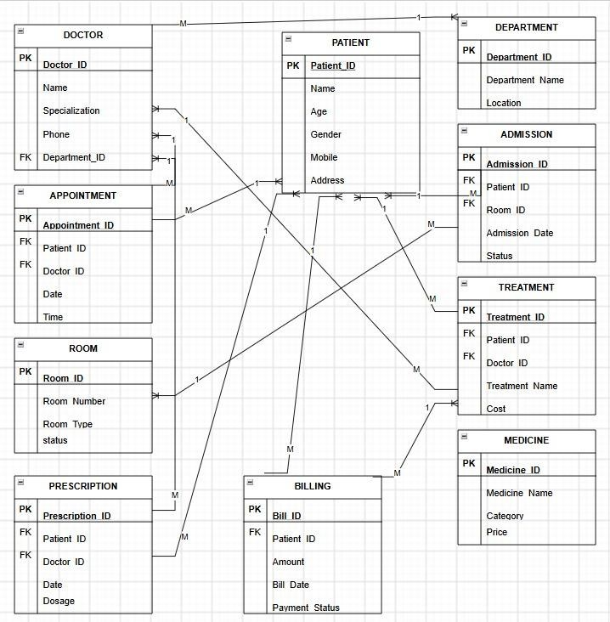
8. ER Diagram

Slide 14
9. Team Responsibilities and GitHub
Team Member | Assigned responsibility
CH Venkata Koushik | Project title, introduction, and problem statement, Objectives
A Mani Krishnan | Scope, and entity identification, Attributes, Primary Keys, and Foreign Keys,
MBV Jaswanth | Relationships and cardinality, Relational schema and ER diagram
B Sri Ram Kishan | GitHub repository and PPT documentation
GitHub Repository: https://github.com/MANIKRISHNA333/AIML_TT1_BATCH03
10

Slide 15
10. Conclusion
Ten major entities have been identified for the Hospital Management System.
Attributes, Primary Keys and Foreign Keys are represented in the project
design.
Relationships and cardinalities have been documented from the supplied ER diagram.
The relational schema organises the identified hospital records into tables.
The ER diagram provides the overall conceptual view of the database.
This design forms the foundation for the next stage of implementation.
Review–I Focus: Database Design
11

