Slide 1

Hospital Management
Database System
Capstone Project – Review II
Database Implementation
Database Management Systems (2501IT05)
Presented by:
25B11AI006 – A MANI KRISHNAN - AIML
25B11AI218 - CH VENKATA KOUSHIK- AIML
26B61AI002- MADDIPATI BHUVANA VENKATA JASWANTH- AIML
25B11AI116 - B SRI RAM KISHAN- AIML
Academic Year: 2026-2027
Under the esteemed guidance of Dr P Kishorekumar Associate Professor Department of AIML Aditya University

Slide 2
1. Project Overview / Abstract
Centralized relational database for hospital information.
Manages patients, doctors, departments, appointments, admissions, treatments, prescriptions, medicines and billing.
Ten related entities connected through one-to-many relationships.
Data integrity enforced with Primary Keys, Foreign Keys and constraints.
Implemented in SQL (MySQL): DDL, DML and DQL.
Normalized up to Third Normal Form (3NF).
2

Slide 3
2. Introduction
Project
Motivation
Contribution
Hospitals handle interlinked records of patients, doctors, rooms and bills.
Relational design of entities, attributes, keys, relationships and ER diagram.
Implemented through SQL.
Manual or separate records cause duplication and inconsistency.
Retrieval is slow; patient records are error-prone.
A centralized database enforces relationships through keys.
Centralized hospital records.
Reduced duplicate data.
Referential integrity via PK/FK.
Faster SQL retrieval.
Base for scheduling, admission and prescriptions.
3

Slide 4
3. Objectives
1
Identify major hospital entities
2
Identify suitable attributes
3
Establish relationships
4
Design the ER diagram
5
Convert ER model to relational schema
6
Identify Primary and Foreign Keys
7
Reduce duplication
8
Maintain consistency
9
Provide an organized database structure
4

Slide 5
4. Existing System
Problems
Impact on the hospital
Patient history and bills are hard to find.
Admissions and bills are not linked.
No consolidated view for administration.
Manual, paper-based records
Disconnected Excel sheets/files
Duplicate, inconsistent information
Time-consuming searches
Difficulty generating reports
Data-entry errors and lost records
5

Slide 6
5. Proposed System
Centralized hospital database with ten entities
Patient registration and record management
Doctor and department management
Appointment scheduling between patients and doctors
Admission and room allocation
Treatment, prescription and medicine tracking
Billing and payment-status management
SQL-based retrieval and reporting
Referential integrity across all tables
6

Slide 7
6. Functional & Non-Functional Requirements
Functional modules
Non-functional
Module | Requirement
Patient | Register, update, search, display
Doctor | Profile, specialization, department
Department | Name and location
Appointment | Patient–doctor date and time
Admission & Room | Allocate rooms, track status
Treatment | Treatment, doctor, cost
Prescription & Medicine | Dosage linked to patient/doctor/medicine
Billing | Bills, amounts, payment status
Search & Reporting | SQL retrieval of information
efficient queries
Performance
no invalid references or duplicate keys
Integrity
controlled access
Security
easy to understand
Usability
consistent transactions
Reliability
supports growth
Scalability
7

Slide 8
7. Database Design – Major Entities
DEPARTMENT
PATIENT
MEDICINE
ROOM
DOCTOR
Name and location
Details and contact
Name, category, price
Number, type, status
Profile, specialization
APPOINTMENT
ADMISSION
TREATMENT
PRESCRIPTION
BILLING
Patient–doctor date/time
Room allocation, status
Treatment and cost
Dosage, medicine
Amount, payment status
8

Slide 9
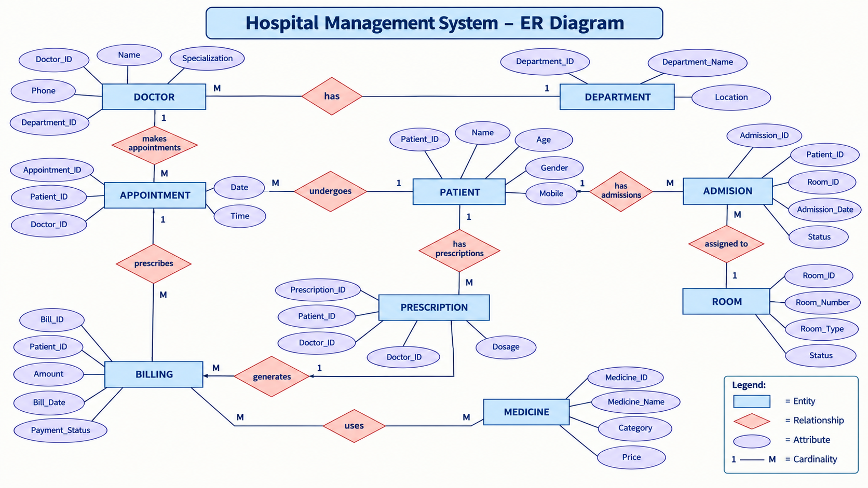
8. ER Diagram
9

Slide 10
9. Relationships & Cardinality
Relationship | Cardinality | Meaning
DEPARTMENT → DOCTOR | 1 : M | One department has many doctors
DEPARTMENT → ROOM | 1 : M | One department contains many rooms
DOCTOR → APPOINTMENT | 1 : M | One doctor has many appointments
PATIENT → APPOINTMENT | 1 : M | One patient has many appointments
PATIENT → ADMISSION | 1 : M | One patient has many admissions
ROOM → ADMISSION | 1 : M | A room has many admissions over time
PATIENT → TREATMENT | 1 : M | One patient has many treatments
DOCTOR → TREATMENT | 1 : M | One doctor provides many treatments
PATIENT → PRESCRIPTION | 1 : M | One patient has many prescriptions
DOCTOR → PRESCRIPTION | 1 : M | One doctor issues many prescriptions
MEDICINE → PRESCRIPTION | 1 : M | One medicine appears in many prescriptions
PATIENT → BILLING | 1 : M | One patient has many bills
ADMISSION → BILLING | 1 : M | Optional link; outpatient bills leave it NULL
10

Slide 11
10. Relational Schema
Relation | Schema | Keys
DEPARTMENT | Department(Department_ID, Department_Name, Location) | PK: Department_ID
PATIENT | Patient(Patient_ID, Name, Age, Gender, Mobile, Address) | PK: Patient_ID
MEDICINE | Medicine(Medicine_ID, Medicine_Name, Category, Price) | PK: Medicine_ID
ROOM | Room(Room_ID, Room_Number, Room_Type, Status, Department_ID) | PK: Room_ID; FK: Department_ID
DOCTOR | Doctor(Doctor_ID, Name, Specialization, Phone, Department_ID) | PK: Doctor_ID; FK: Department_ID
APPOINTMENT | Appointment(Appointment_ID, Patient_ID, Doctor_ID, Date, Time) | PK: Appointment_ID; FK: Patient_ID, Doctor_ID
ADMISSION | Admission(Admission_ID, Patient_ID, Room_ID, Admission_Date, Status) | PK: Admission_ID; FK: Patient_ID, Room_ID
TREATMENT | Treatment(Treatment_ID, Patient_ID, Doctor_ID, Treatment_Name, Cost) | PK: Treatment_ID; FK: Patient_ID, Doctor_ID
PRESCRIPTION | Prescription(Prescription_ID, Patient_ID, Doctor_ID, Medicine_ID, Date, Dosage) | PK: Prescription_ID; FK: Patient_ID, Doctor_ID, Medicine_ID
BILLING | Billing(Bill_ID, Patient_ID, Admission_ID, Amount, Bill_Date, Payment_Status) | PK: Bill_ID; FK: Patient_ID, Admission_ID
11

Slide 12
11. Table Design (1/2)
Table | Attributes & Constraints
DEPARTMENT | Department_ID PK, AUTO_INCREMENT · Department_Name VARCHAR(100) NOT NULL, UNIQUE · Location VARCHAR(100) NOT NULL
PATIENT | Patient_ID PK · Name NOT NULL · Age INT NOT NULL, CHECK (0–120) · Gender ENUM(Male, Female, Other) NOT NULL · Mobile VARCHAR(15) NOT NULL, UNIQUE · Address NOT NULL
MEDICINE | Medicine_ID PK · Medicine_Name NOT NULL · Category VARCHAR(50) NOT NULL · Price DECIMAL(10,2) NOT NULL, CHECK (>= 0)
ROOM | Room_ID PK · Room_Number VARCHAR(10) NOT NULL, UNIQUE · Room_Type ENUM(General, Private, ICU, Deluxe) · Status ENUM(Available, Occupied, Maintenance) DEFAULT Available · Department_ID FK
DOCTOR | Doctor_ID PK · Name NOT NULL · Specialization NOT NULL · Phone VARCHAR(15) NOT NULL, UNIQUE · Department_ID INT NOT NULL, FK
12

Slide 13
11. Table Design (2/2)
Table | Attributes & Constraints
APPOINTMENT | Appointment_ID PK · Patient_ID FK · Doctor_ID FK · Date DATE NOT NULL · Time TIME NOT NULL
ADMISSION | Admission_ID PK · Patient_ID FK · Room_ID FK · Admission_Date DATE NOT NULL · Status ENUM(Admitted, Discharged) DEFAULT Admitted
TREATMENT | Treatment_ID PK · Patient_ID FK · Doctor_ID FK · Treatment_Name VARCHAR(150) NOT NULL · Cost DECIMAL(10,2) NOT NULL, CHECK (>= 0)
PRESCRIPTION | Prescription_ID PK · Patient_ID, Doctor_ID, Medicine_ID FK · Date DATE NOT NULL · Dosage VARCHAR(100) NOT NULL
BILLING | Bill_ID PK · Patient_ID FK · Admission_ID FK, NULL for outpatient · Amount DECIMAL(10,2) NOT NULL, CHECK (>= 0) · Bill_Date DATE NOT NULL · Payment_Status ENUM(Paid, Pending, Partial) DEFAULT Pending
13

Slide 14
12. Keys & Constraints
Constraint | Example from the project
Primary Key | Department_ID, Patient_ID, Doctor_ID, Room_ID … Bill_ID (all AUTO_INCREMENT)
Foreign Key | Doctor.Department_ID → Department; Admission.Room_ID → Room
NOT NULL | Names, identifiers, dates and status values
UNIQUE | Department_Name, Patient.Mobile, Room_Number, Doctor.Phone
CHECK | Patient.Age BETWEEN 0 AND 120; Price, Cost, Amount >= 0
DEFAULT | Room.Status = Available; Admission.Status = Admitted; Payment_Status = Pending
ON UPDATE / ON DELETE | CASCADE on patient-owned records (Appointment, Admission, Treatment, Prescription, Billing); RESTRICT for Department, Doctor, Room, Medicine in use
14

Slide 15
13. Normalization: UNF → 1NF → 2NF → 3NF
UNF
1NF
2NF
3NF
One record holds patient, doctor, department, room plus repeating treatment and prescription groups.
Repeating groups removed; atomic values. Each treatment and prescription is its own row.
Partial dependencies removed: patient, doctor, treatment and prescription attributes depend on their own keys.
Transitive dependencies removed: department, room and medicine details stored once. Result: ten relations.
→
→
→
Redundancy
Update anomalies
Repeated data
Department, room and medicine details stored once
A change is made in one place only
Doctor and patient details are not repeated in every record
15

Slide 16
14. SQL Implementation – DDL
Database & tables (PK, NOT NULL, UNIQUE, CHECK)
Foreign Key, DEFAULT, ON UPDATE / ON DELETE
CREATE DATABASE hospital_management_db;
USE hospital_management_db;
CREATE TABLE DEPARTMENT (
Department_ID INT AUTO_INCREMENT PRIMARY KEY,
Department_Name VARCHAR(100) NOT NULL UNIQUE,
Location VARCHAR(100) NOT NULL
);
CREATE TABLE PATIENT (
Patient_ID INT AUTO_INCREMENT PRIMARY KEY,
Name VARCHAR(100) NOT NULL,
Age INT NOT NULL CHECK (Age BETWEEN 0 AND 120),
Gender ENUM('Male','Female','Other') NOT NULL,
Mobile VARCHAR(15) NOT NULL UNIQUE,
Address VARCHAR(255) NOT NULL
);
CREATE TABLE ROOM (
Room_ID INT AUTO_INCREMENT PRIMARY KEY,
Room_Number VARCHAR(10) NOT NULL UNIQUE,
Room_Type ENUM('General','Private',
'ICU','Deluxe') NOT NULL,
Status ENUM('Available','Occupied',
'Maintenance') NOT NULL
DEFAULT 'Available',
Department_ID INT NOT NULL,
CONSTRAINT fk_room_department
FOREIGN KEY (Department_ID)
REFERENCES DEPARTMENT(Department_ID)
ON UPDATE CASCADE ON DELETE RESTRICT
);
16

Slide 17
15. SQL Implementation – DML
INSERT (sample data)
UPDATE
INSERT INTO DEPARTMENT
(Department_Name, Location) VALUES
('Cardiology', 'Block A, Floor 1'),
('Orthopedics', 'Block A, Floor 2'),
('Neurology', 'Block B, Floor 1'), ...;
INSERT INTO PATIENT
(Name, Age, Gender, Mobile, Address) VALUES
('Ravi Kumar', 34, 'Male',
'9876543210', 'Kakinada, AP'), ...;
INSERT INTO BILLING (Patient_ID,
Admission_ID, Amount, Bill_Date,
Payment_Status)
VALUES (1, 1, 125000.00,
'2026-09-05', 'Partial');
UPDATE ROOM
SET Status = 'Available'
WHERE Room_ID = 2;
DELETE
DELETE FROM APPOINTMENT
WHERE Appointment_ID = 5;
Each table is populated with 5+ FK-consistent rows; parent tables are inserted before child tables.
17

Slide 18
16. DQL – Data Retrieval
SELECT + WHERE (Q2)
WHERE + ORDER BY (Q20)
SELECT Patient_ID, Name, Age, Gender
FROM PATIENT
WHERE Age > 40;
SELECT Bill_ID, Patient_ID, Amount
FROM BILLING
WHERE Payment_Status = 'Pending'
ORDER BY Amount DESC;
Filtering available rooms (Q15)
DISTINCT / LIKE / IS NULL (additional examples)
SELECT * FROM ROOM
WHERE Status = 'Available';
SELECT DISTINCT Specialization FROM DOCTOR;
SELECT * FROM PATIENT WHERE Name LIKE 'R%';
SELECT * FROM BILLING
WHERE Admission_ID IS NULL;
Q2, Q15 and Q20 are from the project query set. The DISTINCT, LIKE and IS NULL examples run on the same schema.
18

Slide 19
17. SQL Joins
Department–Doctor: EQUI JOIN (Q5)
Patient–Admission: LEFT JOIN (Q6)
SELECT D.Name AS Doctor_Name, D.Specialization,
Dept.Department_Name
FROM DOCTOR D
JOIN DEPARTMENT Dept
ON D.Department_ID = Dept.Department_ID;
SELECT P.Patient_ID, P.Name,
A.Admission_Date, A.Status
FROM PATIENT P
LEFT JOIN ADMISSION A
ON P.Patient_ID = A.Patient_ID;
Patient–Appointment: NATURAL JOIN (Q7)
Multi-table: Patient–Admission–Room (Q16)
SELECT Name, Age, Appointment_ID, Date, Time
FROM PATIENT
NATURAL JOIN APPOINTMENT;
SELECT P.Name, A.Admission_Date, R.Room_Number
FROM PATIENT P
JOIN ADMISSION A ON P.Patient_ID = A.Patient_ID
JOIN ROOM R ON A.Room_ID = R.Room_ID
WHERE A.Status = 'Admitted';
19

Slide 20
18. Aggregate Functions & Grouping
COUNT()
SUM()
AVG()
MAX()
MIN()
GROUP BY
HAVING
Doctors with total treatment revenue > 5000 (Q8)
Average bill per payment status (Q9)
SELECT Doc.Name AS Doctor_Name,
COUNT(T.Treatment_ID) AS Treatments_Given,
SUM(T.Cost) AS Total_Revenue
FROM TREATMENT T
JOIN DOCTOR Doc ON T.Doctor_ID = Doc.Doctor_ID
GROUP BY Doc.Doctor_ID, Doc.Name
HAVING SUM(T.Cost) > 5000;
SELECT Payment_Status,
COUNT(Bill_ID) AS Number_Of_Bills,
AVG(Amount) AS Average_Amount
FROM BILLING
GROUP BY Payment_Status;
Dark = used in project queries. MAX() and MIN() are standard MySQL aggregates not used in this query set.
20

Slide 21
19. CRUD Operations
CREATE
→ INSERT
READ
→ SELECT
UPDATE
→ UPDATE
DELETE
→ DELETE
INSERT INTO PATIENT
(Name, Age, Gender, Mobile, Address)
VALUES ('Deepak Sinha', 40, 'Male',
'9876543299', 'Kakinada, AP');
SELECT Patient_ID, Name,
Age, Gender
FROM PATIENT
WHERE Age > 40;
UPDATE ROOM
SET Status = 'Available'
WHERE Room_ID = 2;
DELETE FROM APPOINTMENT
WHERE Appointment_ID = 5;
Q1–Q4 of the project query set, run on the hospital_management_db database.
21

Slide 22
20. Subquery & View
Correlated subquery (Q10)
Patient_Admission_Room_View (Q11)
SELECT P.Patient_ID, P.Name
FROM PATIENT P
WHERE (
SELECT SUM(B.Amount)
FROM BILLING B
WHERE B.Patient_ID = P.Patient_ID
) > (
SELECT AVG(Amount) FROM BILLING
);
CREATE VIEW Patient_Admission_Room_View AS
SELECT P.Patient_ID, P.Name AS Patient_Name,
P.Age, P.Gender, A.Admission_ID,
A.Admission_Date, A.Status AS Admission_Status,
R.Room_ID, R.Room_Number, R.Room_Type,
R.Status AS Room_Status
FROM PATIENT P
JOIN ADMISSION A ON P.Patient_ID = A.Patient_ID
JOIN ROOM R ON A.Room_ID = R.Room_ID;
Query the view (Q12)
SELECT * FROM Patient_Admission_Room_View;
22

Slide 23
21. Data Integrity & Validation
Entity integrity
Referential integrity
Uniqueness
Every table has an AUTO_INCREMENT primary key.
Foreign keys with ON UPDATE / ON DELETE (CASCADE or RESTRICT).
Department_Name, Patient.Mobile, Room_Number, Doctor.Phone.
Mandatory fields
Domain validation
Business validation
NOT NULL on names, identifiers, dates and statuses.
ENUM for Gender, Room_Type, Status, Payment_Status; Age 0–120.
Price, Cost, Amount >= 0; default statuses; Billing.Admission_ID NULL for outpatients.
23

Slide 24
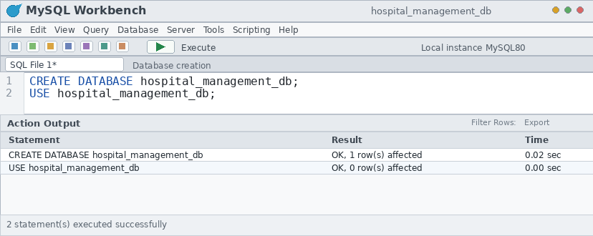
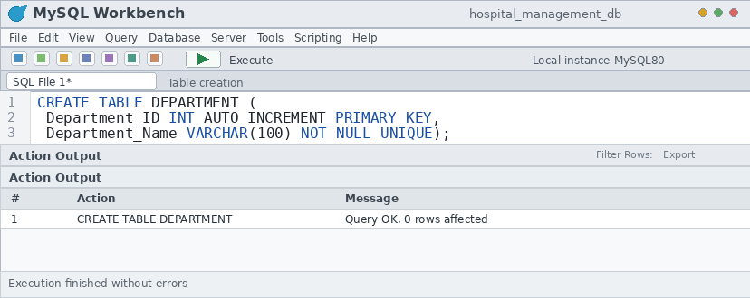
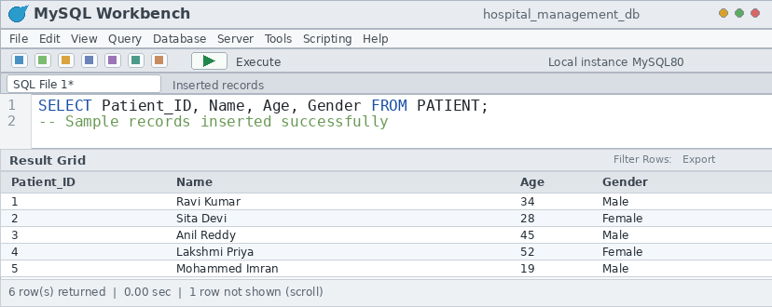
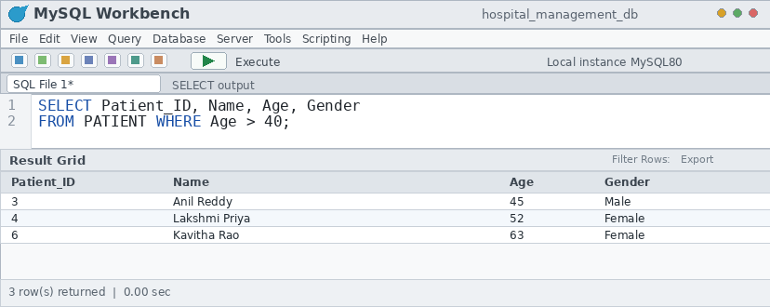
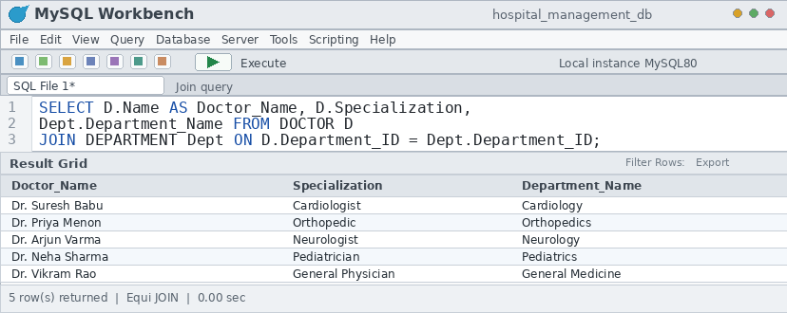
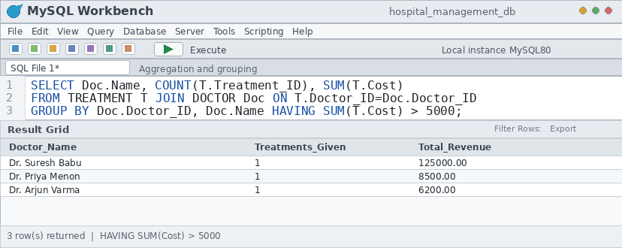
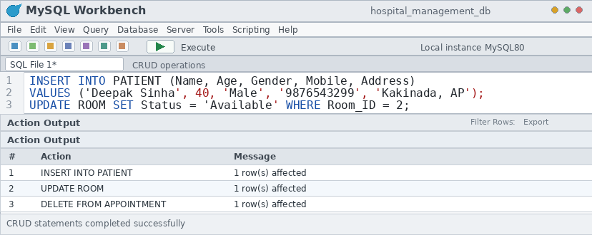
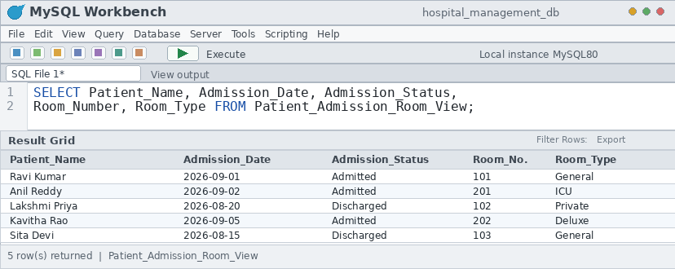
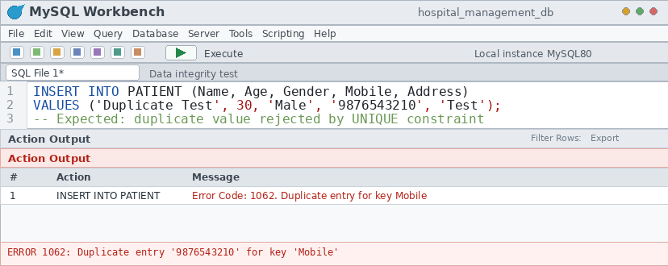
22. SQL Output / Screenshots
INSERT DATABASE CREATION SCREENSHOT HERE
INSERT TABLE CREATION SCREENSHOT HERE
INSERT INSERTED RECORDS SCREENSHOT HERE
INSERT SELECT OUTPUTS SCREENSHOT HERE
INSERT JOINS SCREENSHOT HERE
INSERT AGGREGATES SCREENSHOT HERE
INSERT CRUD SCREENSHOT HERE
INSERT VIEW SCREENSHOT HERE
INSERT VALIDATION / ERROR RESULTS SCREENSHOT HERE
24

Slide 25
23. Query Coverage
Category | Covered by
Basic SELECT | Q2, Q13, Q14, Q15, Q18, Q19
Filtering / Sorting | WHERE (Q2, Q15, Q18); ORDER BY (Q20)
Joins | EQUI (Q5), LEFT (Q6), NATURAL (Q7), multi-table (Q16)
Aggregation | COUNT, SUM, AVG (Q8, Q9, Q17, Q21)
GROUP BY / HAVING | GROUP BY (Q8, Q9, Q17, Q21); HAVING (Q8)
CRUD | INSERT Q1, SELECT Q2, UPDATE Q3, DELETE Q4
Subquery & Views | Correlated subquery Q10; view Q11–Q12
Validation | PK, FK, UNIQUE, NOT NULL, CHECK, DEFAULT in DDL
25

Slide 26
24. Conclusion
Structured relational database for core hospital information
Ten related tables: Department to Billing
Primary Keys, Foreign Keys and constraints protect integrity
Normalized up to 3NF to reduce redundancy and update anomalies
SQL implementation: CRUD, joins, aggregation, correlated subquery and view
Foundation for hospital reporting; extendable to a full hospital information system
26

Slide 27
25. Future Enhancements
Role-based access
Staff & nursing-duty management
Insurance / cashless claims
Laboratory records
Pharmacy inventory
Analytics dashboards
Backup & recovery
Audit logging
Stronger database security
27

Slide 28
26. References
1. Korth, H. F., Silberschatz, A., and Sudarshan, S., Database System Concepts, McGraw Hill.
2. Elmasri, R. and Navathe, S. B., Fundamentals of Database Systems, Pearson.
3. MySQL 8.0 Reference Manual, Oracle Corporation, https://dev.mysql.com/doc/
28

