Slide 1
SMART VEHICLE PARKING SYSTEM
C++ REVIEW 1
TEAM NUMBER-19
PRESENTED BY:-
25B11AI006-ACHANTA MANI KRISHNAN
25B11AI883-PALIVELA SASANK
25B11AI172-UDAYAGIRI SUPRAJA
25B11AIC24-UNNAM NAGARJUNA
COURSE INSTRUCTOR:- N.AKHILA, M.Tech (PhD),
ASSISTANT PROFESSOR,
AIML DEPARTMENT
1

Slide 2
Contents
Project overview and presentation flow
1
Project Abstract
6
Class / OOP Design
What the system does and why it is useful.
Classes and OOP principles used.
2
Problem & Objectives
7
Architecture Diagram
2
Current parking issues and project goals.
Presentation, logic and data layers.
3
Planned Modules / Functions
8
ER Diagram
Core modules that implement the system.
Relationships among the main classes.
4
Users of the System
9
Planning & Timeline
Primary and administrative users.
Development activities across the project weeks.
5
Inputs & Outputs
10
Role of Each Individual
Information entered and generated.
Team responsibilities for implementation.

Slide 3
Project Abstract
C++ application designed to automate vehicle parking management.
Replaces manual paper-based logging with structured digital records.
Handles vehicle entry, slot allocation, live status, search, fee calculation and receipts.
Stores completed parking transactions using file handling.
Uses OOP principles: classes, inheritance, polymorphism and encapsulation.

Slide 4
Problem Statement & Objectives
Problem Statement
  Manual parking relies on paper logs and guesswork, causing difficulty identifying available slots, locating parked vehicles, and calculating fees accurately.
Objectives
  Provide a centralized system to manage vehicle entry, exit, and slot allocation.
  Enable automatic slot assignment and live status display.
  Prevent fee-calculation errors through automated, rate-based billing.
  Maintain a searchable parking history using file handling.

Slide 5
Planned Modules / Functions
Vehicle Entry
Slot Management
Records vehicle number, owner, and type.
Checks, assigns, and releases parking slots.
Parking Status
Vehicle Search
Displays available and occupied slots.
Finds a parked vehicle by number.
Fee & Receipt
Parking History
Calculates charges and generates receipts.
Stores completed transactions via file handling.

Slide 6
Users of the System
Primary Users
Administrative Users
Vehicle Owner — enters vehicle details and receives a slot and receipt.
Parking Attendant / Operator — manages entries, exits and daily operations.
System Administrator — maintains slot data, pricing rules and records.
Auditor / Reviewer — checks parking history and transaction reports.

Slide 7
Inputs & Outputs
Inputs
Outputs
Vehicle number, owner name and vehicle type at entry.
Vehicle number for search or exit.
Menu choice: entry, exit, search, status or history.
Assigned slot number and entry confirmation.
Live list of available and occupied slots.
Vehicle slot and status from search.
Calculated fee and receipt on exit.
Parking history saved to file.

Slide 8
Class / OOP Design
Parking System Class - manages vehicle entry/exit, slot assignment, fee calculation, and history
Vehicle Class - stores vehicle number, owner name, type, and assigned slot
Parking Slot Class - tracks slot number and occupied status; assigns and releases slots
Bike, Car, and SUV inherit from a base Vehicle class; polymorphism applies vehicle-specific fee rates.

Slide 9
Architecture Diagram
Presentation Layer
Console / Menu-driven User Interface
Business Logic Layer
Vehicle Manager | Slot Manager | Fee Calculator | History Manager
Data Layer
File Handling (Vehicle, Slot, Fee, Parking History records)

Slide 10
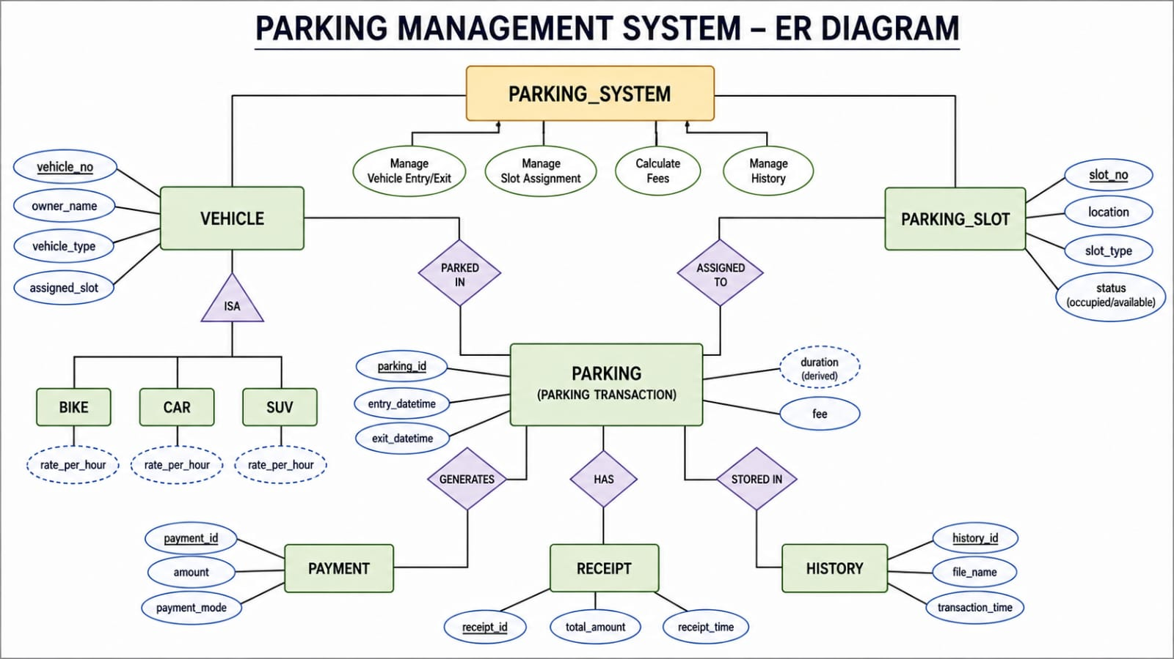
ER Diagram
ParkingSlot

Slide 11
Planning and Timeline Diagram
W1
W2
W3
W4
W5
W6
W7
Requirement Analysis
System Design (Class Diagram)
Coding & Module Development
Integration & Testing
Documentation & Final Review

Slide 12
Role of Each Individual
Roll No. | Name | Role / Responsibility
25B11AI006 | ACHANTA MANI KRISHNAN | Slot Management + Parking Status
25B11AI883 | PALIVELA SASANK | Vehicle Entry + Vehicle Class
25B11AI172 | UDAYAGIRI SUPRAJA | Vehicle Search + Vehicle Exit
25B11AIC24 | UNNAM NAGARJUNA | Fee Calculation + Receipt + File Handling

Slide 13


