Slide 1
SMART VEHICLE PARKING SYSTEM
C++ REVIEW 2
TEAM NUMBER-19
PRESENTED BY:-
25B11AI006-ACHANTA MANI KRISHNAN
25B11AI883-PALIVELA SASANK
25B11AI172-UDAYAGIRI SUPRAJA
25B11AIC24-UNNAM NAGARJUNA
COURSE INSTRUCTOR:- V.Appalakonda , M.Tech,
ASSISTANT PROFESSOR,
AIML DEPARTMENT
1

Slide 2
CONTENTS
Project overview and presentation flow
1
Project Abstract
7
ER Diagram
What the system does and why it is useful.
Relationships among the main classes.
2
Problem & Objectives
8
Limitations
2
Current parking issues and project goals.
Main Drawbacks of this project.
3
Planned Modules / Functions
9
Future Enhancements
Core modules that implement the system.
The improvements of the system that can be done in the future.
4
Users of the System
10
Planning & Timeline
Primary and administrative users.
Development activities across the project weeks.
5
Inputs & Outputs
11
Role of Each Individual
Information entered and generated.
Team responsibilities for implementation.
6
Class / OOP Design
12
Conclusion
Classes and OOP principles used.
Final overview of the project.

Slide 3
PROJECT ABSTRACT
C++ application designed to automate vehicle parking management.
Replaces manual paper-based logging with structured digital records.
Handles vehicle entry, slot allocation, live status, search, fee calculation and receipts.
Stores completed parking transactions using file handling.
Uses OOP principles: classes, inheritance, polymorphism and encapsulation.

Slide 4
PROBLEM STATEMENT & OBJECTIVES
Problem Statement
  Manual parking relies on paper logs and guesswork, causing difficulty identifying available slots, locating parked vehicles, and calculating fees accurately.
Objectives
  Provide a centralized system to manage vehicle entry, exit, and slot allocation.
  Enable automatic slot assignment and live status display.
  Prevent fee-calculation errors through automated, rate-based billing.
  Maintain a searchable parking history using file handling.

Slide 5
PLANNED MODULES & FUNCTIONS
Vehicle Entry:
Slot Management:
Records vehicle number, owner, and type.
Checks, assigns, and releases parking slots.
Parking Status:
Vehicle Search:
Displays available and occupied slots.
Finds a parked vehicle by number.
Fee & Receipt:
Parking History:
Calculates charges and generates receipts.
Stores completed transactions via file handling.

Slide 6
USERS OF THE SYSTEM
Primary Users:
Vehicle Owner — enters vehicle details and receives a slot and receipt.
Parking Attendant / Operator — manages entries, exits and daily operations.
Administrative Users:
System Administrator — maintains slot data, pricing rules and records.
Auditor / Reviewer — checks parking history and transaction reports.

Slide 7
INPUTS & OUTPUTS
Inputs:
Vehicle number, owner name and vehicle type at entry.
Vehicle number for search or exit.
Menu choice: entry, exit, search, status or history.
Outputs:
Assigned slot number and entry confirmation.
Live list of available and occupied slots.
Vehicle slot and status from search.
Calculated fee and receipt on exit.
Parking history saved to file.

Slide 8
CLASS / OOP DESIGN
Parking System Class - manages vehicle entry/exit, slot assignment, fee calculation, and history.
Vehicle Class - stores vehicle number, owner name, type, and assigned slot.
Parking Slot Class - tracks slot number and occupied status; assigns and releases slots.
Bike, Car, and SUV inherit from a base Vehicle class; polymorphism applies vehicle-specific fee rates.

Slide 9
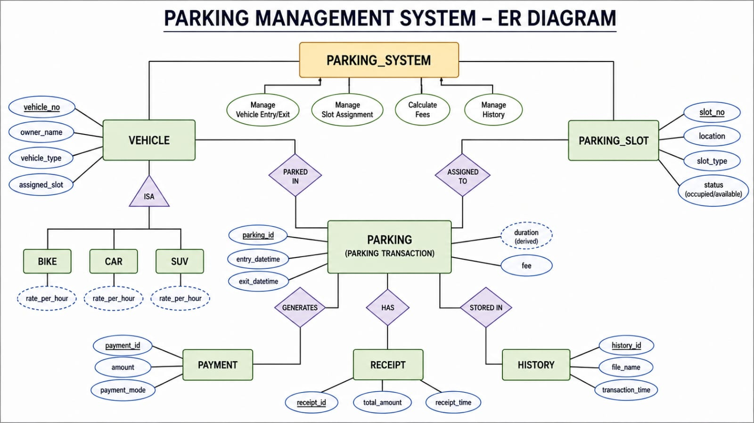
ER DIAGRAM
ParkingSlot

Slide 10
LIMITATIONS
The current version has some limitations:
The system currently supports only 5 parking slots.
It is a console-based application.
Parking history is stored in a text file rather than a database.
There is no graphical user interface.
There is no online or cloud-based access.
The system does not include user login or authentication.
Parking duration is entered manually during vehicle exit.
There is no online payment facility.
The system does not provide real-time hardware/sensor-based slot detection.

Slide 11
FUTURE ENHANCEMENTS
The system can be improved in the future by adding:
1. Database Integration:
Replace the text file with MySQL or another database reliable and scalable storage.
2. Graphical User Interface:
Develop a user-friendly GUI instead of the current console-based interface.
3. More Parking Slots:
Allow the administrator to dynamically configure the number of parking slots.
4. Online Payment:
Integrate digital payment methods such as UPI, cards, and other payment services.
5. Automatic Slot Detection:
Use sensors or IoT devices to detect whether parking slots are occupied.
6. User Authentication:
Add login functionality for administrators and parking operators.
7. QR Code / Digital Receipt:
Generate a QR-based digital parking ticket and receipt.
8. Mobile/Web Application:
Provide remote access through a web or mobile application.

Slide 12
PLANNING AND TIMELINE DIAGRAM
W1
W2
W3
W4
W5
W6
W7
Requirement Analysis
System Design (Class Diagram)
Coding & Module Development
Integration & Testing
Documentation & Final Review

Slide 13
ROLE OF EACH INDIVIDUAL
Roll No. | Name | Role / Responsibility
25B11AI006 | ACHANTA MANI KRISHNAN | Class design, Event & Registration modules
25B11AI883 | PALIVELA SASANK | Coding – core modules & file handling
25B11AI172 | UDAYAGIRI SUPRAJA | Testing, debugging & report generation
25B11AIC24 | UNNAM NAGARJUNA | UI design, documentation & presentation

Slide 14
CONCLUSION
The Smart Vehicle Parking System provides a simple and structured solution for managing vehicle parking using C++. It automates important activities such as vehicle entry, slot allocation, parking-status monitoring, vehicle search, vehicle exit, fee calculation, receipt generation, and parking-history storage. The project also demonstrates practical implementation of OOP concepts including abstraction, encapsulation, inheritance, and polymorphism.
Overall, the project provides a foundation that can later be extended with databases, graphical interfaces, online payments, IoT-based slot detection, and web/mobile access.

Slide 15


