Slide 1

~ENODO~
Team Name : Data Hungers
Task 1 : Bulb EDA
:Team Member :
Manish Sharma – NMIT(Bangalore)
Ayush Pandey – HBTU(Kanpur)

Slide 2
Disclaimer :
The Code and Infographics are present in my github !
Please go through for more information ☺
https://github.com/MANISH007700/ENODO---2020

Slide 3
Task 1 : BULB EDA
Q1 : Bulbs are being manufactured in many countries and are being sold. Is there any relation between the number of hours for which the bulb worked and the place where it was manufactured?

Slide 4
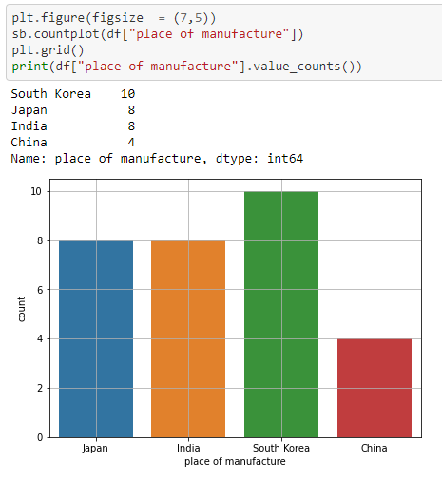
To answer this question , we can plot the countplot with the hour worked and place of manufactured to look for highest co-relation

Slide 5
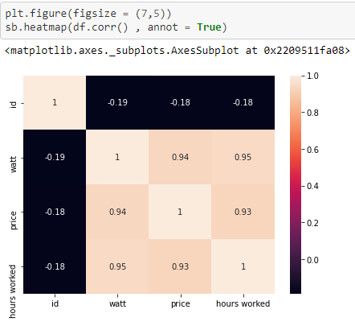
Checking the co-relation of all the columns , just to be sure for the outliers ! All the columns are highly co-related

Slide 6
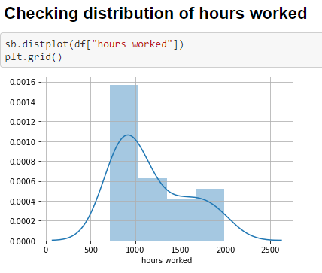
Lets Check the Distribution of hours worked , just in case ! Majority of values lie between 750 – 1200 hr

Slide 7
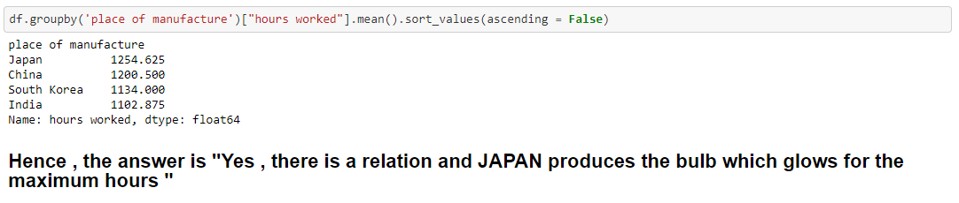
By using a groupby function , we can clearly witness the country having the highest co-relation of hours worked of the bulb by taking the mean Ans : JAPAN

Slide 8
Q2 : Prefered place to manufacture 50 watts bulb ?
Since , we just need to find the best place to look out for 50 watts out of (50,100,200) , we use a groupby function to look at the watts
Do not forget , buying a 50 watt is only worth it , when the output is good ! Buying a 100 watt bulb and giving no sufficient efficiency result is useless !

Slide 9
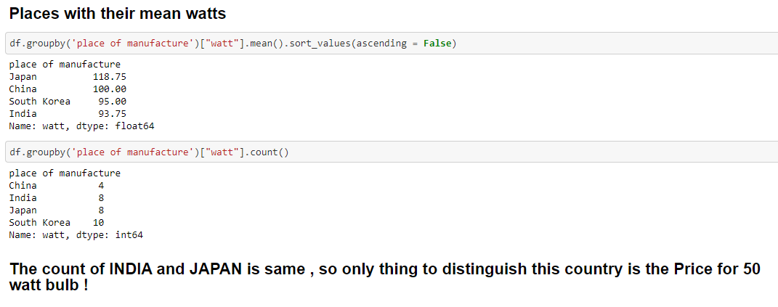
We first check the mean of watts for different country !

Slide 10
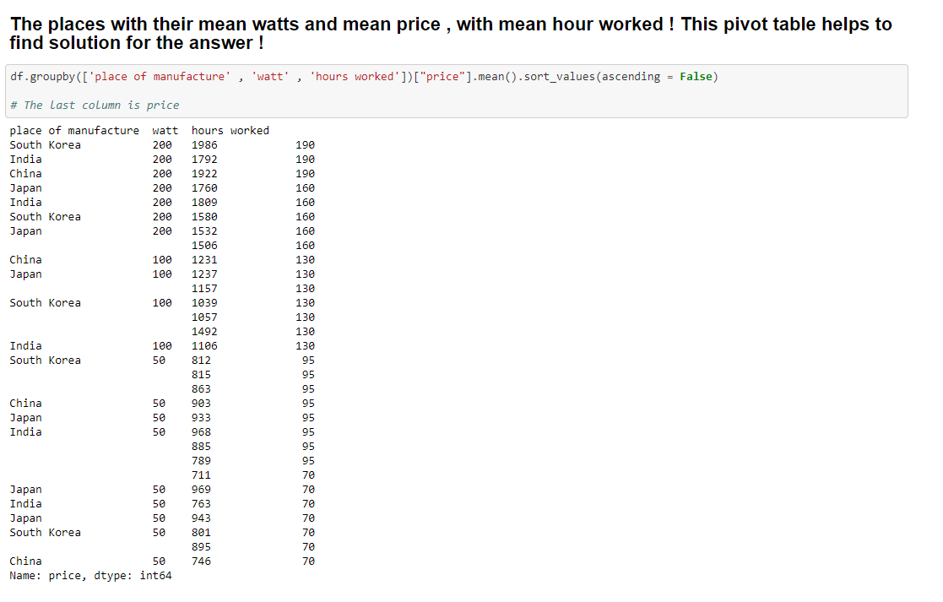
And there you go , by looking at this image, we shall get our answer

Slide 11
When we refer the 50 watts column ,we see that INDIA produes 50 watts for an avg price of 95 ,
where as JAPAN on the other side produces the same 50 watts for 70 rupees with a great mean duration of 969 hr lifespan !
Wanna buy a great bulb of 50 watts for less price ,head to JAPAN my friend :)
The Ans is : JAPAN

Slide 12
Ques 3 : Which country provides more efficiency (price to quality)
This is tricky ques , cause wanting to find the efficiency wrt price and quality ! The efficiency of bulbs range from one another (Ex : Efficiency of LED is far away from Incadescent bulb and CFL)

Slide 13
Here , we have assumed the bulb to be : Incadescent bulb
Whenever you need to find efficiency of Bulb ,you need to understand and find the Lumen value !
1 lumen = 15 times watt for incadescent

Slide 14
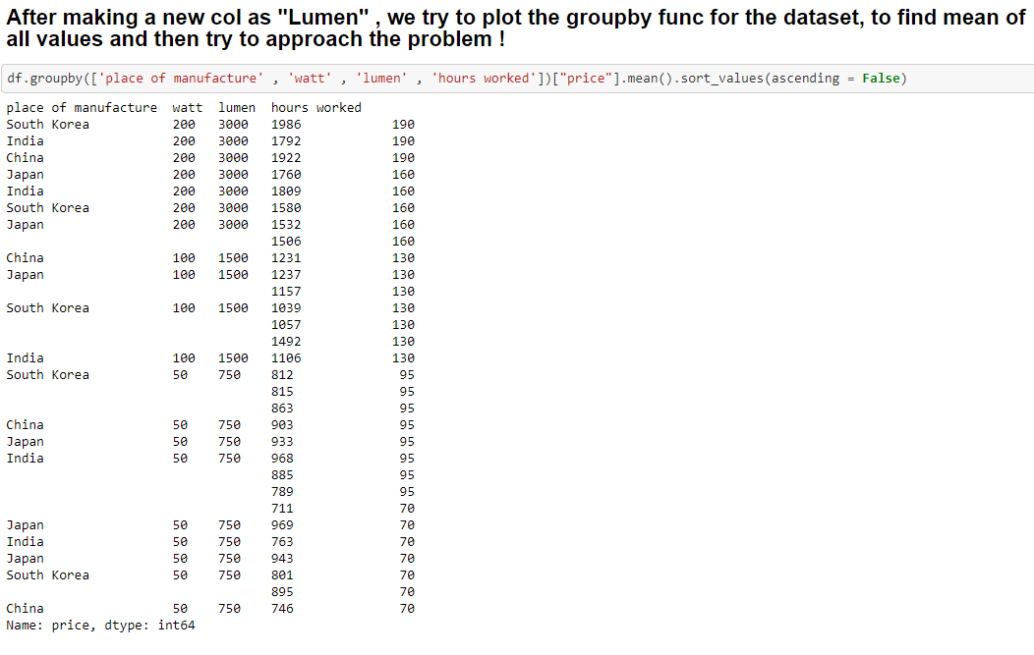

Slide 15
The approach is :
We will find the mean lumen , mean hour worked mean price and mean watt of the bulb from each place and then divide the hours worked by watt , which will give us the efficiency and if some efficiency are equal , we will jump to see the Price value
In short : If Mean Price is less , mean watt is more , mean lumen is more and mean hour is more : That is the preferred Country to choose

Slide 16
The Groupby Table

Slide 17
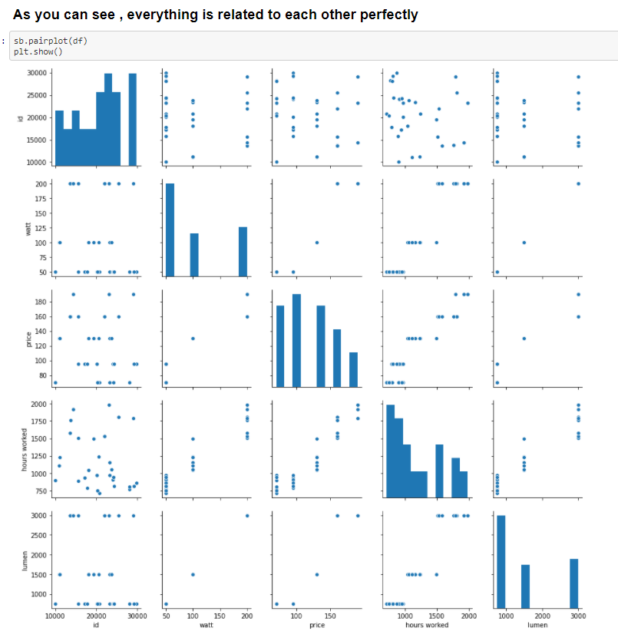
The Pair Plot

Slide 18
The Final Reveal
Values for INDIA Values for SOUTH KOREA
Mean Watt : 120.0 Mean Watt : 120.0
Mean Lumen : 1800.0 Mean Lumen : 1800.0
Mean hour : 1287.6 Mean hour : 1243.6
Mean price : 129.0 Mean price : 129.0
Efficiency in % is : 10.73 Efficiency in % is : 10.36
Lumency is 15.0 Lumency is 15.0
Price for 1 watt 1.075 Price for 1 watt 1.075
Values for CHINA Values for JAPAN
Mean Watt : 100.0 Mean Watt : 108.33
Mean Lumen : 1500.0 Mean Lumen : 1625.0
Mean hour : 1200.5 Mean hour : 1229.0
Mean price : 121.25 Mean price : 114.17
Efficiency in % is : 12.005 Efficiency in % is : 11.39
Lumency is 15.0 Lumency is 15.0
Price for 1 watt 1.21 Price for 1 watt 1.05

Slide 19
There is actually many thing to look now , before actually coming to a conclusion !
Since Efficiency of INDIA and SOUTH KOREA is less , we can rule them out !
Now the left ones are JAPAN and CHINA
Since , the Efficiency of Japan is 11.34 % and China is 12.005 % , China wins here !
but when having a look at
1 : Mean Price : Japan mean price for the bulb is less than china
2 : Price for 1 watt is less in japan than in China
3 : Mean hour of life span of Japan Bulb is 1229 hr , 29 hr greater than China (1220 hr)
4 : Mean Lumen is also higher in Japan , than in China
So , looking at all these points JAPAN win this case , even though it is just 1 % behind china, Statistical approach and Generalised Answer matters more than just jumping to the conclusion from one direction is what is think !
We can also say that mean watt of JAPAN is 108 and China is 100 , this makes all the difference !
But again applying the T-test and p-value , JAPAN wins !
Ans : Japan
THANK YOU

