Slide 1


~ENODO~
TEAM NAME : DATA HUNGERS
Task 2 : Hotel Stay
:Team Member:
Manish Sharma – NMIT(Bangalore)
Ayush Pandey – HBTU(Kanpur)

Slide 2
This task is about predicting the rent house for a young boy named Archit who is a bachelor and searching for rent house near to his Office and at affordable cost.
Bachelorhood
Bachelorhood is the best phase of life for most of us as we are free of responsibilities and also get our freedom to spent time money the way we want.
The challenges we face are in taking rent house as they do not like partying. Many landlords feel that singles have the tendency to remain Unhygenic. And renting out a flat to them is not safe for property . There is a tendency to booze, party , listen to music.

Slide 3
Numerous Problems faced
Higher Rent- Bachelor has to pay more Rent bacause landlords are allowing their property to be disrupted. High amount meet the maintenance fee. Another reason is bachelors change their room frequently which may be loss to landlords.
Huge Deposit- Bachelors have to pay more with heavy security deposit which is for making sure that tenant wont leave home.
Restrictions on Food- Singles fail to maintain good food habit. Landlords question their family's background, caste.
Interrogation – Asking hundreds of questions related to having bf/gf or bringing friends to home are annoying .
Deep Rooted Biases- Working on your looks. Not having tattoos, ripped Jeans, spikes may cause problem in buying houses.

Slide 4
About Archit
Archit is a graduated student and works from 10 AM to 9:30 PM from Monday to Friday and half days on Weekends.
He is looking for Accommodation around his Office.
He is freaked of parties on Sundays....
Non vegetarian and eating at nights.
He want to take society which is not restricted for anything.

Slide 5
Mangharam Residency
Residency with three types of accommodation Facilities which are 1BHK, 2BHK, 3BHK. With a lush green campus with a swimmimg pool .
Cleaning facility is not provided and a compulsory amount of Rs. 500 per month.
Rules:
1.)No deliveries after 10 PM 2.)If illegal works found person has to pay penalty of Rs. 20000 3.) No disturbance after 9 PM. Penalty of 7000
18 km from Archits Office.

Slide 6
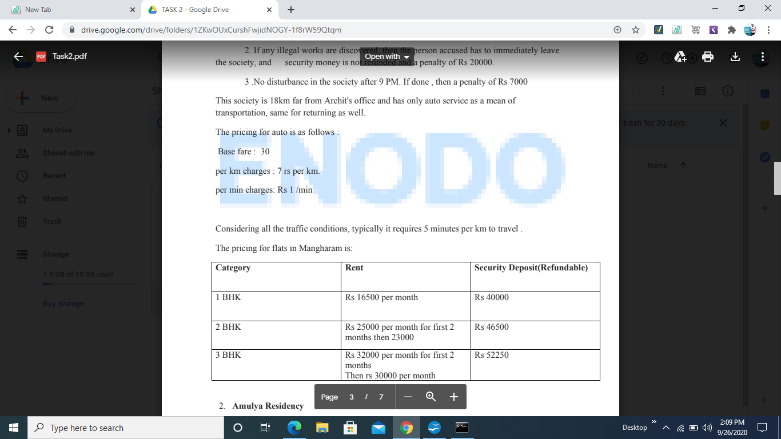
Mangharam Residence Expenses

Slide 7
Amulya Residency
Society with Old Ideas having no internet facility .
Charge is Rs. 2000 for Optic fibre broadband.
Rules:
1.)Deliveries till 11:30 2.) Fine of Rs. 1000 on disturbances 3.)Non Refundable Security of 10000.
24 km from Office
Per km chages- Rs 7.5

Slide 8
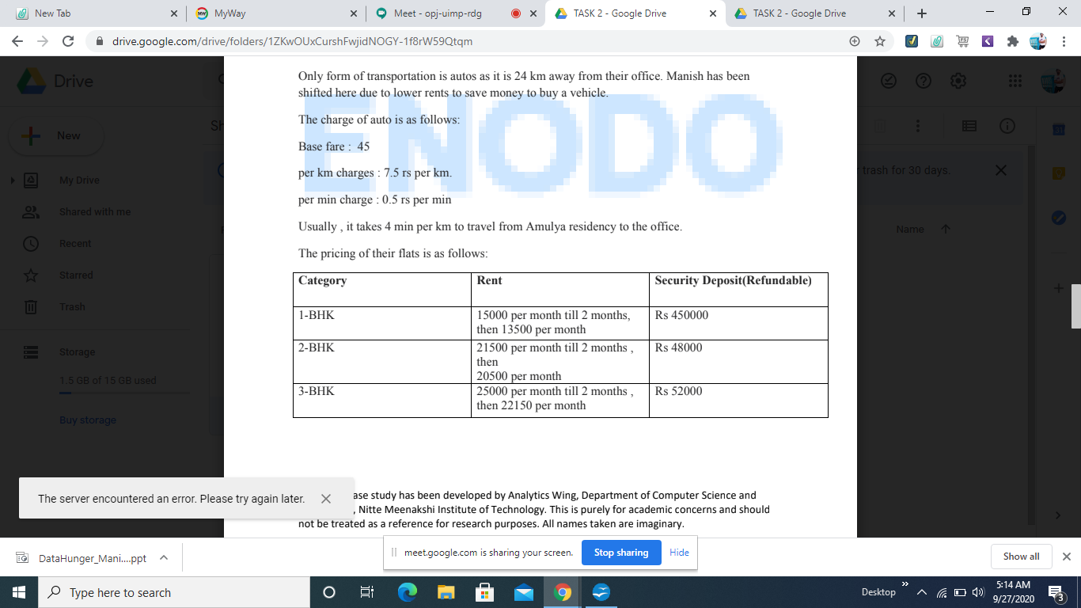
Amulya Residence Expense

Slide 9
Phoenix Residency
Finest Residency with rents usually higher
No 1 BHK instead 4BHK
15km from Office and guards are charging entry fee for deliveries at Night
Bribing is 5% of the bill.
Rules:1.) for partying 16 halls with 3000 per night on weekends and 2000 on weekdays.
Non Refundable amount of 45000.

Slide 10
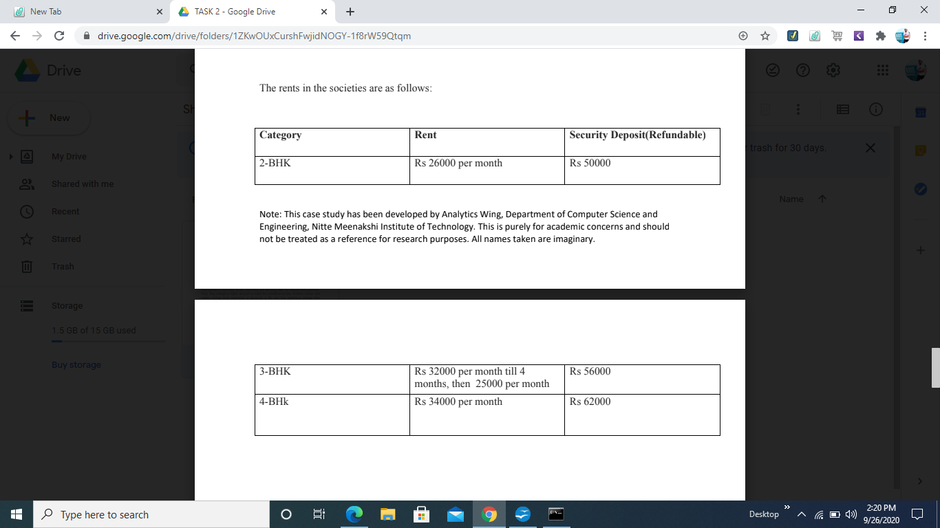
Phoenix Residence Expenses

Slide 11
Assumptions
Archit is seeking accommodation for a period of 1 to 6 months.
One month advance rent and security money has to be paid.
Consider 30 days in month
Considering Archit breaks all the Rules, hence eligible for Fine(Penalty).

Slide 12
Points to Remember
Archit is a graduated student and works from 10 AM to 9:30 PM. From Monday to Friday and half days on Weekends.
He is looking for Accommodation around his Office.
He is freaked of parties on Sundays....
Non vegetarian and eating at nights.
He want to take society which is not restricted for anything

Slide 13
1. Archit is planning for 1 BHK, which society he should prefer considering all the expenses?
Ans :
We know that Amulya and Manghalam both provide 1 BHK.
Amulya Total Expenses: ( 1 BHK )
Cost for 2 months = Rs.30000
Cost for remaining 4 months = Rs.54000
Advance and Security = Rs.15000+45000
Distance for 1 round = 24*2 = 48Km
Travel Charges = Rs 7.5 per Km 1 Day price = 7.5*48 = Rs.360 6 months price = 360*180 = Rs. 64800
Internet Connection(6 months)= 2000*6 = Rs. 12000
Fine / Penalty = 10000+1000 = Rs. 11000
Total Charge = Rs. 231800

Slide 14
Mangharam Total Expenses:( 1 BHK )
Cost for 6 months = Rs.99000
Advance = Rs.16500
Security = Rs. 40000
Distance for 1 round = 18*2 = 36Km
Travel Charges = Rs 7.0 per Km 1 Day price = 7.0*36 = Rs.252 6 months price = 252*180 = Rs. 45360
Cleaning facilities for 6 months = Rs. 3000
Fine / Penalty = 7000+20000 = Rs. 27000
Total Charge = Rs. 230860

Slide 15
Though Mangharam charges Rs. 1000 less than Amulya , Archit will choose Amulya because:
1.Manish,his colleague lives in Amulya
2. There is no delivery after 10:00 PM in Mangharam but this facility is available in Amulya till 11:30 PM.
3. Penalty is less in Amulya.
4. Time taken for 1 km from Amulya is 4 min while for Mangharam it is 5 min.
Answer:1 Archit will choose Amulya Residency

Slide 16
Q2: Incase he plans for 2 BHK, then what should be his choice considering all the expenses.
Mangharam Total Expenses:( 2 BHK )
Cost for 6 months = Rs.142000
Advance = Rs.25000
Security = Rs. 46500
Distance for 1 round = 18*2 = 36Km
Travel Charges = Rs 7.0 per Km 1 Day price = 7.0*36 = Rs.252 6 Months Price = 252*180 = Rs. 45360
Cleaning facilities for 6 months = Rs. 3000
Fine / Penalty = 7000+20000 = Rs. 27000
Total Charge = Rs. 288860

Slide 17
Amulya Total Expenses:( 2 BHK )
Cost for 2 months = Rs.43000
Cost for remaining 4 months = Rs.82000
Advance and Security = Rs.21500+48000
Distance for 1 round = 24*2 = 48Km
Travel Charges = Rs 7.5 per Km 1 Day price = 7.5*48 = Rs.360 6 months price = 360*180 = Rs. 64800
Internet Connection(6 months)= 2000*6 = Rs. 12000
Fine / Penalty = 10000+1000 = Rs. 11000
Total Charge = Rs. 282300

Slide 18
Phoenix Total Expenses:( 2 BHK )
Cost for 6 months = Rs.156000
Advance and Security = Rs.26000+50000
Bribing Charges = (5% 0f 26000) * 6
= 7800
Distance for 1 round = 15*2 = 30Km
Travel Charges = Rs 2.5 per Km 1 Day price =2.5*30 = Rs.75 6 months price = 75*180 = Rs. 13500
Fine / Penalty = 3000*6 + 45000 = Rs. 63000
Total Charge = Rs. 316300

Slide 19
Answer: 2
Looking at the Expenses, Phoenix Residence is Ruled out
1. Considering the expense of Amulya is less .
2. Since Archit is party lover , Amulya provides delivery till 11:30pm.
3. The penalty is less in Amulya Residence.
4. We know Archit is a party lover and his colleague Manish lives with him in Amulya Residence.
So he will choose Amulya Residence

Slide 20
Q3: Should he go for Amulya’s 3 BHK over Mangharam’s 2BHK?
Amulya Total Expenses:( 3 BHK )
Cost for 2 months = Rs.50000
Cost for remaining 4 months = Rs 88600
Advance and Security = Rs.25000+52000
Distance for 1 round = 24*2 = 48Km
Travel Charges = Rs 7.5 per Km 1 Day price = 7.5*48 = Rs.360 6 months price = 360*180 = Rs. 64800
Internet Connection(6 months)= 2000*6 = Rs. 12000
Fine / Penalty = 10000+1000 = Rs. 11000
Total Charge = Rs. 303400

Slide 21
Mangharam Total Expenses:( 2 BHK )
Cost for 6 months = Rs.142000
Advance = Rs.25000
Security = Rs. 46500
Distance for 1 round = 18*2 = 36Km
Travel Charges = Rs 7.0 per Km 1 Day price = 7.0*36 = Rs.252 6 Months Price = 252*180 = Rs. 45360
Cleaning facilities for 6 months = Rs. 3000
Fine / Penalty = 7000+20000 = Rs. 27000
Total Charge = Rs. 288860

Slide 22
Answer : 3
1. Since Archit is a Bachelor, having 3 BHK is more for him
2. The Expense in Mangharam is less than Amulya.
3. Mangharam is closer to his office with higher quality than Amulya.
Conclusion:So acoording to the conditions given , Archit should go for Mangharam Residence.

Slide 23
Q4: He has booked Amulya’s 2 BHK, but he is willing to take Mangharam’s 1BHK. Should he take this step of cancelling the booking in Amulya’s 2 BHK and choosing Mangharam’s 1BHK.

Slide 24
Amulya Total Expenses:( 2 BHK )
Cost for 2 months = Rs.43000
Cost for remaining 4 months = Rs.82000
Advance and Security = Rs.21500+48000
Distance for 1 round = 24*2 = 48Km
Travel Charges = Rs 7.5 per Km 1 Day price = 7.5*48 = Rs.360 6 months price = 360*180 = Rs. 64800
Internet Connection(6 months)= 2000*6 = Rs. 12000
Fine / Penalty = 10000+1000 = Rs. 11000
Total Charge = Rs. 282300

Slide 25
Mangharam Total Expenses:( 1 BHK )
Cost for 6 months = Rs.99000
Advance = Rs.16500
Security = Rs. 40000
Distance for 1 round = 18*2 = 36Km
Travel Charges = Rs 7.0 per Km 1 Day price = 7.0*36 = Rs.252
6 months price = 252*180 = Rs. 45360
Cleaning facilities for 6 months = Rs. 3000
Fine / Penalty = 7000+20000 = Rs. 27000
Total Charge = Rs. 230860

Slide 26
Answer 4:
Considering all the points:
1. Incase he leaves Amulya he won't get his refund of Security and Advance money (i.e. total loss of 69500)
2. Since he is a party animal 2 BHK of Amulya is sufficient .
3. He has his colleague in Amulya.
4. There is Midnight Delivery option in Amulya but not in Mangharam.
Conclusion: In view of above points , it is beneficial for him to stay in Amulya Residence.

Slide 27
THANK YOU
Regards-
Team: Data Hunger

