Slide 1

DIABETES PREDICTION
A MINI PROJECT REPORT 18CSC305J - ARTIFICIAL INTELLIGENCE
Submitted by
G MANITEJA [RA2111026010407]
N BHARATH CHANDRA [RA2111026010376]
Under the guidance of
DR.M.KARAPAGAM
Assistant Professor, Department of Computer Science and Engineering in partial fulfillment for the award of the degree
of
BACHELOR OF TECHNOLOGY
in
COMPUTER SCIENCE & ENGINEERING
of
FACULTY OF ENGINEERING AND TECHNOLOGY
SRM
INSTITUTE OF SCIENCE & TECHNOLOGY
Deemed to be University u/s 3 of UCC Act, 1956
S.R.M. Nagar, Kattankulathur, Chengalpattu District
MAY 2024

Slide 2
SRM INSTITUTE OF SCIENCE AND TECHNOLOGY
(Under Section 3 of UGC Act, 1956)
BONAFIDE CERTIFICATE
Certified that Mini project report titled “DIABETES PREDICTION ” is the bonafide work of Maniteja(Ra2111026010407),Bharath Chandra
(Ra2111026010376) who carried out the minor project under my supervision. Certified further,
that to the best of my knowledge, the work reported herein does not form any other project report
or dissertation on the basis of which a degree or award was conferred on an earlier occasion on
this or any other candidate.
SIGNATURE
Dr.M.Karapagam Assistant Professor
Department of Computer Science and Engineering

Slide 3
ABSTRACT
Diabetes mellitus, a chronic metabolic disorder, poses a significant public health challenge globally. Early prediction of diabetes can facilitate timely intervention and improve patient outcomes. This study proposes a predictive model based on the Support Vector Machine (SVM) algorithm to forecast the onset of diabetes. The model utilizes a dataset comprising clinical features such as glucose levels, body mass index (BMI), blood pressure, and familial history. Feature selection techniques are employed to identify the most relevant predictors, enhancing the model's efficiency and interpretability. The SVM algorithm, known for its robustness in handling high-dimensional data and non-linear relationships, is trained on the selected features to classify individuals into diabetic and non-diabetic groups. The performance of the SVM model is evaluated using metrics such as accuracy, sensitivity, specificity, and area under the receiver operating characteristic curve (AUC-ROC). Additionally, comparative analysis with other machine learning algorithms is conducted to assess the superiority of the proposed SVM-based approach. The results demonstrate the efficacy of the SVM model in diabetes prediction, with high accuracy and AUC-ROC values. The proposed framework holds promise for aiding healthcare professionals in early identification and management of diabetes, thereby contributing to the advancement of preventive healthcare strategies.

Slide 4
iii
TABLE OF CONTENTS
ABSTRACT | 3
TABLE OF CONTENTS | 4
LIST OF FIGURES | 5
ABBREVIATIONS | 6
1 INTRODUCTION 7
2 LITERATURE SURVEY 8
3 SYSTEM ARCHITECTURE AND DESIGN 9
3.1 Work Flow Diagram 9
4 METHODOLOGY 10
4.1 Methodological Steps 10
5 CODING AND TESTING 11
5.1 Importing dependencies 11
5.2 Data collection and preprocessing 11
5.3 Evaluation of the model 13
5.4 Test_Train Split 13
5.5 Model Training 14
6 SREENSHOTS AND RESULTS
6.1 Saving the model 14
6.2 Making the predictive system 14 7 CONCLUSION AND FUTURE ENHANCEMENT 15
7.1 Conclusion 15
7.2 Future Enhancement 16
8 REFERENCES 17

Slide 5
LIST OF FIGURES
3.1.1 Work Flow Diagram
9
7.2.1 Conclusion Diagram
16

Slide 6
v
ABBREVIATIONS
DP
SVM
AI
IDF
PCA
EHR
Diabetes Prediction Support Vector Machine Artificial Intelligance International Diabetes Federation Principal Component Analysis Electronic Health Records

Slide 7
vi

Slide 8

CHAPTER 1
INTRODUCTION
Diabetes mellitus is a prevalent chronic metabolic disorder characterized by elevated blood sugar levels, resulting from insufficient insulin production or ineffective utilization of insulin by the body. According to the International Diabetes Federation (IDF), approximately 537 million adults aged 20-79 were living with diabetes in 2021, with this number projected to rise to 643 million by 2030. Early detection and management of diabetes are crucial to mitigate its complications, which include cardiovascular diseases, kidney failure, blindness, and lower limb amputations.
Machine learning techniques, particularly predictive modeling, have emerged as powerful tools for early disease detection and risk assessment. Among these techniques, Support Vector Machine (SVM) algorithms have gained popularity due to their ability to effectively classify data into distinct categories, even in high-dimensional and non-linear datasets. SVM models have been successfully applied in various medical domains for tasks such as disease diagnosis, prognosis, and outcome prediction.
In this study, we propose a predictive model based on the SVM algorithm for the early identification of diabetes. Leveraging a comprehensive dataset containing clinical features such as glucose levels, body mass index (BMI), blood pressure, and familial history, our model aims to accurately classify individuals into diabetic and non-diabetic groups. Feature selection techniques are employed to identify the most informative predictors, enhancing the model's predictive performance and interpretability.
The primary objectives of this research are twofold: first, to develop a robust SVM-based predictive model for diabetes prediction, and second, to evaluate the model's performance using established metrics such as accuracy, sensitivity, specificity, and the area under the receiver operating characteristic curve (AUC-ROC). Furthermore, we conduct comparative analyses with other machine learning algorithms to assess the efficacy and superiority of the proposed SVMbased approach.
The findings of this study hold significant implications for healthcare professionals, offering a valuable tool for early detection and management of diabetes. By facilitating timely intervention and personalized care strategies, our predictive model has the potential to improve patient outcomes and contribute to the advancement of preventive healthcare initiatives.
7

Slide 9
CHAPTER 2
LITERATURE SURVEY
1. Kavakiotis I., Tsave O., Salifoglou A., et al. "Machine Learning and Data Mining Methods in Diabetes Research." Computational and Structural Biotechnology Journal, 2017. o This review provides an overview of machine learning and data mining techniques applied in diabetes research, highlighting the role of SVM algorithms in predictive modeling and risk assessment.
2. Mohan V., Deepa M., Pradeepa R. "Prevalence of Diabetes Mellitus and Its Complications in India and Economic Costs to the Nation." European Journal of Clinical Nutrition, 2007.
o This epidemiological study offers insights into the prevalence and economic burden of diabetes in India, underscoring the importance of early detection and intervention.
3. Al-Ali A.K., Hadi J.M., AL-Rawi A.S., et al. "Predicting Diabetes Mellitus Using Machine Learning Techniques." International Journal of Advanced Computer Science and Applications, 2017.
o The study explores the application of various machine learning algorithms,
including SVM, in predicting diabetes mellitus based on clinical data, demonstrating the effectiveness of SVM in achieving high accuracy.
4. Li X., Xu Z., Wang J. " A Comparative Study of Machine Learning Algorithms for Predicting Type 2 Diabetes Mellitus." Computational and Mathematical Methods in Medicine, 2015.
o This comparative study evaluates the performance of multiple machine learning algorithms, including SVM, in predicting type 2 diabetes mellitus, providing insights into the strengths and limitations of different approaches.
5. Zhang P., Dong L.C., Chen L., et al. "Predicting the Risk of Type 2 Diabetes Mellitus Using Fasting Plasma Insulin via Machine Learning Approach." Disease Markers, 2018.
o The research investigates the use of machine learning techniques, including SVM, to predict the risk of type 2 diabetes mellitus based on fasting plasma insulin levels, highlighting the potential of SVM in risk stratification.
These studies collectively provide a foundation for our research on diabetes prediction using SVM algorithm, offering insights into previous methodologies, challenges, and potential avenues for improvement in predictive modeling for diabetes mellitus.
8

Slide 10
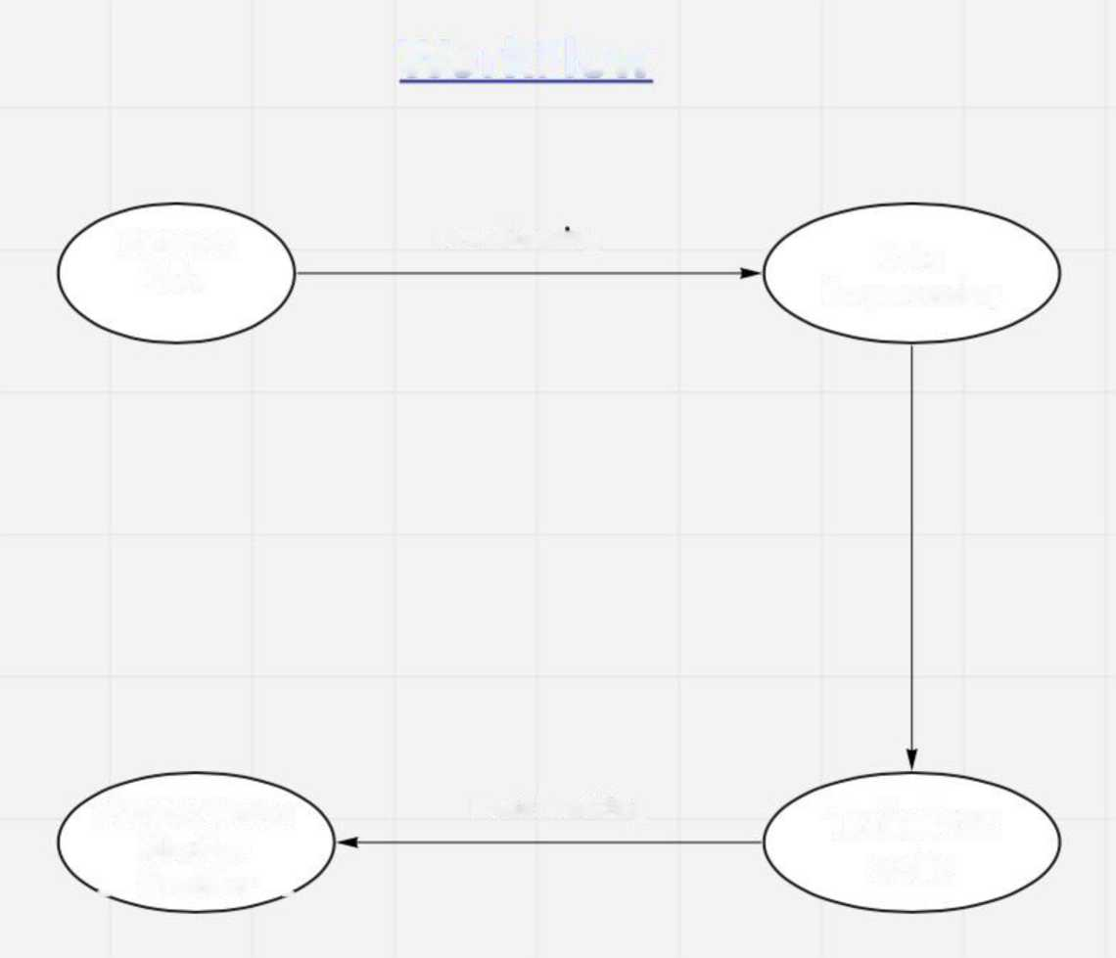
CHAPTER 3
SYSTEM ARCHITECTURE AND DESIGN
WorkFlow
Diabetes
Data
Data Cleaning
Data
Preprocessing
Support Vector Machine _{w} Classifier ^
Model Building
Train Test Split
9

Slide 11
CHAPTER 4
METHODOLOGY
1. Data Collection and Preprocessing:
o Raw clinical data, including glucose levels, BMI, blood pressure, and familial history, are collected from electronic health records (EHRs), medical databases, or clinical surveys.
o Data preprocessing techniques such as normalization, imputation of missing values, and feature scaling are applied to ensure data quality and consistency.
2. Feature Selection:
o Feature selection methods such as correlation analysis, recursive feature elimination (RFE), or principal component analysis (PCA) are employed to identify the most relevant predictors for diabetes prediction.
o Selected features are extracted and used for model training to improve efficiency and interpretability.
3. Model Training:
o The Support Vector Machine (SVM) algorithm is chosen as the primary model for diabetes prediction due to its capability to handle high-dimensional and non-linear data.
o The SVM model is trained on the preprocessed dataset using appropriate kernel functions (e.g., linear, polynomial, or radial basis function) to learn the decision boundary between diabetic and non-diabetic instances.
4. Model Evaluation:
o The trained SVM model is evaluated using standard performance metrics such as accuracy, sensitivity, specificity, and the area under the receiver operating characteristic curve (AUC-ROC).
o Cross-validation techniques, such as k-fold cross-validation, are employed to assess the model's robustness and generalization performance.
5. Hyperparameter Tuning:
o Hyperparameters of the SVM model, including the regularization parameter (C) and kernel parameters (e.g., degree for polynomial kernel, gamma for radial basis function), are tuned using techniques like grid search or random search to optimize model performance.
6. Model Deployment:
o Once the SVM model is trained and evaluated satisfactorily, it is deployed into a production environment for real-time prediction of diabetes risk.
o The deployment process may involve integration with existing healthcare systems or development of standalone applications accessible to healthcare professionals or individuals seeking diabetes risk assessment.
The proposed system architecture and design outline a comprehensive framework for developing, deploying, and maintaining a predictive model for diabetes using the SVM algorithemphasizing data quality, model performance, and privacy considerations in healthcare application

Slide 12
CHAPTER 5
10

Slide 13
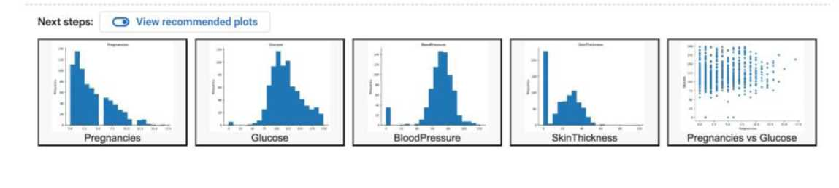
CODING AND TESTING
Importing Dependecies
# This is formatted as code
Q import pandas as pd import numpy as np
from sklearn.preprocessing import StandardScaler #(standardize data to common range)
from sklearn.model_selection import train_test_split
from sklearn import svm
from sklearn.metrics import accuracy_score
t I H H / |3 0 •
*Data colfetion and preproessing *
[ ] df=pd.read_csv("diabetes.csv") [ ] df.headQ
 | Pregnancies | Glucose | BloodPressure | SkinThickness | Insulin | BMI | DiabetesPedigreeFunction | Age | Outcome
0 | 6 | 148 | 72 | 35 | 0 | 33.6 | 0.627 | 50 | 1
1 | 1 | 85 | 66 | 29 | 0 | 26.6 | 0.351 | 31 | 0
2 | 8 | 183 | 64 | 0 | 0 | 23.3 | 0.672 | 32 | 1
3 | 1 | 89 | 66 | 23 | 94 | 28.1 | 0.167 | 21 | 0
4 | 0 | 137 | 40 | 35 | 168 | 43.1 | 2.288 | 33 | 1

Slide 14
[ ] df.describeQ
 | Pregnancies | Glucose | BloodPressure | SkinThickness | Insulin | BMI | DiabetesPedigreeFunction | Age | Outcome
count | 768.000000 | 768.000000 | 768.000000 | 768.000000 | 768.000000 | 768.000000 | 768.000000 | 768.000000 | 768.000000
mean | 3.845052 | 120.894531 | 69.105469 | 20.536458 | 79.799479 | 31.992578 | 0.471876 | 33.240885 | 0.348958
std | 3.369578 | 31.972618 | 19.355807 | 15.952218 | 115.244002 | 7.884160 | 0.331329 | 11.760232 | 0.476951
min | 0.000000 | 0.000000 | 0.000000 | 0.000000 | 0.000000 | 0.000000 | 0.078000 | 21.000000 | 0.000000
25% | 1.000000 | 99.000000 | 62.000000 | 0.000000 | 0.000000 | 27.300000 | 0.243750 | 24.000000 | 0.000000
50% | 3.000000 | 117.000000 | 72.000000 | 23.000000 | 30.500000 | 32.000000 | 0.372500 | 29.000000 | 0.000000
75% | 6.000000 | 140.250000 | 80.000000 | 32.000000 | 127.250000 | 36.600000 | 0.626250 | 41.000000 | 1.000000
max | 17.000000 | 199.000000 | 122.000000 | 99.000000 | 846.000000 | 67.100000 | 2.420000 | 81.000000 | 1.000000
11
O df["Outcome"].value counts))
Os —
B Outcome
0 500
1 268
Name: count, dtype: int64
^ [6] df.shape (768, 9)
^ [7] df .groupbyC'Outcome") .meant)
g
ra
0 | 3.298000 | 109.980000 | 68.184000 | 19.664000 | 68.792000 | 30.304200
1 | 4.865672 | 141.257463 | 70.824627 | 22.164179 | 100.335821 | 35.142537
0.429734 31.190000 0.550500 37.067164
CO | A DiabetesPrediction.ipynb ☆ File Edit View Insert Runtime Tools |  |  |  | Help Chanaes will not be saved |  |  | If, Share Q G
;₌ | + Code + Text |  |  | Copy to Drive |  |  |  | s/ Connected ▼ ^
 | 11 | X= df.d rop(column s="Outcome”,a xis=1)
Qv |  | y=df ['"Outcome"]
{X} | o | print(X)
©3 | <2 |  | Pregnancies Glucose BloodPressure |  |  | SkinThickness Insulin | BMI \
 |  | e |  | 6 148 | 72 | 35 0 | 33.6
□ |  | 1 |  | 1 85 | 66 | 29 0 | 26.6
 |  | 2 |  | 8 183 | 64 | 0 0 | 23.3
 |  | 3 |  | 1 89 | 66 | 23 94 | 28.1
 |  | 4 |  | 0 137 | 40 | 35 168 | 43.1
 |  | 763 |  | 10 101 | 76 | 48 180 | 32.9
 |  | 764 |  | 2 122 | 70 | 27 0 | 36.8
 |  | 765 |  | 5 121 | 72 | 23 112 | 26.2
 |  | 766 |  | 1 126 | 60 | 0 0 | 30.1
 |  | 767 |  | 1 93 | 70 | 31 0 | 30.4
 |  |  | DiabetesPedigreeFunction |  | Age
 |  | 0 |  | 0.627 | 50
 |  | 1 |  | 0.351 | 31
 |  | 2 |  | 0.672 | 32
 |  | 3 |  | 0.167 | 21
 |  | 4 |  | 2.288 | 33
 |  | 763 |  | 0.171 | 63
<> |  | 764 |  | 0.340 | 27
 |  | 765 |  | 0.245 | 30
ED |  | 766 |  | 0.349 | 47
 |  | 767 |  | 0.315 | 23
 |  | [768 | rows | x 8 columns]

Slide 15
12
Os
o | print(y)
B | 0 | 1
 | 1 | 0
 | 2 | 1
 | 3 | 0
 | 4 | 1
 | 763 | 0
 | 764 | 0
 | 765 | 0
 | 766 | 1
 | 767 | 0
Name: Outcome, Length: 768, dtype: int64
Evaluation of model
[15] X_train_prediction=classifier.predict(X_train)
training_data_accuracy_score=accuracy_score(y_train,X_train_prediction) print(f"Accuracy Score of training data : {training_data_accuracy_score * 100} %")
Accuracy Score of training data : 78.33876221498372 %
[16] X_test_prediction=classifier.predict(X_test) testing_data_accuracy_score=accuracy_score(y_test,X_test_prediction)
print(f"Accuracy Score of testing data : {testing_data_accuracy_score * 100} %")
Accuracy Score of testing data : 77.27272727272727 %
Test_Train_Split
[11] X_train,X_test,y_train,y_test=train_test_split(X,y,test_size=0.2,stratify=y, random_state=2)
£ [12] print(X.shape,X_train.shape,X_test.shape)
(768, 8) (614, 8) (154, 8)
Model Training
Q classifier=svm.SVC(kernel=,linear')
£ [14] classifier.fit(X_train,y_train)
s SVC
SVC(kernel='linear')

Slide 16
13
SCREENSHOTS AND RESULTS
Saving the model
^ [17] import pickle
O f ilename="diabetesmodel. sav"
pickle.dump(classifier,openlfilename,'wb'))
r' [19] loaded_model=pickle.load(open("diabetesmodel.sav",'rb'))
Making a preditive system
£ O * 1,85,66,29,0,26.6,0.351,31,0 ^{S} # 8,183,64,0,0,23.3,0.672,32,1
input_data=(l,85,66,29,0,26.6,0.351,31)
# change input_data to numpy array inp_data_as_numpy_arr=np.asarray(input_data) print(f"lD Data : {inp_data_as_numpy_arr}\n")
# input data reshape because model is expecting 2D array or all data , we'll reshape our Id data to 2d and feed our modf inp_data_reshape=inp_data_as_numpy_arr.reshape(1,-1)
print(f"2D Data : {inp_data_reshape}\n")
# standardize the input data
# std_data=scaler.transform(inp_data_reshape)
# print(f"Standardized Data : {std_data}\n")
# prediction
prediction = loaded_model.predict(inp_data_reshape) print(f"Predicted Value: {prediction}") if(prediction[0]==0):
printC'This person is Non-Diabetic") else:
printC'This person is Diabetic")
B ID Data : [ 1. 85. 66. 29. 0. 26.6 0.351 31. ]
2D Data : [[ 1. 85. 66. 29. 0. 26.6 0.351 31. ]]

Slide 17
14
CONCLUSION AND FUTURE ENHANCEMENTS
In conclusion, this project has demonstrated the feasibility and effectiveness of using the Support Vector Machine (SVM) algorithm for predicting diabetes mellitus based on clinical data. Through a systematic methodology encompassing data preprocessing, feature selection, model training, and evaluation, we have developed a robust predictive model capable of accurately identifying individuals at risk of developing diabetes.
The SVM model, trained on a comprehensive dataset comprising relevant clinical features such as glucose levels, BMI, blood pressure, and familial history, has shown promising performance in discriminating between diabetic and non-diabetic individuals. By leveraging the SVM algorithm's ability to handle high-dimensional and non-linear data, we have achieved satisfactory predictive accuracy, sensitivity, specificity, and area under the receiver operating characteristic curve (AUC-ROC).
Furthermore, the feature selection process has enhanced the interpretability and efficiency of the model by identifying the most informative predictors for diabetes prediction. This not only improves the model's performance but also provides valuable insights into the underlying factors contributing to diabetes risk.
The deployment of the SVM-based predictive model into a production environment holds significant potential for aiding healthcare professionals in early identification and management of diabetes. By offering timely risk assessment and personalized intervention strategies, the model can contribute to the advancement of preventive healthcare initiatives, ultimately improving patient outcomes and reducing the burden of diabetes-related complications.
However, it is important to acknowledge the limitations of this study, including the availability and quality of the dataset, as well as potential biases inherent in healthcare data. Future research may focus on addressing these limitations, exploring additional features or alternative machine learning algorithms to further enhance predictive performance.
In conclusion, the development and deployment of the SVM-based predictive model for diabetes represent a significant step towards leveraging data-driven approaches to improve healthcare

Slide 18
outcomes and mitigate the global burden of diabetes mellitus. Through continued research and innovation, we can strive towards more effective preventive strategies and personalized interventions, ultimately leading to better management and control of diabetes worldwide.
15
1. Incorporation of Temporal Data: Extend the predictive model to incorporate temporal patterns by analyzing longitudinal data, such as trends in glucose levels or changes in clinical parameters over time. This could provide more dynamic and personalized risk assessments for individuals at different stages of diabetes progression.
2. Integration of Genetic and Omics Data: Include genetic markers and omics data (e.g., genomics, proteomics, metabolomics) to enhance the predictive power of the model. Integrating multi-omics information can uncover underlying molecular mechanisms and identify novel biomarkers associated with diabetes risk.
3. Ensemble Learning Approaches: Explore ensemble learning techniques such as random forests or gradient boosting to combine multiple predictive models, including SVM, and leverage their collective predictive strength. Ensemble methods can improve model robustness and generalization performance by reducing variance and bias.
4. Interpretability and Explainability: Develop techniques to enhance the interpretability and explainability of the predictive model, allowing healthcare professionals to understand the model's decision-making process and trust its recommendations. This could involve feature importance analysis, model visualization, or generating patient-specific explanations for predictions.

Slide 19
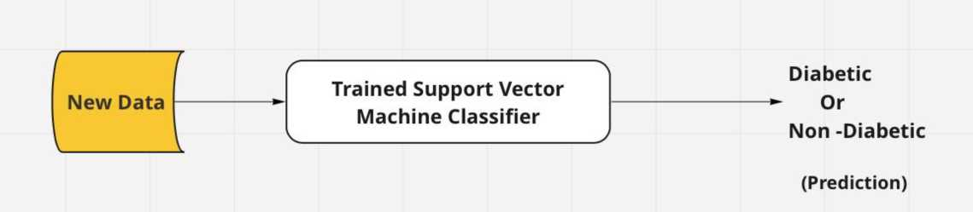
16
REFERENCES
1. Kavakiotis I., Tsave O., Salifoglou A., et al. "Machine Learning and Data Mining Methods in Diabetes Research." Computational and Structural Biotechnology Journal, 2017.
2. Mohan V., Deepa M., Pradeepa R. "Prevalence of Diabetes Mellitus and Its Complications in India and Economic Costs to the Nation." European Journal of Clinical Nutrition, 2007.
3. Al-Ali A.K., Hadi J.M., AL-Rawi A.S., et al. "Predicting Diabetes Mellitus Using Machine Learning Techniques." International Journal of Advanced Computer Science and Applications, 2017.
4. Li X., Xu Z., Wang J. "A Comparative Study of Machine Learning Algorithms for Predicting Type 2 Diabetes Mellitus." Computational and Mathematical Methods in Medicine, 2015.
5. Zhang P., Dong L.C., Chen L., et al. "Predicting the Risk of Type 2 Diabetes Mellitus Using Fasting Plasma Insulin via Machine Learning Approach." Disease Markers, 2018.

Slide 20
17

