Slide 1

Notes:
It’s decentralized review platform built on the top of ethereum blokchain

Slide 2
A Community Review Platform
By : “The Team”
Contributors:
Manohar Lakkoju
Sanket Kumar Gautam
Ashish Patel
Abhijeet Rawat
Notes:
Hurray! Go on

Slide 3
Current Issues:
Community review systems are mostly owned by big centralized organizations, e.g. Amazon, Google.
They can temper user’s review data for their profit.
Systems are centralized. So, it’s like single point of failure.
Notes:
If the system goes down, present system get affected very badly leading to complete loss of “valuable data” of users.

Slide 4
Solution:
We made a Decentralized Review platform using ethereum ecosystem.
The platform is tamper-proof, highly reliable and trusted.
Platform is easy to use.

Slide 5
System flow:
User has to provide us the link to the product(It could be of any kind e.g. product on e-commerce website, a hotel, restaurant, or a website).
User will write the review to the above and the system will add it to the Ethereum Blockchain.
Notes:
Putting data on ethereum block-chain makes it immutable and decentralized.

Slide 6
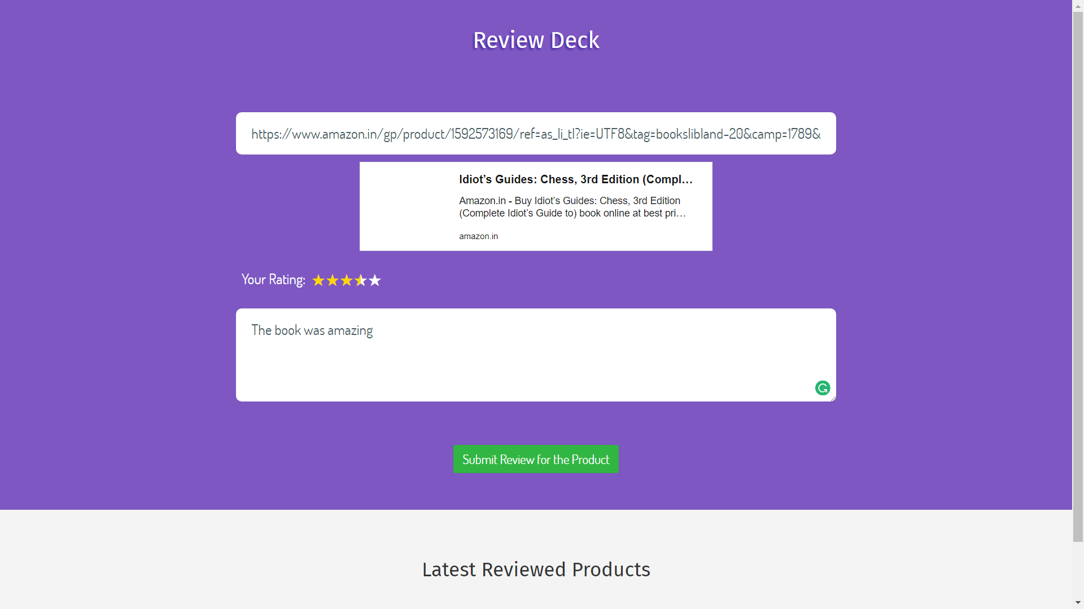
Screenshot of System

Slide 7
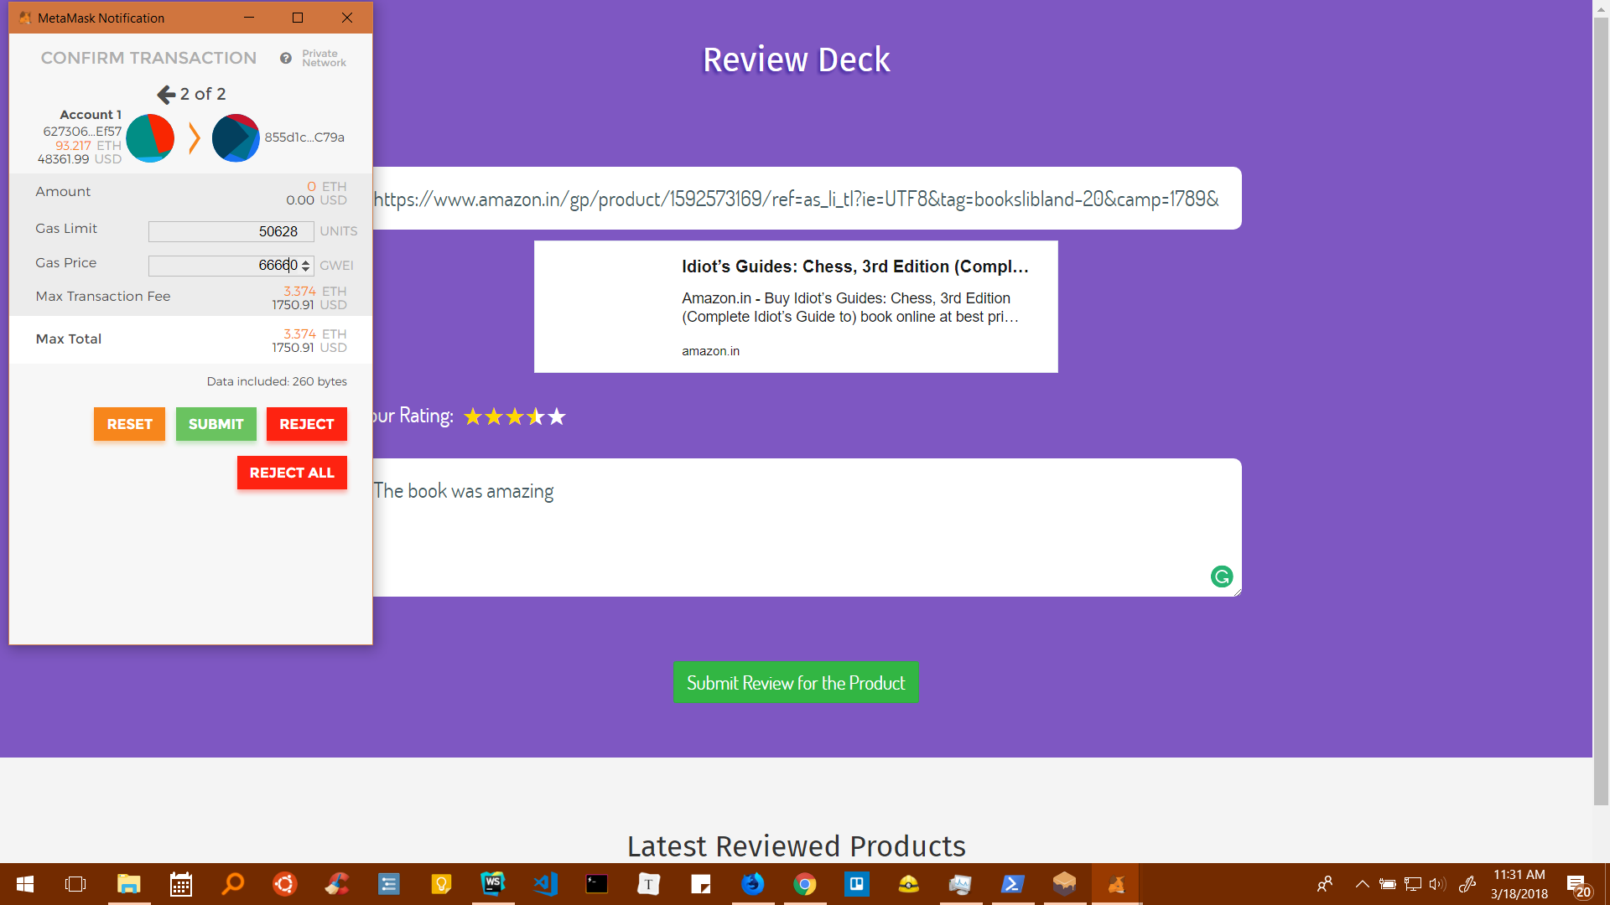

Slide 8
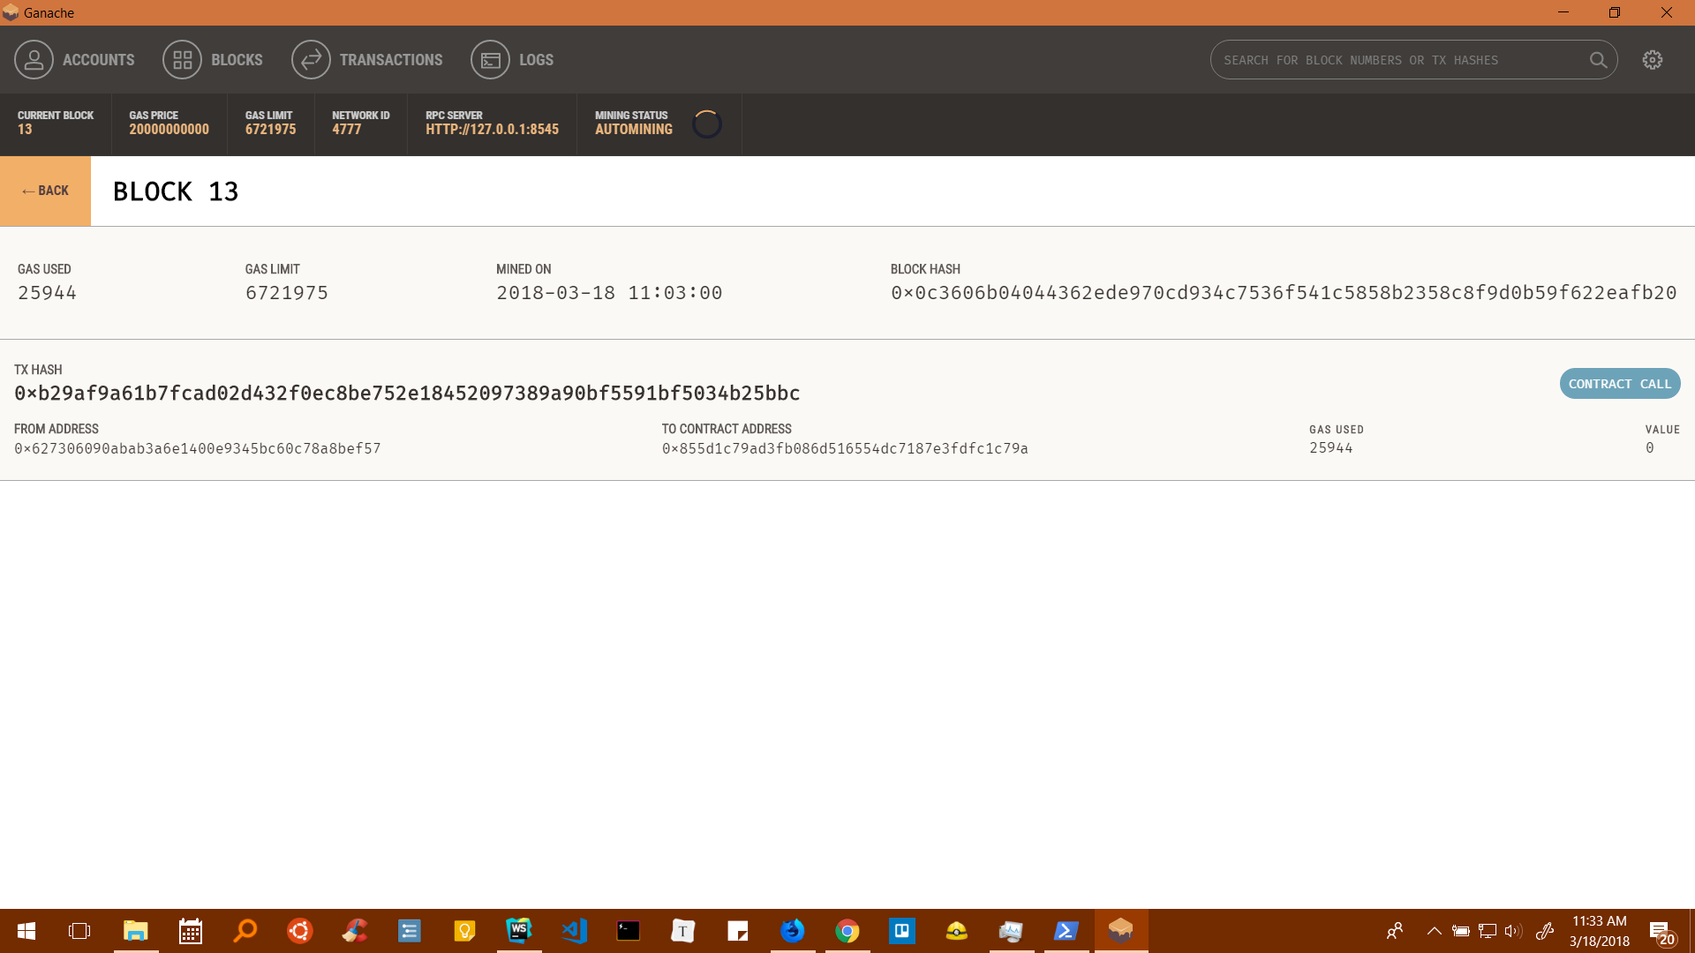

Slide 9
Technology Stack:
Tasks | Technologies Used
Web | ReactJS, Flask(TBD), HTML, CSS
BlockChain | Ethereum(Truffle), Solidity
Integrations | ZulipChat
Machine Learning | MSAzure

Slide 10
Innovations :
We have integrated our system with zulip platform, to categorize all the reviews provided by the users into several categories/topics based on sentiments, product, etc.
We also created a plugin like “Disqus”, which can be added to any web-page.

Slide 11
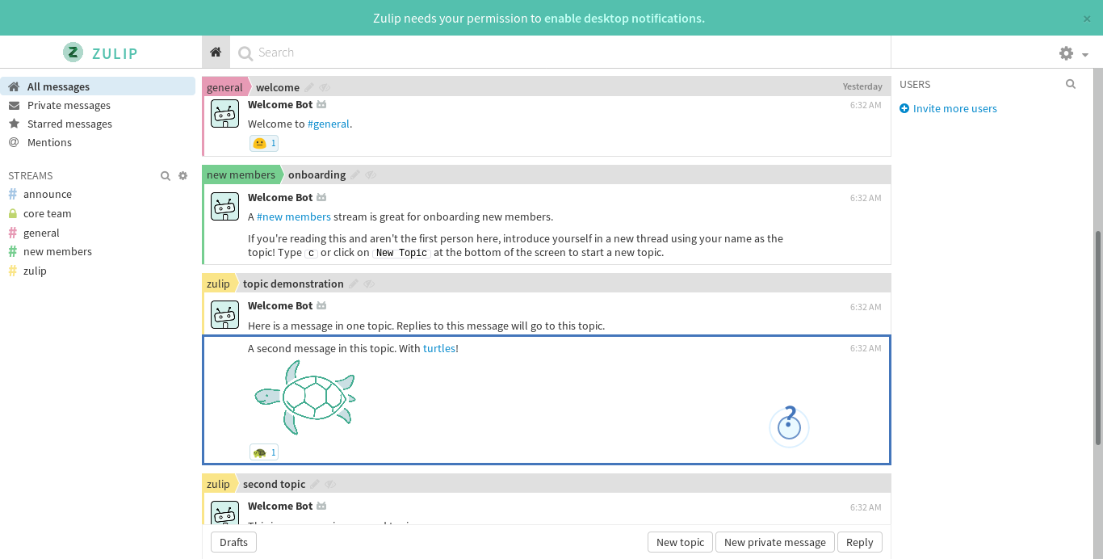
ZulipChat Integration

Slide 12
Thank You
Notes:
It’s a decentralized review Platform built on top of Ethereum..

