Slide 1

IDEAFORGE AI
AI-Powered Project Development Advisor
Raw Idea
Structured Blueprint
IdeaForge AI
From scattered concepts to structured, technically feasible project blueprints — powered by RAG, Groq, and semantic retrieval.

Slide 2

From Project Idea to Buildable Project
Students have ideas. Turning them into structured, technically feasible projects is the challenge.
The Core Problem
What features should I build?
Who are the target users?
The challenge is not generating an idea. The challenge is developing it.
Every student project starts with a spark — but without structure, that spark rarely becomes a buildable plan.
Audience is vague or assumed
Scope is undefined and overwhelming
Which technologies should I use?
Is the idea feasible?
No structured feasibility check exists
Stack decisions are made without context
How should the project be structured?
Architecture and direction remain unclear
"The challenge is not generating an idea. The challenge is developing it."

Slide 3
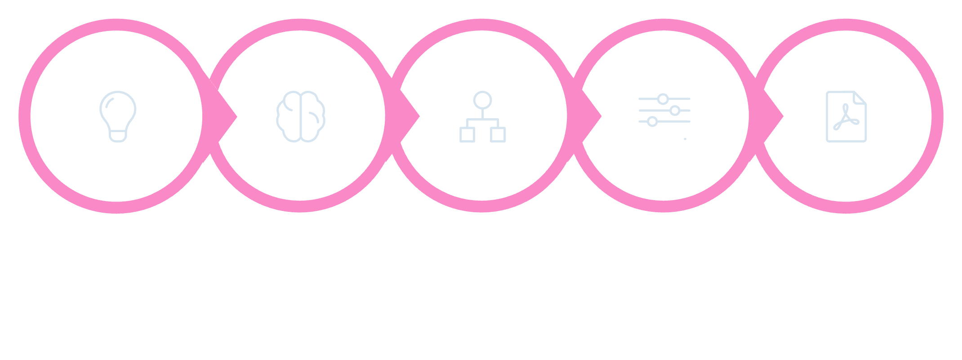





Meet IdeaForge AI
An AI-powered project development advisor that transforms raw ideas into structured, actionable blueprints through intelligent analysis and interactive refinement.
Idea
AI Analysis
Blueprint
Refine
Download
Analyze Ideas
Identify Users
Recommend Stack
Breaks down project concepts into structured components
Defines target audience and user personas
Suggests relevant technologies for the project
Refine via Chat
Generate Blueprint
Iterates through natural conversation
Exports a structured, downloadable PDF
"IdeaForge turns an initial idea into a structured project direction."

Slide 4
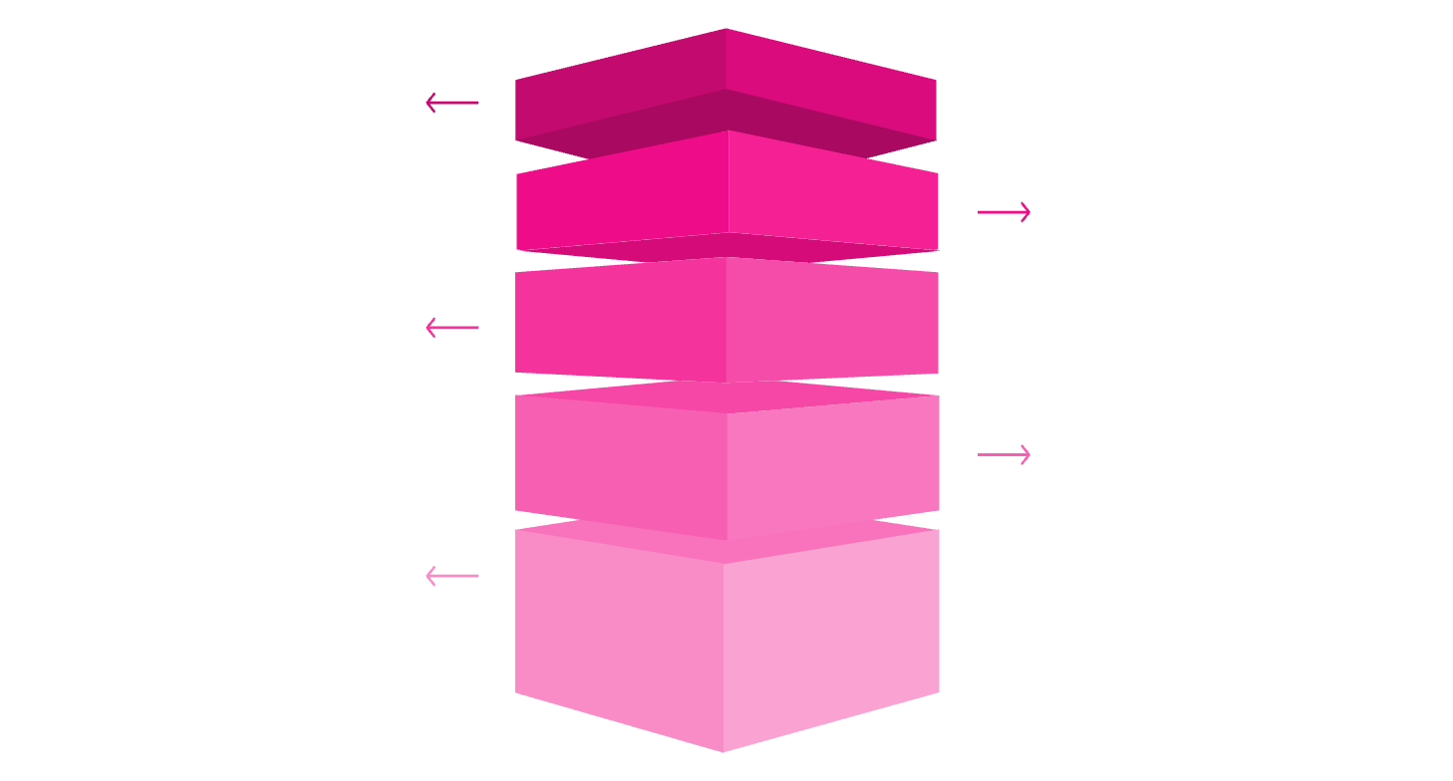


How IdeaForge Works
Technical Architecture
UI Layer
1
Streamlit
Streamlit interface for user interaction.
User interface layer — interactive web frontend
App Core
Python application handles logic and requests.
Understanding
Python Application
Request parsing and intent extraction.
2
Retrieval
Core application logic and state management
RAG pipeline using Sentence Transformers.
Storage & API
ChromaDB storage, Groq API, and final PDF.
Sentence Transformers
3
all-MiniLM-L6-v2 — Text → embedding vector
4
ChromaDB
Vector storage + semantic retrieval engine
5
Groq API
openai/gpt-oss-120b — Cloud LLM inference

Slide 5

RAG — Giving the LLM Relevant Context
Retrieval-Augmented Generation connects project-specific knowledge with LLM generation — ensuring responses are grounded in relevant context, not just general training data.
1
Embedding
User Query
Converts raw text into high-dimensional numerical vectors using all-MiniLM-L6-v2
Embedding
Vector Search
2
ChromaDB
ChromaDB
Performs semantic similarity search to find the most relevant stored knowledge
3
RAG
Retrieves and injects context into the prompt before generation begins
4
Groq LLM
Uses the retrieved context to generate accurate, project-specific responses

Slide 6


From Conversation to Project Change
The AI response is not just displayed — the application can update the project state in real time based on user intent.
Example Interaction
How Intent Drives State
User: "Add playlist sharing."
Natural Language Input
Structured Intent Parsing
01
User speaks in plain English — no commands or syntax required
The application extracts intent type and target entity from the LLM response
Request Understanding
intent = add_feature | target = playlist sharing
Programmatic State Mutation
Persistent Blueprint Update
02
Python logic applies the change directly to the project data model
Every change is reflected immediately in the exportable blueprint
Application Logic
add_feature(target) is called programmatically
This is not a chatbot. IdeaForge is a stateful project advisor — every conversation modifies the underlying project structure.
03
Project State Update
Feature is added to the live project model
04
Blueprint Reflects Change
"Playlist Sharing" appears with auto-generated description

Slide 7


From AI Output to a Real Project Blueprint
The final output is not just an AI response — it is a structured project deliverable ready to guide development.
Project State
Python + ReportLab
Structured Blueprint
LLM
Python
Blueprint Sections
Generates all project content and descriptions
Controls application logic and data flow
1
2
ReportLab
Streamlit
Project Overview
Objectives
Programmatically creates the formatted PDF document
Provides the one-click download interface
3
4
Target Users
Core Features
5
6
Technology Stack
Implementation Direction

Slide 8




From Idea → Blueprint
Transformation Example
INPUT
IDEAFORGE AI
OUTPUT
Playlist Manager
✓ Project analysis
Analyze
✓ Target users
✓ Core features
Retrieve
A raw, unstructured project idea with no defined scope, users, or technical direction.
✓ Technology direction
✓ Interactive refinement
Generate
✓ Downloadable PDF
Refine
"IdeaForge transforms an idea into a structured, editable and actionable project direction."
LIVE DEMO
Built With
ideaforge-ai-a7aiugt57ktpn352ajhb2v.streamlit.app
PYTHON
STREAMLIT
RAG
CHROMADB
SENTENCE TRANSFORMERS
GROQ
REPORTLA

Slide 9


