Slide 1


DON BOSCO INSTITUTE OF TECHNOLOGY Department of Electronics and Communication Engineering
Smart Security Box
For
Intelligent Packing System
Project Associates
Karthik A 1DB18EC051
Kiran B M 1DB18EC057
Manjunatha M 1DB18EC067
Manoj B R 1DB18EC068
Guided By
Prof. Sharanabasappa
Asst.Prof
Dept of ECE, DBIT

Slide 2
Contents
Introduction
Literature Survey
Motivation
Problem Statement
Proposed Methodology
Components of the Project
Timeline
Conclusion
References

Slide 3
Introduction
The Intelligent Packaging solution aims to use an electronic packaging solution to combat the problem of opening packages during transportation and as well as to measure the characteristics of the product, the inner and outer atmosphere of the package.
Some problems that often arise in the packaging of products are difficulty and inaccuracy in determining appropriate packaging options according to type and condition the product to be packaged.
The increasing packaging types and options nowadays also necessitates more systematic and precise way to select the best packaging option for a certain type of product.

Slide 4
Literature Survey
PAPER 1
AUTOMATION OF PARCEL DELIVERY COLLECTION USING IOT – SMART FREIGHT BOX
Date of Publish : 9, September 2018
Authors: Nivedhitha.G, T. Sujithra
Paper Highlights
The SFB is a courier/parcel collecting box which is to be installed in our home like A/C in a place where the outsiders and insiders can be able to access it for placing and collecting the parcel respectively. It consists of barcode sensor, weight sensor loading cell and doors on both sides of the box for placing and collecting the parcel as when the customer is available.

Slide 5
PAPER 2
PAPER 3
A Map-Matching Service Designed for Courier Trajectories”
An Integrated Courier Services Application: A New User Experience.
Date Added to IEEE Xplore: 11 September 2018
Authors: Jiu Wen,Yanchun Sun
Paper Highlights
we design a new map- matching service based on a map-matching algorithm called Courier Trajectory Based Map-Matching (CTB-Matching), which is specially used to deal with courier trajectories. Courier trajectories have some characteristics different from traditional trajectories.
Date Added to IEEE Xplore: 04 February 2019
Authors: Saipunidzam Mahamad, Suziah Sulaiman, Wong Yi Leng
Paper Highlights
The main objective of this project is to integrate a few of the courier services price and information in one stop whilst providing a low-cost peer-to-peer service to assist customer in delivering their parcel.

Slide 6
PAPER 4
PAPER 5
Application of RFID technologies in logistics centers to improving operations of courier firms
Smart security box using Arduino and GSM module” “Smart security box using Arduino and GSM module
Published in: IEEE 2017
Authors: Skowron-Grabowska
Paper Highlights
The application of RFID technologies in logistics centres is the fulfilment of the expectations of courier firms, which in turn enables them to effectively compete on the market of logistics services. RFID technologies have attracted a great deal of interest primarily due to the fact that this technology is between 10 and 20 times faster than the barcode technology.
Date of Publication: 09 August 2019.
Authors: Safial Islam Ayon , Abu Saleh Bin Shahadat
Paper Highlights
This paper presents a smart security box that sends messages to the authorized user if an unauthorized user attempts to breach the security of the smart box. The smart security box is fully automated and works without human interaction.

Slide 7
PAPER 6
PAPER 7
Design and Operation of an Urban Electric Courier Cargo Bike System
Verifiable Smart Packaging with Passive RFID
Authors: Tanja Niels,Moritz Travis Hof, Klaus Bogenberger
Date of Conference: 4-7 Nov. 2018
Paper Highlights
It analyze the delivery data, present an optimization scheme for finding suitable container locations, and simulate the routes conducted by cargo bikes for an average day. It can be concluded that the presented approach is a feasible solution for the package delivery in densely populated cities.
Authors: Ge Wang Jinsong Han Chen Qian Wei Xi Han Ding Zhiping Jiang Jizhong Zhao
Date Added to IEEE Xplore: September 2016
Paper Highlights
This paper investigates the possibility of using RF signals to test the internal status of packages and detect abnormal internal changes. Towards this goal, we design and implement a non destructive package testing and verification system using commodity passive RFID systems, called Echoscope.

Slide 8
PAPER 8
PAPER 9
Development of a Remote Tracking Security Box with Multi-Factor Authentication System Incorporates with a Biometric Sensing Device
RFID and GSM based Intelligent Courier Mailbox System
Authors: Subrata K. Sarker , Shahela Akter.
Date Added to IEEE Xplore: September 2019
Paper Highlights
In this paper, a security box is designed for safe transportation of important and confidential documents. Most often it is necessary to convey confidential documents from one locus to another and these are being unveiled by the unbidden characters.
Authors: Anita Sharma , Himalayee Saini
Date of Conference: June 2019
Paper Highlights
This paper describes a device which is capable of identifying the arrival of the courier and forward the same to the receiver. The idea behind this project is to employ an RFID tag to the courier and send the identity number to the user.

Slide 9
Motivation
In our daily life, ordering things online has greatly reduced the time and effort rather purchasing it personally. But in such cases, the availability of the customer at the time of product delivery is always essential. Hence automation of parcel/product receiving will certainly lead to an easy and safe fulfilment for an online ordering. This is the motive behind the proposal of an approach for automation of parcel receiving.
In the modern world, human mistakes sometimes lead to catastrophic events leading to loss of valuables. One such instance, sometimes intentional is the over loading of all the packages in vehicle. It leads to damage and mishandling of the package. To overcome these problems we propose this system.

Slide 10
Problem Statement
Increased customer's experience, expectations and product complexity are driving traditional packaging techniques obsolete. In addition to this, traditional packaging methods do not provide the customer as well as the manufacturer with important information about the product during shipping.
To develop an intelligent packaging system that uses the Internet of Things and Embedded system to securing, and tracking high-value packages.

Slide 11
Proposed Methodology
The Intelligent Packaging solution aims to use an electronic packaging solution to combat the problem of opening packages during transportation and as well as to measure the characteristics of the product, the inner and outer atmosphere of the package.
This is done by using several sensors in a fail-safe system. IPS uses many sensors that continuously track the physical parameters inside the package to ascertain if the package has been opened or there has been some rise in temperature.
Once this alert has been sent to those concerned, they can take necessary action. If there is no alert and a normal delivery takes place, the customer uses his/her mobile phone to scan a QR code displayed on the IPS kit.
This will result in an OTP that is received at the customer’s mobile number. Entering the OTP will reset the device.

Slide 12
Block Diagram
GPS
Accelerometry sensor
NodeMCU
IR sensor
LCD
Display
keypad
Micro Controller
( ATmega2560 )
LDR
Lock
Power Supply

Slide 13
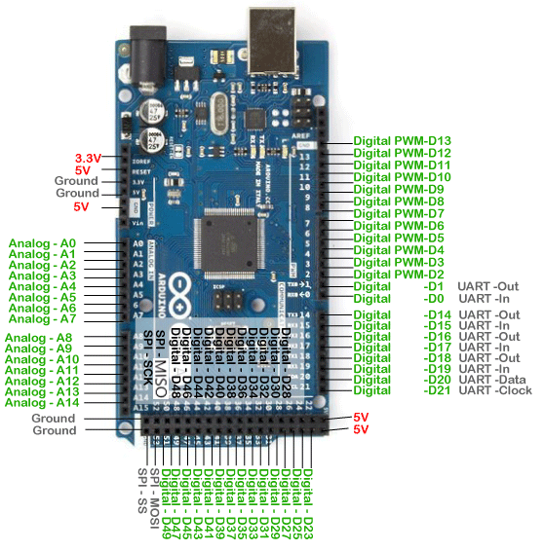
Components Of The Project :
ARDUINO MEGA 2560:

Slide 14
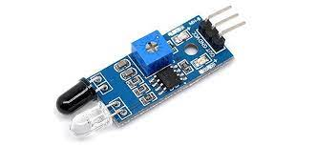
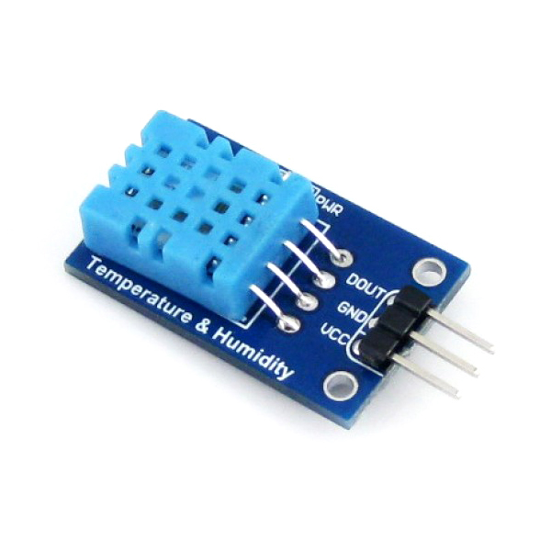
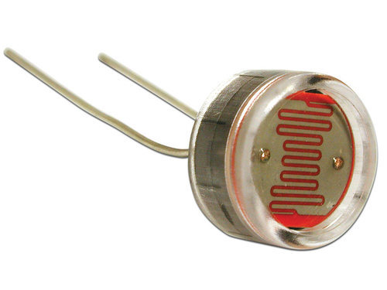
Sensors
IR SENSOR
DHT-11 SENSOR
LDR SENSOR

Slide 15
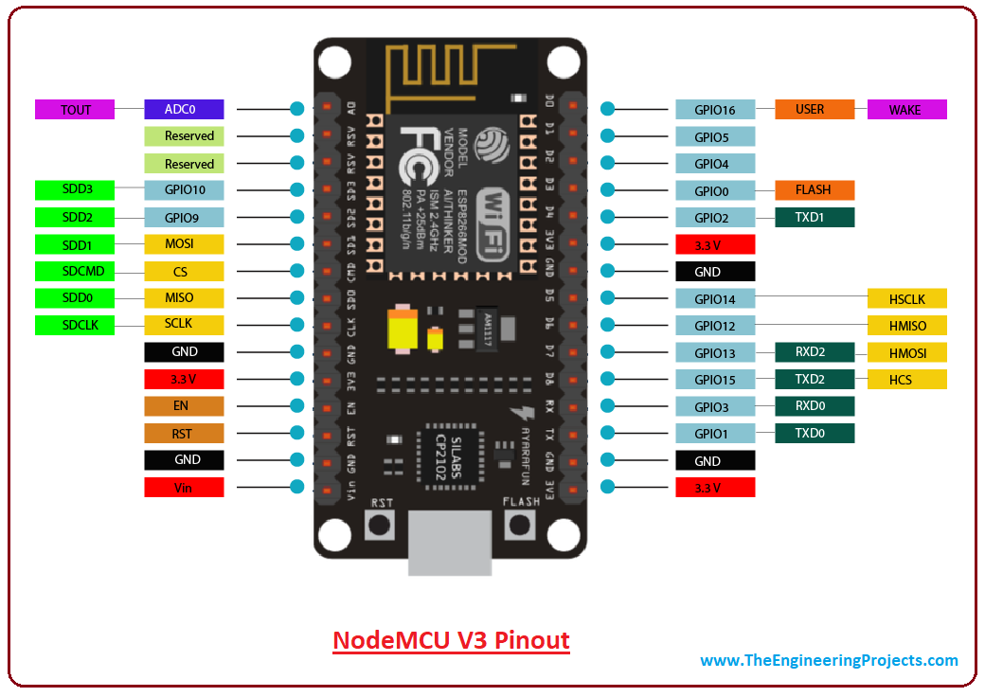
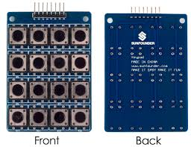
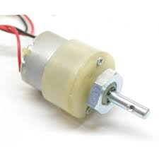
NODEMCU
4X4 KEYPAD BOARD
GEAR MOTOR

Slide 16
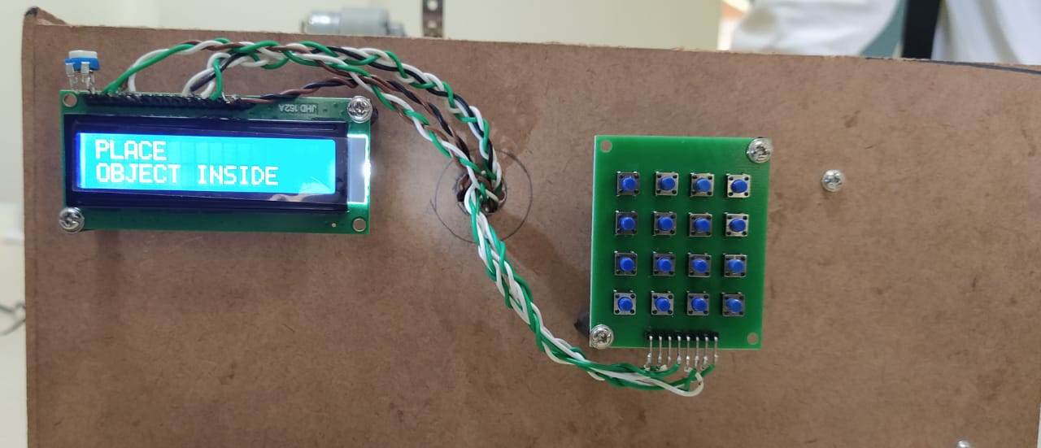
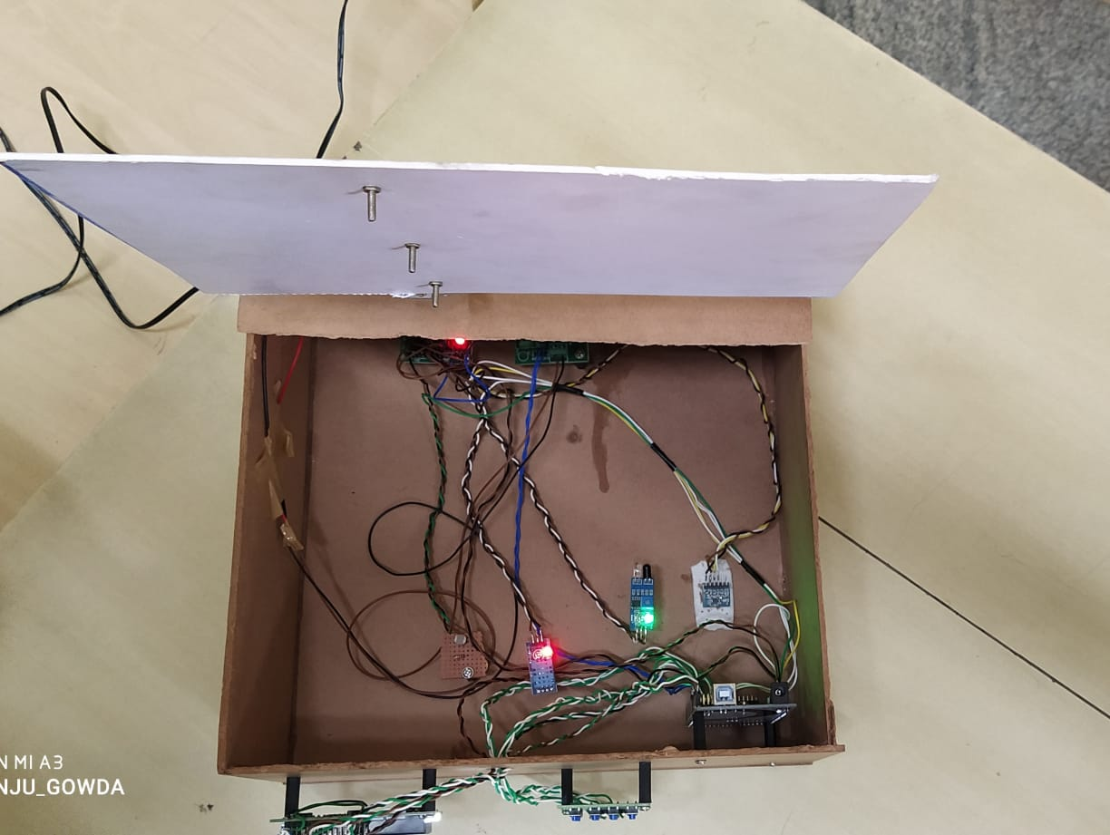
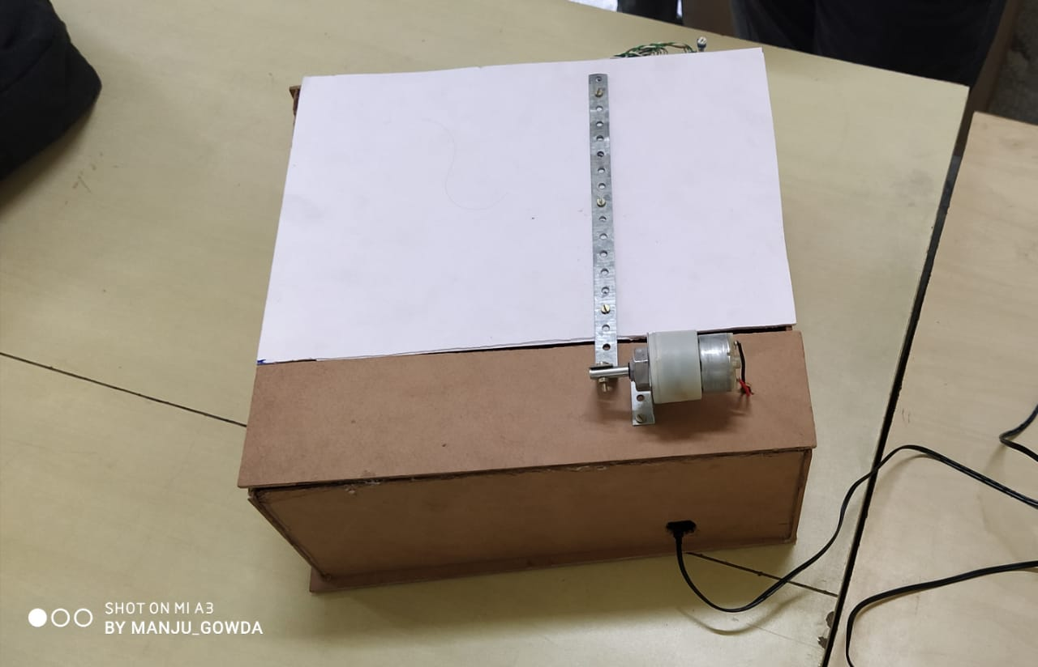
WORKING MODEL:
INTERNAL VIEW
FRONT VIEW
TOP
VIEW

Slide 17
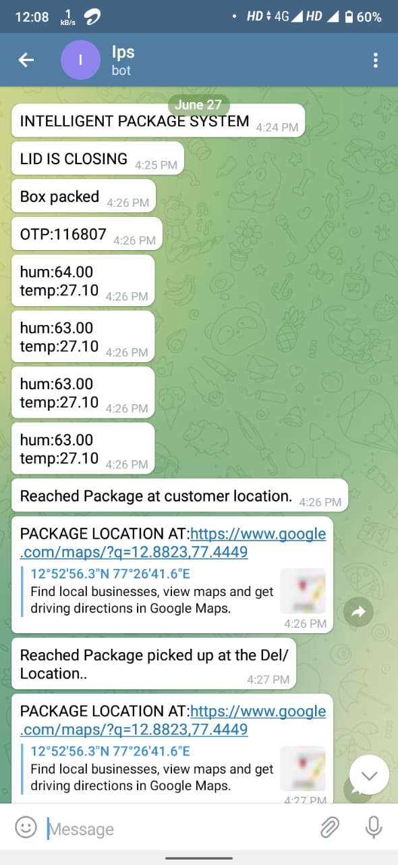
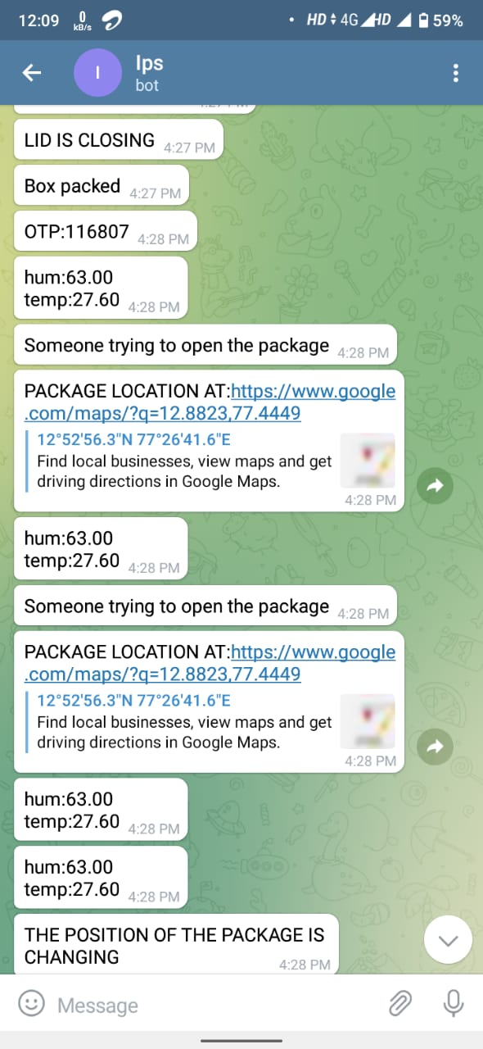
WORKING MODEL ( customer side):
CASE 1
SUCCESSFUL DELIVERY
CASE 2
UNSUCCESSFUL DELIVERY
17

Slide 18
Timeline
Phase 1
Phase 2
Phase 3
Topic and Title selection
Synposis
Literature survey
Completion of 40% of working model
Demo of the working model
Completion ofF 100% of working model
Demonstration OF of the working model

Slide 19
Conclusion
The deficiency in security of courier delivery can be improved in our proposed system. This implementation can prove to be very effective in providing security for the goods and also ensures the safe delivery of goods to respective enterprises/costumers. With the help of GPS we can track the location of the package that has to be delivered from source to customer's destination.
In vehicle, a server and smart phone are used for courier tracking. A vehicle geographic co-ordinate and vehicle unique ID obtained from black box will be recorded who's location can be tracked from anywhere at anytime. This system brings innovation to the existing technology and improvising the safety of the packages.

Slide 20
References
[1] AUTOMATION OF PARCEL DELIVERY COLLECTION USING IOT – SMART FREIGHT BOX, International Journal of Civil Engineering and Technology (IJCIET) Volume 8, Issue 9, September 2018, pp. 966–972, Article ID: IJCIET_08_09_107.
[2] J. Wen and Y. Sun, "A Map-Matching Service Designed for Courier Trajectories," 2017 IEEE International Conference on Web Services (ICWS), Honolulu, HI, 2017.
[3] An Integrated Courier Services Application: A New User Experience. Date Added to IEEE Xplore: 04 February 2019.
[4] Beata Skowron-Grabowska; Tomasz Szczepanik. “Application of RFID technologies in logistics centres to improving operations of courier firms” 2017 IEEE International Conference on RFID Technology & Application (RFID-TA), 09 November 2017 IEEE Xplore.

Slide 21
References
[5] Smart Security Box Using Arduino and GSM Module, Safial Islam Ayon ,Abu Saleh Bin Shahadat ,2019 IEEE International Conference on Robotics ,Automation, Artificial Intelligence and IoT.
[6] Niels, Tanja & Hof, Moritz &Bogenberger, Klaus. (2018). Design and Operation of an Urban Electric Courier Cargo Bike System.
[7] RFID and GSM based Intelligent Courier Mailbox System , Anita Sharma , Himalayee Saini , International Journal of Research in Engineering, Science and Management Volume-2, Issue-6, June-2019
[8] Development of a Remote Tracking Security Box with Multi-Factor Authentication System Incorporates with a Biometric Sensing Device, Shahriar Rahman Fahim, Subrata K. Sarker, Shahela Akter, 2019 5th IEEE International WIE Conference on Electrical and Computer Engineering (WIECON-ECE).
[9] Ge Wang, Jinsongn, “Verifiable Smart Packaging with Passive RFID” IEEE Transactions on Mobile Computing (Volume: 18, Issue: 5, May 1 2019)

Slide 22
THANK YOU

