Slide 1




5th - 7th of May 2023
Datathon by Analytics Club @ ETH
Carlos Parés-Pulido
Data Analytics Consultant
d-one.ai

Slide 2
“My success has been the product of many years’ struggle, and every year, my times have shown gradual improvement.”
Sir Mo Farah, Olympic gold medallist
(Gold 5k and 10k, London 2012 and Rio 2016)

Slide 3
Mission briefing
A partner in the personal fitness industry shared with us historic data from some users’ running sessions.
Your tasks:
prepare the data
predict the type of training where it is not available
design a metric that tracks the evolution of a user’s fitness over time

Slide 4
The data

Slide 5
The data
The next slides will walk you through the data we will share with you.
You will receive three datasets, with highly active users in 2019:
trainings: metadata and aggregated metrics for every sport activity.
run_logs: full logs of sport activities (time series of GPS plus other data).
exam_dataset: extract of trainings that you will have to fill in.
Your algorithm may use any other publicly available, non-paywalled data to complement this (common sense applies).

Slide 6
Overview of the data
run_logs (30m rows)
user_id | training_id | time | GPS, hr, ele
A | 1 | 01-02-2019 12:34:56 | …
A | 1 | 01-02-2019 12:34:57 | …
A | 1 | 01-02.2019 12:35:01 | …
… | … | … | …
A | 2 | 04-08-2019 15:16:23 | …
… | … | … | …
B | 3 | 01-01-2019 8:09:09
… | … | … | …
trainings (16k rows)
user_id | training_id | (metadata) | type
A | 1 | … | LONG JOG
A | 2 | …
B | 3 | … | INTERVAL
… | … | … | …
exam_dataset (250 rows)
user_id | training_id | type
A | 2
… | … | …

Slide 7
Table trainings
Column | Description
user_id : string | Unique ID per user
training_id : string | Unique ID per sport activity
start_date : timestamp | Timestamp of start of this activity
distance: number | Total distance covered in this activity (m)
uphill : number | Total climb in this activity (m)
downhill : number | Total descent in this activity (m)
duration : number | Duration of activity (s)
avg_hr : number | Average heart rate during the activity (bpm)
max_hr : number | Maximum heart rate during the activity (bpm)
power : number | Average power during the activity (W)
type : type of activity | See next slide
~3MB, ~16k rows

Slide 8
Table trainings: field type
type of the training is one of the following, with this exact spelling:
LOW INTENSITY: walks or very slow recovery jogs
LONG JOG: longer distance jogs at a low-to-moderate pace
STEADY JOG: mid-tempo runs
INTERVAL: periods of intense running, interspersed with low-speed rests
RACE: performance in an organized, competitive running event
null: for you to predict
type is as proposed by the app; users may not follow the suggestion.

Slide 9
Table run_logs
Column | Description
user_id : string | Unique ID per user
training_id : string | Unique ID per sport activity
time : timestamp | Timestamp of this entry (precision of seconds)
latitude : number | GPS position (degrees) at the time
longitude : number
hr : number | Heart rate (bpm) at the time
elevation : number | Altitude (m) at the time
~5GB, ~30m rows

Slide 10
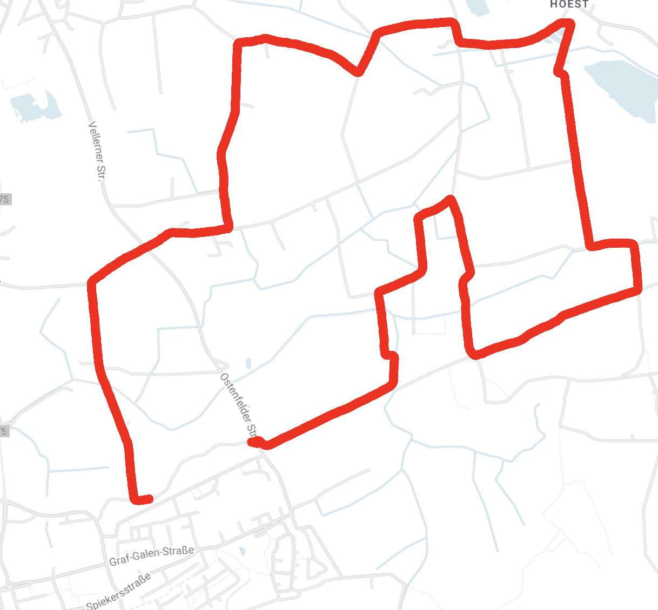
Table run_logs: warnings
This is real world data; preprocessing is essential.
For every run, we have removed entries close to the beginning or ending point for user privacy
Home address; hidden

Slide 11
trainings + run_logs: notes
You can join trainings and run_logs on (user_id, training_id).
Aggregated metrics (distance, avg_hr, max_hr etc) are computed upstream from us, and won’t match between run_logs and trainings.
Attributes may be null, data quality issues may be present.

Slide 12
Table exam_dataset
Column | Description
user_id : string | Unique ID per user
training_id : string | Unique ID per sport activity
type : string (null) | null; write your predictions here
Note
Are these 250 a representative sample of the five types, or manually chosen? Assume at your own peril!
~30KB, 250 rows
250 rows in table trainings have type = null.
We have extracted their (user_id, training_id) into this table for convenience.
You will have to give us this table, in the exact same format, filling in the nulls with a prediction of the type of training (with the exact spelling in slide 8)

Slide 13
The goal

Slide 14
Your tasks
Task 1: understand and pre-process the data.
Task 2: prediction. Create an algorithm that predicts the type of training for the 250 training_id in exam_dataset.
Task 3: design. Develop and prototype a metric that provides insight of how a user’s fitness evolved over time.
Do not focus on comparing different users.
Instead, we want to compare a user’s performance at different points in time.
We encourage you to work on these tasks in parallel.

Slide 15
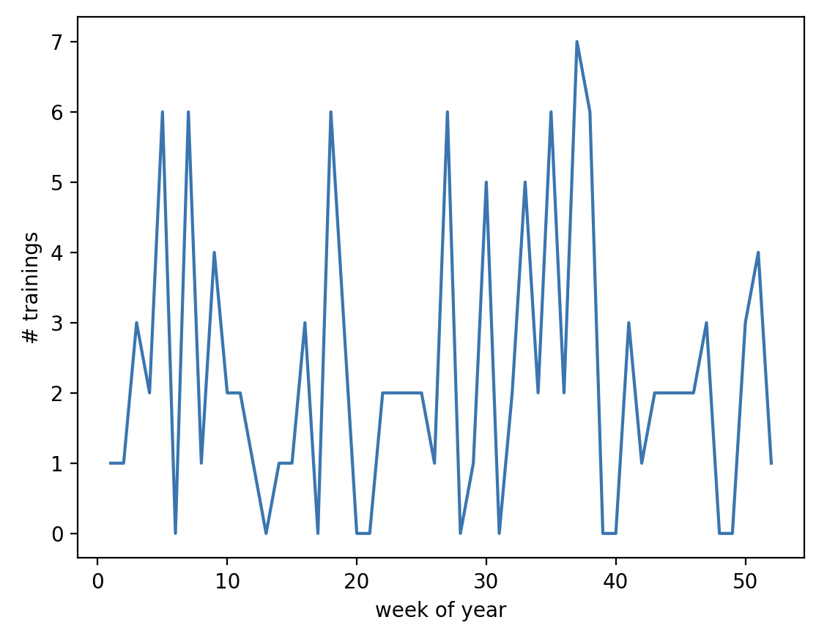
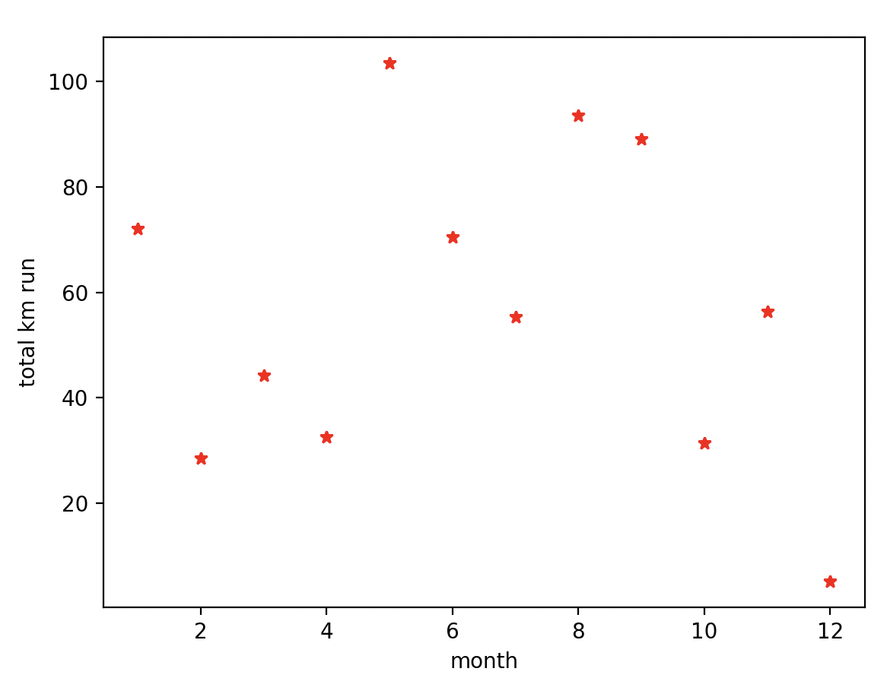
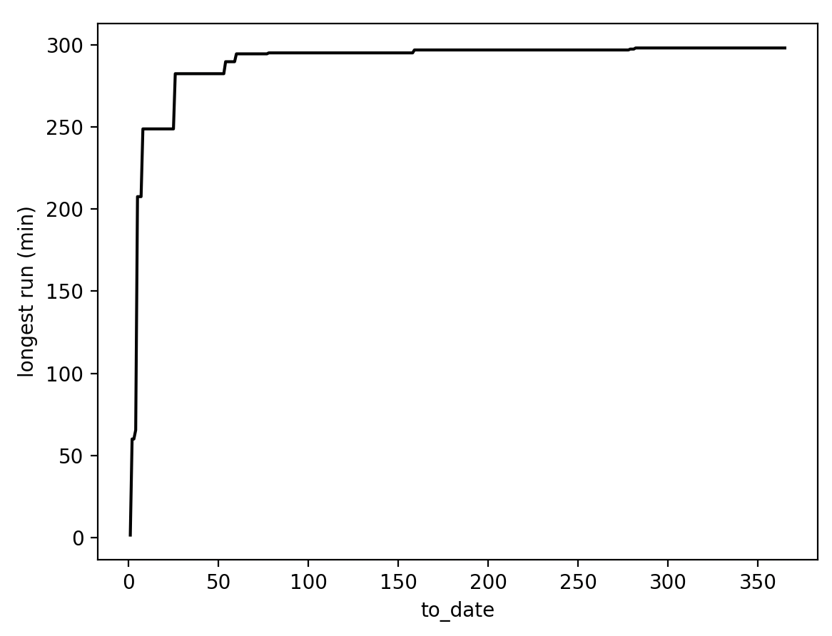
Some unexciting examples of task 3
# runs per week
km run per month
longest run this year
Something along these lines – but providing deeper insight into fitness.

Slide 16
What we expect from you
By Sunday 12.00:
A CSV file [team name]_submission.csv with your model’s predictions, as described in slide 12.
Your code.
By Sunday 14.00:
Slides for a 5-minute presentation, in which you quickly present your work.
There will be a 5-minute question round after the presentation.

Slide 17
How we will evaluate your work
[10%] Data pre-processing: “80% of data science is data prep”. In your presentation, explain some shortcomings you found in the data, and what you did to mitigate them.
[50%] Prediction: we will grade on a curve, based on the accuracy of your algorithm in % of correct labels in exam_dataset.
Smart ideas may provide a bonus to your grade – so present them!
[40%] Design: we will evaluate your proposed metric, as explained in your presentation. Points for originality, intuitiveness and sophistication.

Slide 18
Presentation guidelines
Task 1: one slide with 1-2 interesting problems you’ve come across, and how you dealt with them.
Task 2: one slide presenting your prediction algorithm. Concentrate on key ideas, rather than performance.
Task 3 should be the focus of your presentation – we want to understand your designed metric and see how it works!

Slide 19
Some admin

Slide 20
Accessing the data
You have access to a Google Drive folder on the Datathon page, https://www.datadays.ch/d-one-challenge
If you cannot access the Google Drive, let us know asap!
All the datasets are there as CSV.
If you would rather develop on the cloud, we recommend Google Colab https://colab.research.google.com/
We provide you with a Jupyter notebook stub to access the data in Colab; see challenge description for step-by-step.

Slide 21
Final advice
Gradual improvement: You won’t hit perfection in 24h – but you can beat your results from last hour!
Understand the data: How does the map of a run look like? What metrics are useful to calculate? How does slope affect a runner?
“Fail fast”: Implement, test, evaluate often; don’t get caught up in one idea!
Think like a user: what metrics would you find interesting?
Most of all: Have fun!

