Slide 1
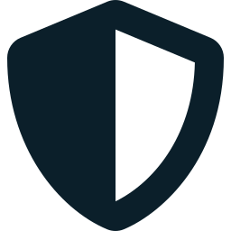
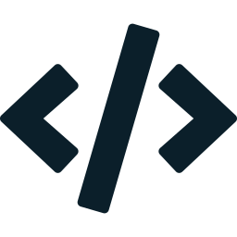
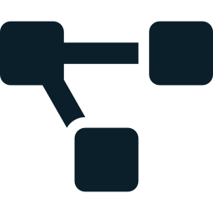
1 · DOMAIN
Security Operations (SOC)
Cybersecurity
AI agents triage alerts, investigate incidents and propose containment.
Autonomous, agentic security operations for mid-market companies and the MSSPs that protect them.
Application Security
Scans code and dependencies, then drafts patches for human review.
Supply-Chain Risk
Continuously scores vendor and open-source exposure across a risk graph.
Cyber Defense · AI Agents · Applied Machine Learning

Slide 2
2 · REAL-WORLD PROBLEM / GAP
Threats scale faster than defenders
4.8M
48%
$4.9M
454K+
cybersecurity jobs unfilled worldwide
of breaches involve a third party (2026 DBIR), up from 15% in 2024
average cost of a supply-chain breach, ~267 days to contain
new malicious open-source packages in 2025, up 75% year over year
The problem
The gap
Alert volume and third-party risk are outgrowing human SOC capacity. A three-analyst team facing tens of thousands of alerts a month cannot hire its way out of the gap.
Enterprise agentic-SOC vendors (Dropzone, Prophet, Radiant, Torq, Microsoft) are priced for mature SOCs and start from the alert queue. Mid-market firms and MSSPs are underserved, and supply-chain risk is barely addressed.

Slide 3

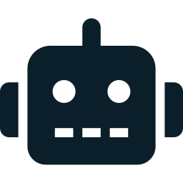

3 · CREATIVITY
What makes it different
Supply-chain risk as a live graph
Built for mid-market and MSSPs
A GraphSAGE network scores vendor and open-source exposure, surfacing fourth-order dependencies as explainable paths instead of annual questionnaires.
Multi-tenant, priced per asset or vendor count, deployable in days. MSSPs run dozens of clients from one console.
Five-agent mesh, trust earned
Explainable and safe by design
Triage, Investigation, Containment, Code-Scan and Supply-Chain agents on LangGraph. Humans approve every destructive action; autonomy grows per action type.
Evidence-cited decisions, a hash-chained audit log and prompt-injection defense, backed by anomaly detection, an RL response policy and diffusion-augmented data.

