Slide 1

Predicting Term Deposit Subscription by a client
PROJECT SUPERVISOR : Dr. G.Kalaiarasi M.E., Ph.D.,
STUDENT NAME : MANOJ SIRIGIRI
REGISTER NO : 39110604

Slide 2
Presentation Outline
Course certificate
Introduction
Objective
Data Set
Algorithm
Ideation Map
Methodology & project implementation
Modules implementation
Results
Conclusion
References

Slide 3

Course Certificate

Slide 4
Introduction
Marketing to potential clients has always been a crucial challenge in attaining success for banking institutions.
With the inception of machine learning - reaching out to specific groups of people have been revolutionized by using data and analytics to provide detailed strategies to inform banks which customers are more likely to subscribe to a financial product.

Slide 5
Introduction
In this project on bank marketing with machine learning, I will discuss how a particular Portuguese bank can use predictive analytics to help prioritize customers which would subscribe to a bank term deposit.

Slide 6
Objectives
Project Objective:
To Predict if a customer subscribes to a term deposit or not, when contacted by a marketing agent, by understanding the different features and performing predictive analytics

Slide 7
DATA SET
The data that is used in this project originally comes from the UCI machine learning repository (link).
The data is related with over 40,000 direct marketing campaigns of a Portuguese banking institution from May 2008 to November 2010. Often, more than one contact to the same client was required,
In order to access if the product (bank term deposit) would be (‘yes’) or not (‘no’) subscribed. The marketing campaigns were based on phone calls.

Slide 8
DATA SET
The marketing campaigns were based on phone calls. more than one contact to the same client was required, in order to access if the product (bank term deposit) would be (‘yes’) or not (‘no’) subscribed.

Slide 9
ALGORITHMS USED IN THIS PROJECT
LOGISTIC REGRESSION
Simple logistic regression assumes that the observations are independent; in other words, that one observation does not affect another. Simple logistic regression assumes that the relationship between the natural log of the odds ratio and the measurement variable is linear.

Slide 10
ALGORITHMS USED IN THIS PROJECT
RANDOM FOREST ALGORITH
Random forests or random decision forests are an ensemble learning method for classification, regression and other tasks that operates by constructing a multitude of decision trees at training time. For classification tasks, the output of the random forest is the class selected by most trees.

Slide 11
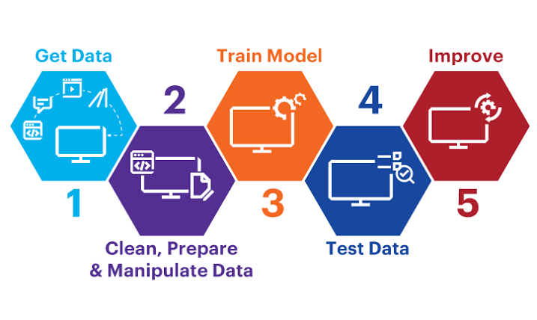
System Architecture / Ideation Map

Slide 12
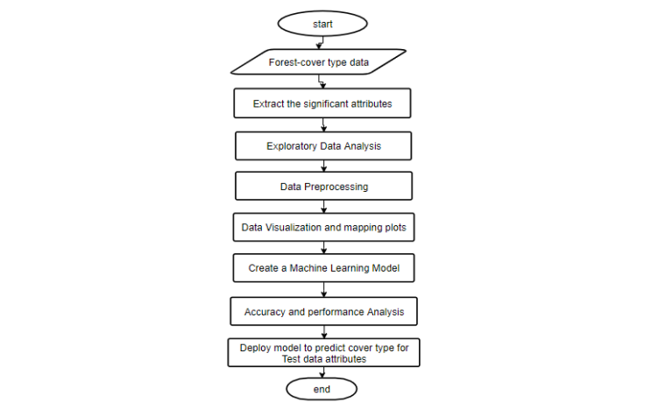
System Architecture / Ideation Map

Slide 13
Methodology and Project Implementation
The dataset consists of approximately 41188 data points, with each data point having 16 features
Target Variable : y
The methodology follows the best practices in the literature and in the industry, including different phases

Slide 14
Methodology and Project Implementation
Importing data file
visualize dataset
Describe Dataset
Checking data transformation

Slide 15
Methodology and Project Implementation
Feature selection
Model selection
Model training and validation
Finding accuracy, precision, recall and plotting data data types of variables

Slide 16
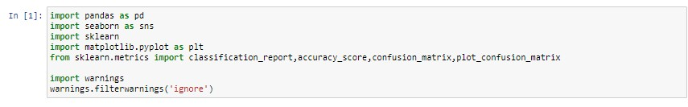
Model Development
Importing the required modules

Slide 17
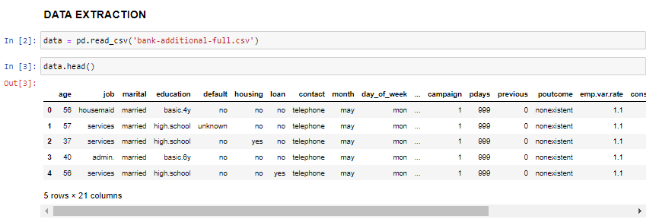
Model Development
Importing csv file and extracting data

Slide 18
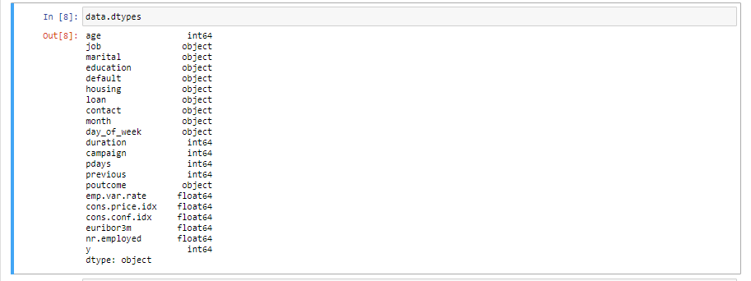
Model Development
Checking data types of variables

Slide 19
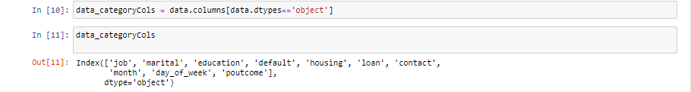
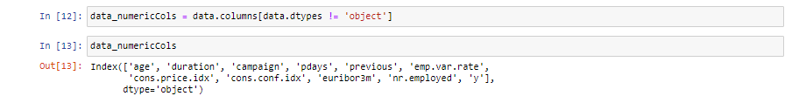
Model Development
Separating columns with category data type
Separating columns with numerical data type

Slide 20
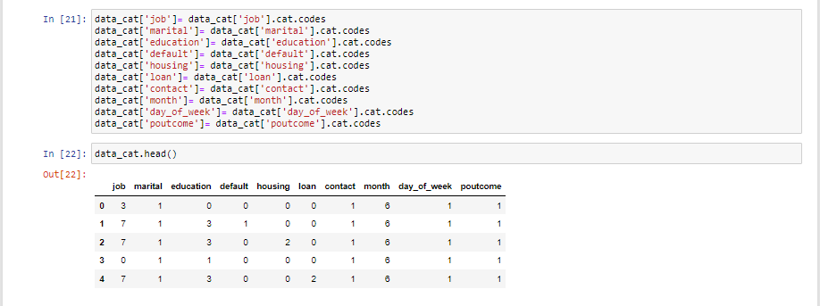
Model Development
Converting categorical to data numerical data

Slide 21
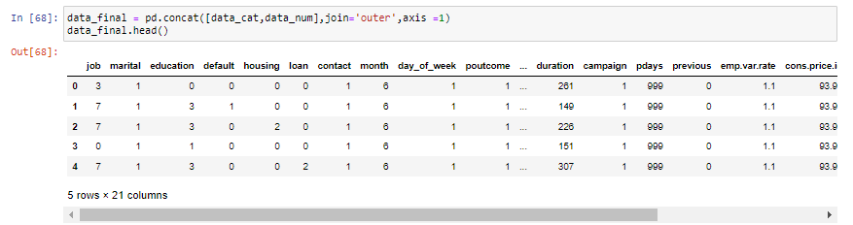
Model Development
Converting categorical to data numerical data

Slide 22
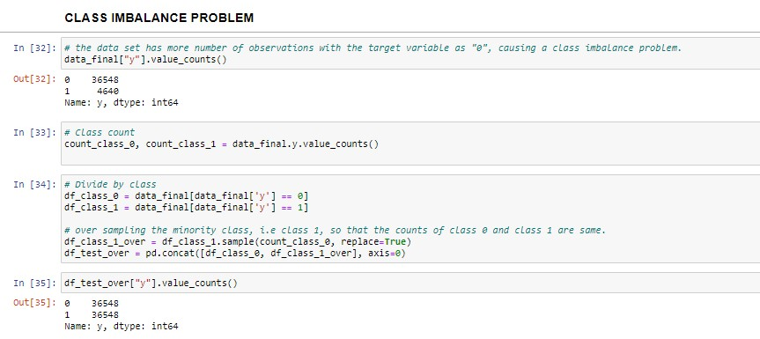
Model Development
class imbalance problem

Slide 23
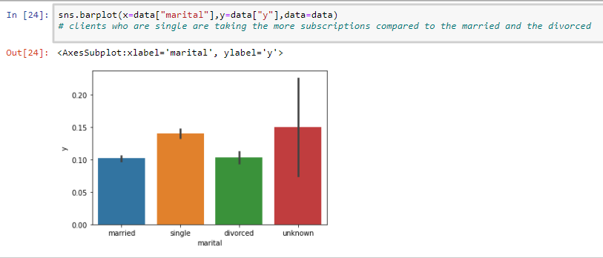
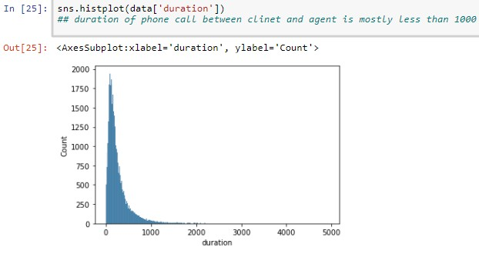
DATA VIZUALIZATION

Slide 24
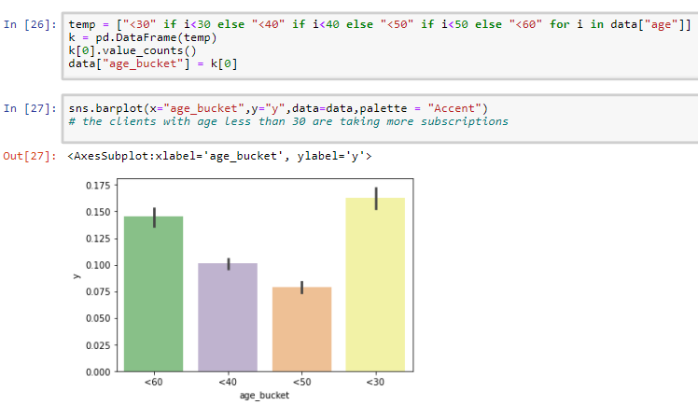
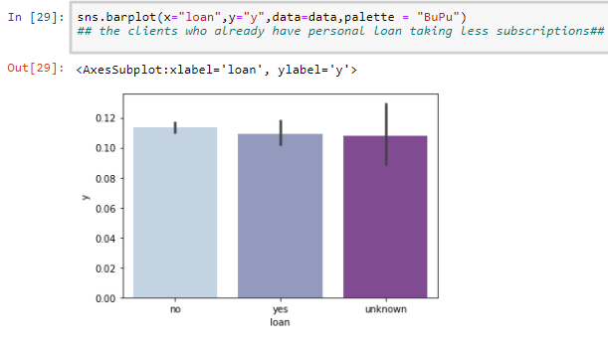
DATA VIZUALIZATION

Slide 25
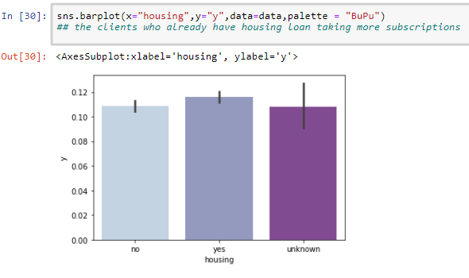
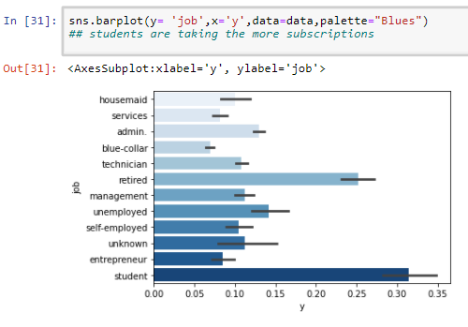
DATA VIZUALIZATION

Slide 26
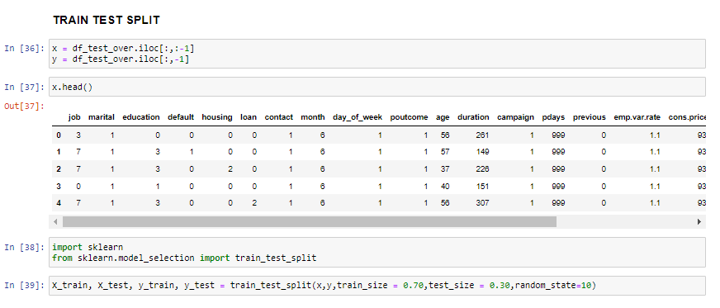
Model Development
splitting the raw data to test data and train data

Slide 27
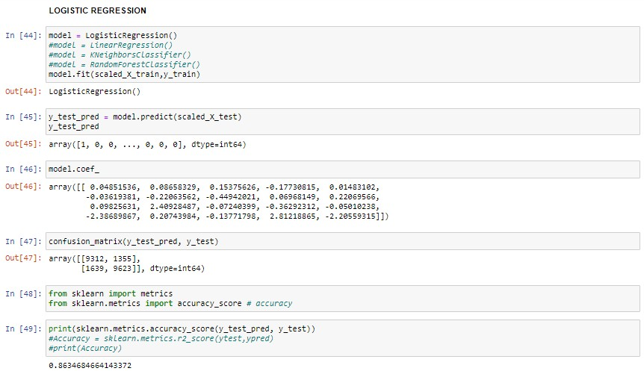
Model Development
Logistic Regression

Slide 28
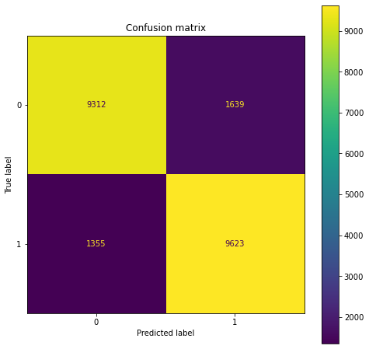
Confusion matrix for Logistic regression

Slide 29
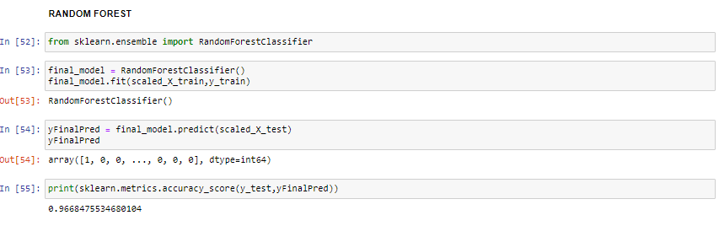
Model Development
Random Forest Algorithm

Slide 30
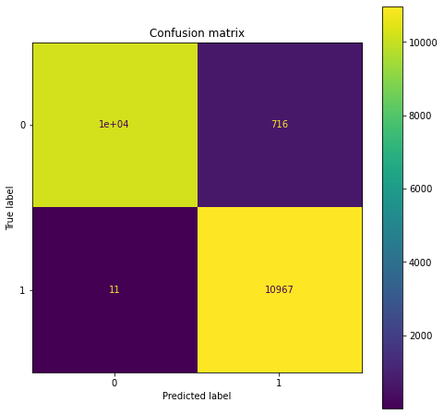
Confusion matrix for random forest algorithm

Slide 31
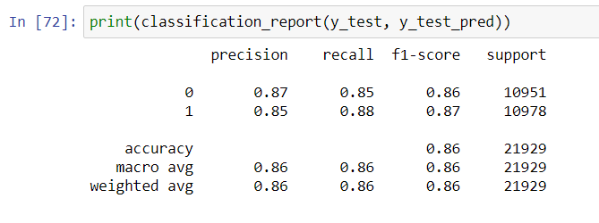
RESULT
F1 score is 0.87 percent for logistic regression

Slide 32
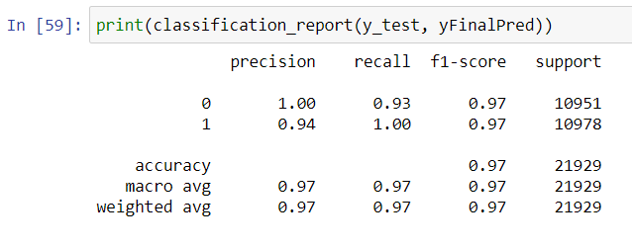
RESULT
F1 score is 97 percent for Random forest algorithm

Slide 33
CONCLUSION
Since the Random forest model had a higher precision, recall, and f1-score for the which is a more important classification of whether a potential client was going to subscribe to the term deposit, the bank should use Random forest model. With different hyperparameter tuning techniques, the model can lead to higher scores.

Slide 34
References
[1] | S. Moro, P. Cortez and P. Rita, "A Data-Driven Approach to Predict the Success of Bank Telemarketing", Decision Support Systems Elsevier, vol. 62, pp. 22-31, June 2014.
[2] | A. Keles and A. Keles, "IBMMS Decision Support Tool for Management of Bank Telemarketing Campaigns", International Journal of Database Management Systems, vol. 7, no. 5, pp. 1-15, 2015.
[3] | O. Apampa, "Evaluation of Classification and Ensemble Algorithms for Bank Customer Marketing Response Prediction", Journal of International Technology and Information Management, vol. 25, no. 4, pp. 6, 2016.
[4] | Amazon Machine Learning: www.aws.amazon.com

Slide 35
THANK YOU

