Slide 1
VIT Vellore | School of Computer Science Engineering and Information Systems
PoolMesh DB
A Campus-to-City Carpooling Database
FINAL REVIEW - Database design, PL/SQL logic and a working application
Manoj Kumar S 24BDE0052
Manoj K 24BDE0147
S M Nithin 24BDE0033
BCSE302P - Database Systems
Fall Semester 2026-2027
Notes:
Introduce the team and the project in one line: PoolMesh DB is a campus-to-city carpooling database where all business rules live inside Oracle. Today we show the full journey: design (Review I), implementation (Review II) and the working Python application on top (Review III). Plan: about 12-15 minutes plus a live demo.

Slide 2



The problem: students travel in half-empty cars
Empty seats, high costs
Safety and trust gaps
Invisible carbon impact
Students and staff travel from VIT to Chennai, Bengaluru and Tirupati every week, often alone or in expensive cabs.
Women need women-only rides; riders and drivers need a way to judge reliability before sharing a car.
Pooling saves emissions, but nobody measures it or rewards it.
PoolMesh DB answers all three with one consistent database: pooled pricing, enforced safety rules, live Trust Scores and a Carbon Ledger.
Notes:
Motivate with the weekly VIT to Chennai/Bengaluru travel. Three needs: cost sharing, safety and trust, and environmental credit. Our answer is a database that enforces these rules itself rather than trusting an app.

Slide 3
PoolMesh DB at a glance
8
99
126
20
Tables
Constraints
Rows loaded
SQL queries
3
3
1
3
Procedures
Functions
Cursor
Triggers
+ Review III: a menu-driven Python application (python-oracledb) that only calls the database's procedures
Notes:
Numbers from Review II: 8 tables, 99 constraints (8 PK, 12 FK, 8 UNIQUE, 26 CHECK, 30 NOT NULL, 15 DEFAULT), 126 rows, 20 queries, 3 procedures, 3 functions, 1 explicit cursor, 3 triggers. New for the final review: the Python CLI that makes it all usable.

Slide 4
Architecture: business rules live inside the database
Python CLI (python-oracledb)
search - book - cancel - offer - complete - rate - reports
Why this matters
Every client sees identical behaviour
A front-end bug cannot create an invalid booking
PK, FK, UNIQUE, CHECK, NOT NULL, DEFAULT are the last line of defence
v
Stored procedures (one business operation = one transaction)
sp_book_ride | sp_cancel_booking | sp_complete_ride (cursor)
v
Functions (pure rules) + Triggers (automatic actions)
fn_calc_fare, fn_co2_saved, fn_trust_level | trg_booking_seats, trg_women_only_check, trg_rating_trust
v
8 constrained tables
USERS VEHICLES LOCATIONS RIDES BOOKINGS PAYMENTS RATINGS CARBON_LEDGER
Procedures call functions and fire triggers; both read and write the constrained tables.
Notes:
Walk the layers top-down. The CLI never repeats a rule; it only calls procedures. Procedures are single transactions. Functions are pure calculations. Triggers fire automatically. Constraints are the final guard. This is why even a direct INSERT cannot overbook a ride.

Slide 5
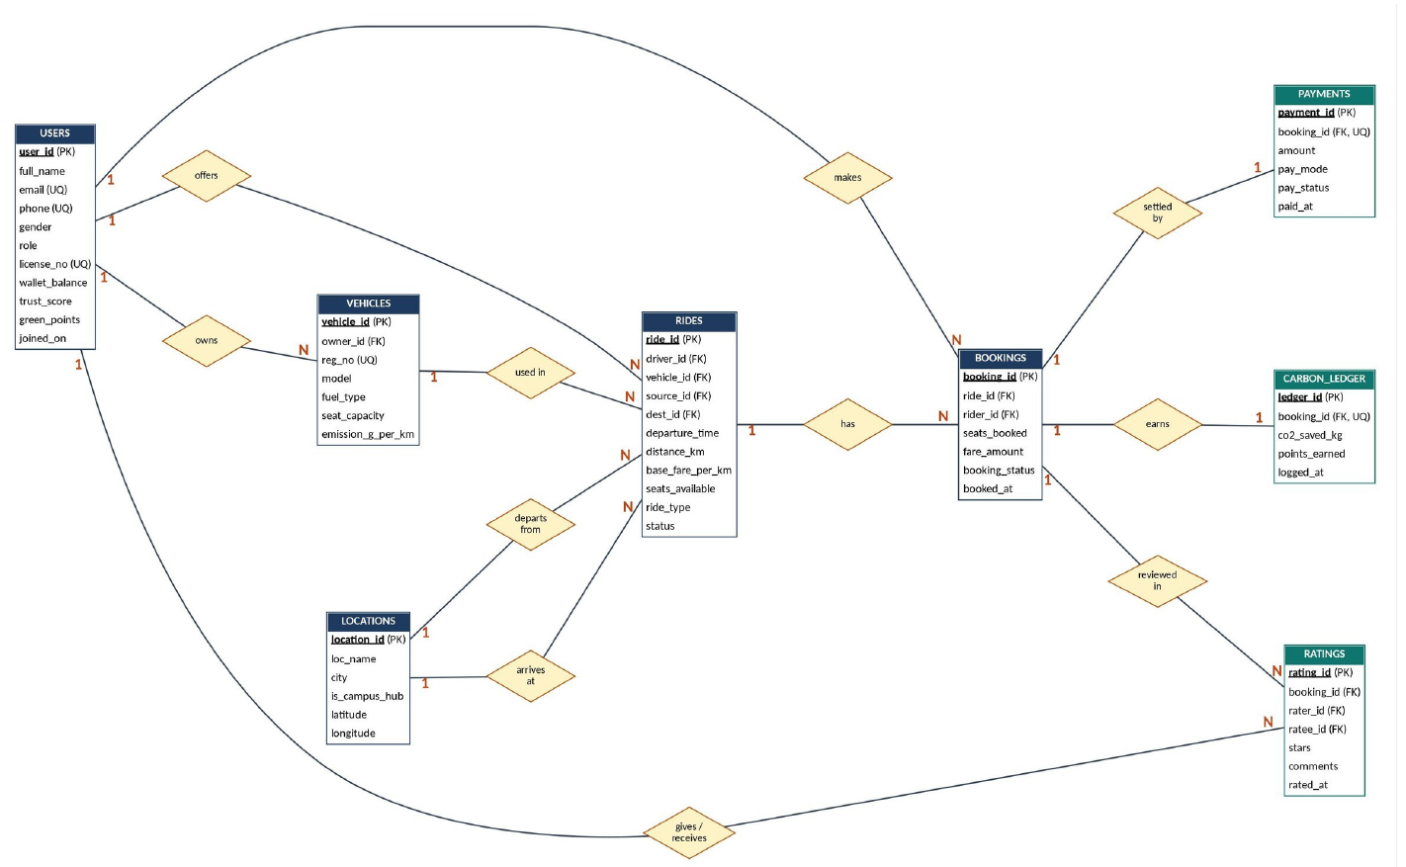
ER design carried from Review I: 8 entities, 12 relationships
How to read it
1:N becomes a foreign key on the N side
1:1 becomes FK + UNIQUE (payment, carbon record)
RIDES has two FKs to LOCATIONS (source, destination)
RATINGS has two FKs to USERS (rater, ratee)
Notes:
Brief recap only; the ER diagram was approved in Review I. Point out the two interesting modelling choices: two FKs from RIDES to LOCATIONS, and two FKs from RATINGS to USERS.

Slide 6
99 constraints: the database refuses bad data
Proof: each rule is tested
Duplicate e-mail -> UQ_USER_EMAIL
Driver w/o licence -> CK_USER_LICENSE
Same source and dest -> CK_RIDE_ROUTE
Trust score 120 -> CK_USER_TRUST
Ride 999 -> FK_BOOK_RIDE
Double booking -> UQ_BOOK_RIDE_RIDER
Self-rating -> CK_RATE_SELF
6 stars -> CK_RATE_STARS
Notes:
Every constraint is named, so Oracle's error message names the rule that failed. The eight tests on the right are in the app under Database tools > self-test, and they all pass on fresh data.

Slide 7
Business rules from Review I and what enforces them
Business rule | Enforced by
No overbooking; FULL / OPEN follows the seat count | CHECK seats_available >= 0, trg_booking_seats, row lock in sp_book_ride
Women-only rides accept female riders only | trg_women_only_check
One booking per rider per ride; driver cannot book own ride | UNIQUE (ride_id, rider_id), sp_book_ride
Driver or BOTH needs a licence number | CHECK ck_user_license
Rating 1-5, no self-rating, one rating per booking | ck_rate_stars, ck_rate_self, uq_rate_once
Trust Score stays 0-100; below 40 is Watchlist | ck_user_trust, trg_rating_trust, fn_trust_level
Pooled fare falls as the car fills | fn_calc_fare
CO2 saved and Green Points per completed trip | fn_co2_saved + cursor in sp_complete_ride
Notes:
Each Review I business rule has a concrete mechanism. Highlight that safety rules (women-only, no overbooking) are in triggers and constraints, not in the app.

Slide 8


Functions: pooled pricing, carbon saving, trust level
fn_calc_fare
distance x rate x seats, reduced by the occupancy discount. Everyone pays less as the car fills, the driver earns more in total.
fn_co2_saved
150 g/km solo baseline minus emission / occupants, over the trip distance. EV rides save the most per km.
fn_trust_level
Worked example (ride 9, 2 seats)
130 km x Rs 2.90 x 2 = Rs 754.00, occupancy 4 -> 15% off = Rs 640.90
80+ Excellent, 40-79 Good, below 40 Watchlist. Used inside the low-trust report query.
Notes:
fn_calc_fare reads RIDES and VEHICLES; the other two are DETERMINISTIC pure calculations. fn_trust_level is called directly inside Query 6, showing that stored functions are reusable in plain SQL.

Slide 9
Triggers: rules that fire automatically
trg_booking_seats
trg_women_only_check
trg_rating_trust
AFTER INSERT / UPDATE on BOOKINGS
BEFORE INSERT on BOOKINGS
AFTER INSERT on RATINGS
Keeps seats_available right; ride flips OPEN <-> FULL.
Rejects non-female riders on WOMEN_ONLY rides.
Recalculates Trust Score: +2, +1, 0, -3, -5, clamped 0-100.
PROOF
4 seats booked: 4 OPEN -> 0 FULL
Cancelled: 0 FULL -> 4 OPEN
PROOF
Rahul (M) books ride 8:
ORA-20050 women-only
PROOF
2-star rating:
Divya 100 -> 97
Notes:
Triggers were created after the data load, so seeded history is stored exactly as recorded and triggers act only on new activity. Each test was run inside a transaction and rolled back.

Slide 10
sp_book_ride: one booking, one transaction
Lock ride row
FOR UPDATE
Validate
(open, seats, mode)
Price with
fn_calc_fare
Redeem points
(1 pt = Rs 0.50)
INSERT booking
(triggers fire)
INSERT payment
debit wallet
COMMIT
Transaction T1: Fathima books 2 seats
Refused calls leave the data untouched
Before | After
Ride 9: 2 seats, OPEN | Ride 9: 0 seats, FULL
Wallet Rs 650.00 | Wallet Rs 19.10
Green Points 344 | Green Points 324
- | Booking 101, Payment 101
ORA-20010 ride is not open
ORA-20011 driver books own ride
ORA-20012 only N seat(s) available
ORA-20013 insufficient wallet
ORA-20015 duplicate booking
ORA-20050 women-only (from trigger)
130 km x 2.90 x 2 = 754.00 - 15% = 640.90 - Rs 10 (20 pts) = Rs 630.90
Notes:
SELECT FOR UPDATE locks the ride row so two riders cannot take the last seat at the same moment. COMMIT is inside the procedure: one operation equals one transaction. Mention sp_cancel_booking too: refund to wallet, seats returned by the trigger, and a Trust penalty of 5 if cancelled less than 2 hours before departure (T2 and T3).

Slide 11
The cursor: sp_complete_ride visits every passenger
1
DECLARE
Parameterised cursor over one ride's confirmed bookings
CURSOR c_pass (cp_ride NUMBER) IS
SELECT booking_id, rider_id,
seats_booked, fare_amount, pay_mode
FROM bookings JOIN payments ...
WHERE ride_id = cp_ride
AND booking_status = 'CONFIRMED';
FOR rec IN c_pass(p_ride_id) LOOP
v_co2 := fn_co2_saved(...) * rec.seats_booked;
INSERT INTO carbon_ledger ...;
UPDATE users SET green_points = ...;
UPDATE bookings SET status='COMPLETED';
END LOOP;
2
OPEN + FETCH
Opened by the FOR loop, one passenger per iteration
3
PROCESS
CO2 -> ledger row -> points -> COMPLETED, 10 pts per kg
4
CLOSE
Closes at loop end; driver credited once (cash excluded)
T4: Vikram completes ride 6
3 passengers x 21.79 kg = 65.37 kg CO2 saved, +218 pts each, driver wallet +Rs 1,556.10
Notes:
Why a cursor and not one set-based statement? Each passenger needs several dependent actions on different tables plus a progress message and a running fare total. The cursor makes that per-row logic explicit. Formula check: 210 km x (150 - 185/4) / 1000 = 21.79 kg per passenger in the 6-seat Innova with 4 occupants.

Slide 12
20 queries answer the questions the business asks
SQL features covered
Joins: inner, left, multi-table (Q1-Q5, Q11, Q15, Q17)
GROUP BY / HAVING (Q3, Q4, Q7, Q8, Q14, Q16)
Subqueries: IN, NOT EXISTS, correlated (Q8-Q12)
UNION (Q18), RANK() OVER (Q20), CASE (Q7)
Stored function inside a query (Q6)
Data-quality audit: 0 women-only violations (Q19)
Notes:
The queries cover the reports named in Review I: driver earnings, route demand, top eco-riders, low-trust alerts and cancellation rate (7.14 percent: 2 of 28 bookings). In the app, option 10 (SQL query explorer) runs any of the 20 and prints the SQL first.

Slide 13



Review III: the PoolMesh command-line application
> python main.py
Connected to Oracle as poolmesh
Logged in: Fathima Begum (id 12, RIDER)
[1] Search rides [7] Top up wallet
[2] Book a ride [8] My dashboard
[3] Cancel booking [9] Reports
[4] Offer a ride [10] Query explorer
[5] Complete a ride [11] Guided demo T1-T5
[6] Rate a user [12] DB tools
Choose: 2
fn_calc_fare says the pooled fare is Rs 640.90
EXEC sp_book_ride(9, 12, 2, 'WALLET', 20)
Booking 101 confirmed. Fare = Rs 630.9
Show-SQL mode
Prints the exact SQL / PL-SQL each menu option sends to Oracle
Log in as any user
Rules adapt: rider vs driver, women-only rides hidden for non-female users
Self-test + installer
Reinstalls the DB and re-proves constraints, triggers and procedures
Notes:
The application is deliberately thin: it collects input, calls stored procedures, and prints the database's answers and errors. Turn on Show-SQL mode (S) during the demo so the examiner sees the SQL behind each option. Replace this terminal mock-up with a real screenshot before presenting if you can.

Slide 14
Live demo: five transactions, one continuous story
T1
Book 2 seats
sp_book_ride, fn_calc_fare, 2 triggers
Ride 9 FULL, wallet 650.00 to 19.10
T2
Cancel booking
sp_cancel_booking, trg_booking_seats
Rs 377 refunded, ride re-opens
T3
Late cancellation
sp_cancel_booking (penalty)
Trust 79 to 74
T4
Complete ride
sp_complete_ride, cursor, fn_co2_saved
65.37 kg CO2, 3 ledger rows
T5
Rate the driver
trg_rating_trust, fn_trust_level
Vikram 42 Good to 34 Watchlist
In the app: Menu 11 (Guided demo) resets the data and walks through T1-T5 with BEFORE / AFTER tables.
Notes:
Run the demo live: python main.py, choose 11, answer y to reset, press Enter through each transaction. Together the five transactions use all three procedures, all three functions, the cursor and all three triggers. Backup plan: the BEFORE/AFTER tables are also in the Review II report.

Slide 15
Impact: carbon saved and trust made measurable
244 kg
CO2 saved across 13 completed trips in the seed data
10 pts / kg
Green Points reward, redeemable at Rs 0.50 each (max 20% of a fare)
42 to 34
Vikram's Trust Score after two bad ratings: moved to Watchlist automatically
Notes:
Total CO2 is 124.41 + 72.20 + 45.30 + 2.40 = 244.31 kg across the 13 ledger rows of Q17, before the T4 transaction adds 65.37 kg more. EV rides score few kg only because the EV ride (ride 3) is just 8 km, not because EVs save less per km.

Slide 16
Design decisions, limitations and future work
Key design decisions
Known limitations
Rules in the database, not the app: identical behaviour for every client
Stored derived columns (seats, trust, points) updated in the same transaction: fast reads
SELECT FOR UPDATE stops two riders taking the last seat
Trust deltas punish more than they reward, so scores are hard to inflate
Triggers created after the load: history stored exactly as recorded
Redeemed Green Points are not returned on cancellation
Refunds always go to the wallet
Payments are records only (no real gateway)
Future work
Configurable rules table (discounts, CO2 baseline)
Web / mobile front end over the same procedures
Real payment gateway and live route distance
Notes:
Be upfront about limitations; examiners respect that. Each one is a known, documented trade-off: for example refunds always go to the wallet to keep the refund path simple.

Slide 17
Thank you
Questions and live demo
8 tables | 99 constraints | 20 queries | 3 procedures | 3 functions | 1 cursor | 3 triggers | 1 working application
Manoj Kumar S (24BDE0052) - Manoj K (24BDE0147) - S M Nithin (24BDE0033)
Notes:
Invite questions, then switch to the live demo (python main.py, option 11).

