Slide 1



Sewage line Mapping and automatic block removal
Presented By
MANOJI T 18ECR094
MAHER SHALAL D 18ECR090
MURUGANANTHAM S 18ECR106
Department of Electronics & Communication Engineering
Guided By
Dr.V.R.SARASWATHY
01

Slide 2



Objective
MAPPING THE SEWAGE LINES
GUI REPRESENTATION
CLEANING
The main objective is to find the blockages in the sewage pipe.
This project doesn't need humans to enter into the man-hole.
Thereby saving the health and life of the workers.
02

Slide 3
Introduction
Our society is developing in a faster rate, hence many steps are taken to improve daily life of an individual.
One of the step is the underground sewage line, which reduces many difficulties for the humans in the form of infection and spread of diseases.
The main disadvantage is that when it made underground it become vulnerable to blocks since it off out of human eyes.
03

Slide 4
Literature Review
No | Topic | Technology Used | Disadvantage
[1] | Shruthi Shri A.S, ”Smart drainage monitoring and clog identification using iot” | The data received from the flow sensors will be compared to generate the alerts. | It just gives data about the tunnel which is overflowing.
[2] | Aruna.R, Bhavishya .G, Venkatesh.S,Ms.D.Jessintha,”Intelligent Detection and Elimination of blockage in sewage pipes using a robot”. | A robot is design to identify and remove block in the pipe. [Based on Australian sewage pipelines] | Pipe line size varies and robot wont enter some pipes. Once water gets filled due to block, it is difficult to put a robot in it.
04

Slide 5
Problem Statement
These sewage line as much vulnerable to blockages, at present it is difficult to identify the location of the block in the line.
05

Slide 6
Existing Method
NO. | Method | Objective | Disadvantage
1. | Using water Pump with Diesel Motor | This method uses a water pump with the help of a diesel motor, by which the municipality workers pump water into sewage pipe, to remove the block | No knowledge about the location of the block. More Time is taken for the transportation of the pump and other stuffs.
2. | Manual Removal of the block. | Here a Municipality Worker is made to get into the tunnel and had to remove the block. | Also No knowledge of the location of the block. The workers are affected by toxic gas, which may lead to death.
06

Slide 7
Block Diagram For The Existing Method
Pump
Block
07

Slide 8
Proposed Method
The sewage water is getting collected from every house and poured into the man-hole
Whenever there is any blockage in these connecting pipes there the pressure develops and the man-hole beyond the pipe gets filled.
In this project a set of Conducting plates are connected inside the pipe. So that if any blockage is there the liquid inside the pipe gets filled and the .
By mapping these voltages in a GUI we may come to know about the blockage in the pipe.
And also from the man-hole a motor is connected.
With the help of GUI, the motor is made ON.
Using flow sensor the water is directed into the node were the block is located.
08

Slide 9
Block Diagram For The Proposed Method
FLOW SENSOR
t1
PIPE
n1
n2
n3
n4
n5
n6
MANHOLE
MANHOLE
MANHOLE
TUNNEL
MOTOR
NODES
CONTROLLER
CONDUCTING PLATE
09

Slide 10
Flowchart For The Proposed Method
Block causes the break in the conduction.
Block Identified ( N15- N16 )
GUI Displays location the block and takes further action
Motor is made ON using GUI
Water redirected using flow sensor into the block location
Block is removed
10

Slide 11
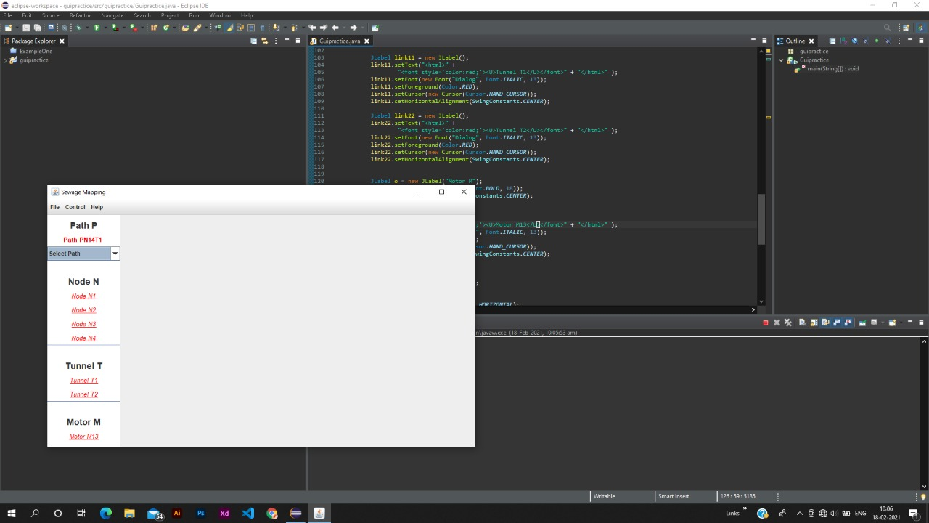
Results And Discussion
PN14T1
Block Details
MOTORM13
Block (1hr)
Random Check
PN46T4
N15
N16
N17
N18
T1
Sewage Flow Status:
Block Found !!!
[ N15 – 1, N16 – 1, N17 – 0, N18 – 0 ]
<< prev
next >>
11

Slide 12
References
[1] Shruthi Shri A. S,”Smart drainage monitoring and clog identification using iot”, ISSN:2395-1990.
[2] Aruna.R, Bhavishya.G, Venkatesh.S,Ms.D.Jessintha,”Intelligent Detection and Elimination of blockage in sewage pipes using a robot”, ISSN:2395-0056.
[3] Saurab S. Satpute , Vithal R.Darole,Mr.Pravin M Khaderao, Mr.Prankaj B. Hiralkarl,”Intelligent Detection and Elimination of blockage in sewage pipes using a robot”, ISSN:2395-0056.
12

