Slide 1
Intelligent Classification of Rural Infrastructure Projects
CAPSTONE PROJECT
Presented By:
MANOJIT SAHA
GARGI MEMORIAL INSTITUTE OF TECHNOLOGY
COMPUTER SCIENCE AND ENGINEERING

Slide 2
OUTLINE
Problem Statement
Proposed System/Solution
System Development Approach
Algorithm & Deployment
Result (Output Image)
Conclusion
Future Scope
References

Slide 3
Problem Statement
The Pradhan Mantri Gram Sadak Yojana (PMGSY) is a flagship rural development program in India, initiated to provide all-weather road connectivity to eligible unconnected habitations. Over the years, the program has evolved through different phases or schemes (PMGSY-I, PMGSY-II, RCPLWEA, etc.), each with potentially distinct objectives, funding mechanisms, and project specifications.
For government bodies, infrastructure planners, and policy analysts, efficiently categorizing thousands of ongoing and completed projects is crucial for effective monitoring, transparent budget allocation, and assessing the long-term impact of these schemes. Manual classification is time-consuming, prone to errors, and scales poorly.
We need to design, build, and evaluate a machine learning model that can automatically classify a road or bridge construction project into its correct PMGSY_SCHEME based on its physical and financial characteristics.

Slide 4
Proposed Solution
The proposed system uses machine learning to automate the classification of
rural infrastructure projects into their correct PMGSY scheme.
It involves:
Data Collection: Download and preprocessed the data from AI Kosh Website.
Feature Engineering (FE): From total of 14 columns, extracted PMGSY_SCHEME as our Label and other columns as our feature.
Model Training: Use a Random Forest Classifier with two rounds of hyperparameter optimization (HPO1 and HPO2).
Deployment: Use IBM Cloud Lite services to deploy the trained model and expose a prediction interface.

Slide 5
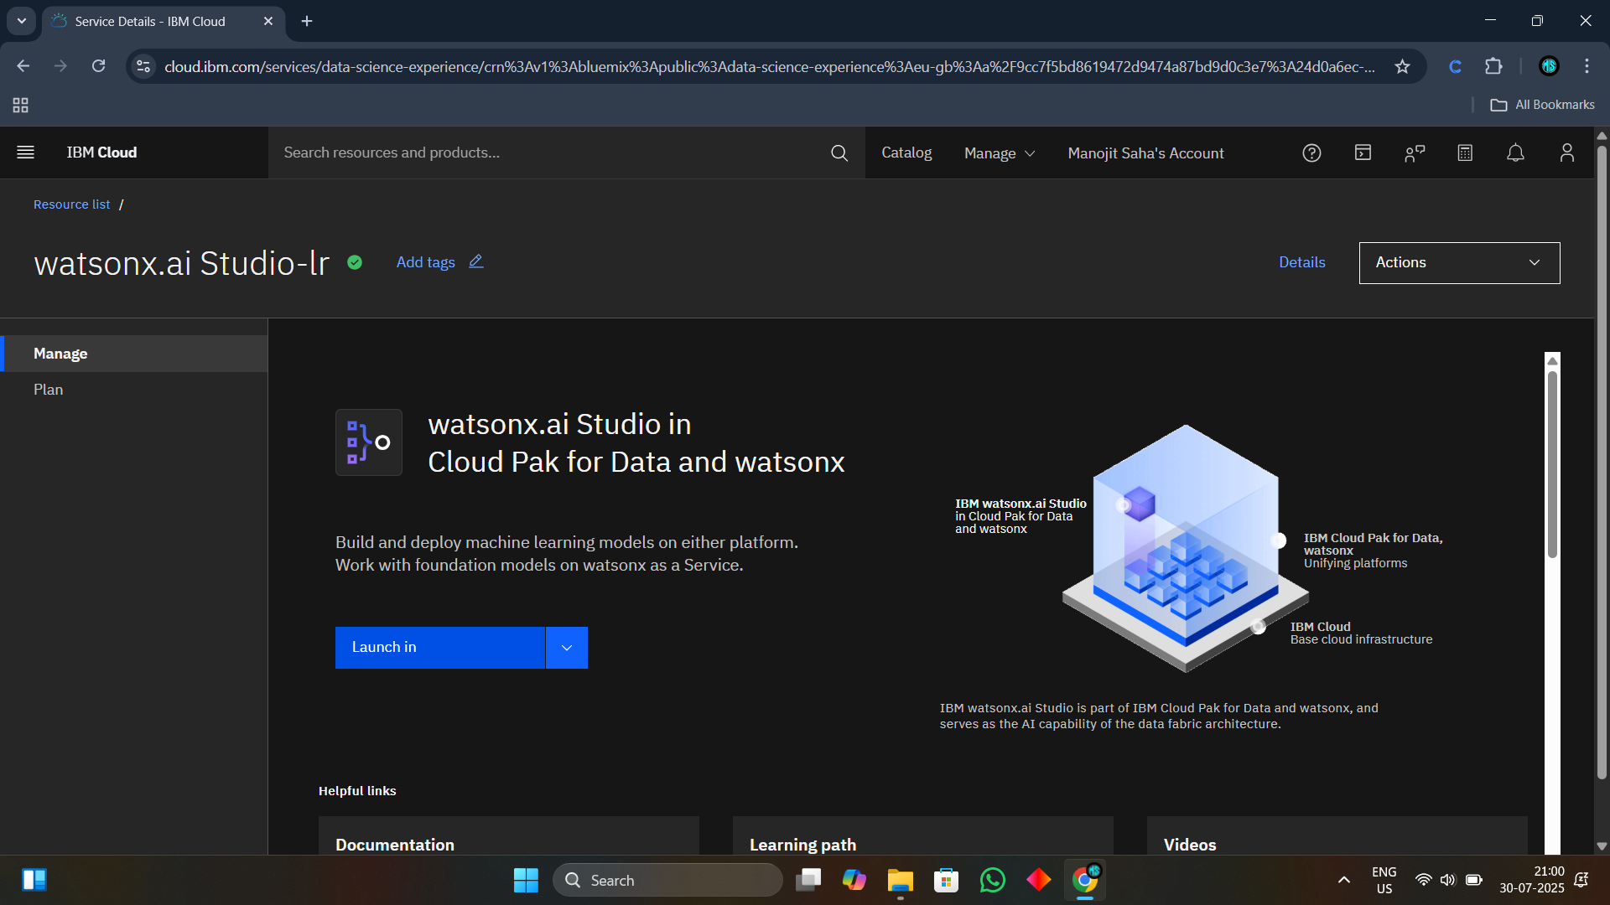
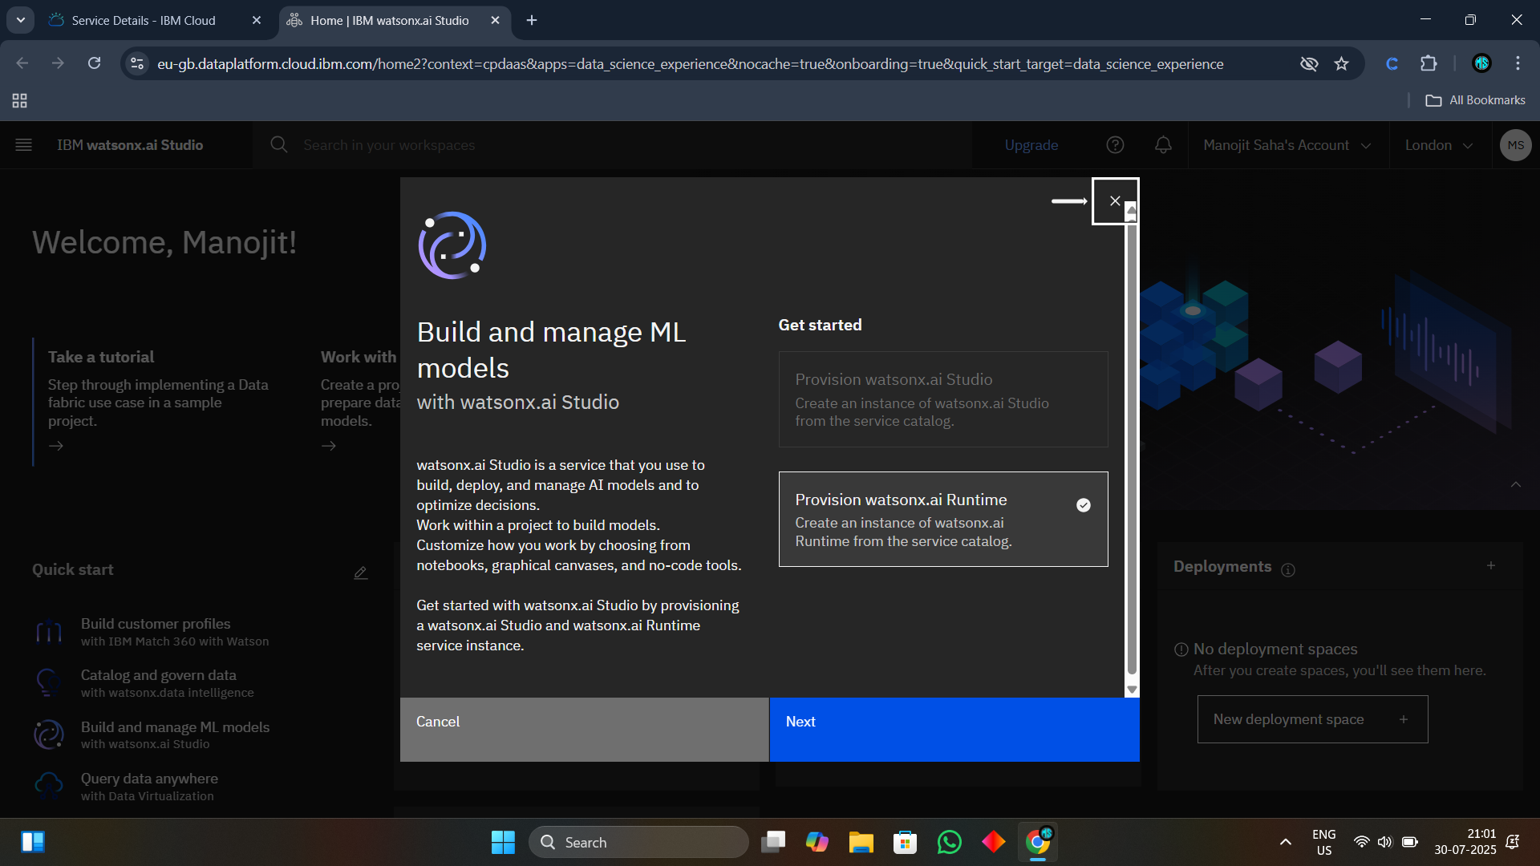
System Approach
System Requirements:
IBM Cloud Lite (Watson Studio, Cloud Object Storage)
Local/Cloud Jupyter Notebook
IBM Watson Machine Learning for deployment
Libraries Used :
pandas, numpy – Data handling
scikit-learn – Random Forest, HPO
matplotlib, seaborn – Visualization
ibm_watson_studio library– IBM Cloud access
Development Steps:
Data upload to IBM Cloud Object Storage.
Model Training: Random Forest with HPO1 → FE → HPO2
Deployment via Watsonx.ai.studio as and endpoint.

Slide 6
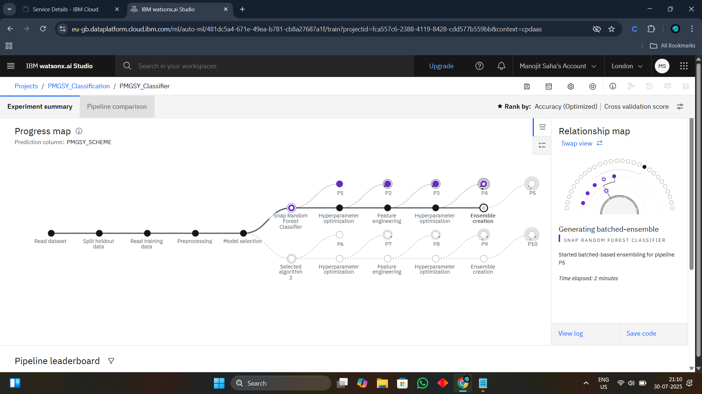
Algorithm & Deployment
Algorithm Selection:
Random Forest Classifier selected for its robustness and high performance on structured data.
Data Input:
Total 14 features as input like Project length, cost, bridge/road type, funding details, etc.
One output PMGSY Scheme with a confidence score in percentage.
Training Process:
Initial hyperparameter tuning→ Feature selection & transformation→ Final optimization for performance
Performance evaluated using accuracy, cross-validation score.
Prediction Process:
Deploy on IBM Watson Machine Learning
Testing predictions via deployed endpoint in watsonx.ai.studio

Slide 7
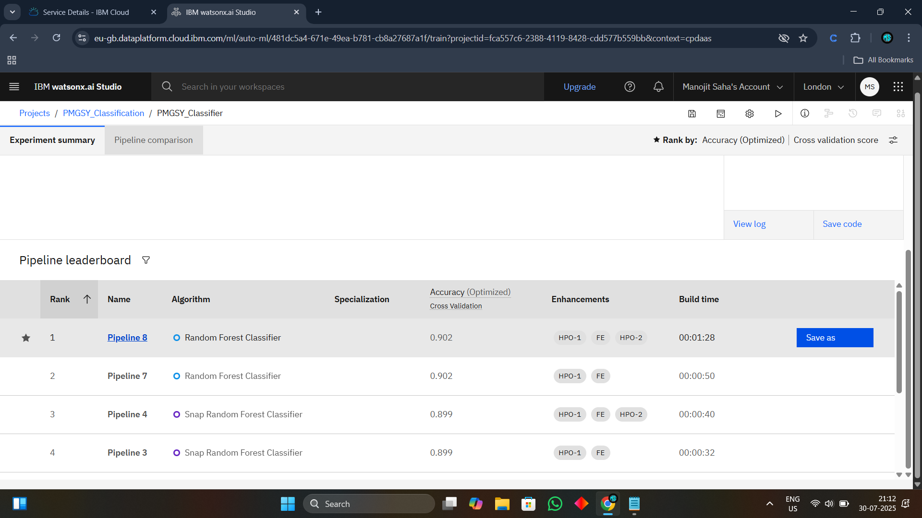
Result
After pipeline executes the best model is Random Forest Classifier algorithm.
Model Accuracy:90%

Slide 8
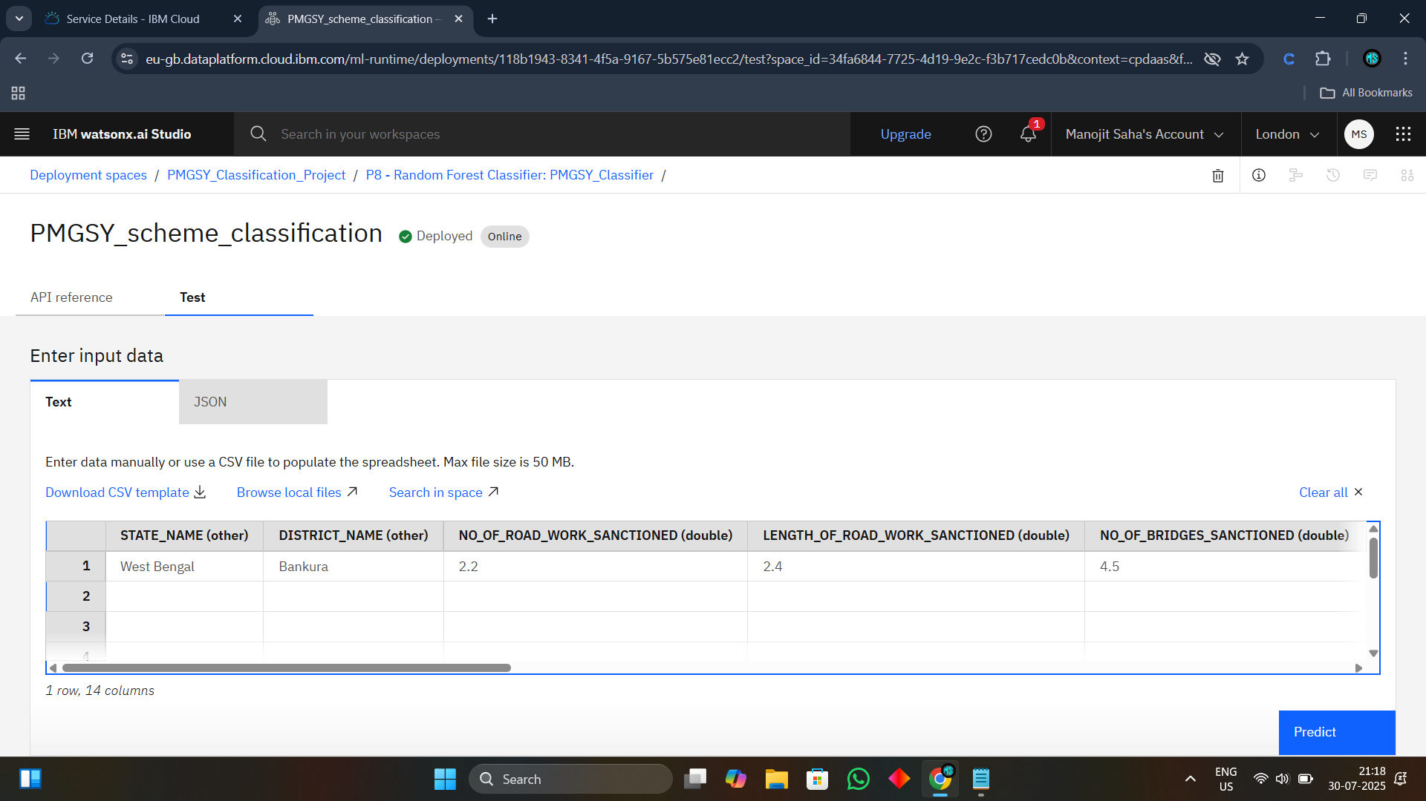
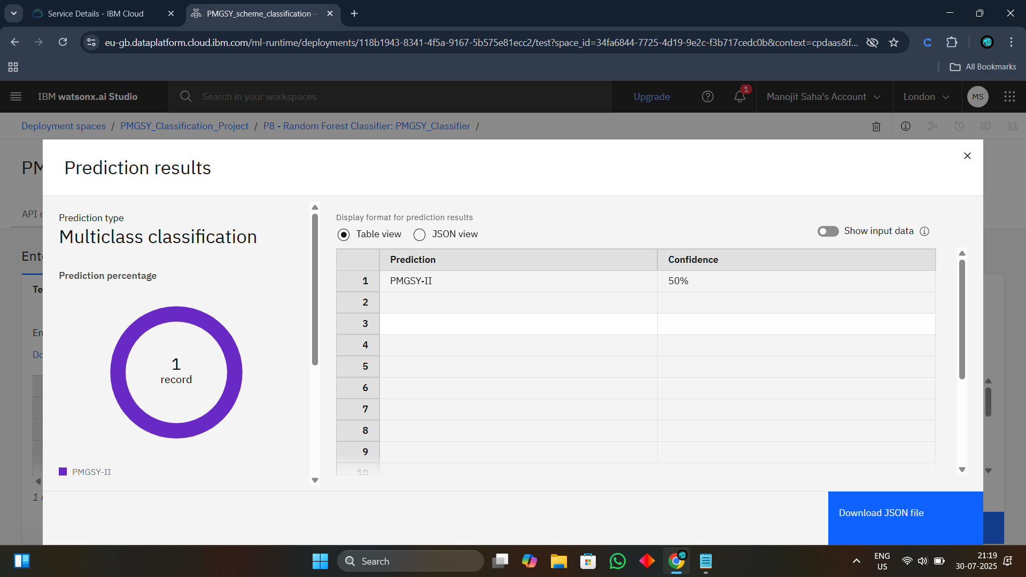
Result
Predicted Result Based given Input
Each prediction has it’s own confidence percentage which represents how much model thinks it’s prediction is correct.

Slide 9
Conclusion
The Random Forest model with optimized hyperparameters effectively classifies infrastructure projects with 90% accuracy. The IBM Cloud deployment ensures scalable access for planners and policymakers, making it a powerful tool for project monitoring and analysis.

Slide 10
Future scope
Integration with real-time project updates and GIS data
Use of ensemble models or deep learning for better performance
Expansion to other rural schemes beyond PMGSY
Dashboard integration for government decision-makers

Slide 11
References
AI Kosh Dataset: https://aikosh.indiaai.gov.in/web/datasets/details/pradhan_mantri_gram_sadak_yojna_pmgsy.html
IBM Cloud Documentation:
https://cloud.ibm.com/docs
scikit-learn Documentation:
https://scikit-learn.org/stable/user_guide.html

Slide 12
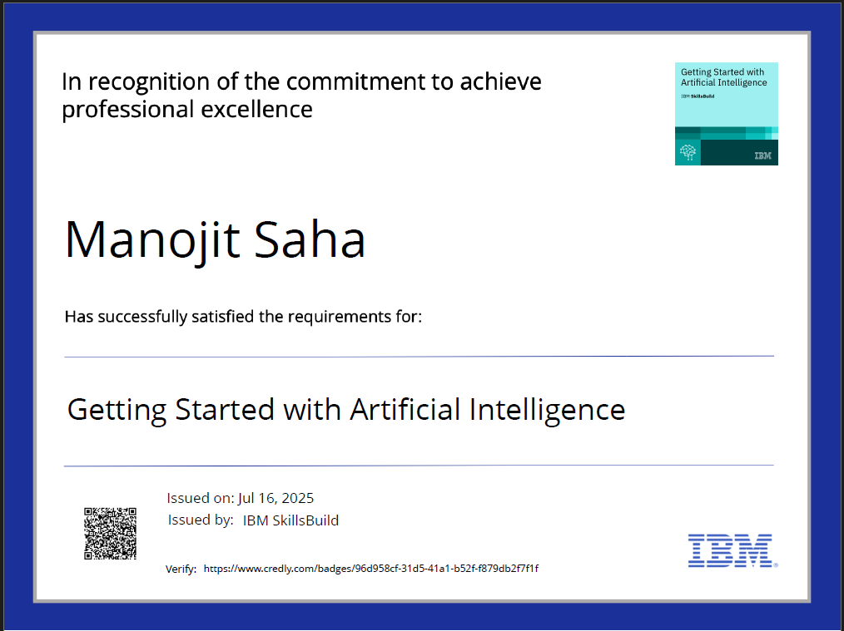
IBM Certifications
Getting started with AI

Slide 13
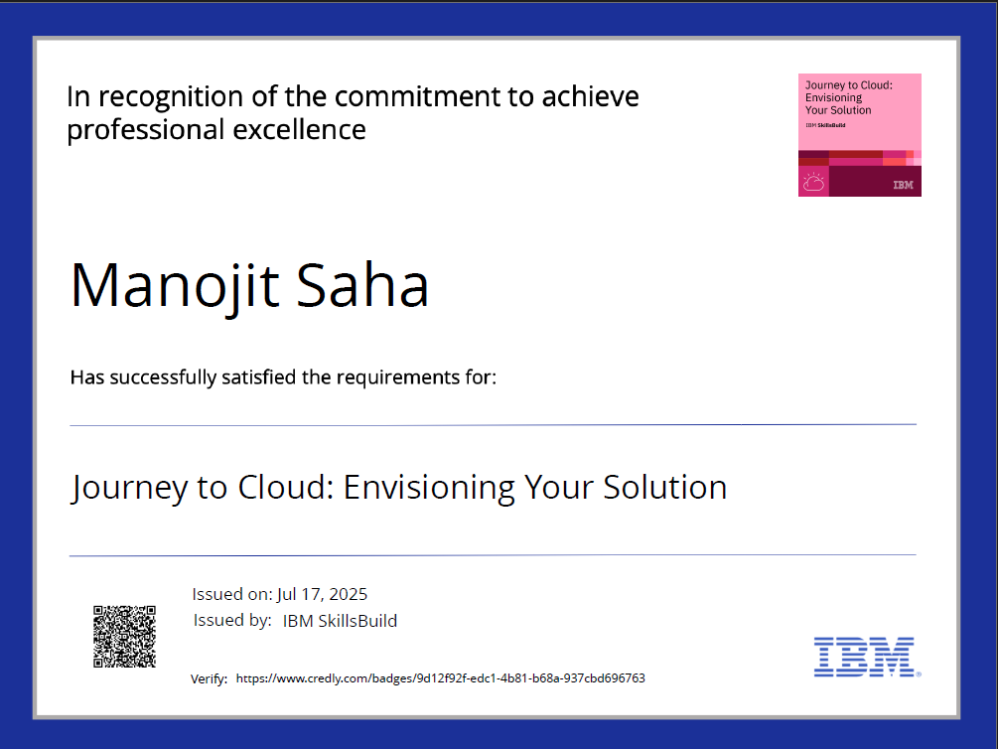
IBM Certifications
Journey to Cloud: Envisioning Your Solution

Slide 14
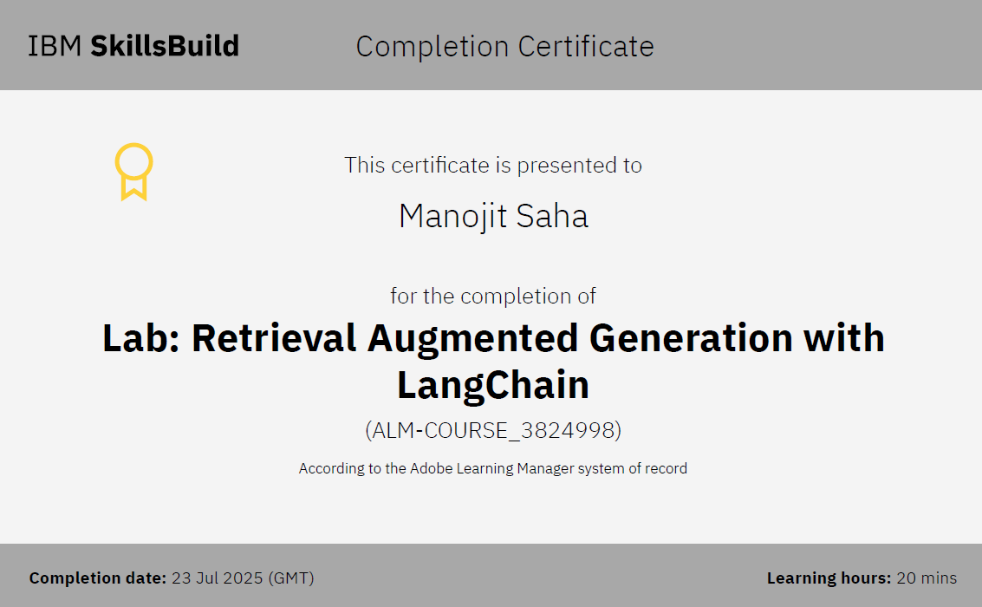
IBM Certifications
Retrieval Augmented Generation Lab

Slide 15
THANK YOU

