Slide 1
ENHANCE SUSTAINABLE AGRICULTURE IN SOUTH AFRICA
By Manojkumar Yerraguntla
Mentored by: Prof. Michael Mann
Guided by: Prof. Abdi Awl

Slide 2
Introduction:
To resolve the significant challenges faced by South Africa in ensuring a stable and sufficient food supply.
Challenges Faced:
Climate Change Identification
Fluctuating in Food Production
Food Supply Assessment
Import/Export Management

Slide 3
Why does it matter?
Economic Stability
Public Health
Environmental Sustainability
Improving Livelihood
Objectives:
Implement Data Science techniques for accurate Crop Identification.
Incorporate diverse Training and Testing Areas.
Generalize model adaptable to different agricultural landscapes.

Slide 4
About the Dataset:
Data source: Satellite imagery from SENTINEL 2 satellites.
Data from satellite images has been extracted as Parquet files.
Dataset covers two geographical locations: 34S_19E_258N and 34S_19E_259N.
Six parquet files per location, each from a different spectral band.
Spectral bands include B2, B6, B11, B12, EVI, and HUE.
Each location file contains approximately 3.7 million rows and 231 variables.
Dataset size: 3.7 GB

Slide 5
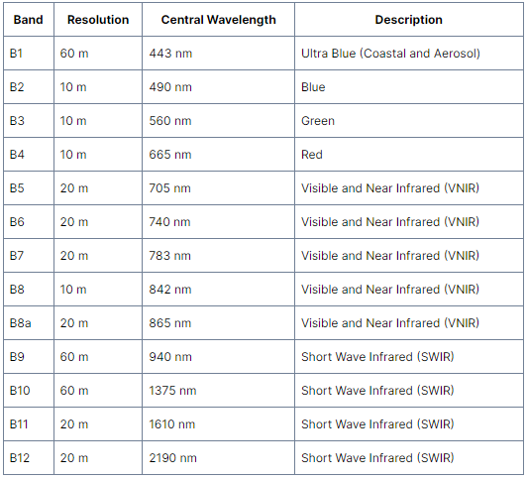
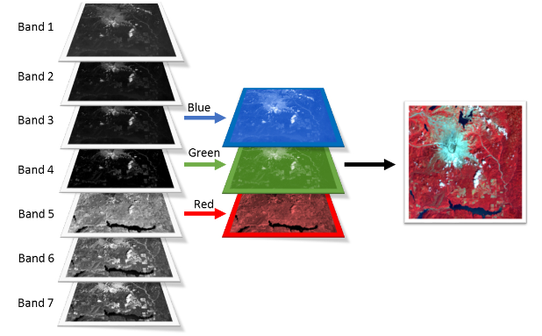
Literature Review:
Significance of different bands in Crop Identification:
B2: Chlorophyll Content
B6: Moisture levels, Crop water stress
B11: Crop Phenology
B12: Vegetation Health, Disease Outbreaks
EVI: Vegetation Density
Hue: Identification of Crops using different color signatures

Slide 6
Project Workflow:
Data Preprocessing
Feature Engineering
Exploratory Data Analysis
Modeling

Slide 7
Data Preprocessing:
Missing Values ts_complexity_cid_ce variable has no values.
Data Integration Combined six bands (parquet files) into a single data frame.
Column Deduplication
75 Column duplicates

Slide 8
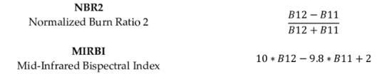




Feature Engineering:
Derived Features from Remote Sensing Data:
Vegetation Ratio Index (VRN)
Normalized Burn Ratio 2 (NBR2)
Enhanced Vegetation Index (EVI)
Soil Adjusted Vegetation Index (SAVI)
Normalized Difference Water Index (NDWI)
Normalized Difference Vegetation Index (NDVI)
Modified Improved Ratio Brightness Index (MIRBI)

Slide 9
Data Preprocessing:
Outliers
Location (34S_19E_258N): 47476 Location (34S_19E_259N): 118119
Duplicates
No Duplicates
Feature Elimination
74 -The least important features (Feature Importance) are removed

Slide 10
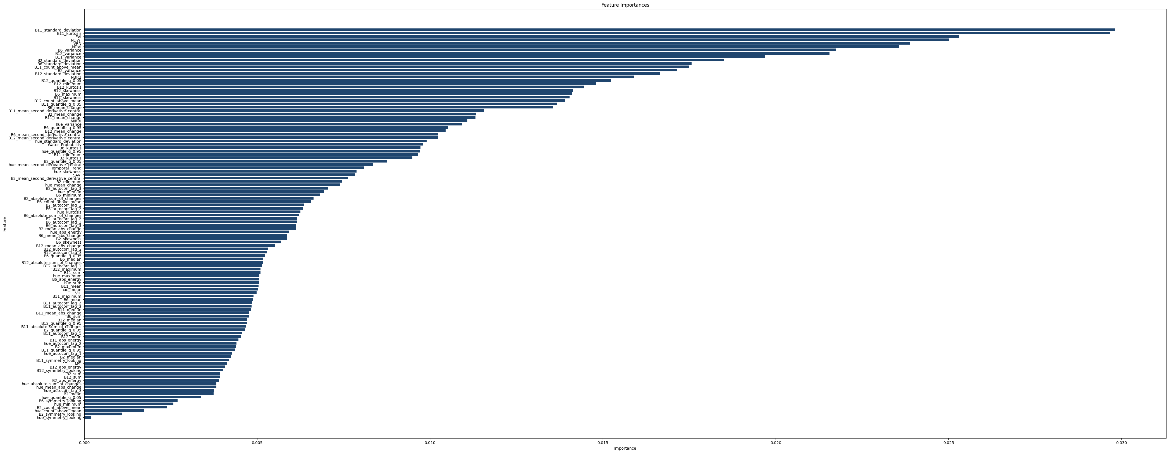
Exploratory Data Analysis:

Slide 11
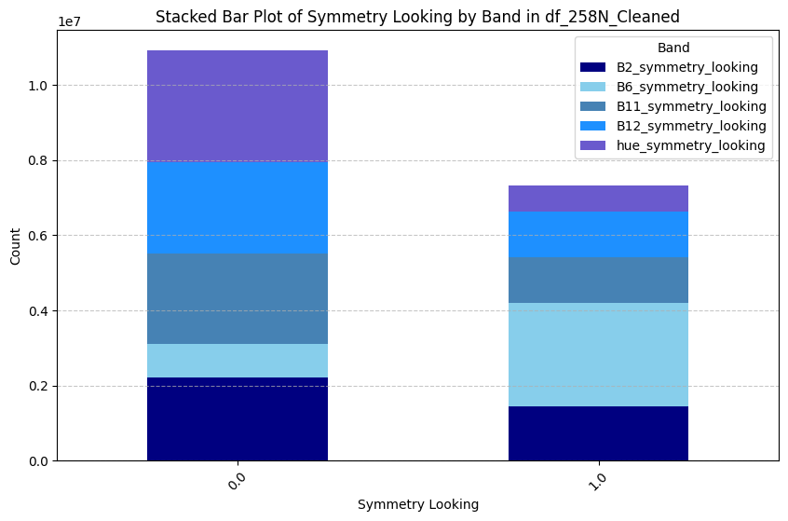
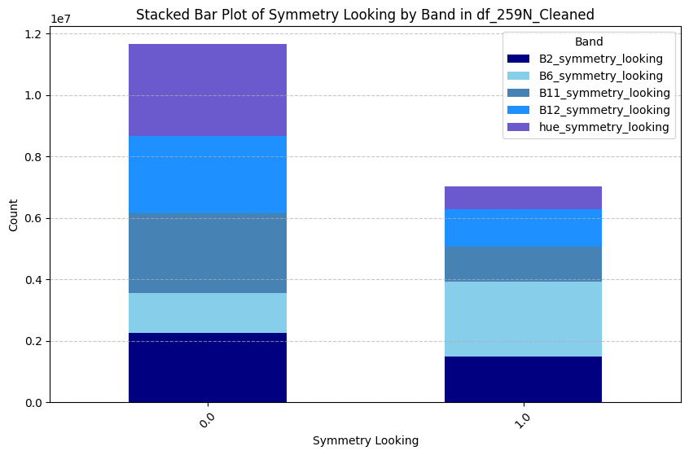
Exploratory Data Analysis:
All bands except B6 have more non-symmetrical looking than symmetrical looking.

Slide 12
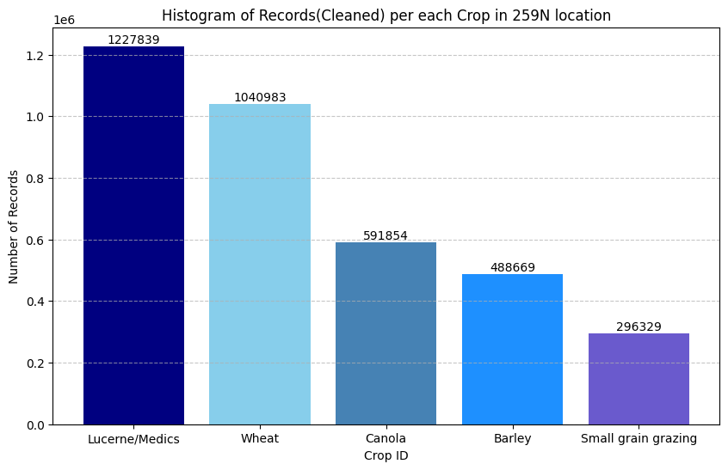
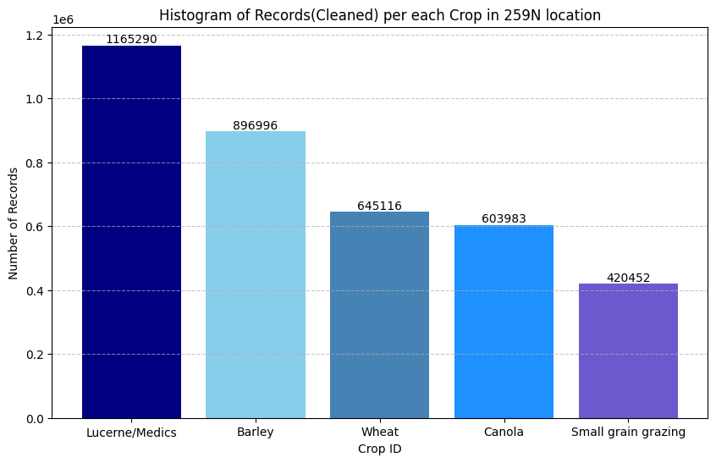
Exploratory Data Analysis:
The most grown crop in both locations is Lucerne and the least grown crop is Small grain grazing.

Slide 13
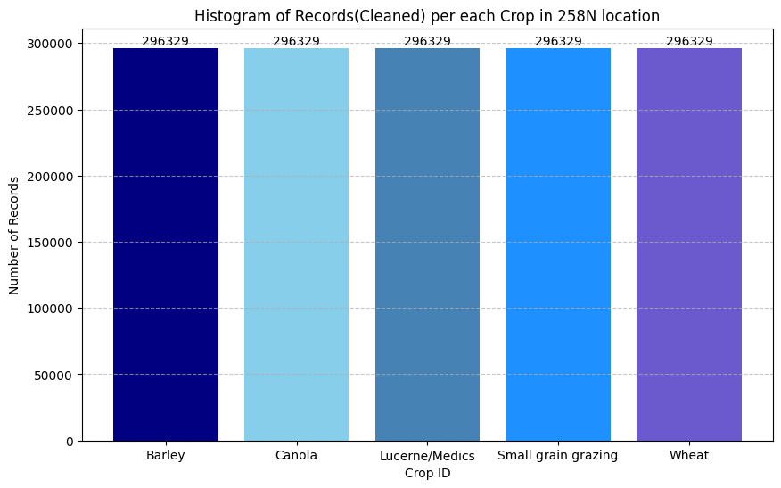
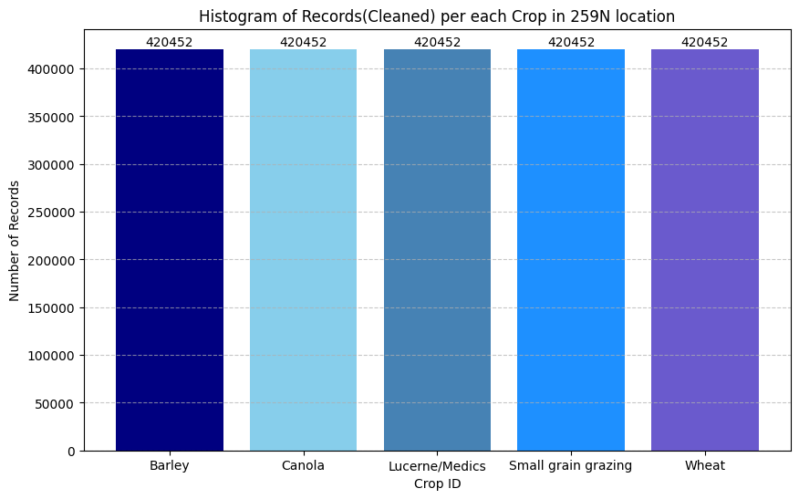
Handling Data Imbalance:
Data Imbalance: Performed Under Sampling Technique
Feature Scaling: Standard Scaler

Slide 14
Modeling:
Implemented three ensemble learning algorithms:
Random Forest
XG Boost
Light GBM
Advantages:
Robustness for multicollinearity
Ability to capture complex relationships
Efficient to handle large datasets
Handling Imbalance in Dataset

Slide 15
Hyperparameters:
n_estimators
max_depth
Criterion
min_samples_split
n_estimators
max_depth
learning_rate
colsample_bytree
gamma
learning_rate
max_depth
num_boost_round
reg_lambda
reg_alpha
Random Forest
XG Boost
Light GBM

Slide 16
Results & Conclusion:
Model | Precision | Recall | F1-Score
Random Forest | 0.58 | 0.57 | 0.55
XG Boost | 0.58 | 0.58 | 0.56
Light GBM | 0.49 | 0.47 | 0.42
Precision is high for both Random Forest and XGBoost.
XGBoost is the best-performing model with higher prediction values (Precision: 0.58; Recall: 0.58; F1-Score: 0.56)

Slide 17
References:
https://gisgeography.com/sentinel-2-bands-combinations/
https://gsp.humboldt.edu/olm/Courses/GSP_216/lessons/composites.html
https://www.researchgate.net/figure/Spectral-indices-adopted-equations-with-Sentinel-2-Multispectral-Instrument-MSI-bands_tbl3_342010458
https://isprs-archives.copernicus.org/articles/XLII-5/683/2018/isprs-archives-XLII-5-683-2018.pdf
https://custom-scripts.sentinel-hub.com/custom-scripts/sentinel-2/bands/

Slide 18
THANK YOU

