Slide 1

Velagapudi Ramakrishna Siddhartha Engineering College Deemed to be University Department of Electronics and Communication Engineering
Smart Grass Cutter – The Future Of Lawn Maintenance
Guide : Dr. Pratikhya Raut
Assistant Professor, Dept of ECE
Batch No : C20
228W1A04E1-B.Swathi
228W1A04H8-P.Manoj
228W1A04F4-J.Tejaswini Sai

Slide 2
CONTENTS:
Introduction
Problem statement
Objectives
Literature review
Methodology
Block diagram
Circuit diagram
Result & Analysis
Conclusion
Future work
References

Slide 3
INTRODUCTION:
Traditional lawn mowing is time-consuming, labor-intensive, and often inefficient. Moreover, it can pose challenges for people with mobility issues or those with large lawn areas.
By leveraging autonomous systems, the smart grass cutter addresses these challenges, providing an intelligent and programmable alternative that ensures consistent grass cutting with minimal effort.
The smart grass cutter is an innovative solution with advancements sensor technologies, this project aims to create a self-operating grass cutter that can efficiently maintain lawns without human intervention.
The smart grass cutter integrates features such as obstacle detection, energy efficiency, making lawn care more convenient, environmentally friendly, and safe.
Conventional lawn mowing is often a hassle and time consuming in cutting the grass. The task of manual lawn mowing is often a hassle and time consuming in cutting the grass.
A robotic lawn mower is designed and installed in this project. The objective of the electric remote control lawn mower is to extend the design of currently used lawn mowers, and to improve the capabilities of standard robotic lawn mowers as well as assuring cost efficiency. It is safe use, as well as efficient because it electric powered and cordless.

Slide 4
PROBLEM STATEMENT:
In today's world, automation is essential for reducing labor and improving efficiency. Traditional grass-cutting machines, powered by internal combustion (IC) engines, contribute to pollution, are costly to maintain, and require skilled labor.
To address these issues, we propose a smart, budget-friendly grass cutter powered by a battery and controlled using an Arduino Uno.
The system features an ultrasonic sensor for obstacle detection and a motor driver to control the chassis movement, allowing it to navigate and cut grass autonomously.
This solution aims to reduce manpower, minimize environmental impact, and eliminate the need for IC engines in lawn maintenance.
The problem is to develop a smart remote control grass cutter that addresses these issues by providing an autonomous, user-friendly, and eco-friendly solution.
This device should be capable of precise navigation and cutting,obstacle avoidance, and ,ultimately reducing the time, effort, and environmental impact associated with traditional lawn mowing methods.

Slide 5
OBJECTIVES:
The main objectives of a smart grass cutter , automation, and safety. Here are some potential objectives:
1. Automated Lawn Mowing: Automatically cut grass in a lawn without requiring manual intervention.
2. Obstacle Detection and Avoidance: Use Ultra sonic sensor to detect and avoid obstacles such as rocks, pets, or garden furniture.
3.Autonomous Operation: Develop a fully automated grass cutter to operate without manual intervention. Ensure the system can function independently for extended periods. Minimize human involvement in lawn maintenance tasks.
4.Safe Navigation: Utilize ultrasonic sensors for precise obstacle detection and avoidance. Prevent collisions with objects, ensuring safety during operation.
5.Noise Reduction: The Smart Grass Cutter minimizes noise using low-noise motors and efficient blade design, ensuring quiet operation. This makes it ideal for residential areas, reducing disturbances while maintaining user comfort.
6.Low Maintenance: The Smart Grass Cutter is built for low maintenance with durable, rust resistant materials that extend its lifespan. Its simple design reduces moving parts, minimizing wear and tear.

Slide 6
LITERATURE REVIEW:
S.NO | Author name | Journal /Year | Title | Observation
1. | Mrudal Kanhekar and Sachinwaghmare | Propulsion Technology 2021 | Smart Grass Cutter Using Solar Power System | Explained that cutting the grass itself requires human effort, time and can create a unique structure of grass length.
2. | Jose Anand,Renugha Devi.R | ICAECA 2021 | Solar Grass Cutter with Water Spraying Vehicle | Has implemented the designing and fabricating a solar grass cutter with water spraying system using RF Technology to reduce man power, pollution and usage of electricity in gardening.
3. | Pranay Pohankar,Prashikdable | IEEE 2022 | Smart Lawn Bluetooth Mower with sprinkler and Time tracker | Operation uses a lawn mower with a battery that can be charged with solar power. This can be done using an android phone
4. | Mr.Abhishek Pawar,Miss.Anushka Bhalerao. | IFJMR 2023 | Hybrid Fully Automatic Solar Grass cutter | Semi-Automatic Solar Powered Grass Cutter
5. | K.N. Baluprithviraj, R Harini, M.M Janarthanan and C JasodhaSree | IOSEC 2021 | Design and Development of Smart Lawn Mower | It enables remote control and realtime monitoring of the lawnmower, making grass cutting more convenient and efficient while reducing the need for manual operation.

Slide 7
METHODOLOGY:
The heart of the system is the Arduino uno, a popular microcontroller that provides the necessary processing power to control various inputs and outputs. Its ease of programming and compatibility with a wide range of sensors make it an ideal choice for managing the overall functionality of the smart grass cutter.
For obstacle detection, an Ultrasonic sensor is integrated into the system. This sensor emits sound waves and measures the time it takes for the waves to bounce back from objects, enabling the mower to detect and avoid obstacles such as trees, rocks, or pets.
The movement of the smart grass cutter is driven by motors, This motor driver allows the microcontroller to regulate the speed and direction of the motors, ensuring that the grass cutter moves smoothly across the lawn and adjusts when encountering obstacles.
Lastly, a battery pack is used to power the entire system. The battery must be chosen to provide sufficient power for the microcontroller, sensors, motors, and Bluetooth module while ensuring long operational hours.
Grass Cutting - While moving, the grass-cutting mechanism is engaged. ensure the blades adjust dynamically for an even cut.

Slide 8
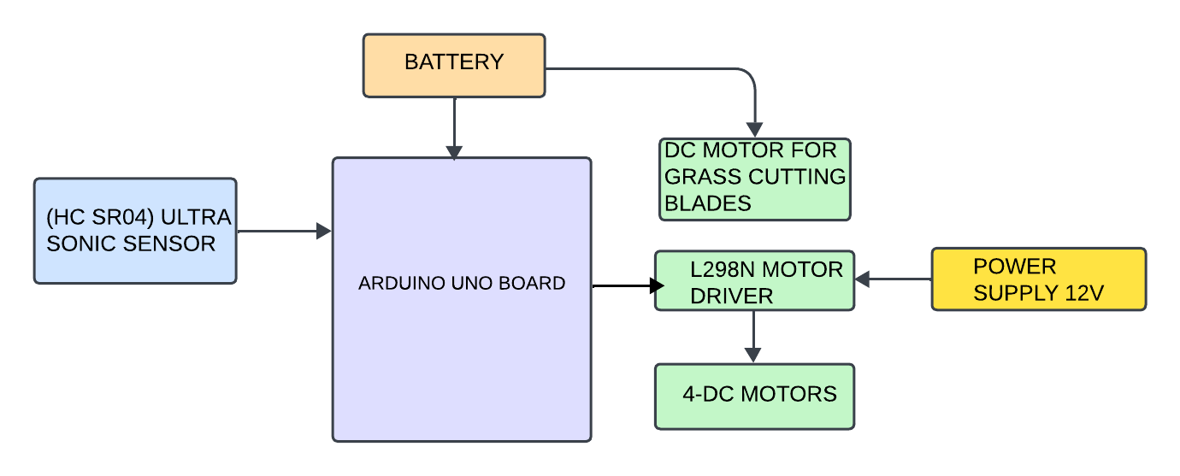
BLOCK DIAGRAM:
The Arduino Uno receives inputs from the Ultrasonic Sensor to detect obstacles or measure distance.
The direction of the 4-Gear Motors and 30 RPM Gear Motor, which likely work together to move the robot forward, backward, or steer it.
A 12V power supply powers the motors through the motor driver, and a Battery powers the Arduino and other components.
DC motors, powered by an L298N motor driver, control the grass cutter’s wheels. The motor driver regulates motor speed.
Fig :1 Block of smart grass cutter

Slide 9
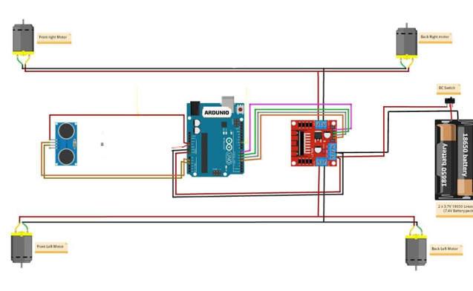
CIRCUIT DIAGRAM:
Power Supply : The system is powered by a 14.8V battery pack (4 x 18650 Li-Ion batteries). The battery pack provides energy to the Arduino board.
Arduino Microcontroller : The Arduino serves as the brain of the system, controlling the motors and receiving input from sensors.
Motor Driver (H-Bridge): The motor driver (L298N or similar) is used to control the speed and direction of the motors. Four DC motors are connected to the motor driver: front-left, front-right, back-left, and back-right. The motor driver receives control signals from the Arduino to operate the motors.
DC Motors: The four DC Gear motors are responsible for the movement of the robotic vehicle. The motors allow forward, backward, left, and right movement depending on the control logic.
Ultrasonic Sensor: An ultrasonic sensor is used for obstacle detection. It sends distance data to the Arduino, which processes this information to avoid collisions.
Connections: The motors are powered directly the Control signals from the Arduino are sent to the motor driver to manage motor speed and direction. The ultrasonic sensor is connected to the Arduino for real-time obstacle detection and response. This system can be used for a variety of applications, such as an autonomous grass-cutting robot or obstacle-avoiding vehicle.
Fig 2: circuit diagram of smart grass cutter

Slide 10
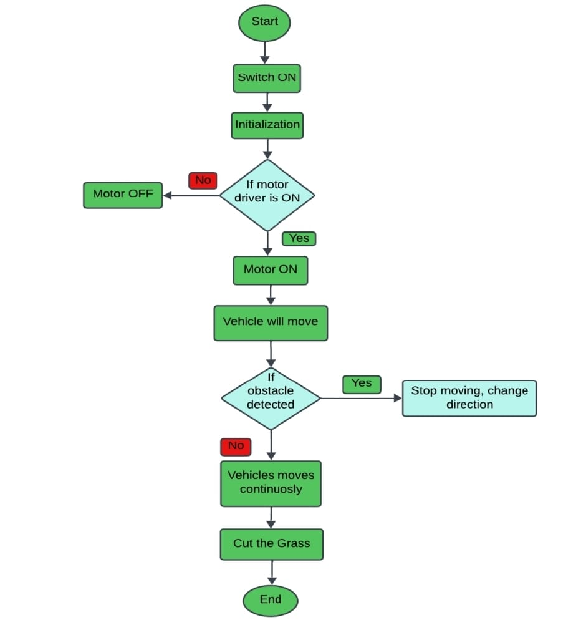
FLOW CHART:
Fig 3: Working of smart grass cutter

Slide 11
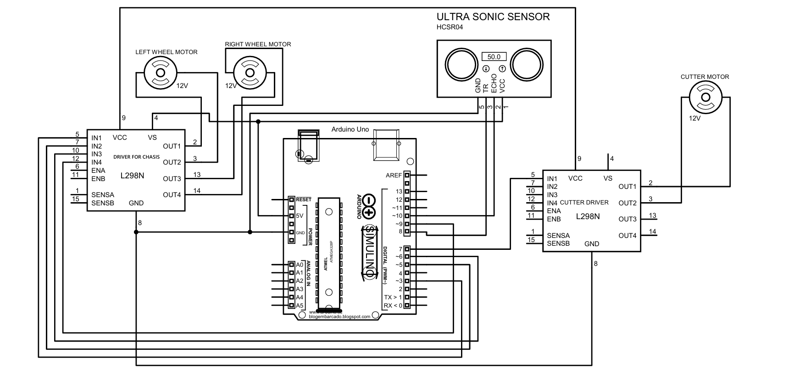
Circuit Diagram:

Slide 12
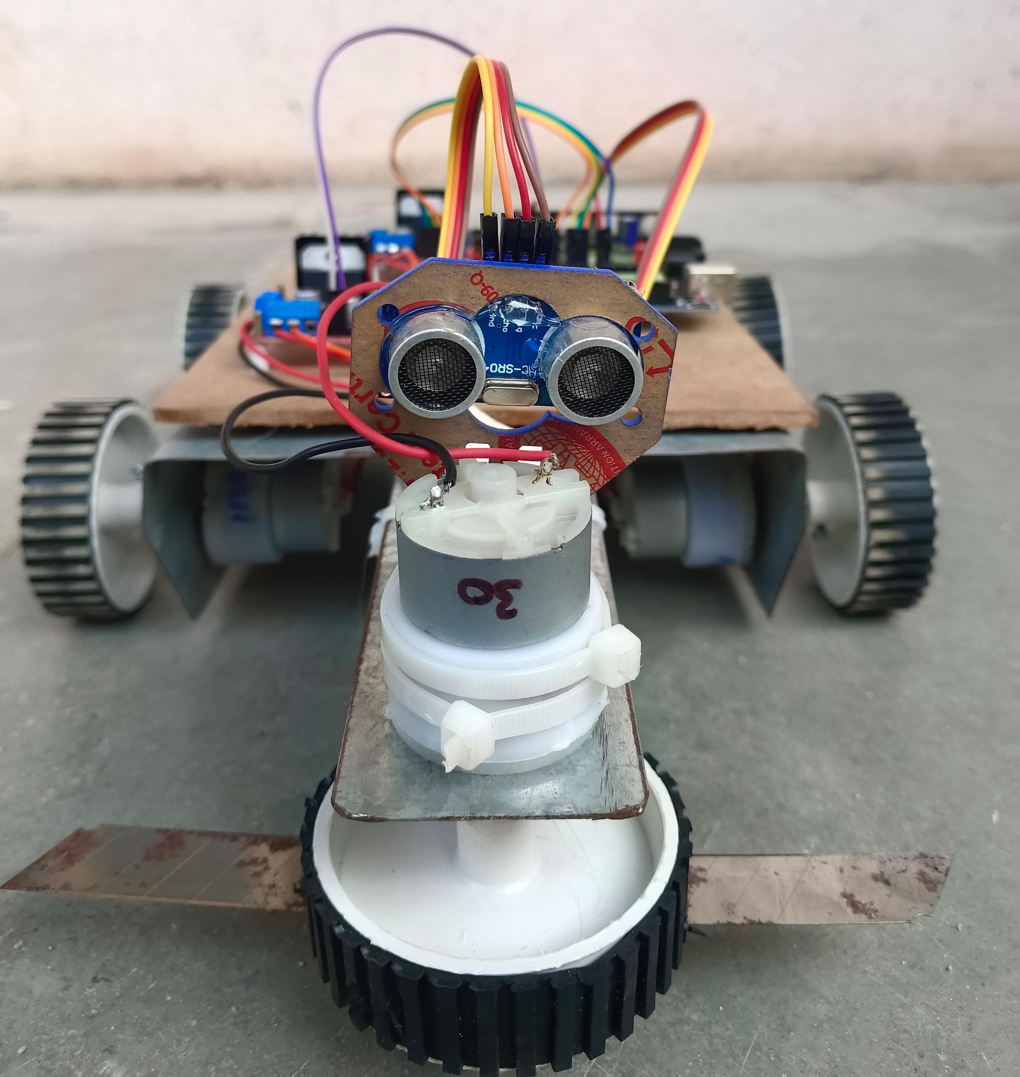
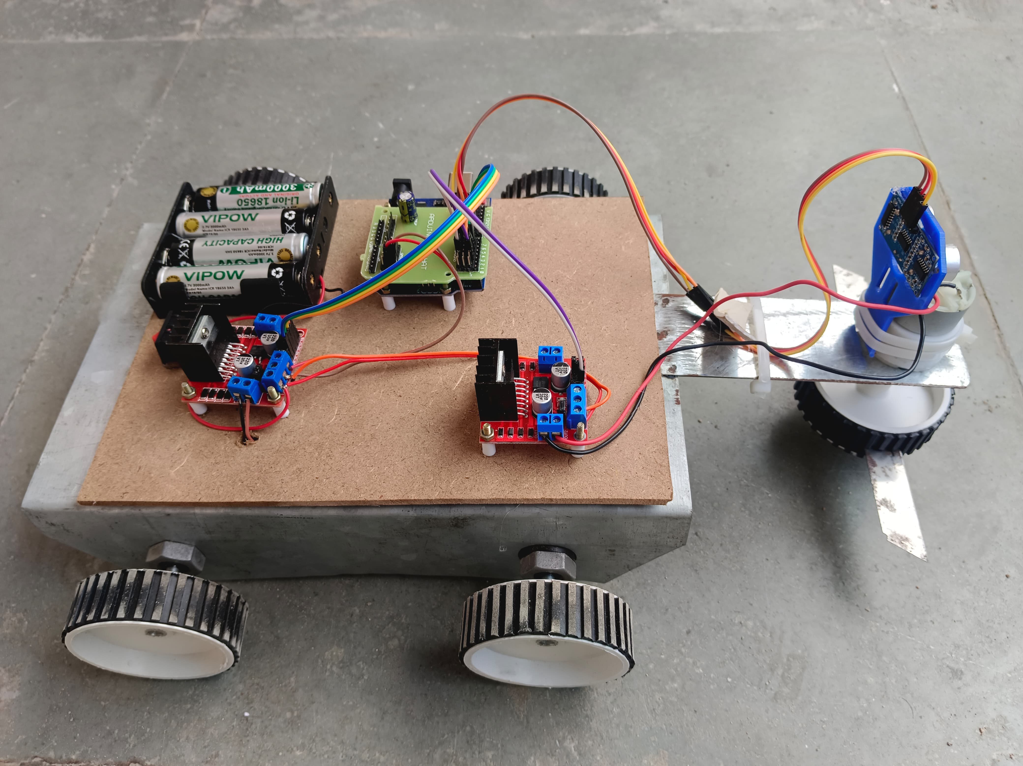
RESULT&ANALYSIS:
Fig-4 : Front view of smart grass cutter. Fig-5 : Side view of smart grass cutter.

Slide 13
RESULT&ANALYSIS:
Proposed method demonstrates clear advantages over existing methods in the literature across several key areas.
By incorporating advanced robotic integration, sensor fusion, our system outperforms traditional robotic mowers in terms of accuracy, efficiency, scalable , cost-effectiveness, and robustness.
While existing methods may be simpler and more cost-effective upfront, they often lack the advanced features that make our system more reliable and adaptable to a wide range of environments and user needs.
By offering greater automation, efficiency, and control, the proposed method represents a significant step for ward in the evolution of smart lawn care systems.
The result of this smart grass cutter prototype is an autonomous robot capable of cutting grass efficiently. It uses an ultrasonic sensor for obstacle detection and avoidance, ensuring safe and uninterrupted operation. The rotating blade at the front cuts grass while the motorized wheels enable movement.
This robot reduces manual effort and can be used for maintaining small lawns or gardens.

Slide 14
CONCLUSION:
The smart grass cutter offers a fully automated solution to lawn care, reducing the need for manual intervention and making lawn mowing more efficient.
The system relies on the Arduino Uno, which serves as the core control unit. Its easy programming and broad compatibility with sensors ensure smooth and coordinated operation of all components.
Ultrasonic sensors are integrated into the grass cutter to detect obstacles like trees, rocks, or pets. This ensures that the mower avoids collisions, enhancing safety and efficiency.
DC motors, controlled through the L298N motor driver, enable the mower to navigate various terrains smoothly. The motor driver allows the Arduino to regulate the direction and speed of the motors, ensuring accurate movement.
The system is designed to be affordable, making it a viable option for consumers looking for an automated lawn mower that doesn't require significant investment.
The grass cutter is designed to be easy to operate, even for users with no technical expertise. Its simple functionality makes it accessible to a wide range of users.
The system requires low maintenance, thanks to its durable components and efficient design. This ensures reliability and reduces long-term upkeep costs.

Slide 15
FUTURE WORK:
Enhanced Navigation and Path Planning: Future developments could focus on improving the navigation system, incorporating more advanced sensors like infrared or computer vision. These enhancements would enable the grass cutter to better handle complex terrains, navigate efficiently in tighter spaces, and optimize mowing paths for faster operation.
Improved Obstacle Detection and Avoidance: While the current system uses ultrasonic sensors for obstacle detection, future versions could integrate advanced sensor technologies like LiDAR or camera-based systems. These would provide more accurate obstacle detection and enable the mower to identify and react to obstacles with greater precision, such as small objects or even moving pets.
Integration of Machine Learning for Adaptability: Machine learning algorithms could be used to teach the smart grass cutter to recognize different terrains, patterns of grass growth, and even weather conditions. The mower could adapt its operation based on these factors, optimizing mowing times and patterns automatically.
Weather Resistance and Durability: Future designs could focus on making the mower more weather-resistant and durable. This could include waterproofing, reinforced housing to protect against harsh conditions, and components designed to withstand long-term outdoor use.

Slide 16
REFERENCES:
[1] Muhammad Ali Raza1,Hussnain Hamza,faisal Naeem.(2024 16th July). Design of smart and self- controlled solar grass cutter with lawn coverage. https://doi.org/10.5875/z29mv916.
[2] Gao, Z., Tian, Y., Cheng, T., Li, W., & Zhang,(2022,March).Survey on Robot Lawn Mowers: Development, Challenges, and Future Trends.IEEE Access, 10, 27203- 27222. https://ieeexplore.ieee.org/document/90749.
[3] Gong, L., Cheng, S., & Chen, Y. (2021, December). Path Planning Strategies for Navigation of Autonomous Lawn Mowers: A Review. Sensors, 21(24), 8547. https://www.mdpi.com/2076-3417/13/13/7.
[4] K.N Baluprithviraj, R Harini, M.M Janarthanan and C JasodhaSree, Design and Development of Smart Lawn Mower,2021.
[5] Environmental Protection Agency. (2023, April 21). Lawns and Landscaping. United States Environmental Protection Agency (.gov).https://www.epa.gov/safepestcontrol/lawn-and-garden.

Slide 17
THANK YOU

