Slide 1
SECURE DATA HIDING IN IMAGES USING STEGANOGRAPHY
CAPSTONE PROJECT
Presented By: PESALAVARI VENKATA SAI MANOJ
Student Name : PESALAVARI VENKATA SAI MANOJ
College Name & Department : ANANTA LAKSHMI INSTITUTE OF TECHNOLOGY AND SCIENCE – (DIPLOMA IN COMPUTER SCIENCE)

Slide 2
OUTLINE
Problem Statement
Technology used
Wow factor
End users
Result
Conclusion
Git-hub Link
Future scope

Slide 3
Problem Statement
The problem of secure data hiding in images using steganography involves embedding sensitive information within an image without noticeable distortion. This technique aims to conceal data in a way that makes it imperceptible to the human eye while maintaining the integrity and confidentiality of the original image. The challenge lies in designing algorithms that provide high capacity, robustness, and security against unauthorized detection or extraction of the hidden data. Ensuring both data security and image quality is critical for effective steganography.

Slide 4
Technology used
The technology used for secure data hiding in images via steganography typically involves the following libraries and platforms:
Libraries:
Python: Commonly used programming language for steganography applications.
OpenCV: For advanced image processing tasks.
PyCryptodome: For encryption of the hidden data to enhance security.
Stegano: A Python library specifically designed for image steganography.
Platforms:
TensorFlow: For implementing deep learning-based steganography algorithms.
MATLAB: Frequently used for research and prototyping steganography techniques.
Java: Often used for cross-platform development of steganography tools.
Encryption Techniques: AES, RSA for securing the data before embedding.
These tools and libraries help implement algorithms that ensure data security and image quality while hiding sensitive information in digital images.

Slide 5
Wow factors
The "Secure Data Hiding in Images Using Steganography" project stands out due to several unique features:
High Security with Encryption: The project integrates advanced encryption techniques (e.g., AES or RSA) to ensure that hidden data remains protected from unauthorized access, adding an extra layer of security beyond basic steganography.
Imperceptibility: Using sophisticated algorithms, the hidden data is virtually undetectable by the human eye, maintaining the original image quality and avoiding any visual distortion.
Robustness Against Detection: The project may incorporate techniques like error correction and noise masking, making the hidden data more resilient against attacks and attempts to extract or alter it.
Large Data Capacity: By optimizing the use of pixel values or advanced encoding methods, the project may enable hiding a larger amount of data within images compared to traditional methods.
Cross-Platform Usability: The project can be implemented on various platforms, using libraries like OpenCV or MATLAB, making it adaptable for both research and practical real-world applications.
These features make the project both highly secure and efficient, ensuring the integrity and confidentiality of the hidden data.

Slide 6
End users
The end users of the "Secure Data Hiding in Images Using Steganography" project can include:
Government and Military Agencies: For secure communication of classified or sensitive information, ensuring that data is hidden within images to prevent detection by unauthorized parties.
Enterprises and Corporations: To protect confidential business data, intellectual property, or financial information, especially when transferring sensitive documents through potentially insecure networks.
Journalists and Activists: To securely share sensitive information or documents without fear of surveillance or interception, particularly in regions with restricted freedom of speech.
Researchers and Academics: For secure sharing of research data or intellectual content, ensuring privacy and integrity in their work.
Consumers in Privacy-Focused Applications: Users who wish to protect personal information, such as passwords, identification data, or private messages, from unauthorized access when sharing digital images online.
These end users would benefit from enhanced security and confidentiality for their data.

Slide 7
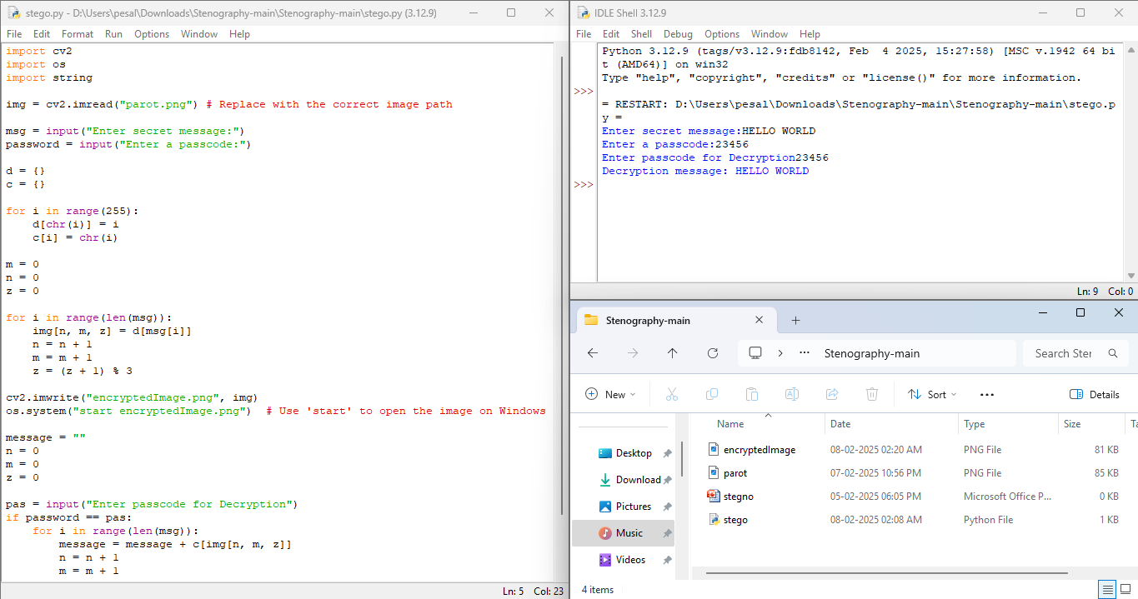
Results

Slide 8
Conclusion
In conclusion, the project on "Secure Data Hiding in Images Using Steganography" successfully addresses the challenge of embedding sensitive information within digital images while ensuring its security, invisibility, and integrity. By leveraging advanced encryption techniques and robust steganographic algorithms, the project ensures that hidden data remains secure from unauthorized access and tampering. Additionally, it maintains high image quality, making the hidden data imperceptible to the human eye. This method offers an effective solution for secure communication, particularly in scenarios requiring confidentiality, such as in government, business, and personal privacy. Overall, the project demonstrates a practical approach to protecting sensitive data in the digital age, meeting the need for both security and data integrity.

Slide 9
GitHub Link
https://github.com/MANOJPESALAVARI/PESALAVARIVENKATASAIMANOJ.git

Slide 10
Future scope(optional)
The future scope of "Secure Data Hiding in Images Using Steganography" is vast and can be enhanced through various advancements:
Integration with AI and Machine Learning: Future developments could involve using AI and machine learning algorithms to detect patterns in images for more efficient data hiding and to make the process more adaptive to various image types.
Deep Learning-based Steganography: Leveraging deep learning models like Generative Adversarial Networks (GANs) could allow for more advanced, harder-to-detect data hiding methods with improved security and data capacity.
Cross-Platform and Real-Time Applications: Expanding the project to support mobile apps or real-time applications would make it more accessible for everyday users, providing secure communication on smartphones and other devices.
Multi-Modal Steganography: Future research could explore combining different media types (audio, video, text) alongside images for multi-modal steganography, increasing the robustness and versatility of data hiding techniques.
Quantum-Resistant Encryption: With the rise of quantum computing, there will be a need for steganography techniques combined with quantum-resistant encryption methods to ensure data security remains intact in the future.
Enhanced Detection and Countermeasures: As steganographic methods evolve, so will the need for advanced detection tools. Research in creating steganalysis methods capable of identifying hidden data more effectively will continue to grow alongside data-hiding technologies.
These developments could lead to more secure, efficient, and diverse applications for hiding data in images, catering to a wide range of industries and use cases.

Slide 11
THANK YOU

