Slide 1


Simple Linear Regression Analysis
This presentation covers simple linear regression. It is a fundamental tool in statistical analysis. We will explore its principles, applications, and interpretation.
by MOHAMMED SHADIK M

Slide 2
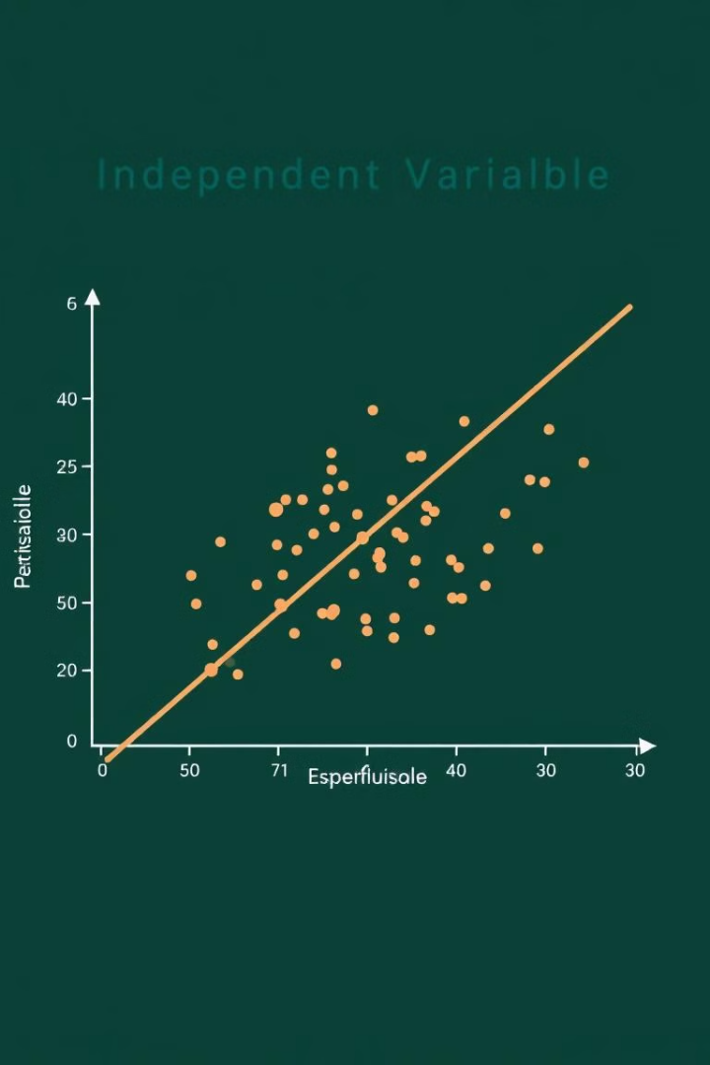
Understanding Linear Regression
Predictive Modeling
Linear Relationship
Regression models predict outcomes. These models use independent variables.
It assumes a linear connection. One independent variable impacts another.
Equation
Represented by a straight line. The formula: Y = a + bX.

Slide 3
Key Components
Dependent Variable (Y)
Independent Variable (X)
Intercept (a)
Slope (b)
The value of Y when X is zero. Also called the constant term.
The change in Y for each unit increase in X. Measures the effect of X on Y.
The variable we want to predict. Its value depends on X.
The predictor variable. Used to forecast Y.

Slide 4
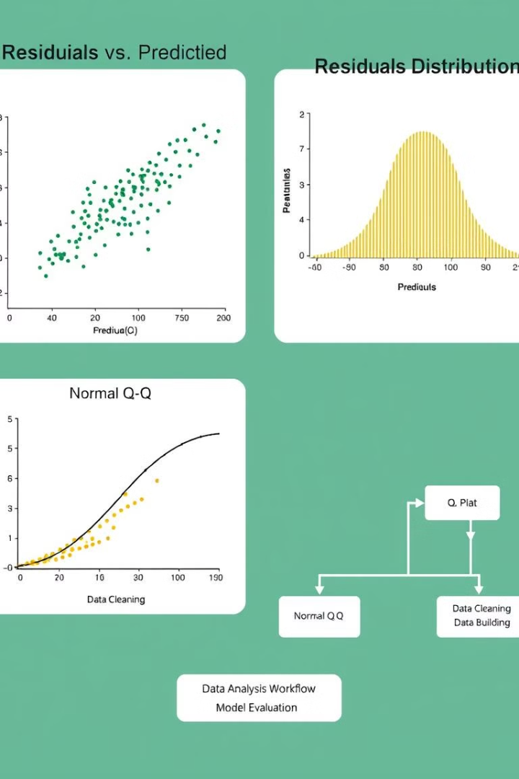
Assumptions
Linearity
The relationship between X and Y is linear.
Independence
Observations are independent of each other.
Homoscedasticity
The variance of errors is constant.
Normality
Errors are normally distributed.

Slide 5




Applications
Sales Forecasting
Predicting future sales based on advertising spend.
Real Estate
Estimating property values using size and location.
Healthcare
Analyzing the impact of lifestyle on health outcomes.

Slide 6

Key Takeaways
1
Simplicity
2
Insights
Easy to implement and interpret.
Provides valuable insights into relationships.
3
Limitations
Assumptions must be met for valid results.

